Slide 1


Slide 2

Smart Contracts and Blockchain
Drones
Streamline Insurance Claims

Slide 3
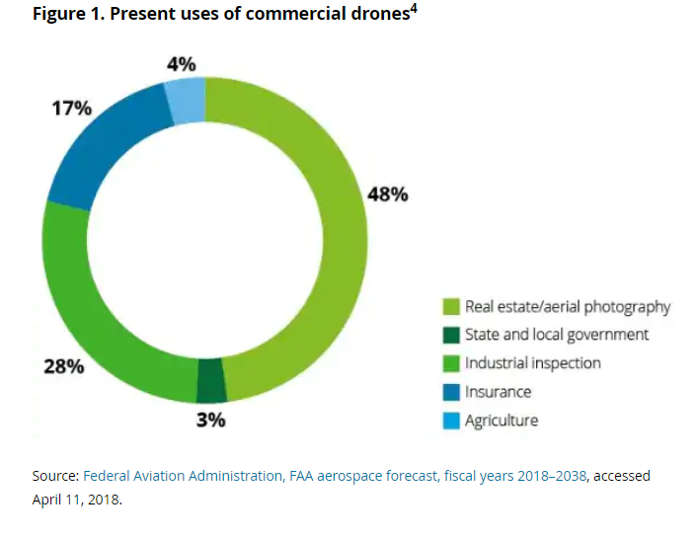
Drones
“This new drone capability was utilised to assess the property and infrastructure damage caused by some of the major insurance events of 2017 including hurricanes Irma, Harvey and Maria in the US, the fires in California, Cyclone Debbie in North East Australia, flooding in Japan and the earthquake in Mexico. Most recently, drones have been used in the small Pacific Island nation of Tonga to assess the extensive damage caused by Cyclone Gita.”

Slide 4
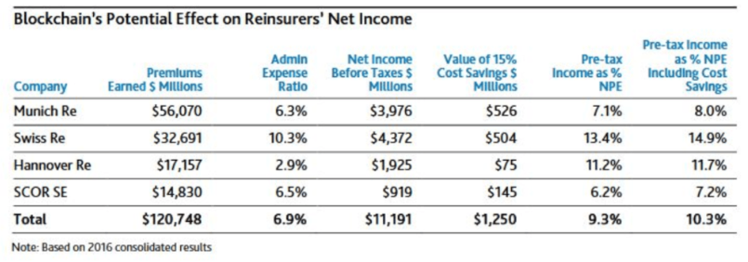
Smart Contracts & Blockchain
PricewaterhouseCoopers estimates that the blockchain can deliver reinsurance industry-wide savings of up to $10B by increasing operational efficiencies.

Slide 5
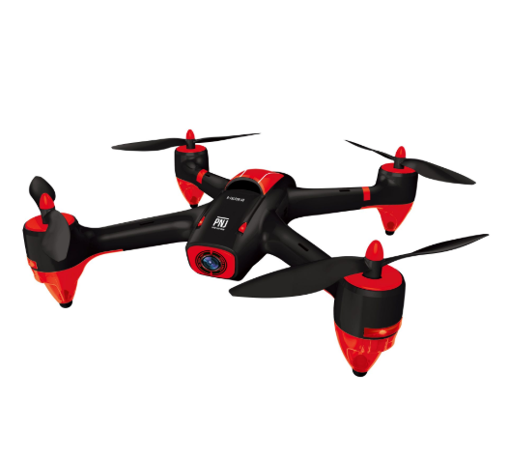



What was used

Slide 6
Benefits using Truelayer
Customer:
Receives better quality products from Third Parties
BOC:
The brand becomes more visible to more clients
The brand name appears next to other global banks
Automatically becomes available as an option within third party apps using Truelayer
Third Party Apps:
A single implementation makes the product relevant to a wide user base

Slide 7
Problem | Solution | Unique Value Proposition |  | Unfair Advantage | Customer Segments
 | Key Metrics |  |  | Channels
Cost Structure |  |  | Revenue Streams
Web Application
leveraging bank & Transferwise APIS
Acquired access to Transferwise by contacting support directly
Bank Aggregation
People with accounts in different countries
Have all your finances in one place
Interactive Charts
Remote workers
Business Model
Send money between accounts in different banks/currencies
Facebook
Number of banks
Number of accounts
Number of transactions
Number/size of FX transfers
AdWords
Transferwise Support
Uni Students studying abroad
Bank “partnerships”
Technology
Paid subscription to unlock “Advanced” features
Marketing/Advertising
Market Research

