Slide 1
Pahunch
hackFront India 2026 · Problem Statement 01 · General Track
Tell an Indian driver the truth, with a confidence level attached.
An EV arrival engine that refuses to print a range figure, and proves the number it prints instead.
0.112
0.067
117 km
Brier score
Calibration error
Longest charger gap
vs 0.542 for the nameplate figure
on 118 held-out trips
Delhi → Shimla, found in Neo4j
Notes:
Pahunch answers the question a driver actually asks. The three figures at the bottom are the evidence, and every one of them is reproducible from the repo: npm run validate.

Slide 2
The number on the brochure was never a promise
A Tata Nexon EV 45 claims 465 km. Drive Delhi to Jaipur in May, four people, air conditioning on:
90 Wh/km
207 Wh/km
2.3×
What the MIDC claim implies
What the trip actually costs
The gap
465 km from a 41.9 kWh usable pack
measured by this model, 42 °C, AC on
and nothing on the dashboard says so
Why the usual fix does not work
The industry response is a better number — a “real-world range” estimate. That is still the wrong shape of answer. Whether you make it depends on a forecast that could be wrong, traffic you cannot see yet, your own right foot, and whether the charger at Behror is working today. Those are distributions, not constants. A single number cannot carry them, however carefully it is tuned.
Notes:
The MIDC cycle is run on a dynamometer: no AC, one occupant, no gradient, no traffic. It is repeatable, which is what it is for. It is not a forecast.

Slide 3
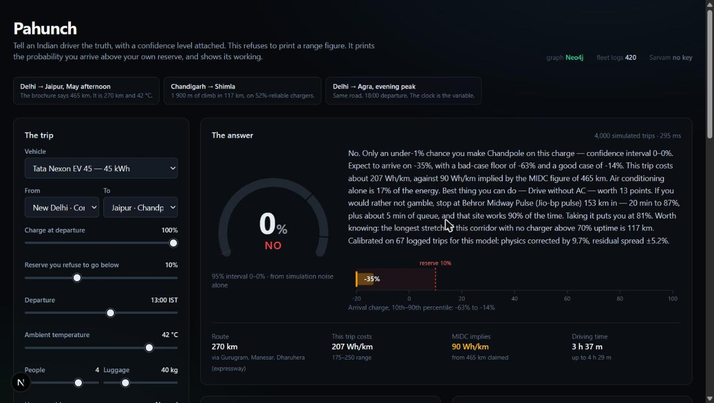
So it answers the question that was asked
Not “how far can I go” but “will I make it” — as a probability, with everything behind it on screen.
P(arrive above your own reserve)
A reserve is the driver's, not ours. Range anxiety, quantified and respected.
Arrival charge as a band
p10 / p50 / p90. The axis runs below zero on purpose: “you run out 30 km short” is information, and clipping it would hide that.
The claim, alongside
Every verdict shows the certification figure next to what this trip really costs.
Live product, answering from Neo4j in 295 ms
Notes:
Note the dial: the faint wide band behind the value arc is the confidence interval on the probability itself. The number is uncertain and the instrument says so.

Slide 4
Four layers, each doing one job
HOW IT WORKS
Physics · Calibration · Uncertainty · Graph

Slide 5
Four layers
1
Physics that knows it is in India
Rolling, aero, gradient, stop-go and accessory load, integrated per segment. Air density from the barometric formula; HVAC as a first-class load — a 3.2 kW compressor in traffic is ~178 Wh/km alone.
2
Calibration against logged trips
A physics model of a car is biased, per model, by everything it omits. Observed-to-predicted ratios are fitted in log space: the mean corrects the bias, the spread becomes measured model error.
3
Uncertainty, sampled not guessed
4 000 simulated trips per verdict over temperature, traffic, driver, wind, tyres, HVAC duty and model error. Every spread is justified where it is drawn — invented spreads make invented confidence.
4
A graph, because these are graph questions
Neo4j holds the road network: weighted path enumeration, bounded traversal for reachable chargers, charger coverage composed along a corridor. Runs with it and without, and says which answered.
Notes:
The split matters: physics answers 'how much energy given exactly these conditions'. Nobody knows those conditions. Layer 3 is what turns that into an honest answer.

Slide 6
Our percentage is checkable, and checked
The number is worth something only if it is calibrated — if the trips called 80% actually succeed about 80% of the time. One command checks it, on 118 trips the calibration layer never saw.
0.067
Expected calibration error
below 0.08 means the stated confidence is usable
0.520
Brier skill score
vs knowing only how often trips succeed
npm run validate
asserts 5 criteria, exits non-zero on failure
Notes:
The harness prints the full reliability diagram bin by bin, so you can see where it is weakest rather than trusting one summary statistic. It is a test, not a report.

Slide 7
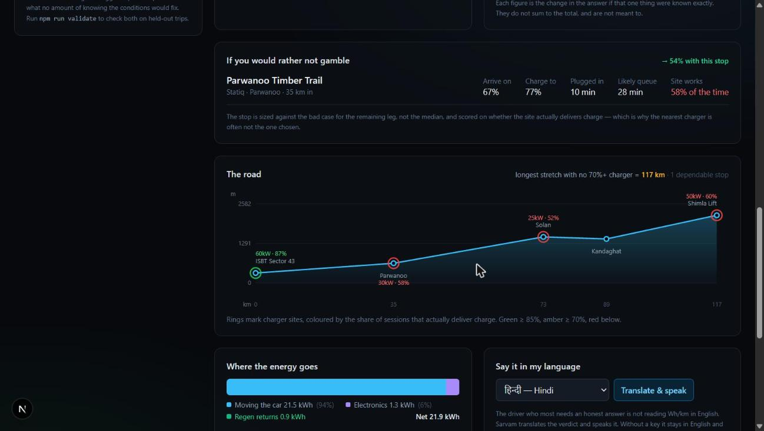
The question that earns a graph database
Attempt one was elegant and useless.
“P(at least one charger on this corridor works)” = 1 − Π(1−r). With seven sites it reads 1.0000 for every route. A metric that cannot tell the Jaipur expressway from the Shimla ghat is decoration.
What a driver is actually exposed to
is not “is there a working charger on this road” but “how far must I go with no dependable option”. Cypher returns each waypoint with its distance and composed odds; the caller reduces that to the longest uncovered stretch.
Delhi → Shimla: 117 km
Every dependable site is on the plains. The entire ghat climb has nothing above 70% uptime.
Charger reliability — the share of sessions that actually deliver charge — is the field no public map exposes
Notes:
The stop planner scores a candidate on P(reach it) x P(it works) x P(finish from there), which is why it routinely passes over the nearest charger.

Slide 8
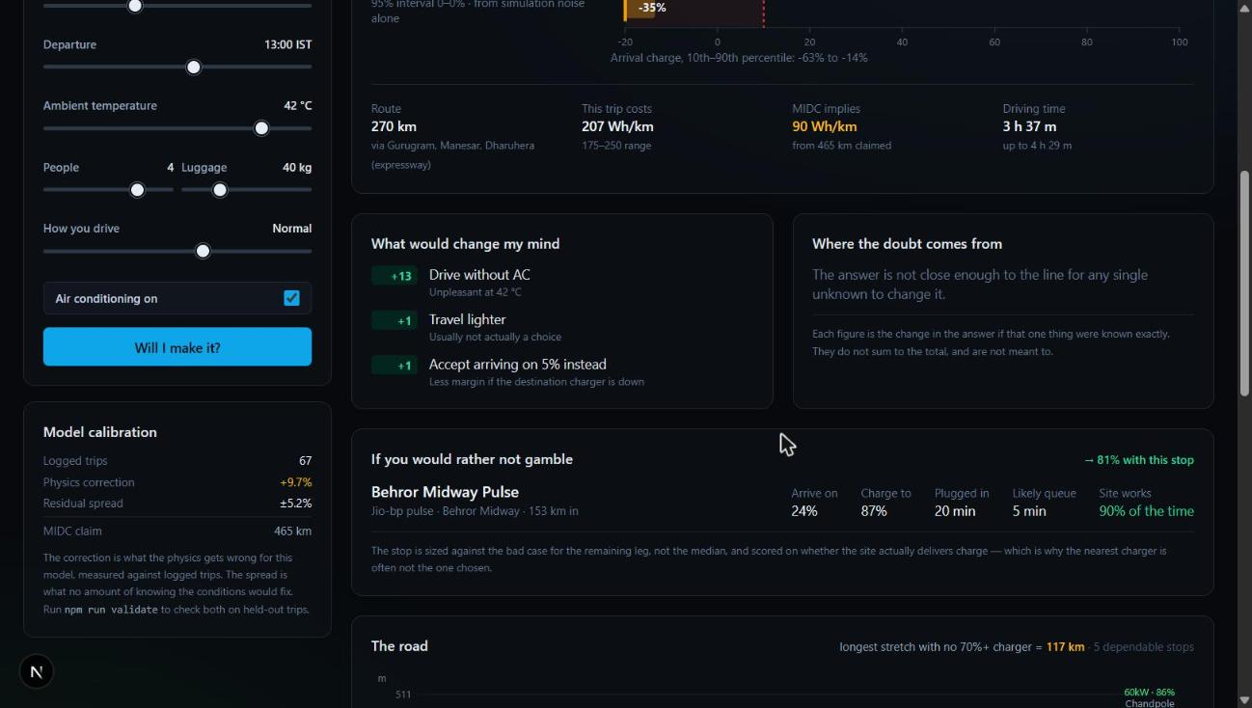
A probability you cannot act on is trivia
What would change my mind
Every lever is a full re-simulation under a changed request, not a heuristic nudge — so it is consistent with the headline by construction. All 24 departure hours are scanned.
Where the doubt comes from
Each uncertainty source pinned to its expected value, reporting how far the answer moves. It answers “what would I have to know to stop guessing”.
A result we did not design for
With the AC off, traffic uncertainty works in the driver's favour — slower is cheaper once the compressor is not running. The model found that on its own.
Levers, sensitivity, and the fallback charging plan

Slide 9
Five real bugs, four caught by our instruments
We built the validation harness, the tests and the fallback logging to catch our own mistakes. They did.
Double-counted uncertainty
Calibration measured residual spread with traffic and load at their means; the Monte Carlo then sampled them again. Probabilities collapsed toward 50% (ECE 0.099). Fixed with a variance decomposition over a shared sampler → 0.067.
Caught by the validation harness
Cold packs charged too fast
The temperature derate was applied to energy going in as well as to the rate limit, and the two cancelled.
Caught by a unit test
Cypher hop bound of 9
Delhi → Shimla is ten segments, so the query returned nothing and fell back silently. Now asserted in the seed script.
Caught by review, then pinned by a test
Promise.all on one session
A session holds one transaction, so three concurrent reads threw — and the app showed “bundled” with a seeded database right there.
Caught by fallback logging we added on principle
A stale verdict on screen
The form updated and the answer did not. The worst kind of bug: it looked like an answer to the question on screen.
Caught by opening it in a browser
Notes:
We are showing the bugs deliberately. A prototype with no bug history either has not been exercised or is not telling you about them.

Slide 10
What is real and what is not
A demo that overstates its data is worth less than one that does not. So, plainly:
Real
Hand-built
Synthetic
The physics, from first principles
The calibration machinery
The uncertainty sampling
The Cypher and the graph model
The validation harness
All of it runs unchanged against a production telematics feed
24 waypoints across the Delhi NCR corridors
NH48, Yamuna Expressway, NH44, the Shimla ghat
Real distances, elevations and charger operators
Traffic curves and reliability are plausible per road and operator class, not a licensed dataset
The 420 fleet logs — and the file says so at length
Each vehicle carries a hidden efficiency offset the model cannot see
Logged conditions are degraded copies of the true ones
The harness checks we recover those offsets from degraded logs: mean error 0.022
If the logs were real, exactly one file would change.

Slide 11
Built to be used, and to be handed over
Sarvam
Known limitations
Verdicts translated and spoken in 10 Indian languages, in modern-colloquial register. The driver who most needs an honest answer is not reading Wh/km in English.
Stated, not discovered later
The stop planner evaluates one charging stop. A 24 kWh Tiago on Delhi → Agra at 18:00 needs two.
No live traffic or weather feed. Both layers are shaped to accept one.
Ambient stands in for pack temperature — wrong for the first twenty minutes.
Calibration cannot prove the physics right in absolute terms against synthetic logs. Real telematics is the first thing we would ask a partner for.
Scooter consumption looks ~20% optimistic, and we did not tune it toward the remembered figure.
Runs anywhere
npm install && npm run dev. No API key, no database, no map tile server required. Every visualisation is hand-rolled SVG, because venue wifi cannot reach a CDN.
Degrades honestly
Neo4j down, no Sarvam key, unseeded database — it keeps working and states which path answered and why. A silent downgrade is worse than a failure.
Notes:
The limitations slide is deliberate. We would rather a judge hear these from us than find them.

Slide 12
Say it. Then defend it.
PAHUNCH
Every range estimator prints a figure. Very few can tell you how often they are right.
This one can, on trips it has never seen, in one command.
83
420
4 000
~300 ms
tests passing
fleet trips calibrated
simulations per verdict
to a full answer

