Slide 1






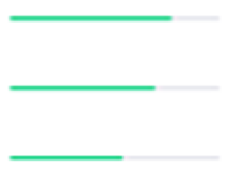
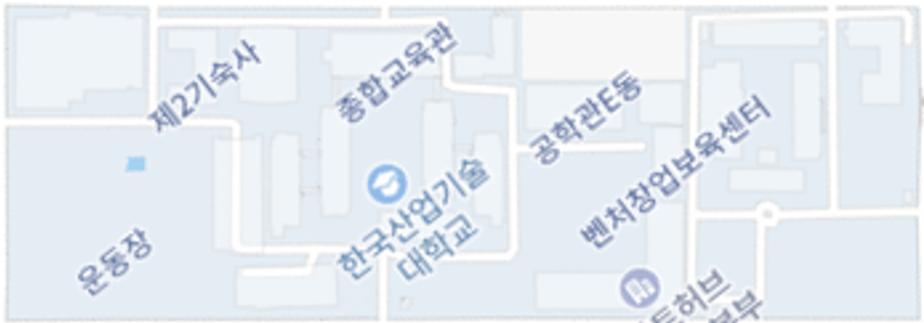
History
Possible Danger
3 events occurred
2020. 12. 03
Undefined Person
2020-12-03 10:33
Low Temperature 34.1℃
2020-12-03 14:14
High Temperature 37.1℃
2020-12-03 16:51
842
221
842
Access Status
Campus
Recent Activity
Recent Event
DATE
Show Status
Admin Login
1 hours ago
종합관
유영균 입장
2020-12-03 12:33
TIP
85%
15%
Warning
2 hours ago
G동
조성욱 퇴장
2020-12-03 12:32
G동
80%
20%
Request
2 hours ago
TIP
송인걸 퇴장
2020-12-03 12:32
종합관
70%
30%
News
3 hours ago
SEE ALL EVENT

