Slide 1
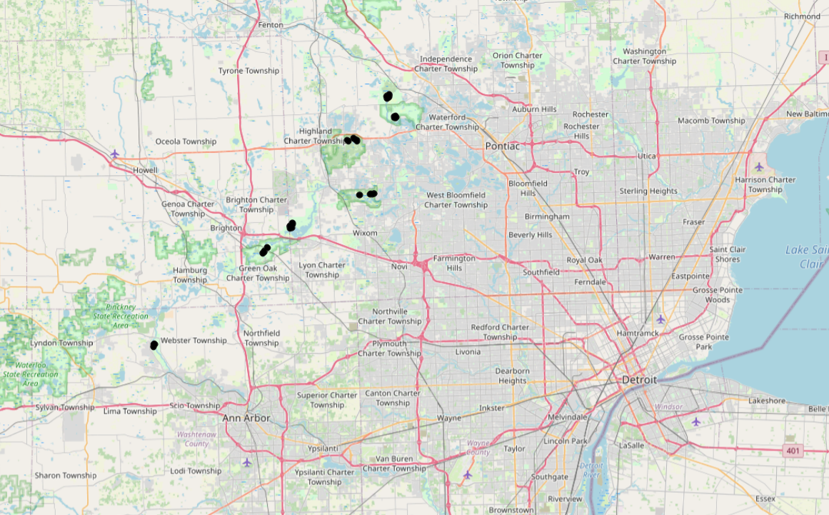
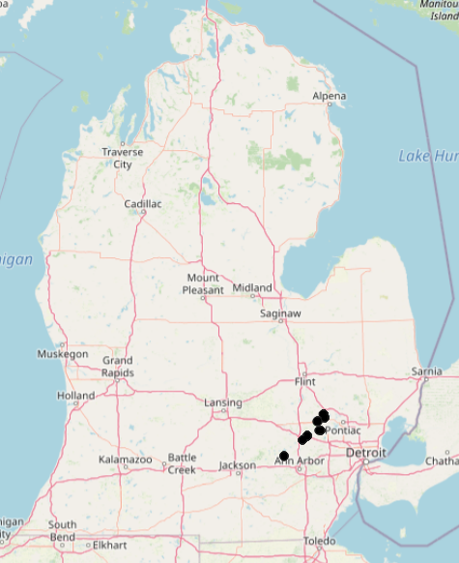
Indian Springs
Highland
Pontiac Lake
Kensington
Hudson Mills
Proud Lake
Island Lake

Slide 2
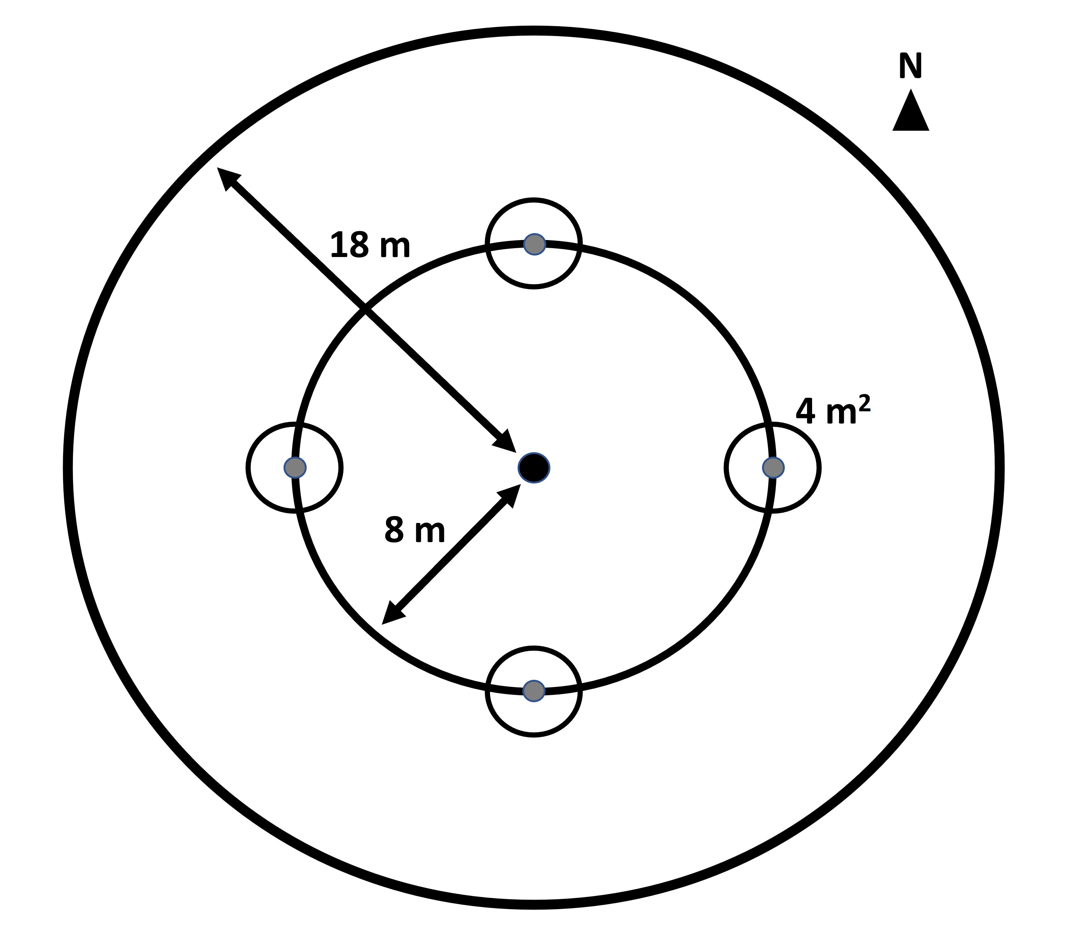
A
Indian Springs
B
Highland
Pontiac Lake
Kensington
Hudson Mills
Proud Lake
Island Lake

