Slide 1
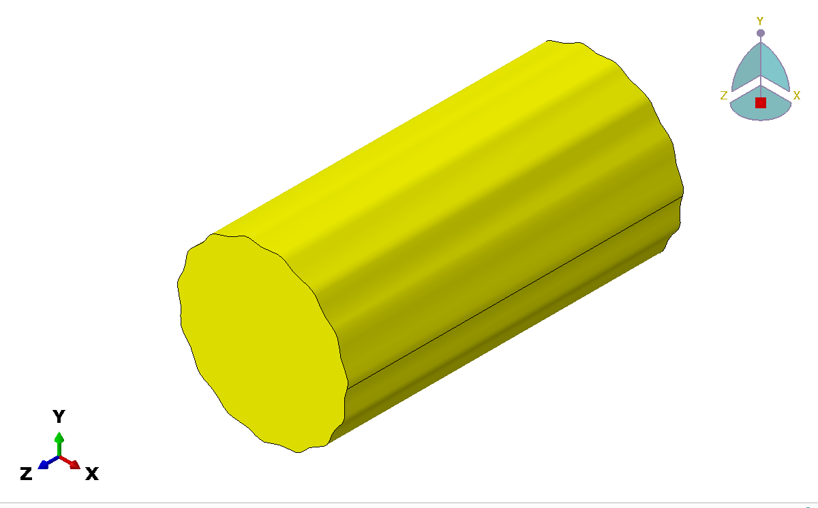
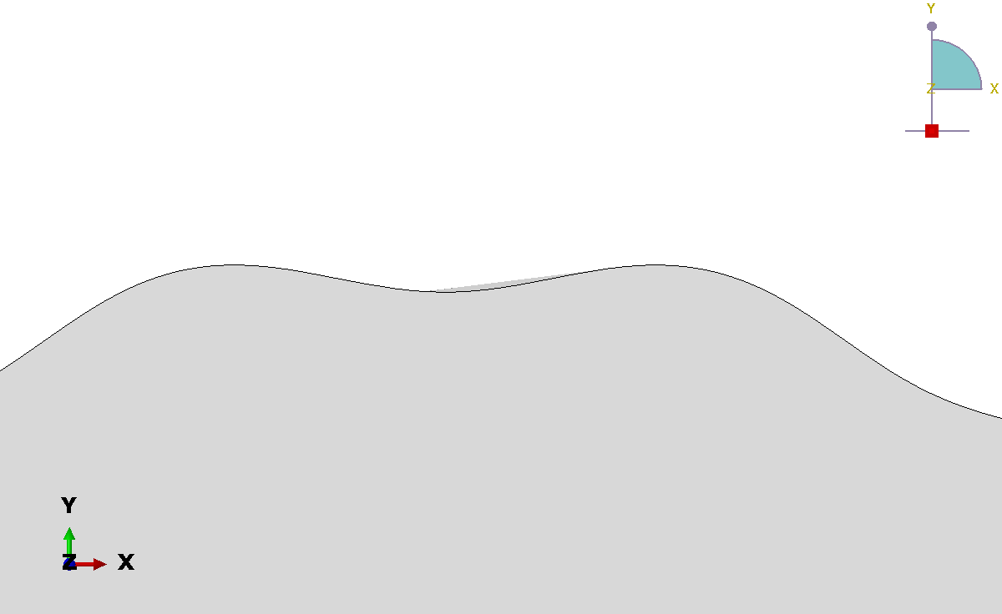
model_cylinder_CX_0_CY_0_Rad_50_Amp_1_freq_15.cae
2mm
20mm

Slide 2
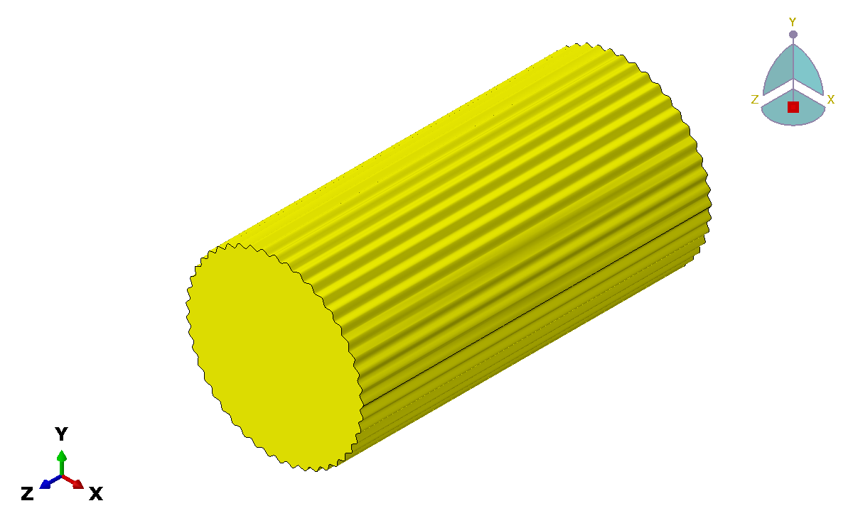
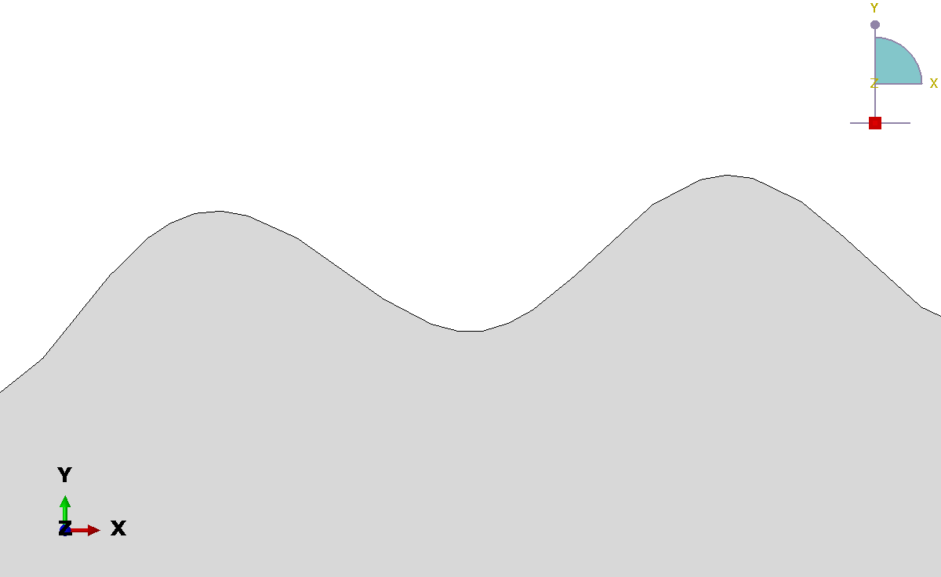
model_cylinder_CX_0_CY_0_Rad_50_Amp_1_freq_45.cae
2mm
7.5mm

Slide 3
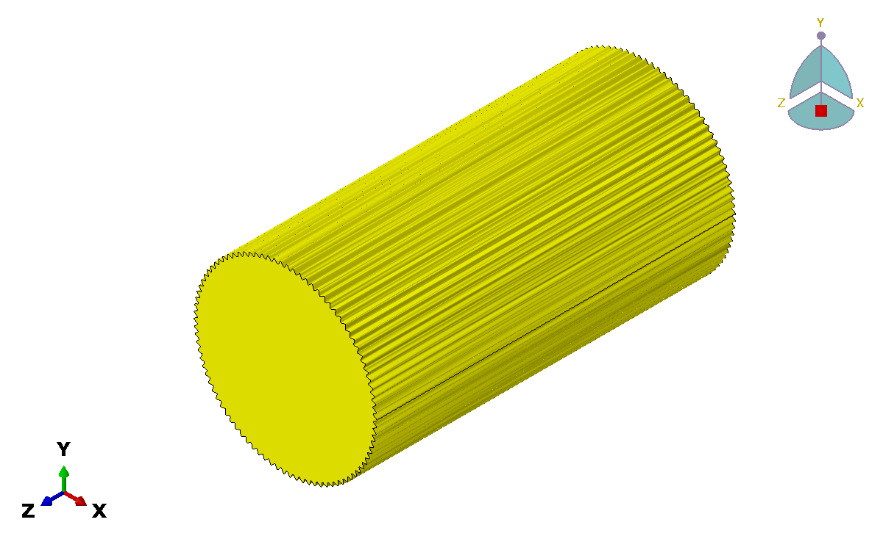
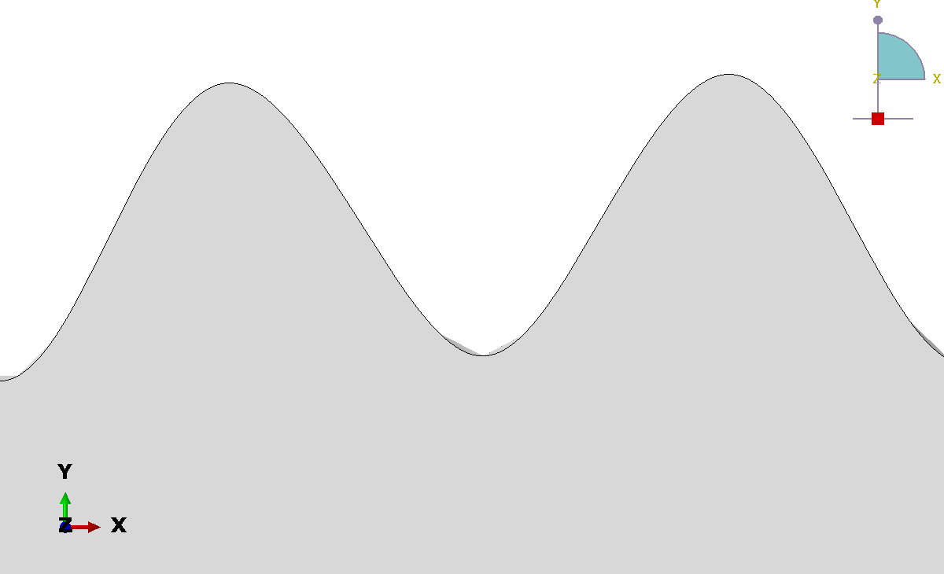
model_cylinder_CX_0_CY_0_Rad_50_Amp_1_freq_90.cae
2mm
4mm

Slide 4
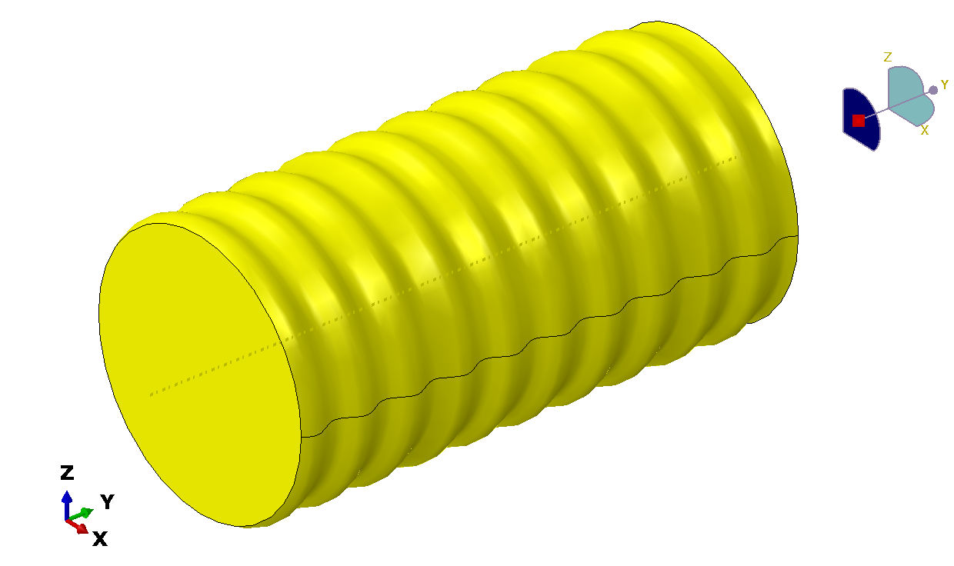
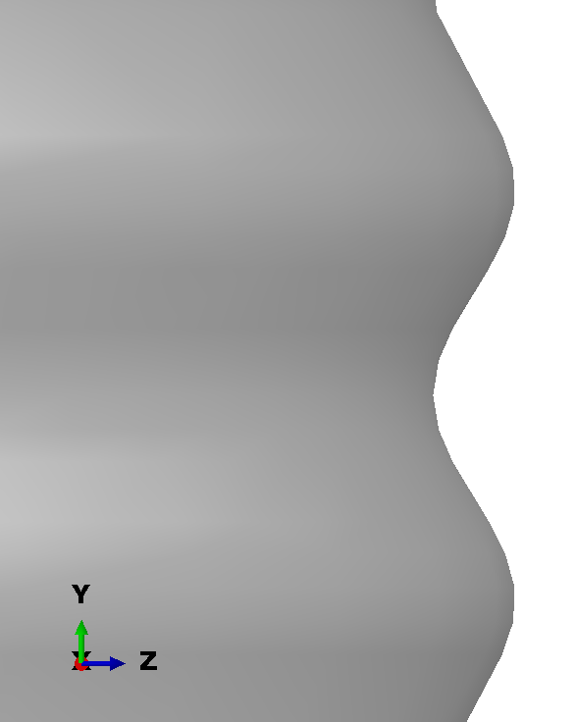
model_cylinder_A_2.0_freq_0.05_radius_50_lenght_200.cae
2mm
20mm

Slide 5
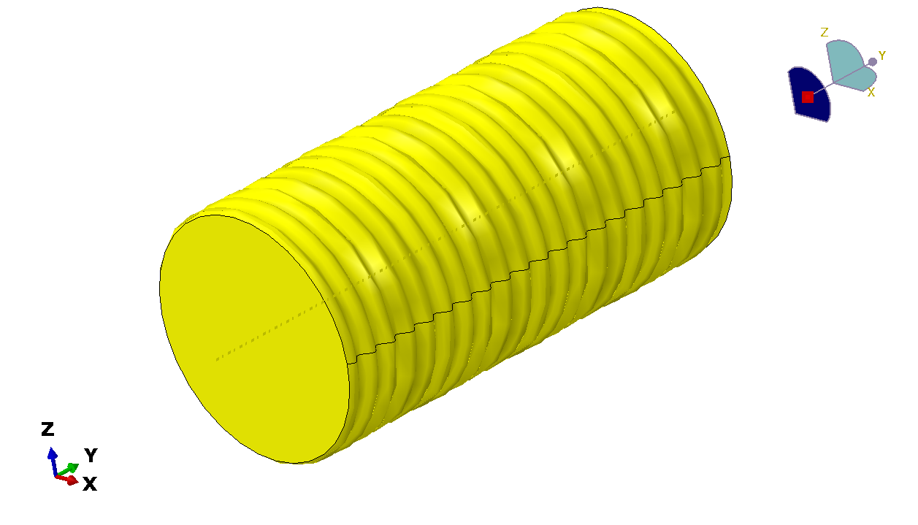
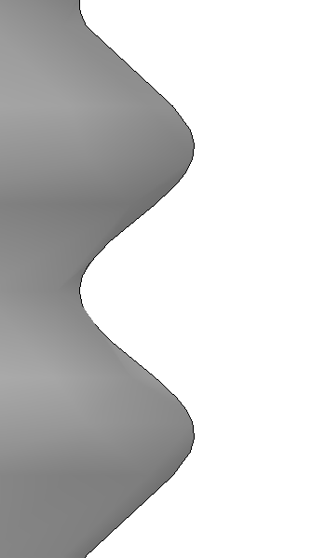
model_cylinder_A_2.0_freq_0.1_radius_50_lenght_200.cae
2mm
7.5mm

Slide 6
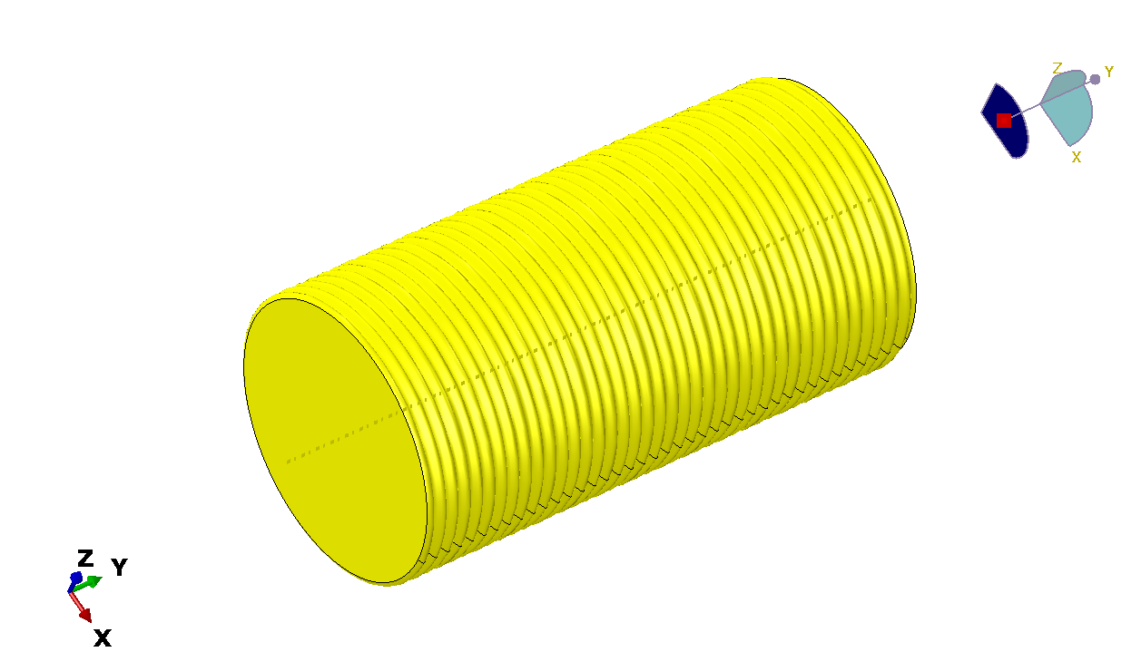
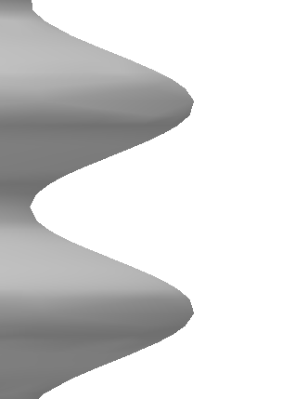
model_cylinder_A_2.0_freq_0.2_radius_50_lenght_200
2mm
5mm

