Slide 1
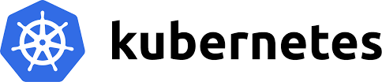
What is Kubernetes (“k8s” or “kube”)
Kubernetes Architecture
Core Concepts of Kubernetes
Kubernetes resources
Load Balancer & Service Introduction
Deployment and release strategy with Kubernetes
Kubernetes Networking – Ingress, Egress, Kubeproxy
Kubernetes YAML Files
Kubernetes Volumes
Kubernetes Commands

Slide 2
Kubernetes
Kubernetes is an open-source container orchestration system for automating software deployment, scaling, and management. Originally designed by Google, the project is now maintained by the Cloud Native Computing Foundation.
The name Kubernetes originates from Greek, meaning 'helmsman' or 'pilot'

Slide 3
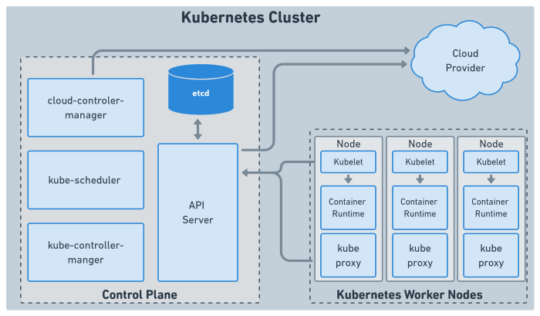

Slide 4
Node & POD
Pods are simply the smallest unit of execution in Kubernetes, consisting of one or more containers, each with one or more application and its binaries.
Nodes are the physical servers or VMs that comprise a Kubernetes Cluster.

Slide 5
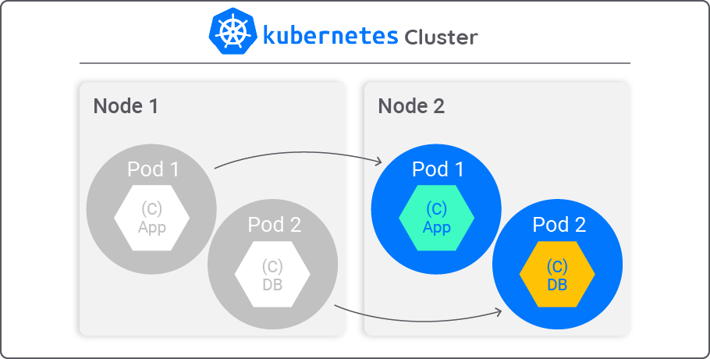
Node &Pod …… At a Glance

Slide 6
Master Node & Worker Node
A master node is a node which controls and manages a set of worker nodes (workloads runtime) and resembles a cluster in Kubernetes. A master node has the following components to help manage worker nodes
Worker nodes within the Kubernetes cluster are used to run containerized applications and handle networking to ensure that traffic between applications across the cluster and from outside of the cluster can be properly facilitated.
Kubelet Service: The agent that allows each worker node to communicate with the API Server running on the master node.
Components of Worker Node
Kube-proxy
Kubelet
Container Runtime

Slide 7
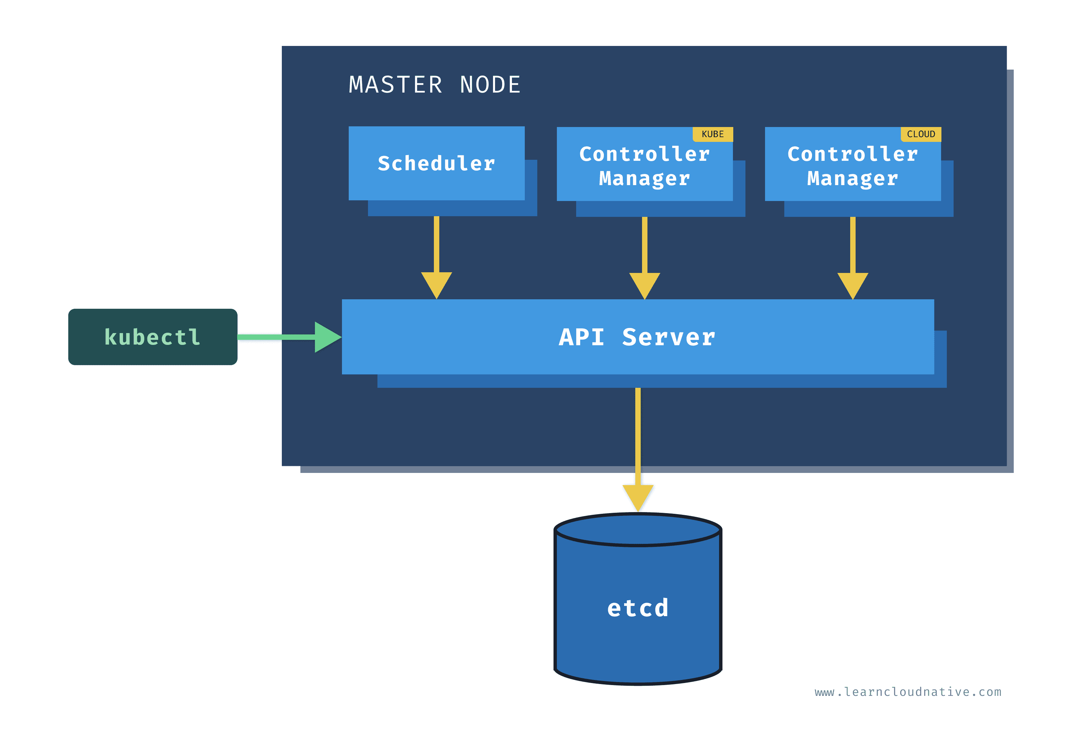
MASTER NODE COMPONENTS

Slide 8
Node Components
Pod: A pod is the smallest execution unit in Kubernetes. A pod encapsulates one or more applications.
Kubelet: An agent that runs on each node in the cluster. It makes sure that containers are running in a Pod
kube-proxy: kube-proxy is a network proxy that runs on each node in your cluster, implementing part of the Kubernetes Service concept. kube-proxy maintains network rules on nodes. These network rules allow network communication to your Pods from network sessions inside or outside of your cluster
Container runtime: The container runtime is the software that is responsible for running containers.
Node Port Range : 30000 - 32767

Slide 9
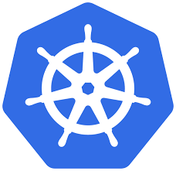
CONTROL PLANE COMPONENTS
API server - Entry point for a user to communicate cluster
Scheduler - Decides on which node new pod should be scheduled (It gets request from Kubelet processor)
Controller Manager - Checks the status of pods like crashing etc., It sends request to scheduler to like restart which worker node and restart pods
Cluster IP: The Cluster IP provides a load-balanced IP address. One or more pods that match a label selector can forward traffic to the IP address.
ETCD: It is stores all the cluster information like
1. what resources are available
2. Did the cluster state change
3. Cluster is healthy
4. Application Deployment status
etcd doesn't store application data

Slide 10
Kubelet & Kubectl
kubelet: the component that runs on all of the machines in your cluster and does things like starting PODs and containers.
Kubectl: the command line until to talk to your cluster

Slide 11
Kubernetes Namespaces
Namespaces are a way to organize clusters into virtual sub-clusters — they can be helpful when different teams or projects share a Kubernetes cluster. Any number of namespaces are supported within a cluster, each logically separated from others but with the ability to communicate with each other.
Types of Namespaces
kubesystem: Do not create
Kube-public:
kube-node release: heart bets of nodes
Deafult:

Slide 12
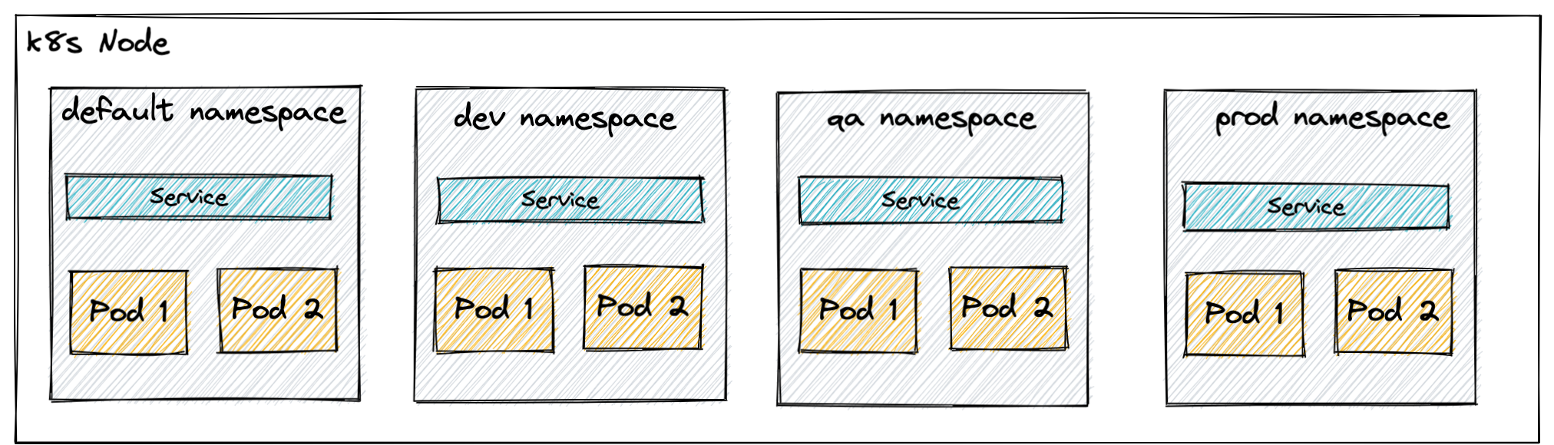
Kubernetes Namespaces

Slide 13
Kubernetes Networking
Kubernetes networking addresses four concerns:
Containers within a Pod use networking to communicate via loopback.
Cluster networking provides communication between different Pods.
The Service API lets you expose an application running in Pods to be reachable from outside your cluster.
Ingress provides extra functionality specifically for exposing HTTP applications, websites and APIs.
You can also use Services to publish services only for consumption inside your cluster.

Slide 14
Kubernetes Networking
Ingress
Egress
Kube-proxy
Load Balancing
Auto Scaling

Slide 15
Ingress & Egress
The Ingress concept lets you map traffic to different backends based on rules you define via the Kubernetes API. An API object that manages external access to the services in a cluster, typically HTTP. Ingress may provide load balancing, SSL termination and name-based virtual hosting
Egress is the outgoing traffic from pods. You can set rules to “allow” traffic in and out of Kubernetes Pod

Slide 16
Kube Proxy
kube-proxy is a network proxy that runs on each node in your cluster, implementing part of the Kubernetes Service concept. It maintains network rules on nodes.
These network rules allow network communication to your Pods from network sessions inside or outside of your cluster

Slide 17
Load Balancing
Kubernetes Load balancing is a key tactic for enhancing availability and scalability because it effectively divides network traffic among numerous backend services. In the Kubernetes environment, there are several solutions for load balancing external traffic to pods
Components of Kubernetes Load Balancing
Pods and Containers
Service
Ingress or Ingress Controller
Kubernetes load balancer

Slide 18
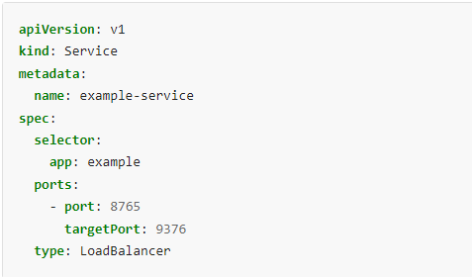
Load Balancer YAML File

Slide 19
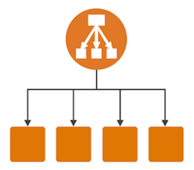
Auto Scaling
Vertical Pod Autoscaler (VPA): Increases and decreases pod CPU and memory
Horizontal Pod Autoscaler (HPA): Adds and removes pods
Cluster Autoscaler (CA): Adds and removes cluster nodes

Slide 20
Kubernetes Resources
A resource is an endpoint in the Kubernetes API that stores a collection of API objects of a certain kind; for example, the built-in pods resource contains a collection of Pod objects.
API resources, such as Pods and Services are objects that can be read and modified through the Kubernetes API server
CPU and memory are each a resource type. A resource type has a base unit. CPU represents compute processing and is specified in units of Kubernetes CPUs. Memory is specified in units of bytes.

Slide 21
Kubernetes Service
In Kubernetes are collections of pods with a common name. Services serve as the point of access for outside customers and have consistent IP addresses. Services are designed to distribute traffic to a group of pods, much like traditional load balancers.
The Service API, part of Kubernetes, is an abstraction to help you expose groups of Pods over a network. Each Service object defines a logical set of endpoints (usually these endpoints are Pods) along with a policy about how to make those pods accessible.

Slide 22
YAML File
The YAML configuration is called a “manifest”, and when it is “applied” to a Kubernetes cluster, Kubernetes creates an object based on the configuration.
A Kubernetes Deployment YAML specifies the configuration for a Deployment object—this is a Kubernetes object that can create and update a set of identical pods.
kubectl create -f /k8s/deployments/deployment1.yaml
kubectl apply -f /k8s/deployments/deployment1.yaml

Slide 23
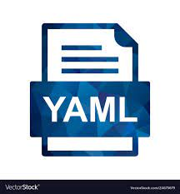
YAML FILE COMPONENTS
API VERSION
KIND
META DATA
LABEL
SPEC
SELECTORS
PORTS
NODE PORT
CONTAINER PORT

Slide 24
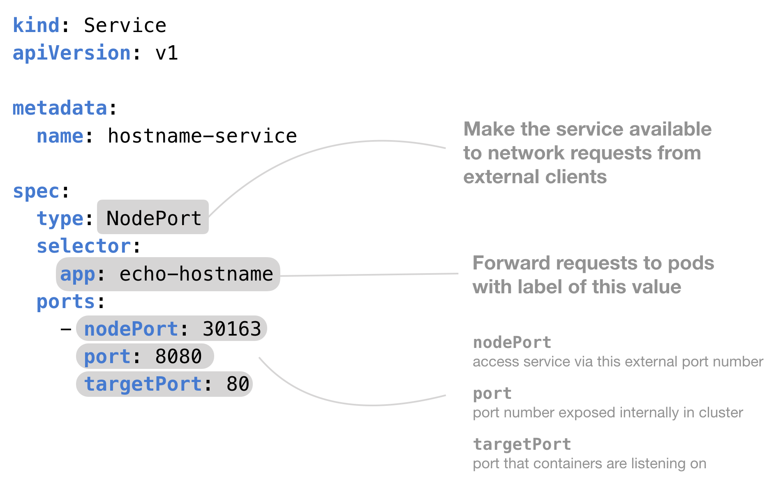
What kind of object you want to create (deployment, service, Pod, Persistent volume)
Which version of the Kubernetes API you're using to create this object.

Slide 25
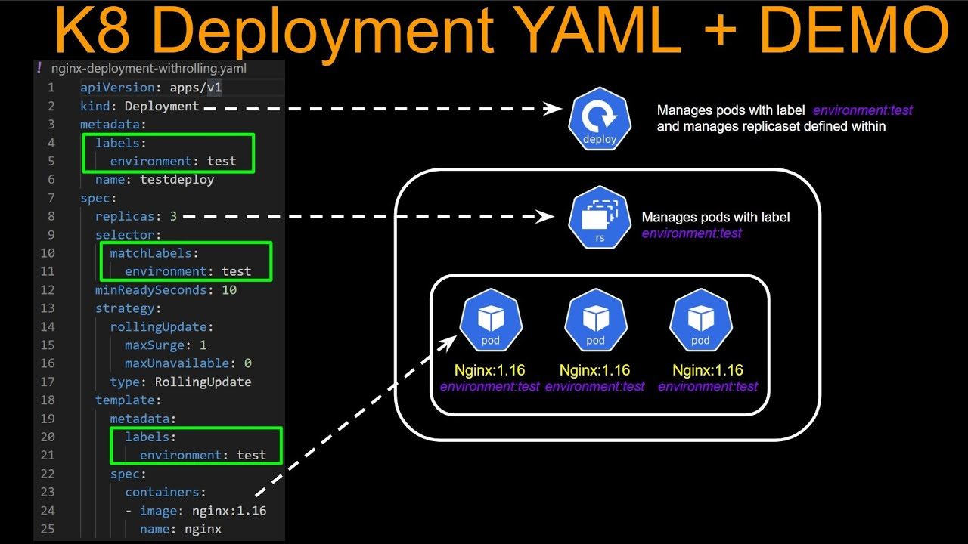

Slide 26
MOST USED YAML FILES
DEPLOYMENT. YAML
SERVICE.YAML
CONFIG.YAML
Deployment YAML: It allows users to declare the desired state in the manifest (YAML) file, and the controller will change the current state to the declared state.
SERVICE YAML: Creates a Service that is available to external network requests
CONFIG YAML:A file that defines the configuration for a Kubernetes object.

Slide 27
Config Maps & Secret
Config maps ideally stores application configuration in a plain text format whereas Secrets store sensitive data like password in an encrypted format.
Both config maps and secrets can be used as volume and mounted inside a pod through a pod definition file.

Slide 28
Kubernetes Volumes
A Kubernetes volume is a directory that contains data accessible to containers in a given Pod in the orchestration and scheduling platform.
Volumes provide a plug-in mechanism to connect ephemeral containers with persistent data stores elsewhere.
Types of Volumes
Persistent volume (PV)
Persistent volume Claim(PVC)

Slide 29
Kubernetes Volumes
Persistent volume (PV): persistent volume (PV) is the "physical" volume on the host machine that stores your persistent data
Persistent volume Claim(PVC): A persistent volume claim (PVC) is a request for the platform to create a PV for you, and you attach PVs to your pods via a PVC

Slide 30
KUBERNETES COMMANDS
Pods and Container Commands
Lists all current pods | Kubectl get pods
Describes pod names | Kubectl describe pod<name>
Lists all replication controllers | Kubectl get rc
Lists all replication controllers | Kubectl get rc –namespace=”namespace”
Shows the replication controller name | Kubectl describe rc <name>
Lists services | Kubectl get cvc
Shows a service name | Kubectl describe svc<name>
Deletes a pod | Kubectl delete pod<name>
Watches nodes continuously | Kubectl get nodes -w
Debugging Commands
Executes the command on service by choosing a container | Kubectl exec<service><commands>[-c< $container>]
Gets logs from the service for a container | Kubectl logs -f<name>>[-c< $container>]
Shows metrics for a node | Kubectl top node
Shows metrics for a pod | Kubectl top pod

Slide 31
KUBERNETES COMMANDS
Cluster Introspection Commands
To get version-related information | Kubectl version
To get cluster-related information | Kubectl cluster-info
To get configuration details | Kubectl config g view
To get information about a node | Kubectl describe node<node>
Quick Commands
Launching a pod with a name and image. | Kubectl run<name> — image=<image-name>
To create a service detailed in <manifest. yaml> | Kubectl create -f <manifest.yaml>
To scale the replication counter, counting the number of instances. | Kubectl scale –replicas=<count>rc<name>
Mapping the external port to the internal replication port. | Expose rc<name> –port=<external>–target-port=<internal>
Stopping all pods in <n> | Kubectl drain<n>– delete-local-data–force–ignore-daemonset
To create a namespace. | Kubectl create namespace <namespace>
To let the master node run pods. | Kubectl taint nodes –all-node-role.kuernetes.io/master-

