Slide 1
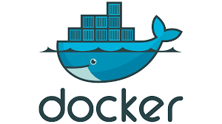
CONTENTS
Introduction to Docker
What is container
Docker Architecture Container
Lifecycle Port Binding Detached and Foreground Mode
Docker file
Docker file Instructions
Docker Image Docker Registry
Volumes Docker Compose
Docker Commands
Docker Inspect

Slide 2
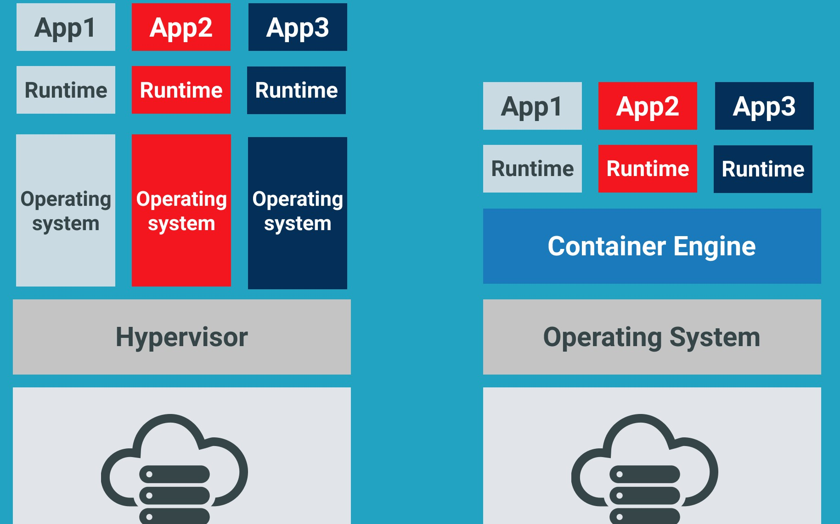
MONOLITH ARCHITECTURE vs MICROSERVICES ARCHITECTURE

Slide 3

Docker
Docker is a software platform that allows you to build, test, and deploy applications quickly. Docker packages software into standardized units called containers that have everything the software needs to run including libraries, system tools, code, and runtime.

Slide 4
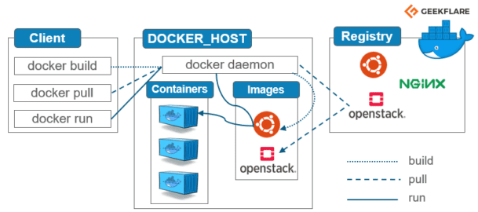
DOCKER ARCHITECTURE

Slide 5
Docker Client
The Docker client ( docker ) is the primary way that many Docker users interact with Docker. When you use commands such as docker run , the client sends these commands to docker d , which carries them out. The docker command uses the Docker API. The Docker client can communicate with more than one daemon.
Docker Build
Docker Pull
Docker Run

Slide 6
Docker Host
Host is a machine responsible for running one or more containers.
Docker host is the machine where you installed the docker engine
Host = container implementation
Docker = app packaging and container management

Slide 7
Docker Daemon
Listens for Docker API requests and manages Docker objects such as images, containers, networks, and volumes. A daemon can also communicate with other daemons to manage Docker services.
The purpose of the daemon is to respond to network, hardware, or system requests to perform certain tasks.

Slide 8
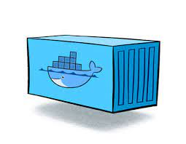
Docker Container
A Docker container image is a lightweight, standalone, executable package of software that includes everything needed to run an application: code, runtime, system tools, system libraries and settings.

Slide 9
Docker Image
Application code.
Libraries
Tools
Dependencies
Other files needed to make an application run.
When a user runs an image, it can become one or many instances of a container. Docker images have multiple layers, each one originates from the previous layer but is different from it.

Slide 10
Docker Registry
A Docker registry is a storage and distribution system for named Docker images. The same image might have multiple different versions, identified by their tags. A Docker registry is organized into Docker repositories , where a repository holds all the versions of a specific image.

Slide 11
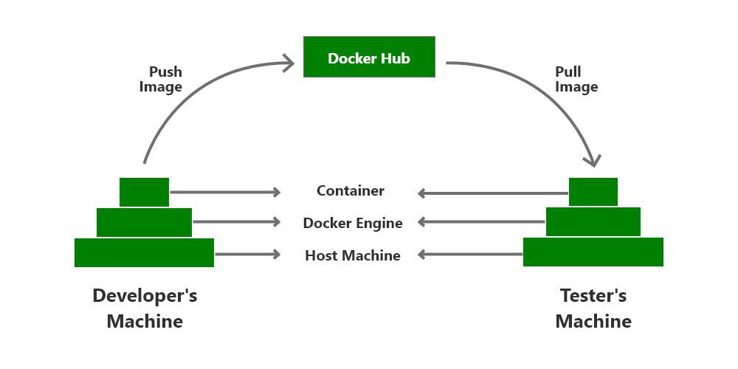
Docker Hub
Docker Hub is a cloud-based repository that lets you create, test, store, and deploy Docker container images. It provides access to public open source image repositories and lets you create your own private repositories.

Slide 12
DOCKER HUB | DOCKER REGISTRY
It is the public repository provided by the Docker itself for pushing and pulling the Images. | Registry is the feature provided by the Docker to create your own private repository for storing the Images.
When any particular Image is required by for the container, docker first checks the local system if the required image is present. If the Image is not present it simply downloads it from the Docker HUB. | For creating a registry, docker provides an image Registry:2.0. We can customize it with the certificates and run it as container.
Docker HUB is for public use and the default repository, anyone can fetch and pull the Images using the “docker pull” command. | Registry provides security as only the limited users within the organization will have access of the same.

Slide 13
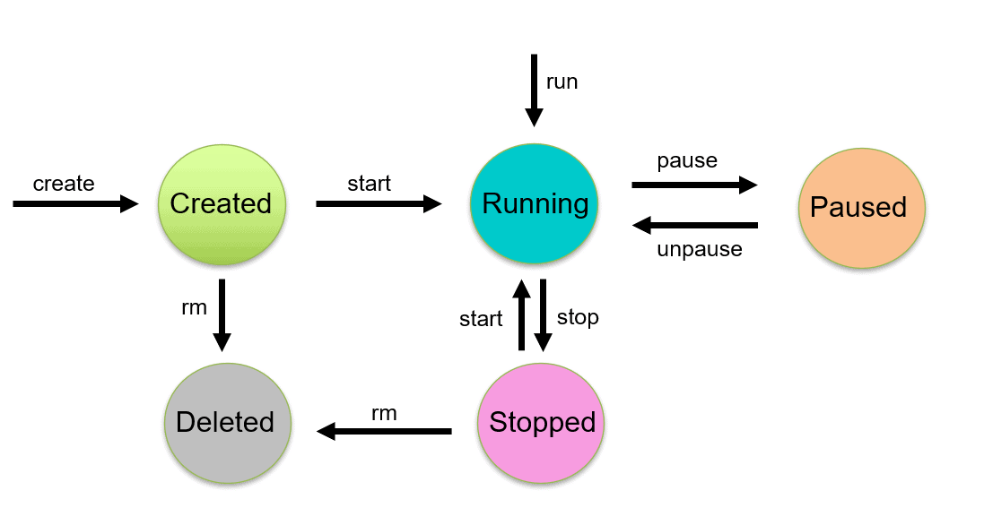
DOCKER CONTAINER LIFECYCLE

Slide 14
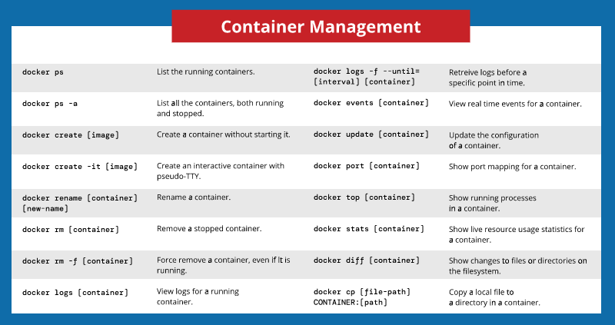

Slide 15
Docker File vs Docker compose
A Docker file is a simple text file that contains the commands a user could call to assemble an image. | It is a tool for defining and running multi-container Docker applications.
 | define the services that make up your app in docker-compose.yml so they can be run together in an isolated environment.
 | get an app running in one command by just running docker-compose up

Slide 16
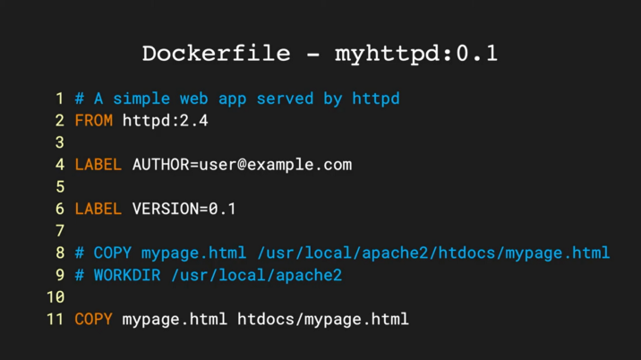
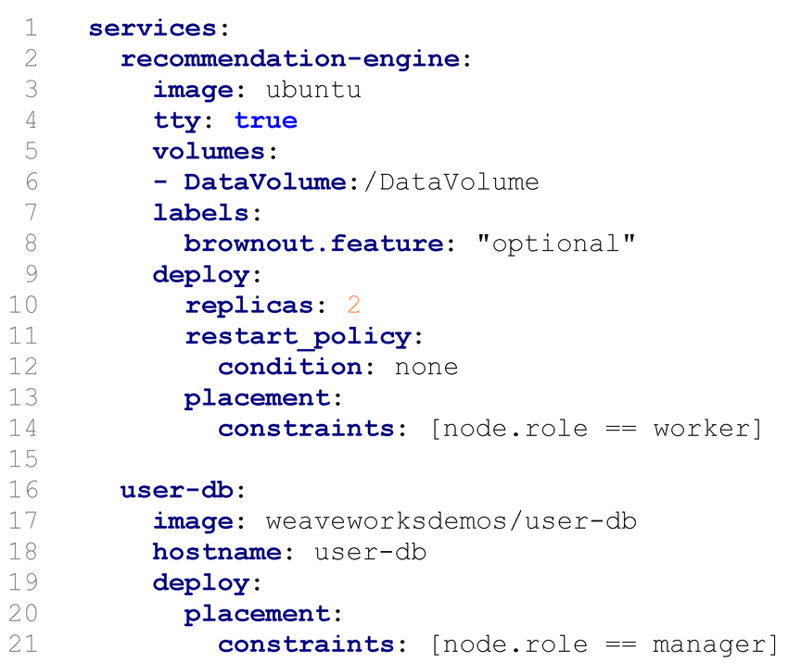
Docker File
Docker Compose File

Slide 17
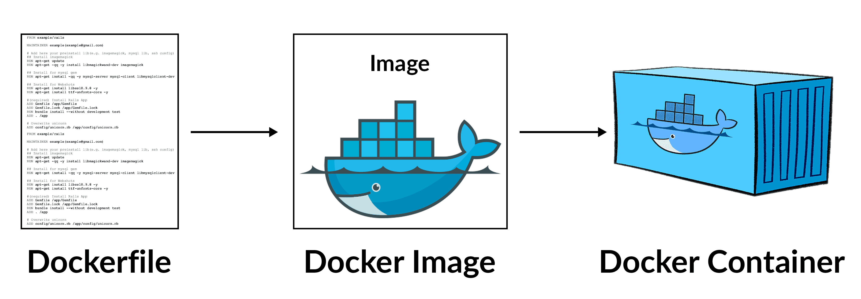

Slide 18
COMPONENTS OF DOCKER FILE
FROM — The base image can be Ubuntu, Redis, MySQL, etc.
LABEL — Labeling like EMAIL, AUTHOR, etc.
RUN — It is used to tell the container what to do after creating the container from the image. Such as, apk add — update-redis, rm -fr
Note: If we need to run the file externally that is inside of the container use cp command in the RUN command RUN cp /usr/share/zoneinfo/Asia/Colombo /etc/localtime && echo “Asia/Colombo” > /etc/timezone && apk del tzdata
COPY — Copy the files from our host system. src: source path dest: container destination path
ADD — It is like a COPY command, but it downloads tar, zip, or web file and extracts and copies inside of our image.
WORKDIR — It is used to set the directory that we are going to work. If we are adding some files from host local machine and saves in the container, the working directory path is the default directory
ENTRYPOINT — The command the executes inside of container. like server running command in httpd container, bash shell in Ubuntu

Slide 19
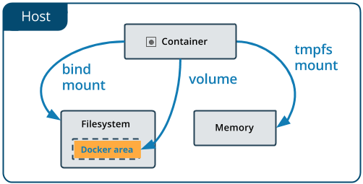
DOCKER VOLUMES

Slide 20
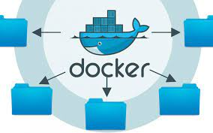
Docker Volumes Types
Volumes
Bind Mounts
Tmps Mounts

Slide 21
Docker Volume
These are the most common mount option available for Docker containers and is fully managed by Docker engine. You can create a volume through Docker commands and can share it within the Docker containers.
When you create a volume, it is stored within a directory on the Docker host (/var/lib/docker/volumes/ on Linux) and is completely isolated from Docker host.
Multiple Docker containers can use the same volumes and can read-write simultaneously.
When the container is not running, data still persist in volumes.

Slide 22
Bind Mount
These are the host machine file systems which are mounted on Docker container and this Docker don’t have control over it and host machine only manages it.
When you use a bind mount, a file or directory on the host machine is mounted into a Docker container. Their performance is good, but containers have to rely on the host machine’s filesystem having a specific directory structure available.

Slide 23
TMPS Mount
As the name suggests, these mounts are temporary and once the Docker container is stopped the data present on these mounts is also lost.
tmpfs mounts are stored in the host system’s memory only and are never written to the host system’s filesystem and thus does not hold data permanently.

Slide 24
DOCKER NETWORKING
Docker networking allows you to attach a container to as many networks as you like. You can also attach an already running container. Go ahead and attach your running web app to the my_bridge .
Types of Docker Network
Bridge
Host
Overlay
Ipvlan
Mcvlan
None

Slide 25
Bridge | The default network driver. If you don’t specify a driver, this is the type of network you are creating. Bridge networks are usually used when your applications run in standalone containers that need to communicate
Host | For standalone containers, remove network isolation between the container and the Docker host, and use the host’s networking directly
Overlay | Overlay networks connect multiple Docker daemons together and enable swarm services to communicate with each other.
IP Vlan | IPvlan networks give users total control over both IPv4 and IPv6 addressing. The VLAN driver builds on top of that in giving operators complete control of layer 2 VLAN tagging and even IPvlan L3 routing for users interested in underlay network integration
Mcvlan | Macvlan networks allow you to assign a MAC address to a container, making it appear as a physical device on your network. The Docker daemon routes traffic to containers by their MAC addresses. Using the macvlan driver
None | For this container, disable all networking. Usually used in conjunction with a custom network driver.
docker network create [OPTIONS] NETWORK

Slide 26
Docker Inspect
Docker inspect provides detailed information on constructs controlled by Docker. By default, docker inspect will render results in a JSON array.
Troubleshooting commands
docker --tail 100 = displays last 100 lines
docker logs --since 10 = displays last 10 minutes log
docker inspect --format={{.LogPath}} <Container ID>
grep error <location>
tail -f 'docker inspect --format={{.LogPath}} <Container ID>'
docker ps --filter="status-exited"

