Slide 1

By Phani Prasad

Slide 2
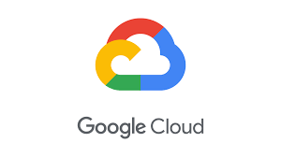
GCP At a Glance….
GCP Started on April 7, 2008
URL: https://cloud.google.com
Written in : Java, C++, Python & Go Ruby

Slide 3
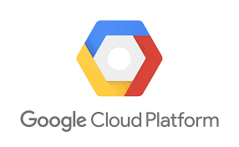
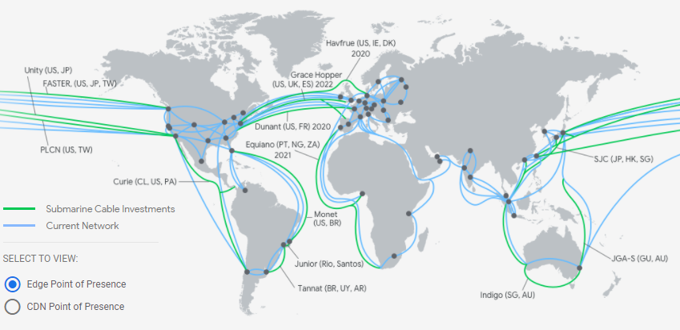
GCP GLOBAL PRESENCE
20+ regions
70+ zones
140+ network edge locations

Slide 4
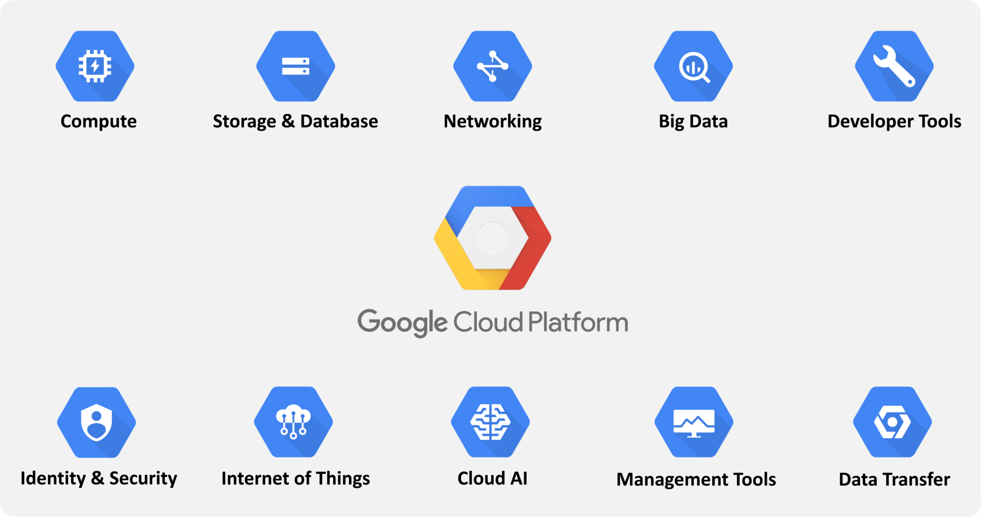

Slide 5

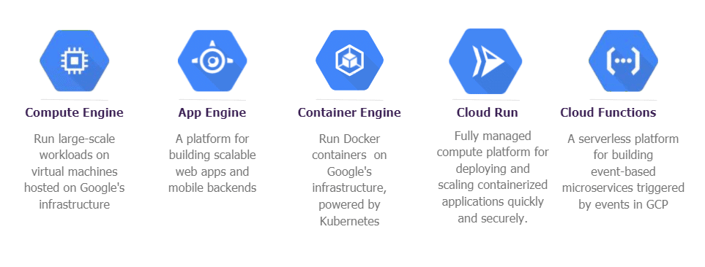
GCP COMPUTE

Slide 6
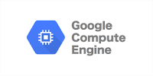
COMPUTE ENGINE
Google Compute Engine is a part of Google’s IaaS (Infrastructure as a Service) service that provides virtual machines (VMs). It is an unmanaged compute service and is generally referred to as customizable virtual machines in Google cloud.

Slide 7
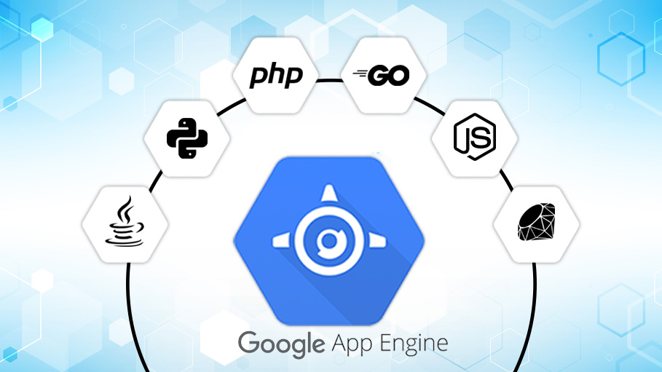
GOOGLE APP ENGINE
Google App Engine (GAE) is a service for developing and hosting Web applications in Google’s data centers, belonging to the platform as a service (PaaS) category of cloud computing. App Engine automatically allocates additional resources to the servers to accommodate increased load.

Slide 8
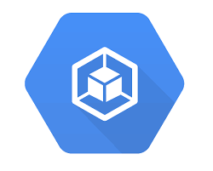
CONTAINER ENGINE
Container engines can run multiple, isolated instances, known as containers, on the same operating system kernel. Containers perform virtualization at the operating system level, and provide a controllable, easily manageable environment for running applications and dependencies.

Slide 9
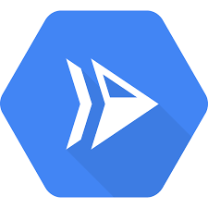
CLOUD RUN
Cloud Run is a managed compute platform that lets you run containers directly on top of Google's scalable infrastructure. You can deploy code written in any programming language on Cloud Run if you can build a container image from it. In fact, building container images is optional

Slide 10
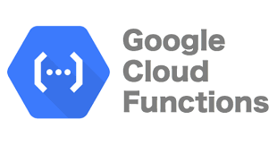

CLOUD FUNCTIONS
Run your code in the cloud with no servers or containers to manage with our scalable, pay-as-you-go functions as a service (FaaS) product.
Cloud functions is server-less
Let’s see some use cases

Slide 11
Use case | Description
Data processing / ETL | Listen and respond to Cloud Storage events such as when a file is created, changed, or removed. Process images, perform video transcoding, validate and transform data, and invoke any service on the internet from your Cloud Functions.
Webhooks | Via a simple HTTP trigger, respond to events originating from 3rd party systems like GitHub, Slack, Stripe, or from anywhere that can send HTTP requests.
Lightweight APIs | Compose applications from lightweight, loosely coupled bits of logic that are quick to build and that scale instantly. Your functions can be event-driven or invoked directly over HTTP/S.
Mobile backend | Use Google's mobile platform for app developers, Firebase, and write your mobile backend in Cloud Functions. Listen and respond to events from Firebase Analytics, Realtime Database, Authentication, and Storage.
IoT | Imagine tens or hundreds of thousands of devices streaming data into Pub/Sub, thereby launching Cloud Functions to process, transform and store data. Cloud Functions lets you do it in a way that's completely serverless.

Slide 12
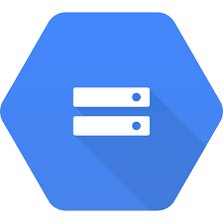
STORAGE SERVICES
Cloud Storage
Cloud Storage for firebase
File store
Local SSD
Persistent Disk

Slide 13
Storage type | Description | Best for
Standard storage | Storage for data that is frequently accessed ("hot" data) and/or stored for only brief periods of time. | "Hot" data, including websites, streaming videos, and mobile apps.
Nearline storage | Low cost, highly durable storage service for storing infrequently accessed data. | Data that can be stored for 30 days.
Coldline Storage | A very low cost, highly durable storage service for storing infrequently accessed data. | Data that can be stored for 90 days.
Archival storage | The lowest cost, highly durable storage service for data archiving, online backup, and disaster recovery. | Data that can be stored for 365 days.

Slide 14
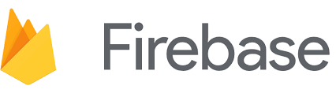
Cloud Storage for Firebase
A scalable, flexible database service for server, web, and mobile development. It serves as a NoSQL document database. You can use it to store, query, and sync your app data. It is supported for Android, iOS, and web applications.

Slide 15

File Store
File store is a managed file storage service for applications that require a file system interface and a shared file system for data. It gives the user a native experience for standing up managed network detached storage with their VM in the compute engine and Google Kubernetes Engine.

Slide 16
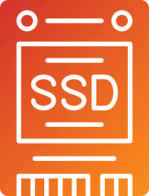
Local SSD
Local SSDs are designed for temporary storage use cases such as caches or scratch processing space. Which makes them suitable for workloads like media rendering, data analytics, or high-performance computing.

Slide 17
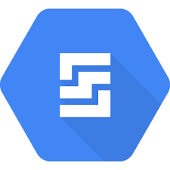
Persistent Disk
Persistent Disks are designed for durability. We automatically store your data redundantly to ensure the highest level of data integrity. Whether you're worried about planned maintenance or unexpected failures, we ensure your data is available, and your business stays uninterrupted.
Types of Persistent Disk:
Zonal standard PD
Regional standard PD
Zonal Balanced PD
Regional Balanced PD
Zonal SSD
Regional SSD PD
Zonal extreme PD
Hyper disk Extreme

Slide 18
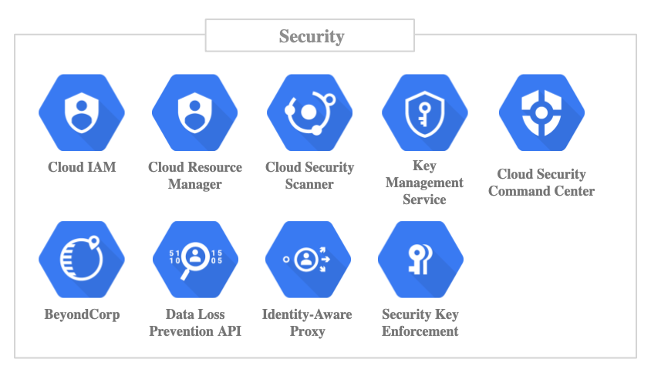

Slide 19
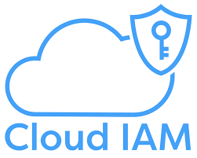
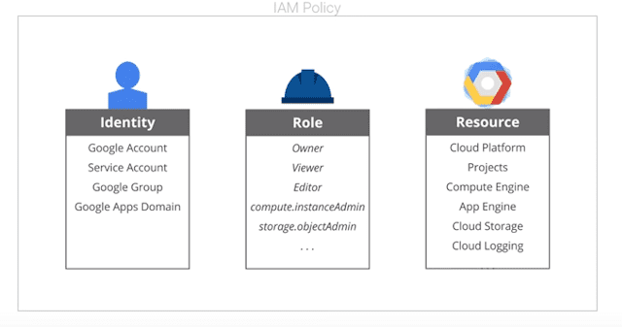
CLOUD IAM
Identity and Access Management (IAM) lets administrators authorize who can take action on specific resources, giving you full control and visibility to manage Google Cloud resources centrally.

Slide 20
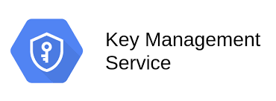
KEY MANAGEMENT SERVICE
A cloud-hosted key management service that lets you manage symmetric and asymmetric cryptographic keys for your cloud services the same way you do on-premises. You can generate, use, rotate, and destroy AES256, RSA 2048, RSA 3072, RSA 4096, EC P256, and EC P384 cryptographic keys.

Slide 21
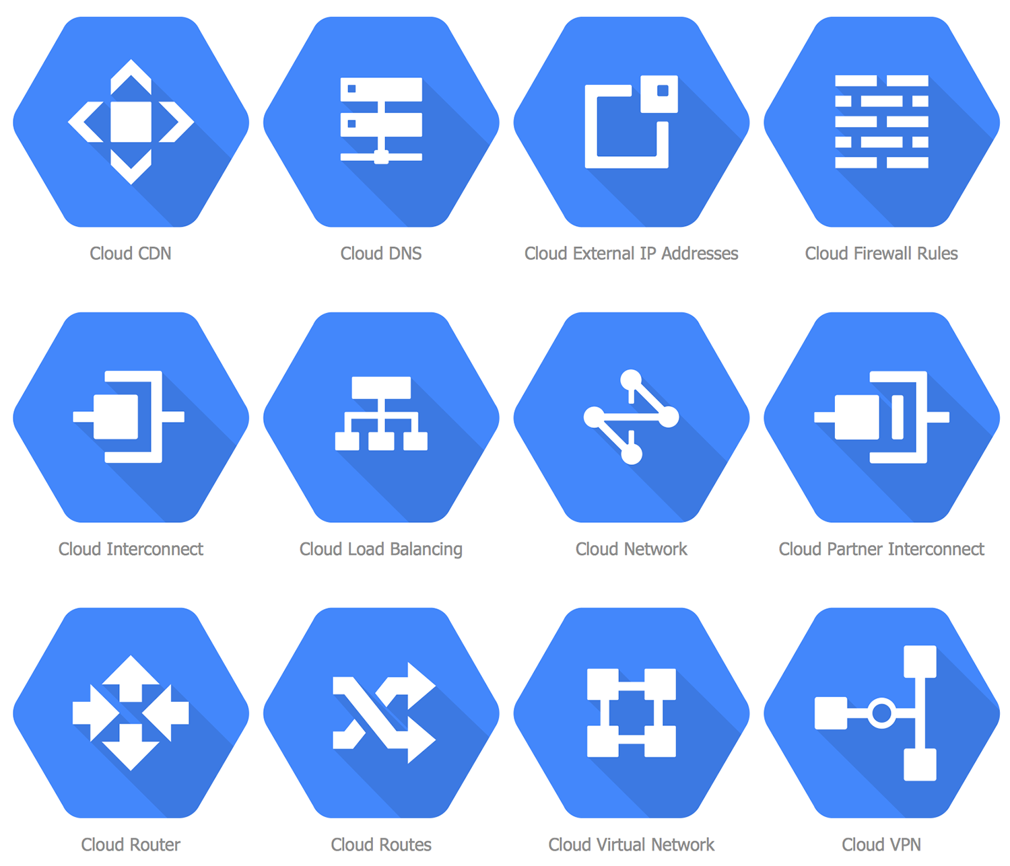
CLOUD NETWORKING

Slide 22
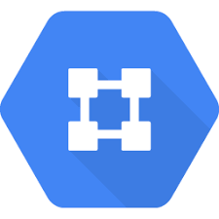
CLOUD VPC
Google Cloud VPC is global, scalable, and flexible. It provides networking for Compute Engine VM, GKE containers, and the App Engine environment

Slide 23
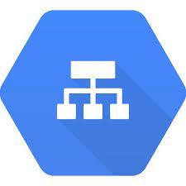
CLOUD LOAD BALANCING
Google Cloud Load Balancing allows you to put your resources behind a single IP address.
Features
Can be set to be available externally or internally with your Virtual Private Network (VPC).
HTTP(S) load balancing can balance HTTP and HTTPS traffic across multiple backend instances, across multiple regions.
Enable Cloud CDN for HTTP(S) load balancing to optimize application delivery for your users with a single checkbox.
You can define the autoscaling policy and the auto-scaler performs automatic scaling based on the measured load. No pre-warming required — go from zero to full throttle in seconds.
Manage SSL certificates and decryption.

Slide 24
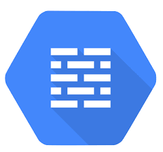
Firewall Rules
Firewall rules are defined at the network level.
They only apply to the network where they are created but the name defined for each of them must be unique to the project.
Firewall rule components
The direction of connection:
Ingress rules apply to incoming connections from specified sources to Google Cloud targets
Egress rules apply to connections going to specified destinations from targets.

Slide 25

Communications & Access for App Engine
VPC firewall rules apply to resources running in the VPC network. For App Engine instances, firewall rules work as follows:
App Engine standard environment
Only App Engine firewall rules apply to ingress traffic. App Engine standard environment instances do not run inside your VPC network which means VPC firewall rules do not apply to them.
App Engine flexible environment
Both App Engine and VPC firewall rules apply to ingress traffic. Inbound traffic is only permitted if it is allowed by both types of firewall rules. For outbound traffic, VPC firewall rules shall apply.

Slide 26
TYPES OF CLOUD LOAD BALACING
Internal or external | Regional or global | Traffic type | Load Balancer type
Internal | Regional | TCP or UDP | Internal TCP/UDP load balancer
 |  | HTTP or HTTPS | Internal HTTP(S) load balancer
 |  | TCP | Internal regional TCP proxy load balancer
External | Global | HTTP or HTTPS | Global external HTTP(S) load balancer
 | Global in Premium Tier | HTTP or HTTPS | Global external HTTP(S) load balancer (classic)
 |  | SSL | External SSL proxy load balancer
 | Effectively regional1 in Standard Tier | TCP | External TCP proxy load balancer
 | Regional | TCP, UDP, ESP, GRE, ICMP, and ICMPv6 | External TCP/UDP Network load balancer
 |  | HTTP or HTTPS | Regional external HTTP(S) load balancer

Slide 27
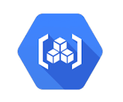
CONTAINERS
Containers are packages of software that contain all of the necessary elements to run in any environment. In this way, containers virtualize the operating system and run anywhere, from a private data center to the public cloud or even on a developer's personal laptop.

Slide 28
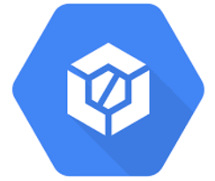
GCP Code Build
Build, test, and deploy on Google Cloud Platform’s serverless CI/CD platform.
Features
Cloud build is a fully serverless platform that helps you build your custom development workflows for building, testing, and deploying.
Cloud Build can import source code
Supports Native Docker.
You can also automate deployments to Google Kubernetes Engine (GKE) or Cloud Run for continuous delivery.

Slide 29

Knative
Knative provides an open API and runtime environment that enables you to run your serverless workloads anywhere you choose: fully managed on Google Cloud, or on Anthos on Google Kubernetes Engine (GKE), or on your own Kubernetes cluster.
Knative offers features like scale-to-zero, autoscaling, in-cluster builds, and eventing framework for cloud-native applications on Kubernetes. Whether on-premises, in the cloud, or in a third-party data center, Knative codifies the best practices shared by successful real-world Kubernetes-based frameworks.

Slide 30
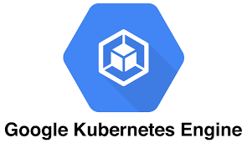
Birth of Kubernetes
Google Cloud is the birthplace of Kubernetes—originally developed at Google and released as open source in 9th September, 2014.
Kubernetes builds on 15 years of running Google's containerized workloads and the valuable contributions from the open source community.

Slide 31
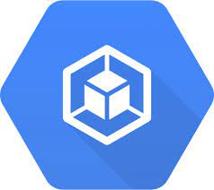
Google Kubernetes Engine (GKE)
Google Kubernetes Engine (GKE) provides a managed environment for deploying, managing, and scaling your containerized applications using Google infrastructure
Features:
Serverless Kubernetes experience on Autopilot
Container-native networking and security
Prebuilt Kubernetes applications & templates
Pod and cluster autoscaling
Automated tools for easily migrating workloads

Slide 32
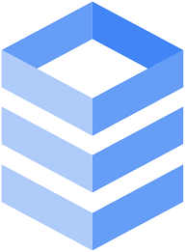
GCP Database Services
Google Big Query
Google Cloud Bigtable
Google Cloud SQL
Google Cloud Spanner

Slide 33
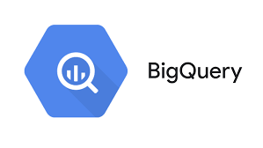
Google Big Query
A fully managed data warehouse where you can feed petabyte-scale data sets and run SQL-like queries.
Features
Cloud Big Query is a serverless data warehousing technology.
It provides integration with the Apache big data ecosystem allowing Hadoop/Spark and Beam workloads to read or write data directly from Big Query using Storage API.
Big Query supports a standard SQL dialect that is ANSI:2011 compliant, which reduces the need for code rewrites.
Automatically replicates data and keeps a seven-day history of changes which facilitates restoration and data comparison from different times.

Slide 34
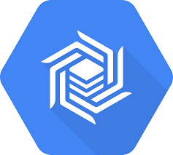
Google Cloud Big table
A fully managed NoSQL database service designed for large analytical and operational workloads and enables you to store terabytes or even petabytes of data.
Features
You can use Cloud Big Table to store and query time-series data.
It is ideal for storing large amounts of single-keyed data.
Scales seamlessly from thousands to millions of reads/writes per second.

Slide 35
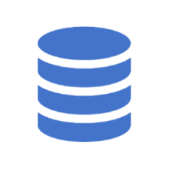
Google Cloud SQL
A fully managed relational database service. Cloud SQL is available for:
MySQL
PostgreSQL
SQL Server
Features
Scale instantly with a single API call as your data grows.
Automated and on-demand backups are available.
You can restore your database instance to its state at an earlier point in time by enabling binary logging.
Data replication between multiple zones with automatic failover.
You can perform an analytics job by using Big Query to directly query your Cloud SQL instance.

Slide 36
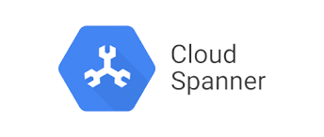
Google Cloud Spanner
A fully managed relational database service that scales horizontally with strong consistency.
Features:
SLA availability up to 99.999% for multi-regional instances with 10x less downtime than four nines.
Optimizes performance by automatically sharding the data based on request load and size of data so you can spend less time thinking about scaling your database and more time scaling your business.
You can run instances on a regional scope or multi-regional where your database is able to survive regional failure.
All tables must have a declared primary key (PK), which can be composed of multiple table columns.
Can make schema changes like adding a column or adding an index while serving live traffic with zero downtime.

Slide 37
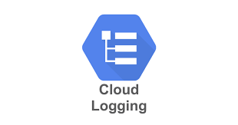
Cloud Logging
Cloud Logging is a fully managed service that allows you to store, search, analyze, monitor, and alert on logging data and events from Google Cloud and Amazon Web Services. You can collect logging data from over 150 common application components, on-premises systems, and hybrid cloud systems

Slide 38
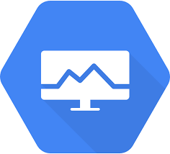
Cloud Monitoring
Cloud Monitoring collects metrics, events, and metadata, hosted uptime probes, and application instrumentation to gain visibility into the performance, availability, and health of your applications and infrastructure.
Features
Collect metrics from multi-cloud and hybrid infrastructure in real time.
Metrics, events, and metadata are displayed with rich query language that helps identify issues and uncover significant patterns.
Reduces time spent navigating between systems with one integrated service for metrics, uptime monitoring, dashboards, and alerts.

