Slide 1
Android Studio, Android System Basics and Git
GITMAD

Slide 2
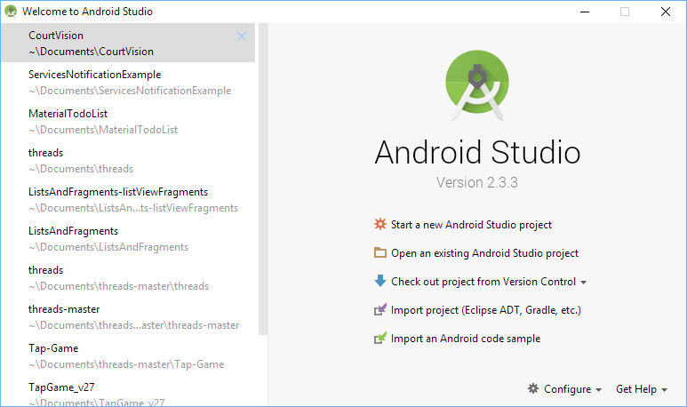
Project Creation

Slide 3
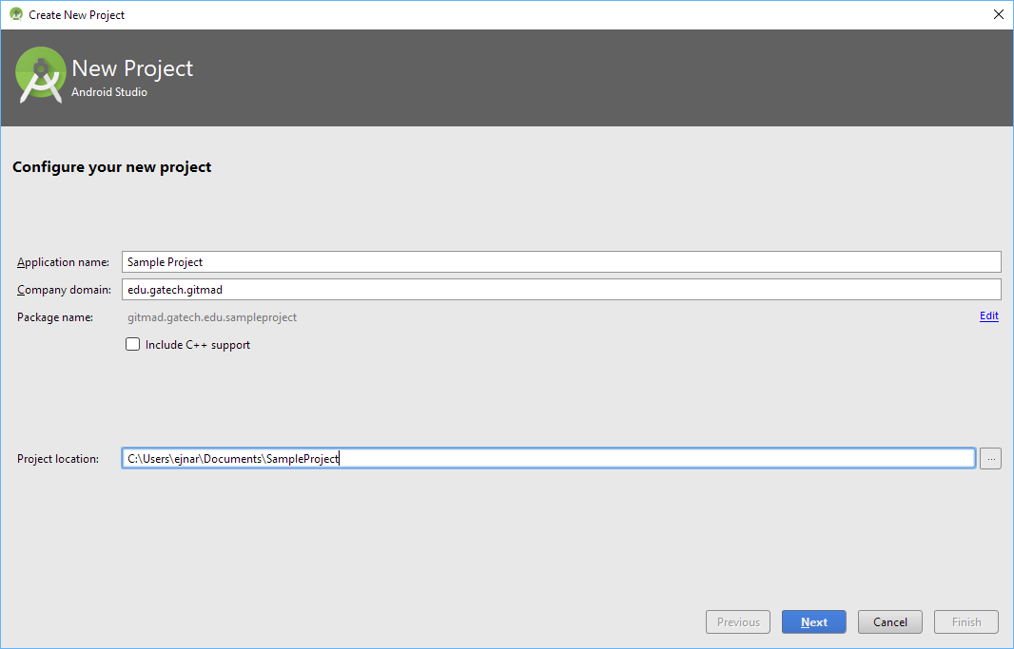
Project Configuration
Notes:
-Make sure project location is not too long
-Company domain is the name for the project(reverse url)
-C++ support is for Native Development, not Software Dev

Slide 4
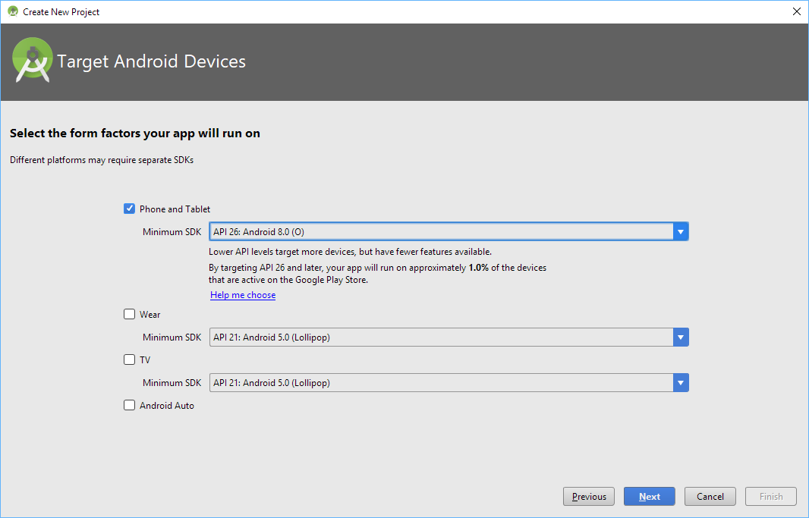
Project Configuration
Notes:
Usually want to target the most recent for the newest features and updates unless you’re trying to reach a wide range and want to support lots of versions

Slide 5
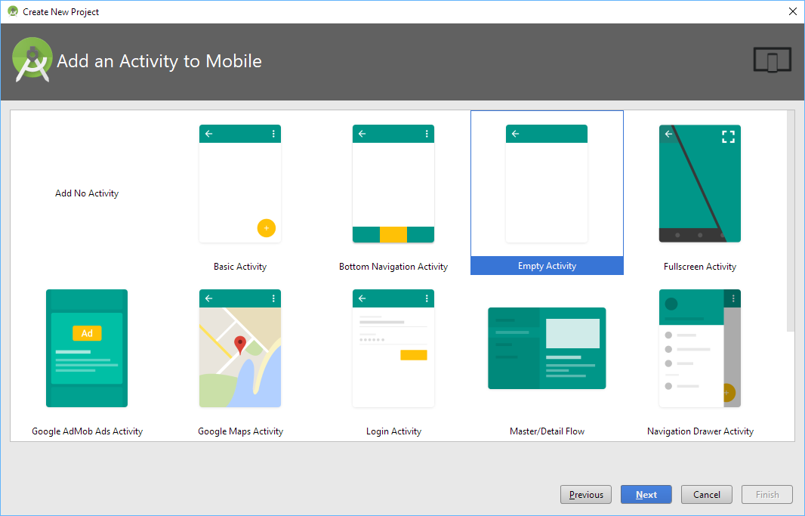
Project Configuration
Notes:
-Activities represent single screen with UI
-Can work together to form application, can also be run independently

Slide 6
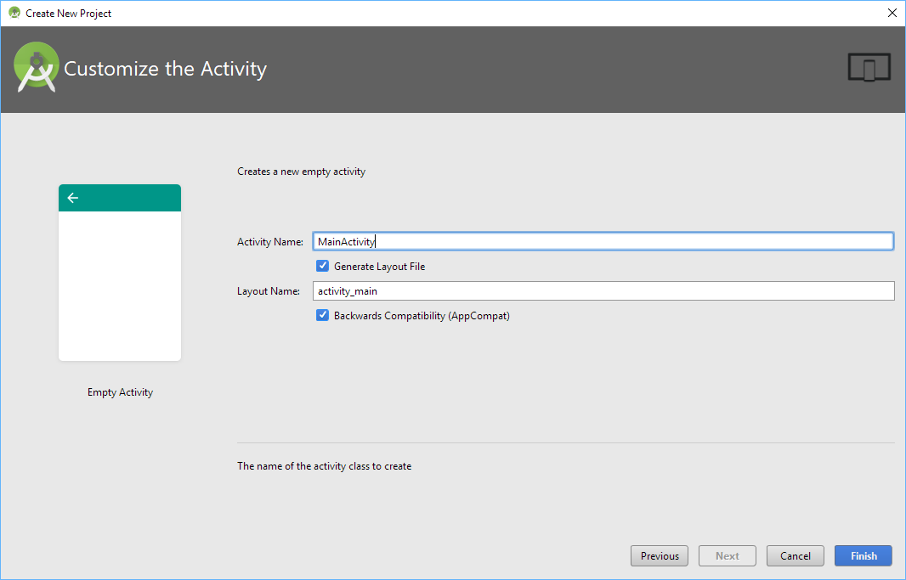
Project Configuration
Notes:
-Activity Name is for the Java file where all the logic will be
-Layout Name is made for the xml file where the design elements go

Slide 7
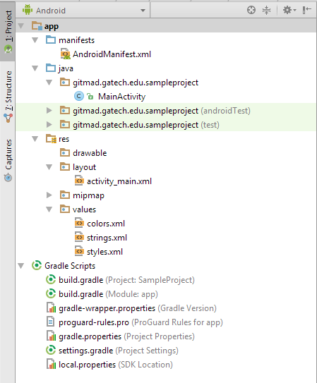
Android Folder Structure
Manifest XML
Java Folder
Classes
Activities
Resource Folder
Layouts
Colors
Gradle

Slide 8
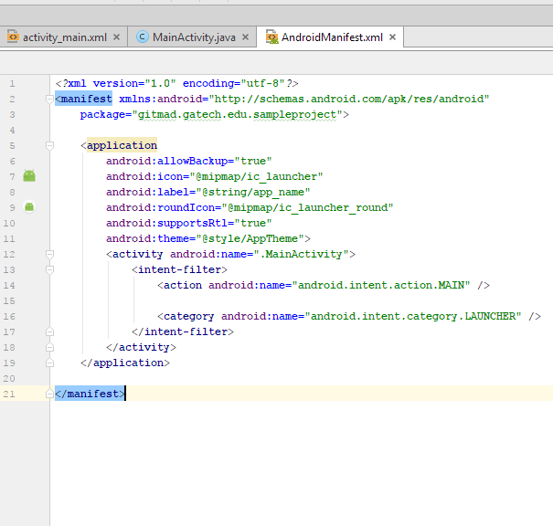
Android Manifest
Permissions
Internet, files, etc.
Components
Activities, Services, Receivers, Providers
Activity relationships
API Level
Hardware Features
Camera, Bluetooth, etc.
Notes:
Manifest declares an app’s component, permissions, API Level(Android version), Hardware/Software featuers(camera, Bluetooth, etc.), API libraries to be linked (Google Maps) https://developer.android.com/guide/components/fundamentals.html#Manifest
<activity> elements for activities.
<service> elements for services.
<receiver> elements for broadcast receivers.
<provider> elements for content providers.
<uses-feature android:name="android.hardware.camera.any" android:required="true" /> <uses-sdk android:minSdkVersion="7" android:targetSdkVersion="19" />

Slide 9
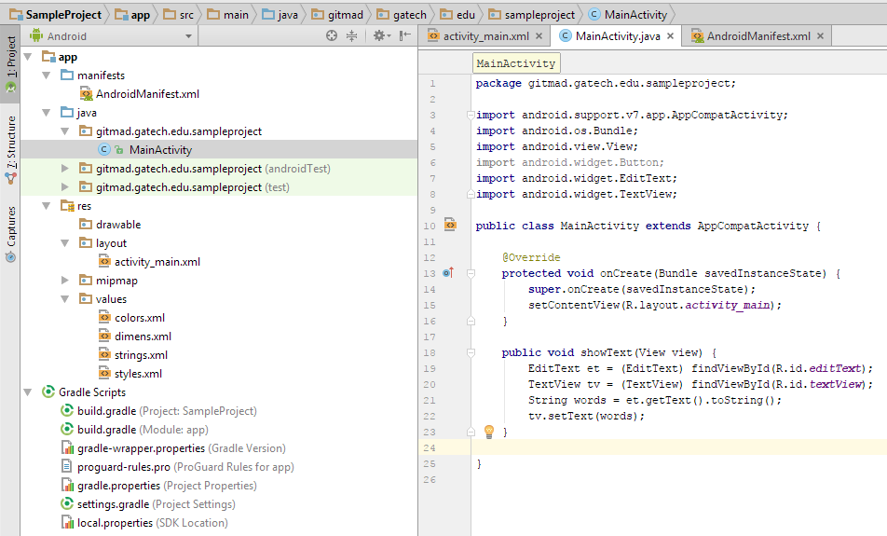
Java Folder
Where actual code implementation is located
Contains Classes and Interfaces

Slide 10
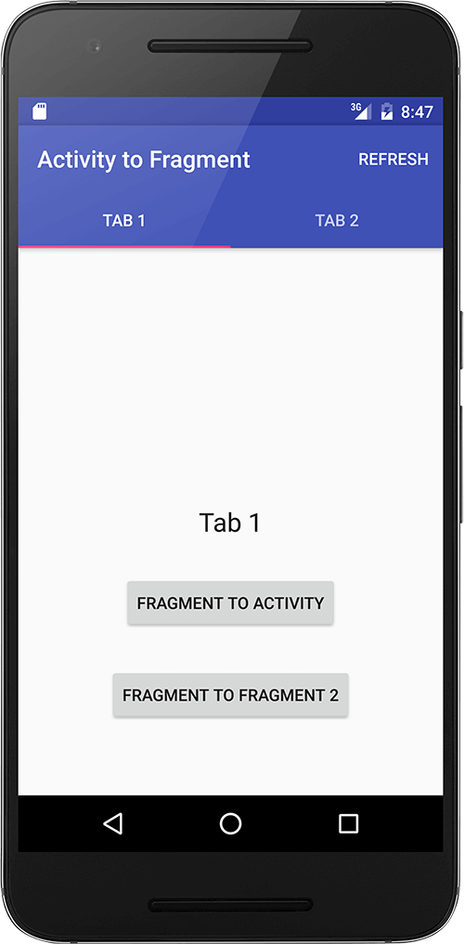
Activities
Represents a single screen with a user interface
All interactions everything for programing and implementation
Keeps track of processes that the user cares about
Mostly use fragments (advanced)

Slide 11
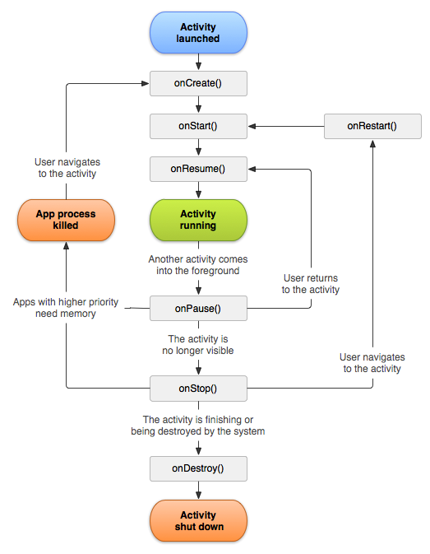
Life Cycle
Most important functions
onCreate()
onPause()
onResume()
Used by the Android system to manage resources
Notes:
Explain how the Life Cycle works and the methods we use the most as programmers.

Slide 12
‘R’ Reference System
R holds all the references to items in the project, stored as integers
References everything in the ‘res’ folder.

Slide 13
Res Folder
Layouts
Layouts for Screens and Views
Colors
Colors that will be reused
Strings
Strings used throughout project (e.g. labels)
Dimensions
Used dimensions such as margins, padding, font sizes, etc.

Slide 14
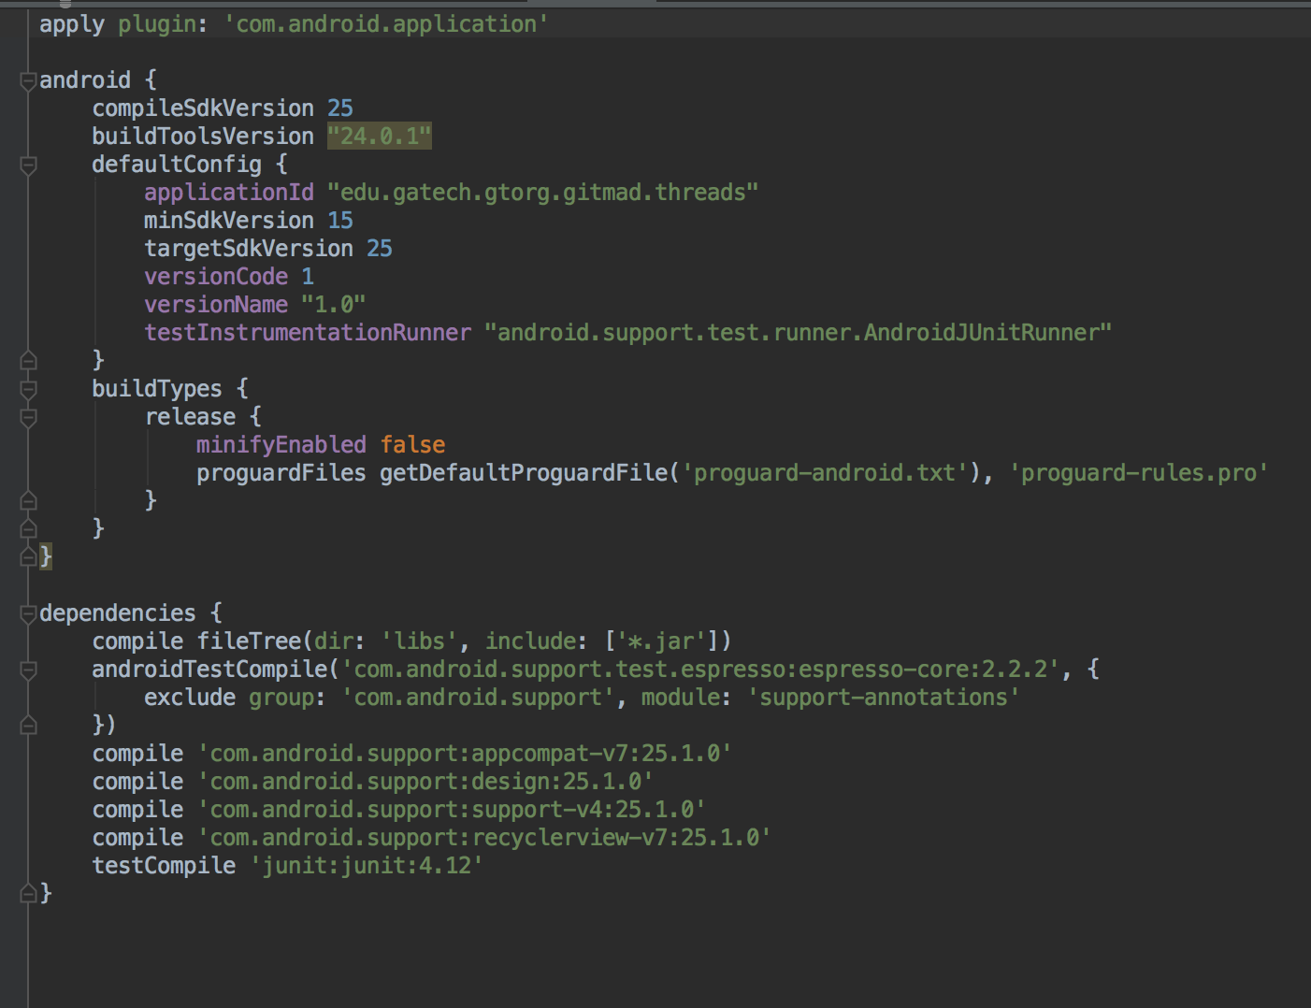
Gradle
Builds the app
States additional libraries that are added
Mostly change what’s in the highlighted box

Slide 15
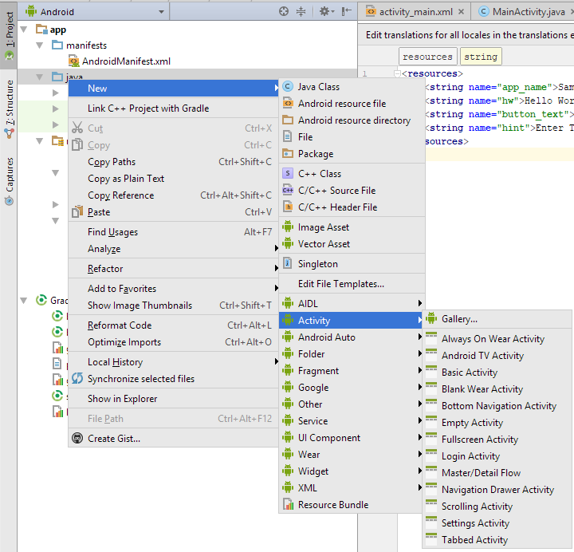
Activity Creation
Create new Activity
Right Click on ”Java” folder -> New -> Activity
Found towards the bottom
Same method to create other type of files
Play around with right click to see what you can create.

Slide 16
Tips
Set line numbers View -> Active Editor -> set line numbers
Launch Standalone SDK manager about once a month to stay up to date
Found in the toolbar far to the right
Create a separate folder to hold classes and adapters
Check for drivers necessary to debug on android device
Use Debugger
Use phone over emulator if you can

Slide 17
Git/GitHub
A Version Control System, based on a distributed system.
Four need to know commands - Add, Commit, Push & Pull
Can use Terminal or GitHub Graphical User Interface (GUI)
If you like GUI more, try SourceTree
Add Git Path to Android Studio

Slide 18
Classic Problems
Can’t run phone on computer
Need to enable Virtualization
Can’t use your phone
Either need a better cord
Download drivers
Can’t crunch file
Path to project is too long move it somewhere else

