Slide 1
Android Studio, Android System Basics and Git
GITMAD

Slide 2
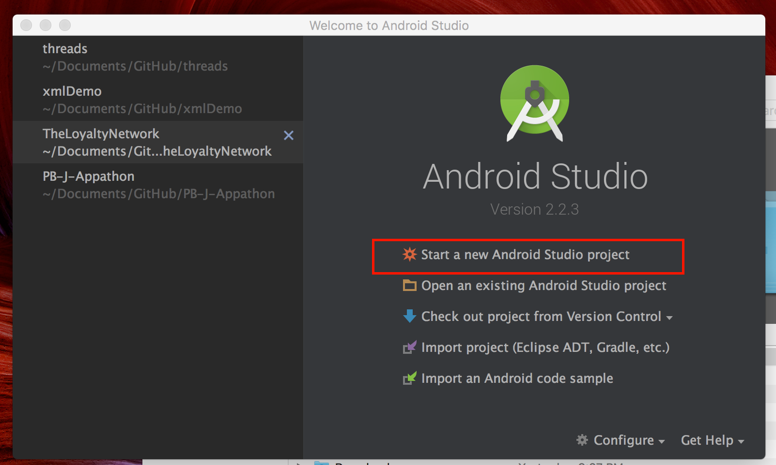
Project Creation
Create a dummy project for walkthrough.

Slide 3
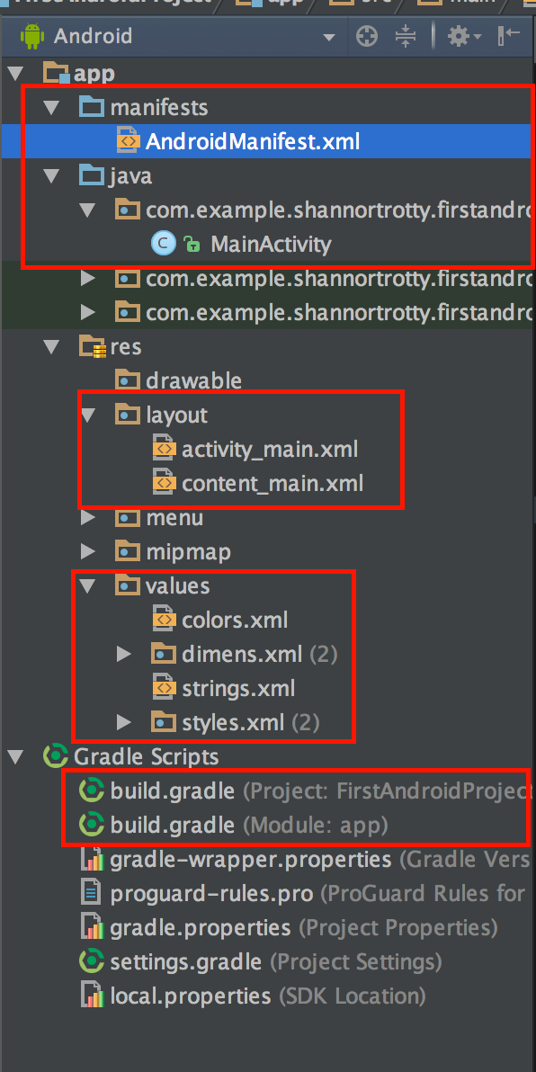
Android Folder Structure
Manifest XML
Java Folder
Classes
Activities
Resource Folder
Layouts
Colors
Gradle
Notes:
Explain each boxed object and show in Android Studio how they look and what they do.

Slide 4
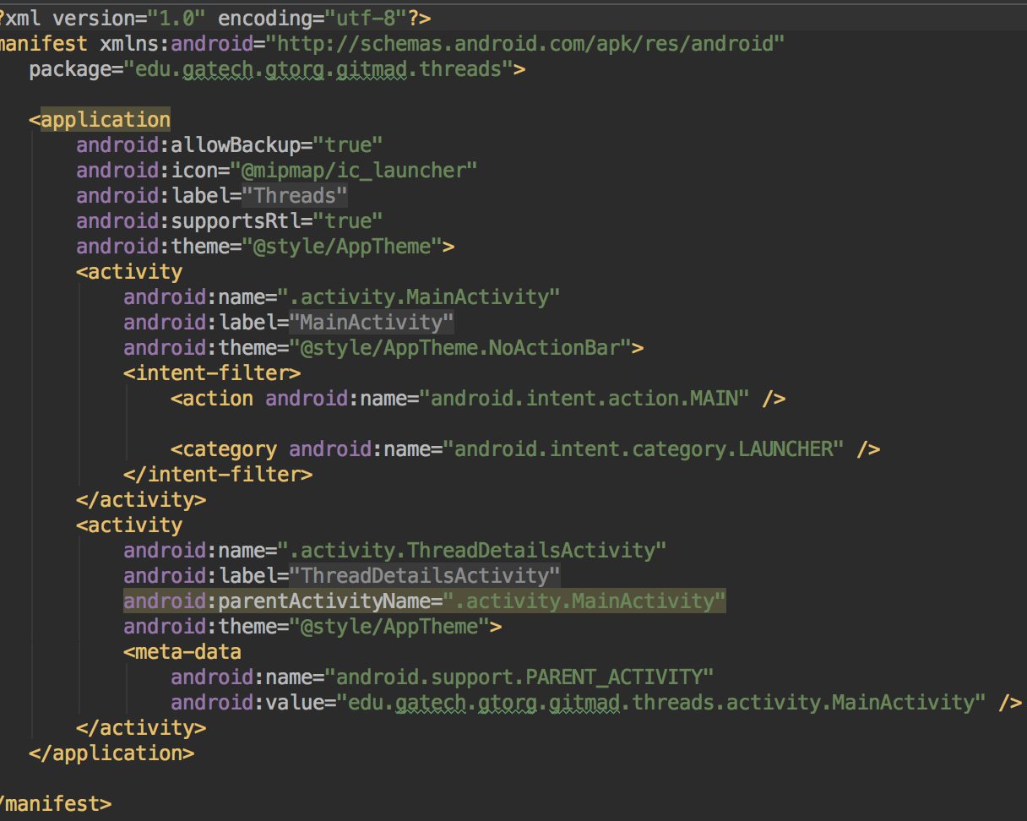
Android Manifest
App permissions located here
Activity relationships
States the Main activity

Slide 5
Java Folder
Where actual code implementation is located
Classes and Interfaces

Slide 6
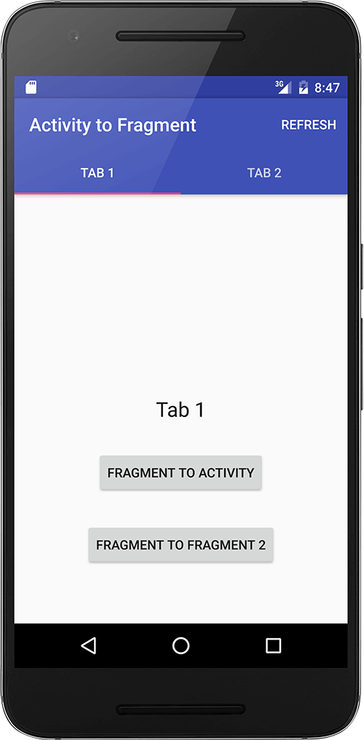
Activity/Activities
Main screen that a user sees and interacts with
All interactions everything for programing and implementation
Mostly use fragments (advanced)
Notes:
Explain an Activity

Slide 7
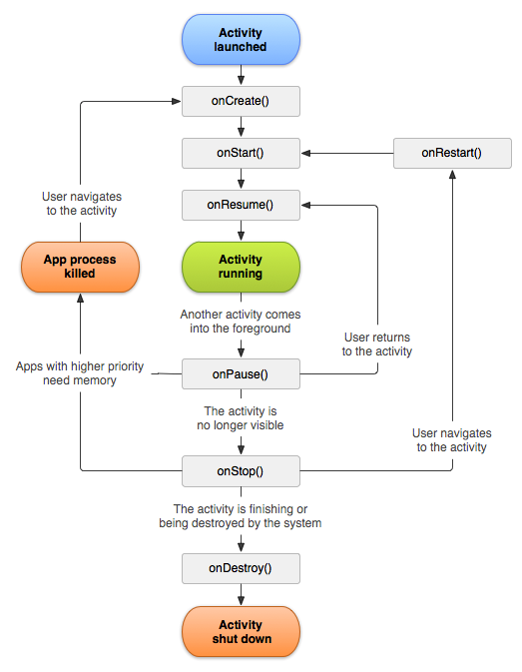
Life Cycle
Most important functions
onCreate()
onPause()
onResume()
Used by the Android system to manage resources
Notes:
Explain how the Life Cycle works and the methods we use the most as programmers.

Slide 8
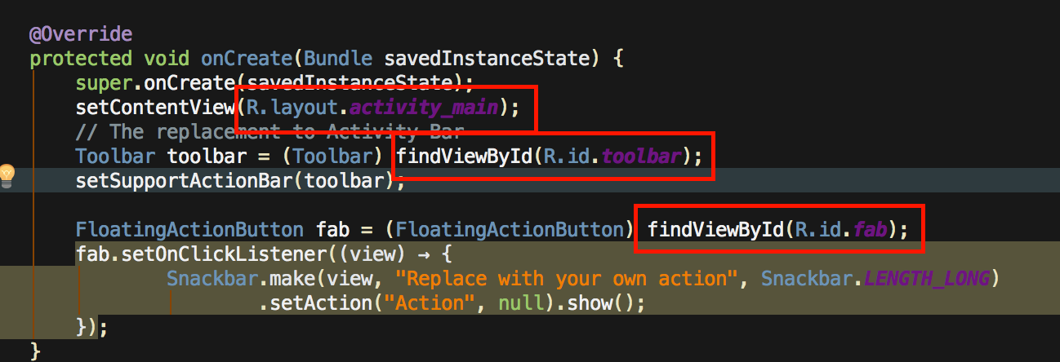
”R” Reference System
R holds all the references to items in the project, stored as integers
References everything in the ‘res’ folder.

Slide 9
Res Folder
Layouts
Layouts for Screens and Views
Colors
Colors use will be reusing
Strings
Where strings should be stored that are used in project
Dimensions
Used dimensions such as margins, padding, font sizes, etc.

Slide 10
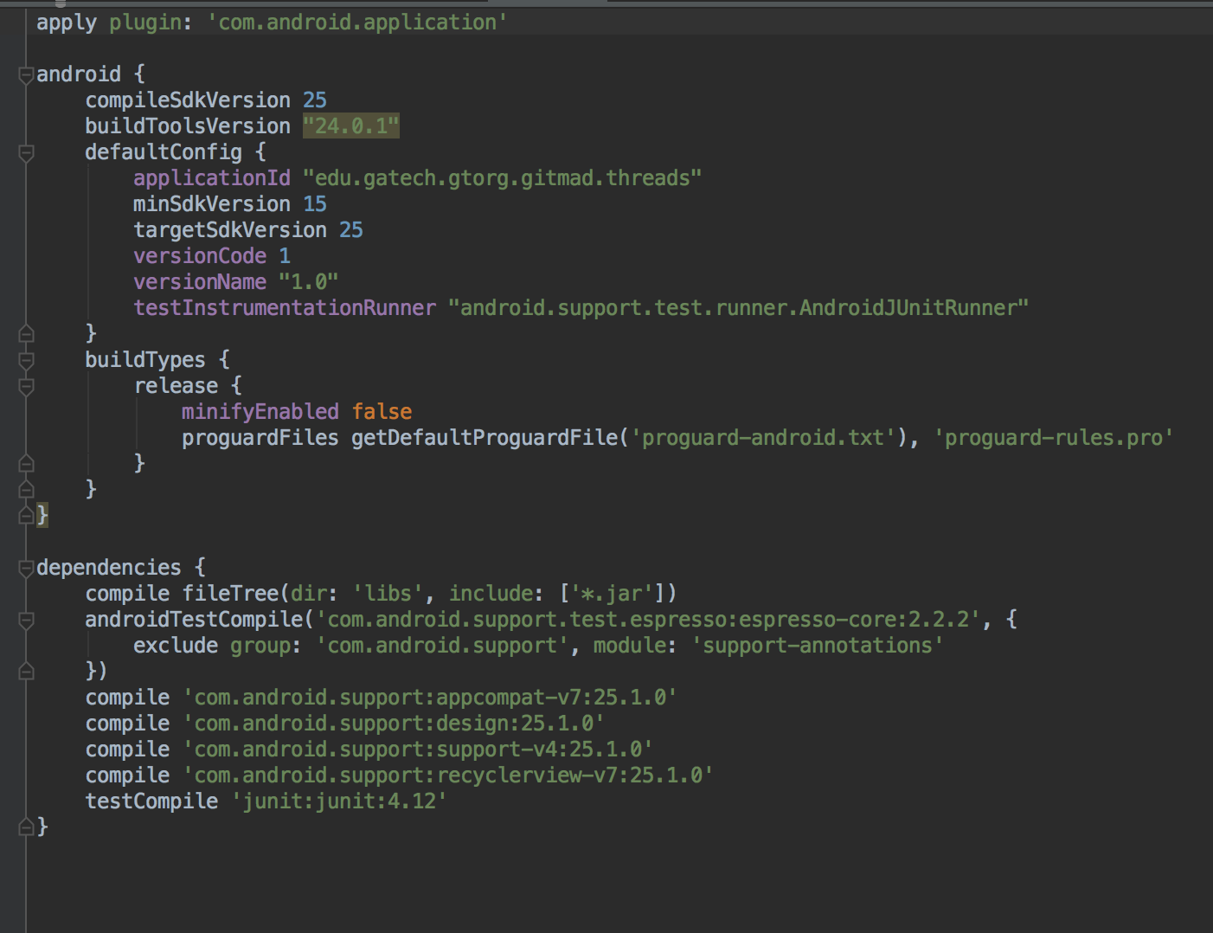
Gradle
My one and only true love
Builds the app
Where additional libraries are added
Mostly chage the red area

Slide 11
Activity Creation
Create new Activity
Right Click on ”Java” folder -> New -> Activity
Found towards the bottom
Same method to create other type of files
Play around with right click to see what you can create.

Slide 12
Tips
Set line numbers View -> Active Editor -> set line numbers
Launch Standalone SDK manager about once a month to stay up to date
Found in the toolbar far to the right
Create a separate folder to hold classes and adapters
Check for drivers necessary to debug on android device
Use Debugger
Use phone over emulator if you can

Slide 13
Git/GitHub
A Version Control System, based on a distributed system.
Four need to know commands - Add, Commit, Push & Pull
Can use Terminal or GitHub Graphical User Interface (GUI)
If you like GUI more, try SourceTree
Add Git Path to Android Studio

Slide 14
Classic Problems
Can’t run phone on computer
Need to enable Virtualization
Can’t use your phone
Either need a better cord
Download drivers
Can’t crunch file
Path to project is too long move it somewhere else

