Slide 1
Intro to the First Project
Shannor Trotty
GITMAD

Slide 2
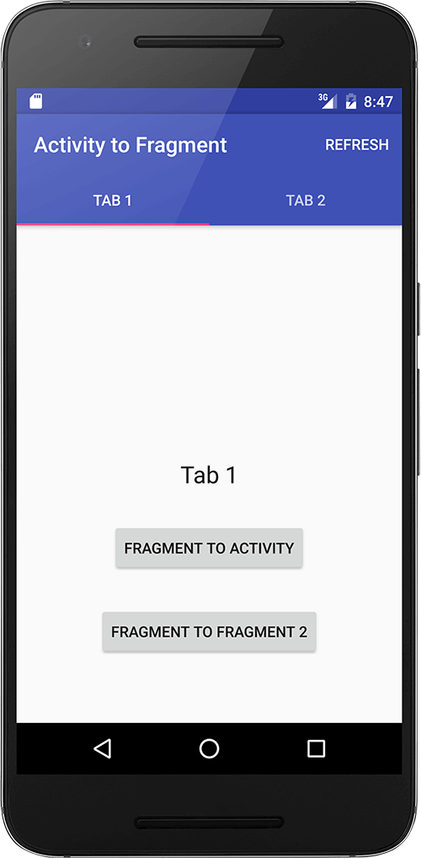
Activity/Activities
Main screen that a user sees and interacts with
All interactions everything for programing and implementation
We also use Fragments. (will be covered in later lecture)
Run Application
Notes:
Explain an Activity

Slide 3
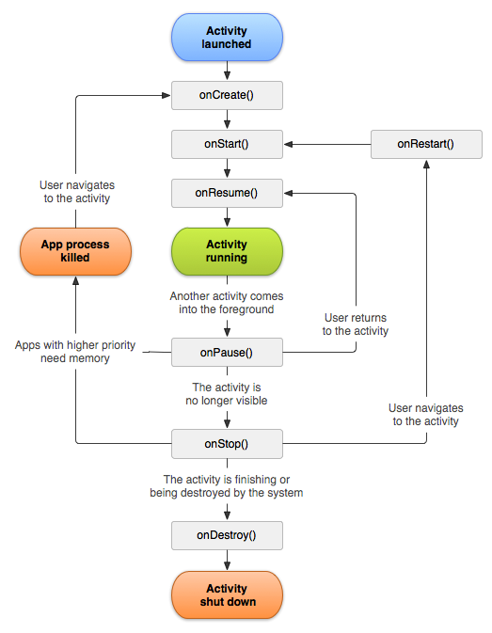
Life Cycle
Most important to know
onCreate()
onPause()
onResume()
Used by the Android system to manage resources
Add onResume() and onPause()
Notes:
Explain how the Life Cycle works and the methods we use the most as programmers.

Slide 4
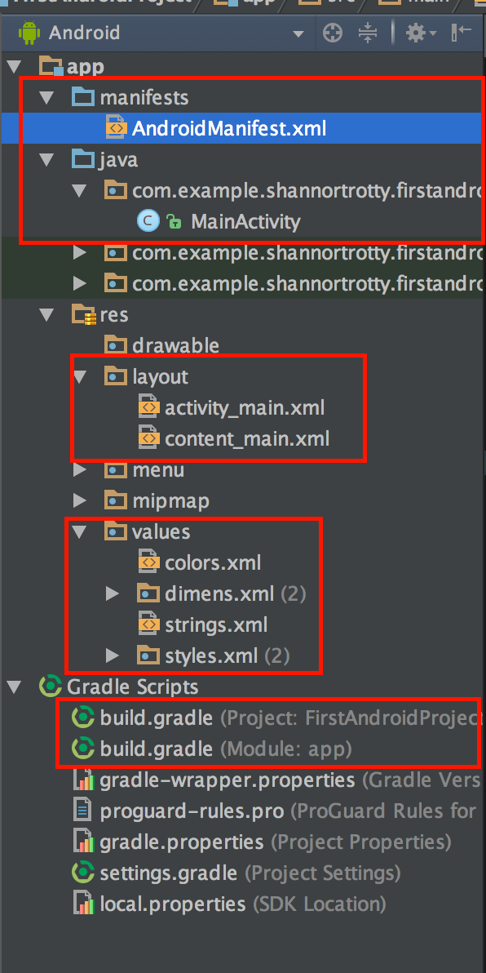
Walkthrough Android structure
Manifest XML
Java Folder
Classes
Activities
Resource Folder
Layouts
Colors
Gradle
Notes:
Explain each boxed object and show in Android Studio how they look and what they do.

Slide 5
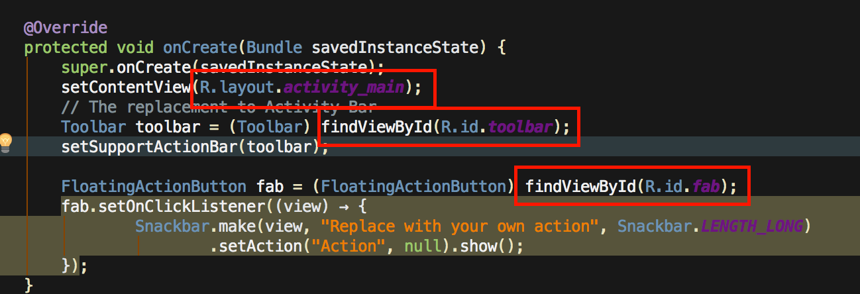
”R” Reference System
R holds all the references to items in the project, stored as integers

Slide 6
Go through Android Studio
Create new Activity
Right Click on ”Java” folder -> New -> Activity
Found towards the bottom
Same method to create other type of files

Slide 7
Tips
Set line numbers View -> Active Editor -> set line numbers
Launch Standalone SDK manager about once a month to stay up to date
Found in the toolbar far to the right
Create a separate folder to hold classes and adapters
Check for drivers necessary to debug on android device
Use Debugger

Slide 8
Git/GitHub
A Version Control System, based on a distributed system.
Three need to know commands, - Commit, Push & Pull
Can use Terminal or GitHub Graphical User Interface (GUI)
If you like GUI more, try SouceTree
Lets add this project to your GitHub Account
Notes:
Show how to use git in terminal
Show how to use git in GUI

