Slide 1
Fragments
Modular UI

Slide 2
Before we Start
Download the project here:
https://github.com/git-mad/ListsAndFragments.git
Keep the code guide handy. It has useful info about how to complete the coding exercises:
https://goo.gl/bcLY5o

Slide 3
Modularity
Software developers are lazy!
We don’t want to do write the same code more than once
We want to be able to re-use our code
This makes better software
More debuggable
Cleaner
Quicker to develop

Slide 4
Modularity in Android
Goals:
Re-use UI building blocks
Don’t want to re-write the logic that makes the UI work
Ability to place a component inside an existing UI

Slide 5
Fragments
A subsection of the UI, plus the code that makes it work
(A “Fragment” of the UI)
Placed inside the UI of an Activity
Can be added/removed/exchanged while the application is displaying
Can be added in xml files

Slide 6
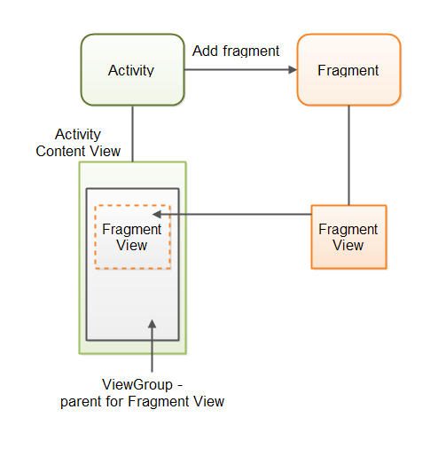
Fragments
Like an activity:
Can use XML Views
Operated by Java callbacks
Unlike an Activity:
Can be nested inside another Activity
Don’t need to be started with an intent

Slide 7
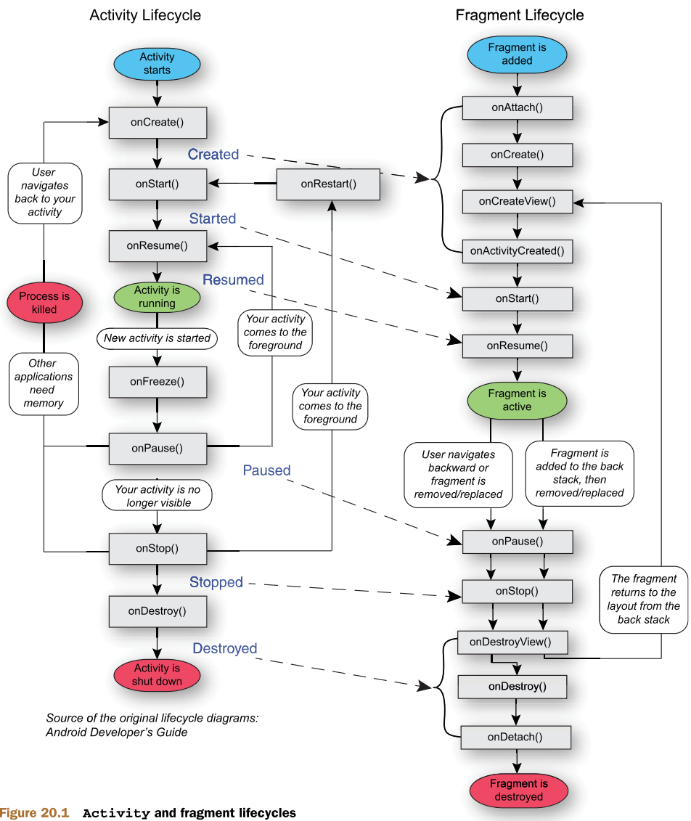
Fragments
Fragments can be added to a UI any time after the Activity has been created.
They use lifecycle methods that are very similar to the Activity lifecycle methods.

Slide 8
Time to Code!
Checkout step3 from git, and take a look at page 4 of the guide https://goo.gl/bcLY5o
You need to put ThreadDetailsActivity’s UI into a Fragment
The application shouldn’t look any different when you’re done. We just want it the UI in a Fragment for the next step
Checkout step3_solution if you get stuck; it has the solution.

Slide 9
Adaptive UI
Android developers have a problem:
Android devices come in tons of different sizes!
There are tablets, small phones, large phones, high resolution screens, low resolution screens
All of these affect how the layout will appear on a screen

Slide 10
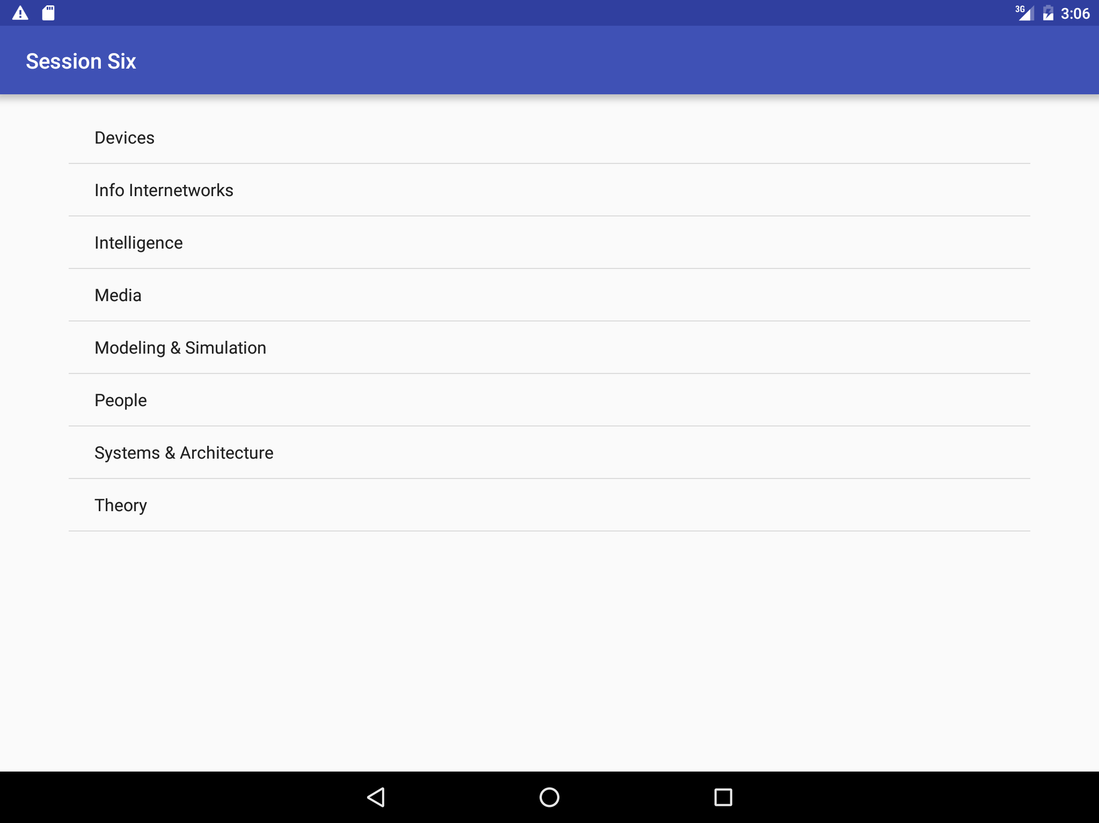
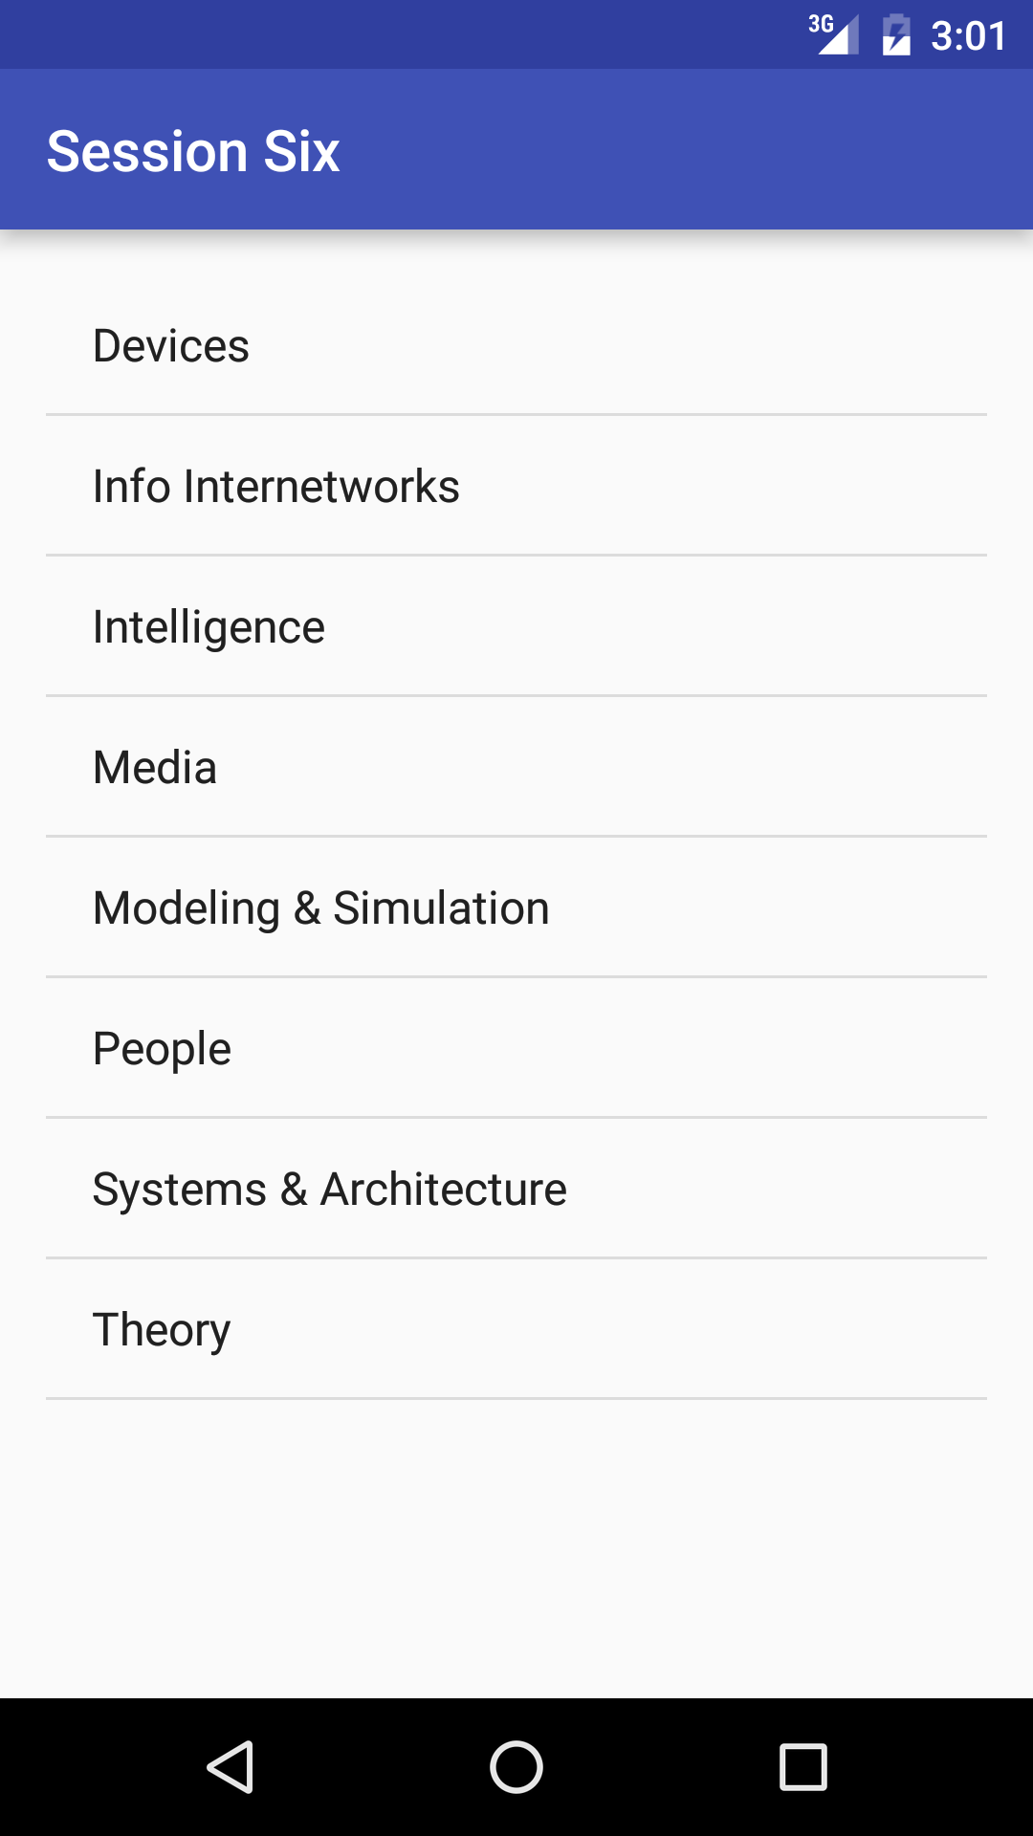
Tablet Screen
Phone Screen
An layout might make sense on one screen, but not on another!

Slide 11
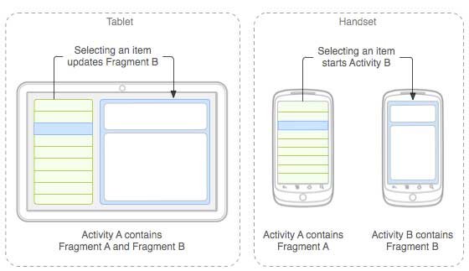
We can use adaptive UI to make the best use of whatever screen size we have

Slide 12
Fragments Make This Possible
Because Our UI is made up of Fragments, we don’t need to individually code each different layout
We can simply check the screen orientation, and launch the fragment in a new Activity if the layout is portrait

Slide 13
Time To Code!
Checkout part4, and look at page 9 of the guide https://goo.gl/bcLY5o
Make the app display Thread details on the same screen as the Thread list when the screen is landscape
You’ll need to create some resource folders, and add some logic to place the ThreadDetailsFragment in the right spot.
Checkout part4_solution if you get stuck

