Slide 1
HANDLING EVENTS
CLAYTON LAWRENCE
GIT MAD FALL 2016

Slide 2
ONCLICK LISTENERS
Listener: an object that waits for a certain action to happen and reacts accordingly
Attached to UI elements to indicate when a particular element has been clicked
Concept implemented in either Java or XML

Slide 3
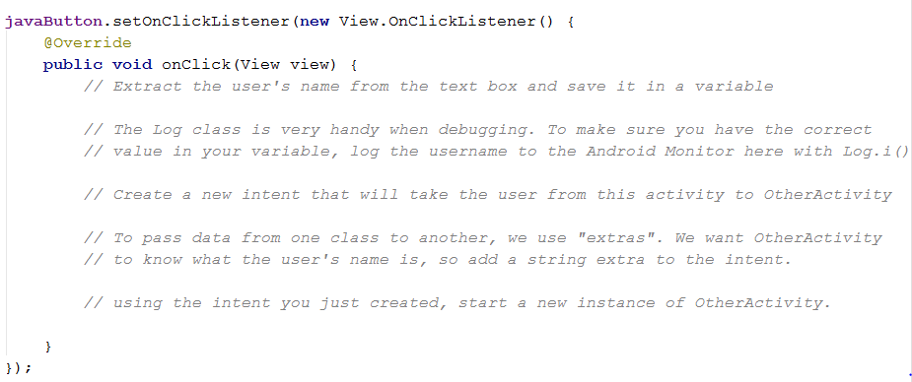
ONCLICK LISTENERS - JAVA

Slide 4
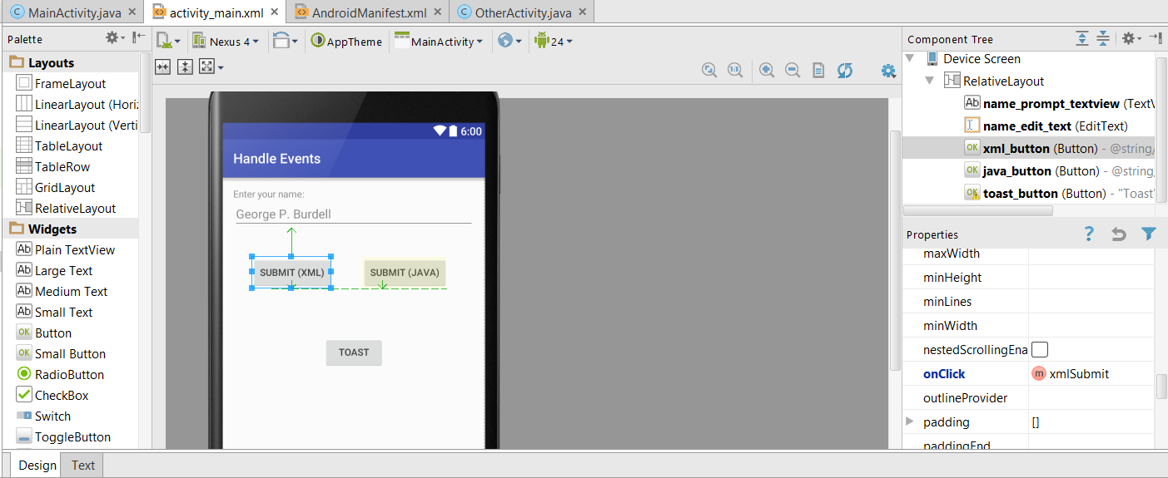
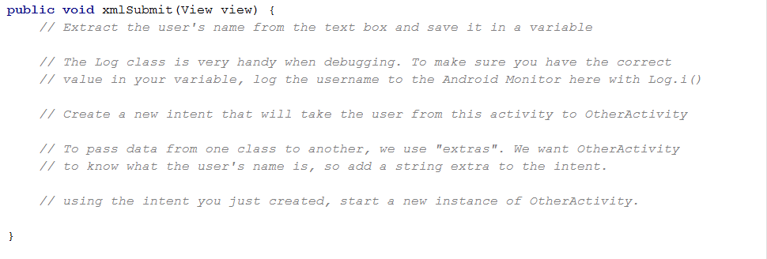
ONCLICK LISTENERS - XML
SET UP
IMPLEMENT

Slide 5
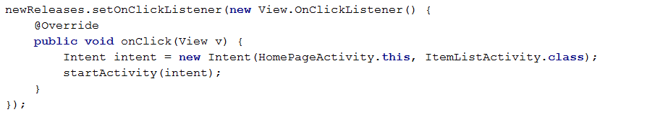
STARTING ACTIVITIES
Explicit intents
“Intend” on doing something
new Intent(…);
Act on this intention
startActivity(…);
Go from this instance of X Activity to a new instance of Y class

Slide 6
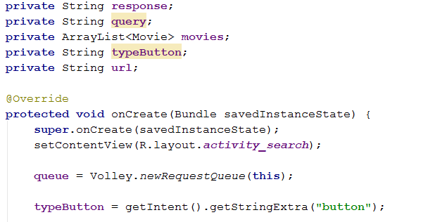
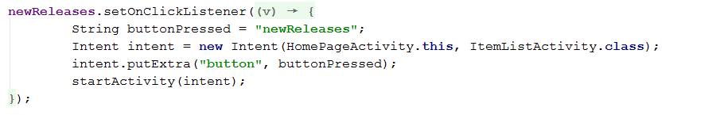
PASSING DATA BETWEEN ACTIVITIES
HOME PAGE ACTIVITY
ITEM LIST ACTIVITY

Slide 7
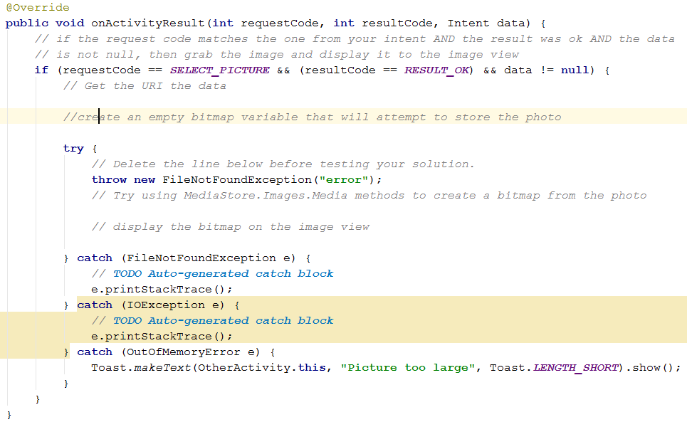
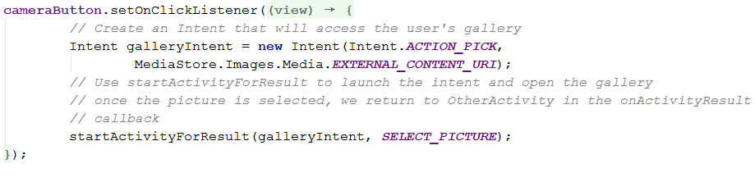
GETTING RESULTS FROM INTENTS
IMPLICIT INTENTS
ON ACTIVITY RESULT

Slide 8

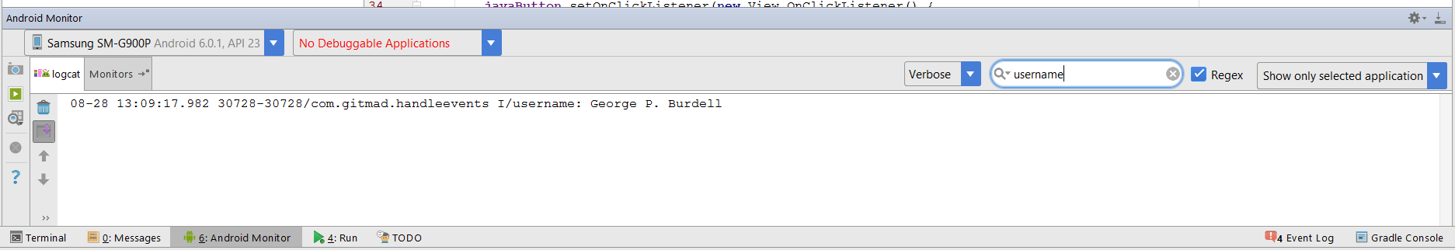
DEBUGGING - LOGS

Slide 9
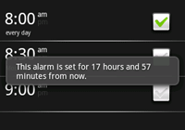
DEBUGGING - TOASTS

Slide 10
QUESTIONS?

