Slide 1
Intro into XML
GITMAD Beginner Session

Slide 2
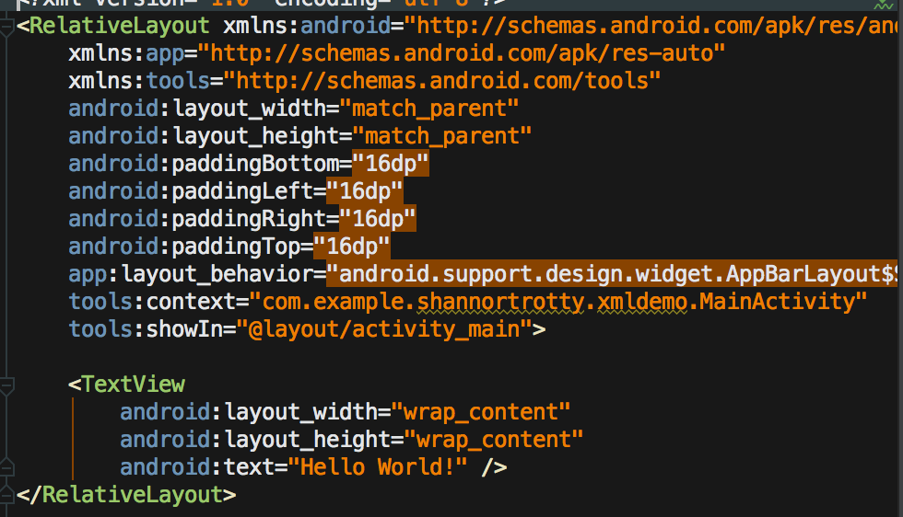
XML Format
Extensible Markup Language (XML)
Used in Resources Folder
Layouts, Menus, Styles, Etc.
Created dynamically or statically

Slide 3
Types of Layouts
Relative Layout
Children in relative positions (ex. left of, above, below)
Linear Layout
Children single direction vertical or horizontal
Frame Layout
Only one view inside, used often with Fragments
Coordinator Layout
Upgraded Frame Layout, used for top level décor
Constraint Layout (New)
Drag n’ Drop type of layout. Just released.

Slide 4
Types of Views
Text View
Display text, like a label
Buttons
List View
Displays a list of items for the user
Edit Text
Takes in input from the user (Textbox)

Slide 5
Interaction with Layouts
Through Text (Code)
Used often
For specific views and children
Through Design (Drag-n-Drop)
Sometimes works great (normally doesn't)
Useful for common views
Edit Text, Text View, List View

Slide 6
Size types
Dp
Density-independent pixels – abstract values based on the density of the screen
Used for layouts on the screen and placement
Used often
Sp
Scale-independent pixels – abstract values just like dp but for font sizes
Px, pt, mm, in
Based on actual screen size of the phone. Shouldn’t be used as different results are given on a phone bases

Slide 7
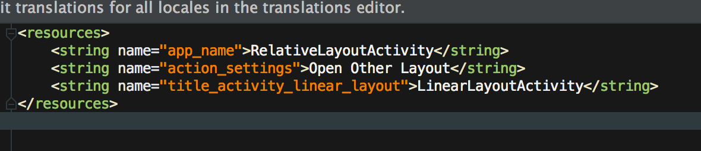
Strings
Storage for frequently used strings
Not required, though Android prefers it

Slide 8
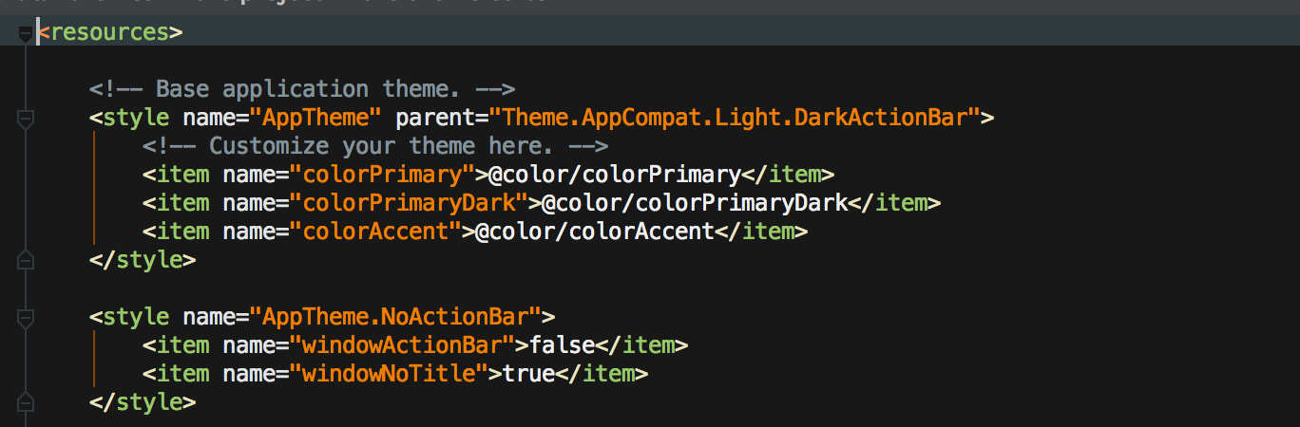
Styles
Defines how the application should look

Slide 9
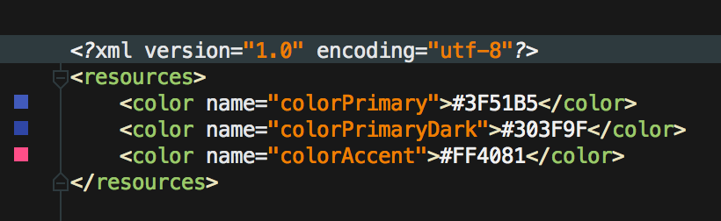
Colors
Strings equivalent for colors
Stores hard coded value for the colors and a easy reference for each one

Slide 10
Mipmap & Drawable
Mipmap
Used only for launcher icon
Generates multiple resolution density icons
Drawable
Used for every other image to display
Generates multiple resolutions
Use import tool to load pictures
Right click -> new -> image asset

Slide 11
Hands on
Create login layout with different layouts
Change color scheme
Change name of application
Extra
Add or change Styles
Create your own layout for a different application

