Slide 1
Android Layouts
Basic UI

Slide 2
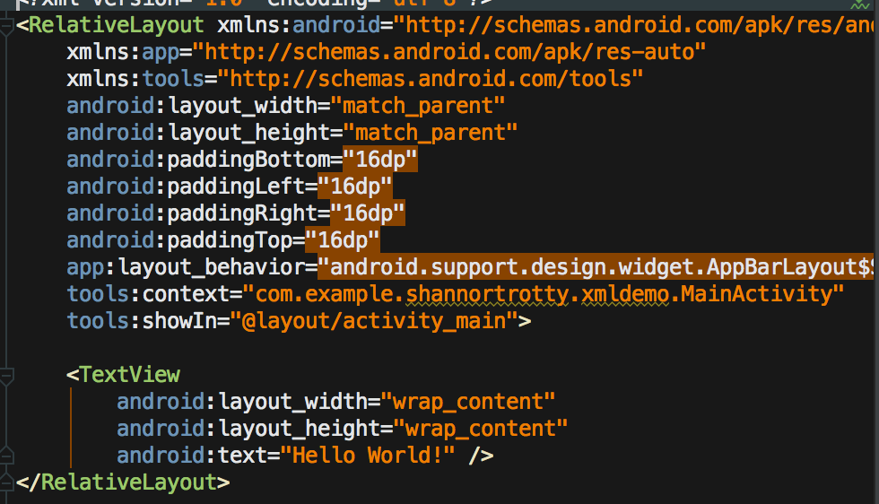
XML
Extensible Markup Language (XML)
Used in Resources Folder
Layouts, Menus, Styles, Etc.
Created dynamically or statically

Slide 3
Types of Layouts
Relativelayout
Children in relative positions (ex. left of, above, below)
Linearlayout
Children single direction vertical or horizontal
Frame Layout
Only one view inside, used often with Fragments
Coordinator Layout
Upgraded Frame Layout, used for top level décor
Constraint Layout (New)
Drag n’ Drop type of layout. Relatively new.
Replaces Relativelayout

Slide 4
Common Views
Textview
Display text, like a label
Button
Listview/ Recyclerview
Displays a list of items for the user
Edittext
Takes in input from the user (Textbox)

Slide 5
Designing Layouts
Through “Text” tab (XML)
Situational
For specific views and nesting
Useful for simple layouts
Through “Design” Tab (Drag-n-Drop)
Useful for common views
Useful with complex layouts

Slide 6
Size types
Dp (Density-independent pixels)
abstract values based on the density of the screen
Used for layouts on the screen and placement
Sp (Scale-independent pixels)
abstract values just like dp but for font sizes
Px, pt, mm, in
Based on actual screen size of the phone. Shouldn’t be used as different results are given on a phone bases

Slide 7
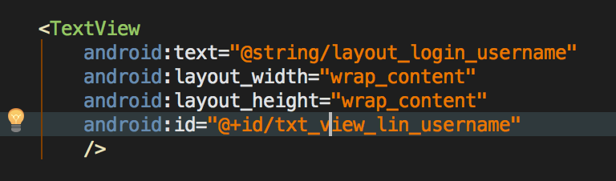
Id Tags
How to get Reference to a View
“What_Where_Description”
What -> Activity, List, Button, Edit text
Where -> all, main, linear, etc.
Description -> title, username, password, sign up, sign in, etc.

Slide 8
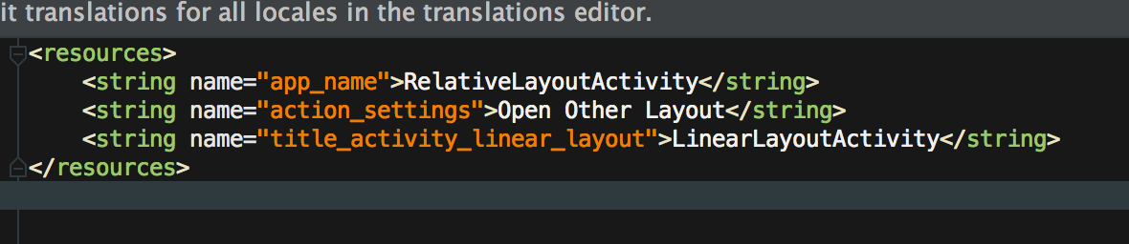
Strings
Storage for frequently used strings
Not required, but good coding practice

Slide 9
Using String from Res
Good coding practice.
Good for Reuse
Naming convention isn’t the same as Id’s
Should have readability

Slide 10
Task
Follow TODOs: In the code
Design the login screen for the CS Thread Project using Linear Layout
Design the login screen using the Constraint Layout
Create a layout for the Listview (Advanced)
Add more to the ListView if you can think of more (Advanced)

