Slide 1
Lists, Navigation
How and why

Slide 2
Before we start
Download the project here:
https://github.com/git-mad/ListsAndFragments.git
Keep the code guide handy. It has useful info about how to complete the coding exercises:
https://goo.gl/bcLY5o

Slide 3
ListView
Display info in a list
Must be efficient (space, time)
Two concerns:
How to display things on screen (the View)
What data to display (the Adapter)

Slide 4
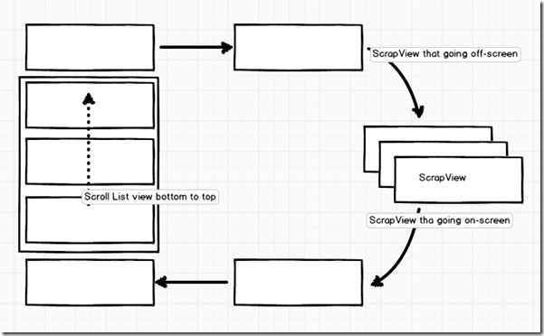
ListView reuses Views that are moves off screen to save memory for Views and time to allocate them.

Slide 5
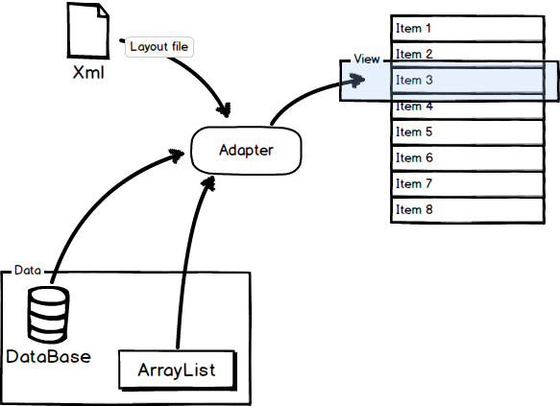
List Adapter
List adapter organizes data
Knows how to make a row of the list view
Adapter provides rows as the ListView asks for them

Slide 6
ListView: time to code!
Checkout the branch part1
You need to edit MainActivity.java and layout/main_activity.xml
If you get stuck, checkout part1_solution.
The guide will also give you step-by-step instructions:
https://goo.gl/bcLY5o

Slide 7
Navigation
Apps have multiple ‘screens’
This corresponds to multiple Activities
Need to:
Seamlessly transition between screens
User needs to know how the app is structured
Provide a way go back one screen... or many screens

Slide 8
Navigation
Sometimes there is a natural hierarchy to screens
Parent Activity starts child Activities
But do we have to go back to the parent every time we want to switch children?
What if we allow them to change from one child Activity to another?

Slide 9
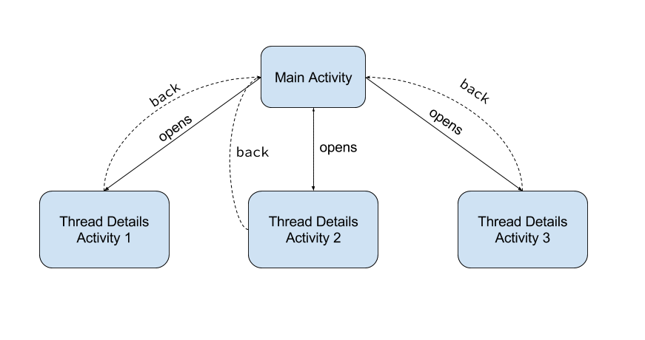

Quicker --->
Allowing users to navigate among child Activites/screens saves effort

Slide 10
But what happens when the user presses ‘back’, in Thread Details Activity 3?
Allowing users to navigate among child Activites/screens saves effort

Slide 11
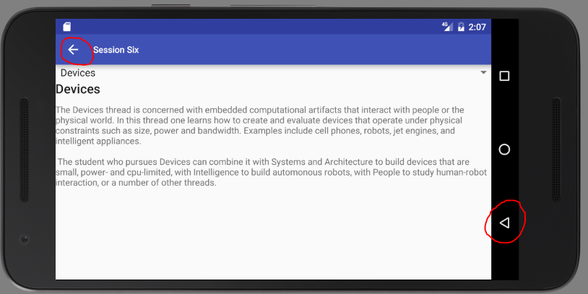

Up vs Back Navigation
(up)
Gives the user multiple options on where to navigate
Back navigation takes the user to the last screen visited.
Up navigation takes the user to the parent screen.
(back)

Slide 12
Navigation: time to code!
Checkout the part2 branch.
Android will automatically handle back navigation for you
Android will also handle up navigation for you, but you have to tell it which Activity is the parent.
You will need to edit the manifest.xml
The solution is in the branch part2_solution

