Slide 1
Email Classification API
Architecture & Documentation

Slide 2
System Overview
The Email Classification API processes and classifies emails, PDFs, and DOCX files. It uses OpenAI's GPT model for fine-tuned classification and MongoDB for duplicate detection. Batch processing is supported for handling multiple files simultaneously.

Slide 3
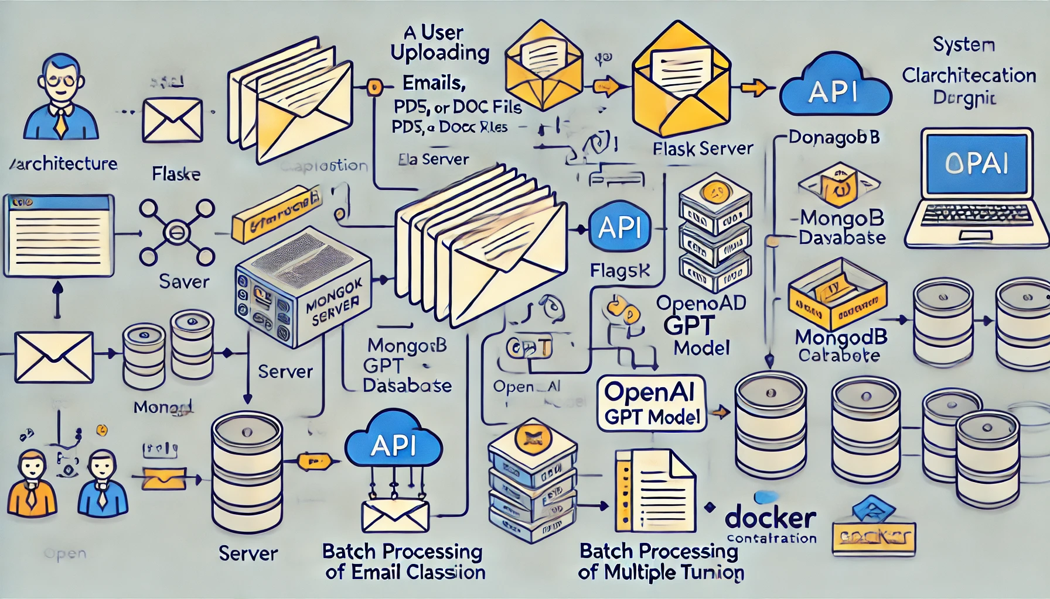
Architecture Diagram

Slide 4
Key Features
- Batch classification of emails, PDFs, and DOCX files
- Duplicate detection using MongoDB
- Fine-tuning with OpenAI's GPT model
- Scalable architecture using Docker and MongoDB
- YAML-based configuration for flexibility

Slide 5
Tech Stack
- **Backend:** Flask (Python)
- **Database:** MongoDB (for duplicate detection)
- **Model:** OpenAI GPT (fine-tuned)
- **File Parsing:** PDFMiner, python-docx, email module
- **Containerization:** Docker & Docker Compose

Slide 6
API Endpoints
- `/batch_classify` → Batch classify emails, PDFs, DOCX
- `/fine_tune` → Fine-tune model with JSONL dataset
- `/fine_tune_status` → Check fine-tuning job status
- MongoDB duplicates → Prevent reprocessing duplicates

Slide 7
MongoDB Duplicate Detection
- Hashes email content and stores in MongoDB
- Prevents reprocessing of duplicate emails
- Improves efficiency and reduces redundant operations

Slide 8
Batch Processing & Fine-Tuning
- Batch processing handles multiple files concurrently
- Fine-tuning uses OpenAI's endpoint with JSONL dataset
- Supports custom dataset creation for improved accuracy

Slide 9
Scalability Options
- **Load Balancing with NGINX:** Distribute requests across multiple servers
- **Horizontal Scaling with Kubernetes:** Manage containerized deployment and scale instances
- **Asynchronous Processing with Celery:** Improve performance by offloading tasks to worker nodes
- **Caching with Redis:** Cache results to reduce repeated processing and speed up performance
- **Auto-scaling Cloud Deployment:** Deploy on AWS/GCP with auto-scaling based on traffic

