Slide 1
Team 6 Space Shooter Game
May 2, 2024
Seiji Aoyama, Kevin Qian, Patrick Sharp, Stephen Donlin

Slide 2
Vision
Develop an immersive web-based arcade-style game, featuring multiple pages, where players can test their skills and compete for leaderboard supremacy against others.

Slide 3
Purpose
To create an engaging game that allows players to challenge themselves and others by competing for a high score that is recorded and available for others to see

Slide 4




Tools: Project Management
GitHub
Source control and code sharing platform
Benefits:
Easy to learn basic commands
Remote collaboration
All work is backed up
Drawbacks:
Steep learning curve to leverage potential
Discord
Instant messaging and social platform used for communication
Benefits:
Offers text, voice, and video communication
Servers are configurable to team needs
Free
Drawbacks:
Distracting – platform not designed for business use
Learning curve
Monday.com
SAAS application for project management
Benefits:
Easy project management tool for making
Student account (free with .edu login) offers more features than competing tools free tier
Drawbacks:
Many features locked behind paywall
Zoom
Video conferencing platform used for team meetings
Benefits:
Available on on platforms and browser
Easy recordings of meetings
Integrates with Google Calender, Outlook, iCal
Drawbacks:
Free tier limited to 40 minute meetings

Slide 5




Tools: Development
Flask
Framework for developing the Python web application powering the project
Benefits:
Built-in development server and debugger
Template engine
Drawbacks:
Does not scale for large projects
SQLite
Relational database system used to maintain user data
Benefits:
Easy Python integration
File-based, easy to share
Support for most standard SQL commands
Drawbacks:
Database size is limited compared to PostgreSQL, MySQL, etc.
Render
Cloud hosting provider used for the project
Benefits:
Free for basic individual or student use
Easy to use
Drawbacks:
Low priority for free users
VS Code
Open source, extensible code editor
Benefits:
Lightweight
Cross-platform
Highly customizable
Drawbacks:
Not a true IDE - requires extensions to incorporate all but basic editing features

Slide 6
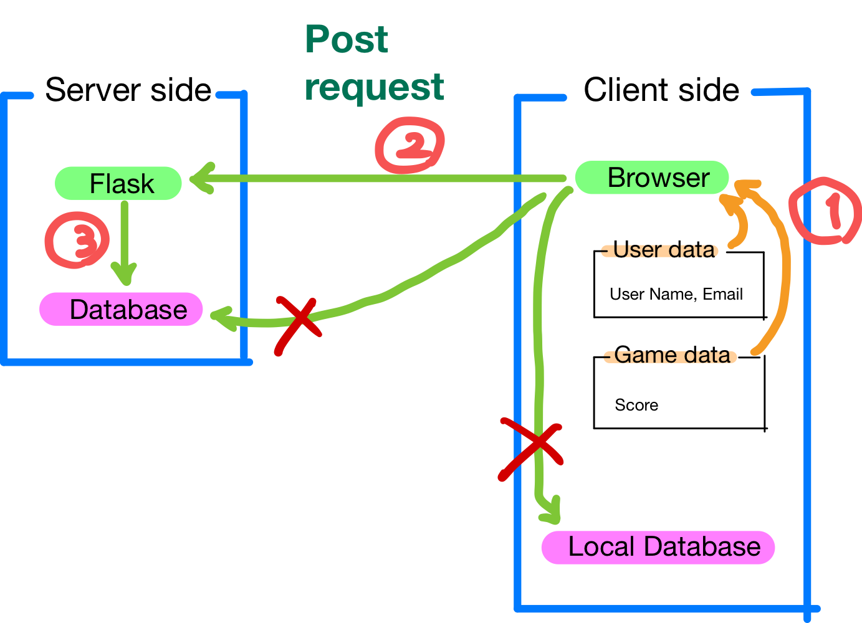
Database:
Database structure (Post)
SQLite3
SQLite3 is a lightweight SQL-like database management tool with excellent integration with Python
Challenge
Understand and illustrate the concepts of database design.
Implement the operation of the server-side database via a POST request.
Especially, it was difficult to retrieve the game score from TypeScript at game end. I had to use try-except checks and console.log for detailed debugging to handle frequent errors in data transmission.

Slide 7





Tools: Development
HTML / CSS
Standards used for online documents
Benefits:
Anyone with a browser can access documents created in HTML / CSS
Easy to learn
Tons of information available
Phaser
Open-source framework for developing HTML5 and mobile games.
Benefits:
Large community of users make it easy to find information
The built-in feature set provides everything needed to get started
Games developed with the framework can deploy across multiple platforms
Drawbacks:
Not suited for large scale games
Official documentation is lacking detail
Javascript / Typescript
Scripting languages
Benefits:
Easy to learn
Information readily available
Gimp
Image creation
Audacity
Audio creation
Rollup.js
Module for compiling
Vite
Local development server

Slide 8
Testing
Unit testing with Python's unittest framework
Tests Performed:
Input errors in database filename
Input errors in database filename, playerId, and score
Input errors in playerName and/or playerEmail in addPlayer() function
getTopTenScore() function
GetTopTenPersonalScores()
Cross device testing
Functional testing
Integration testing

Slide 9
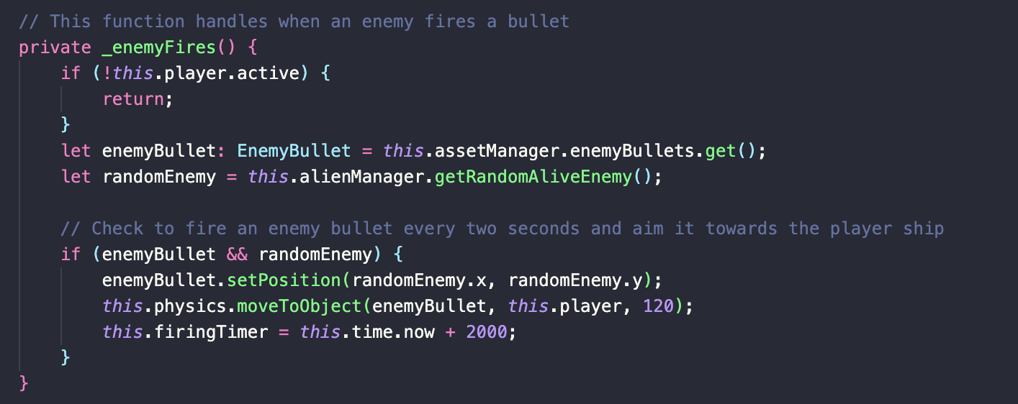
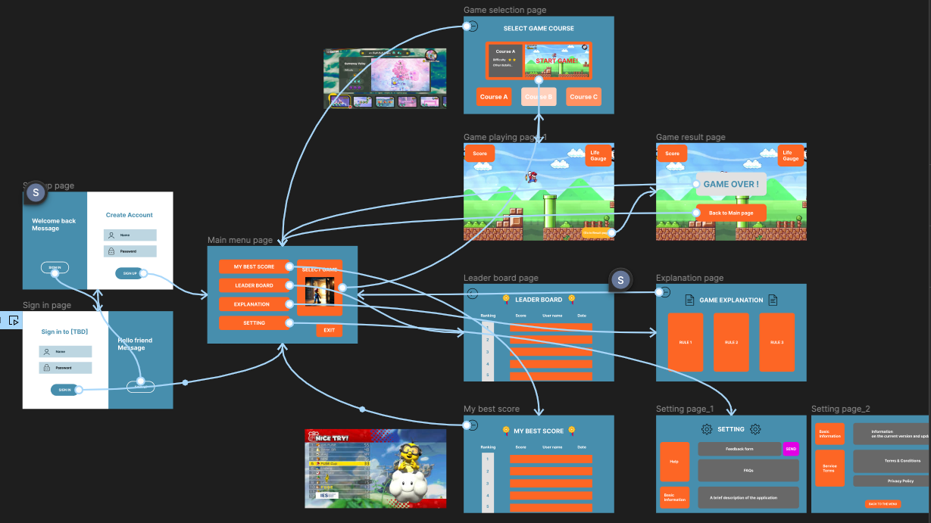
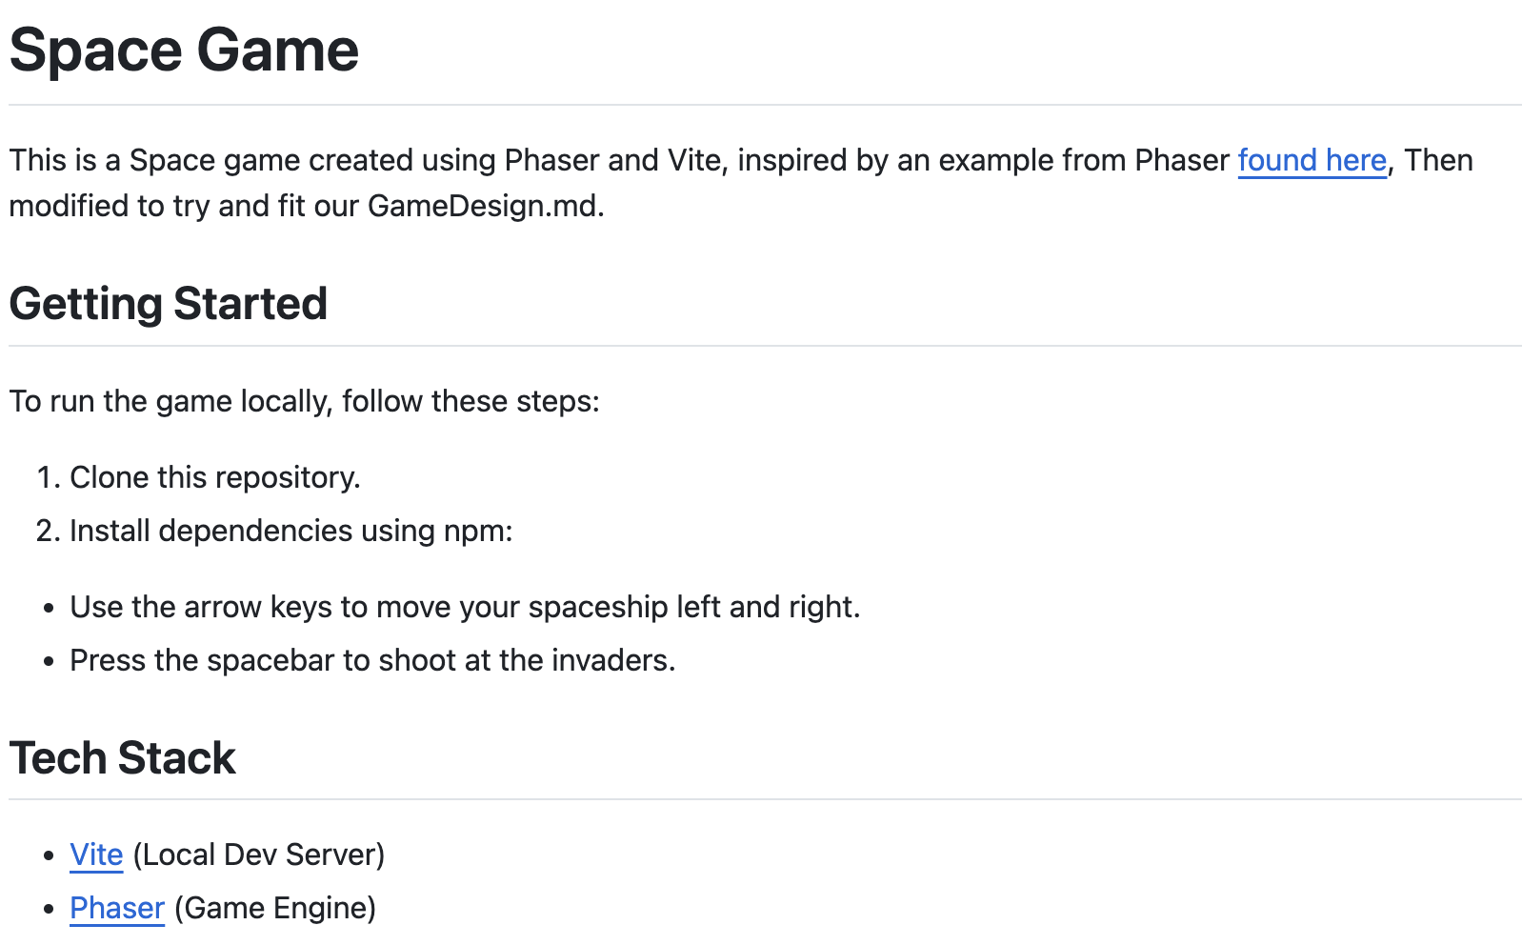
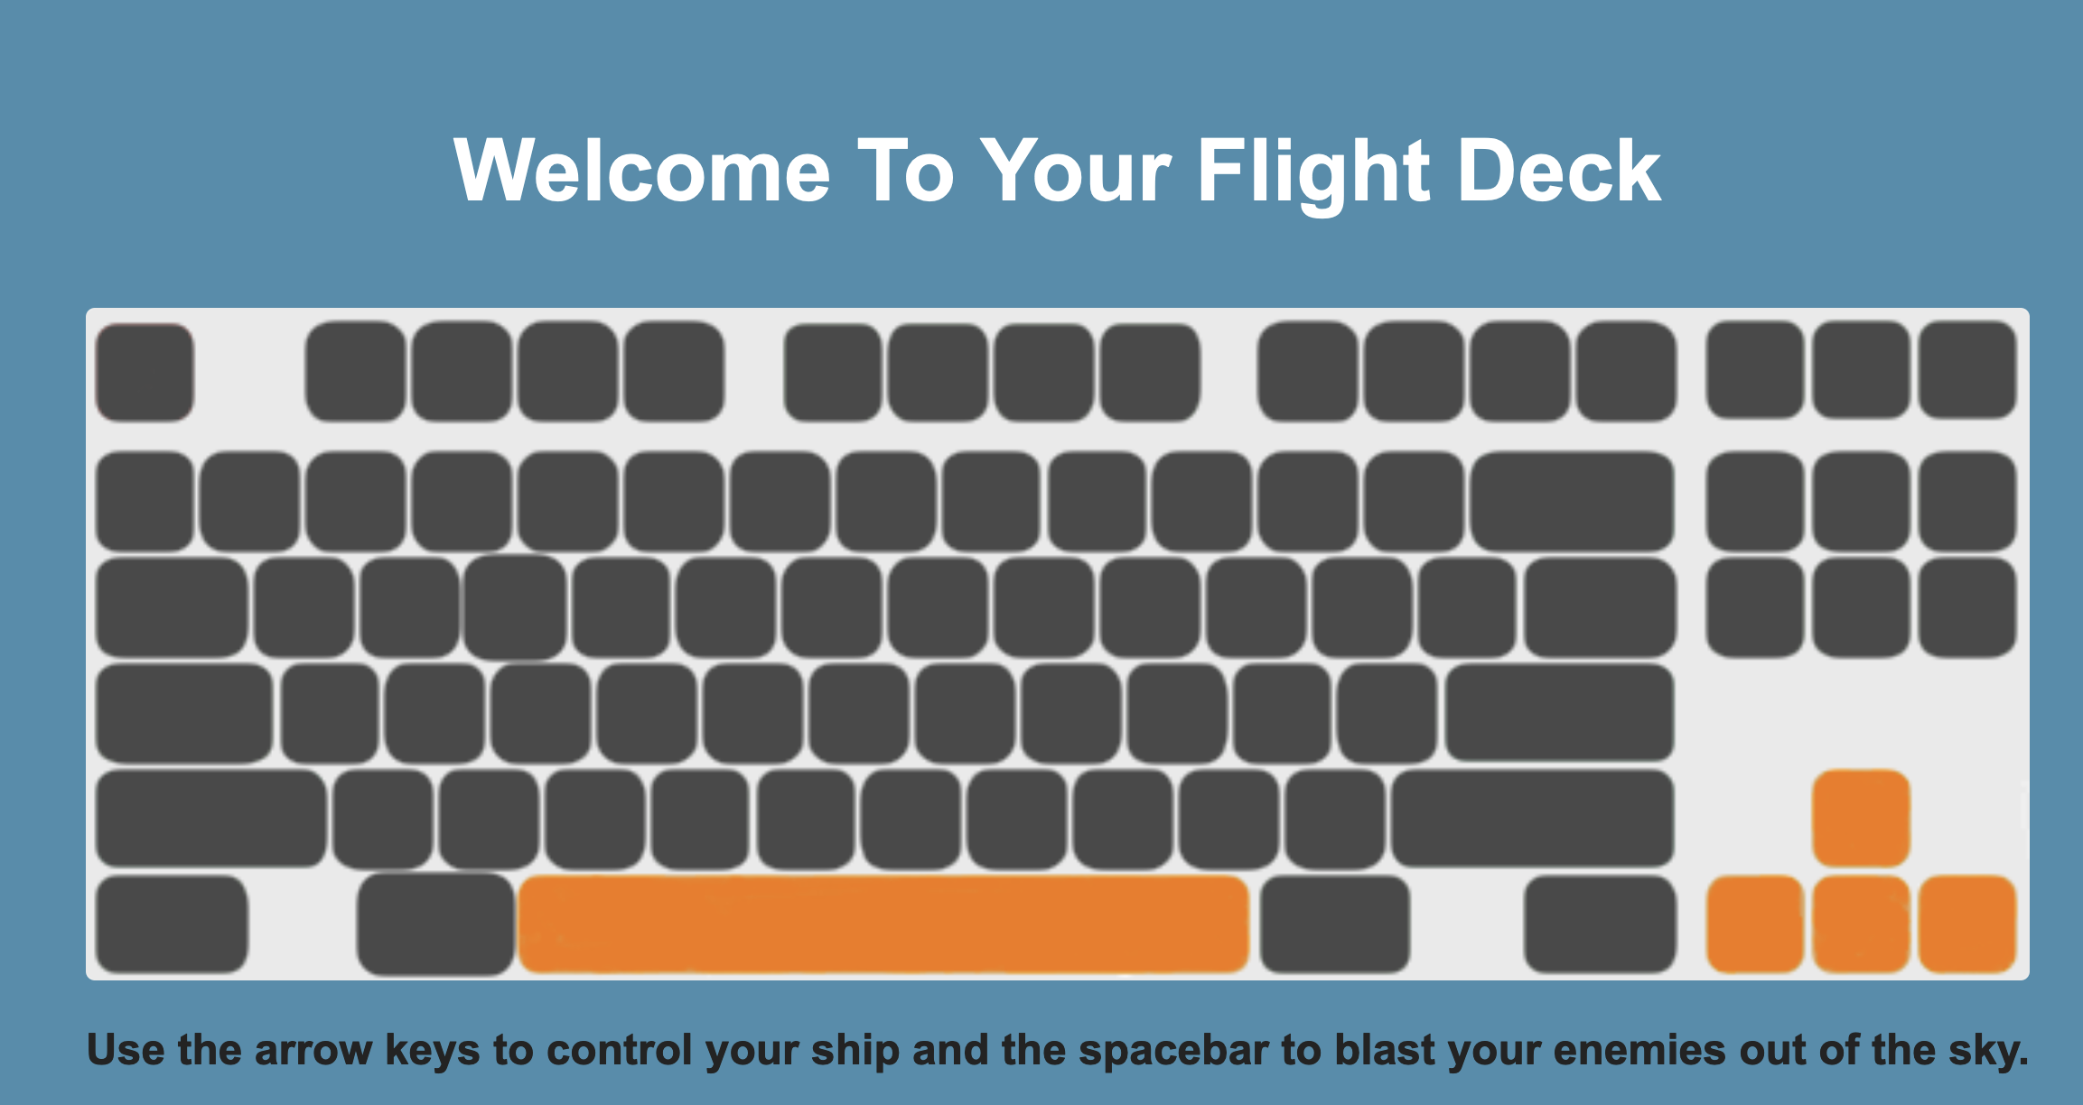
Documentation
In-Code documentation
README
User Guide
Game Design Document

Slide 10
Challenges and Solutions
Challenge
New languages
Hosting
Game Development process
Scope of project
User interface
Database connection
Remote work

Slide 11
Demo

