Slide 1

The Relational Model and Database Normalization
DAVID M. KROENKE and DAVID J. AUER
DATABASE CONCEPTS, 7th Edition, Global Edition
Chapter Two

Slide 2
Chapter Objectives
Learn the conceptual foundation of the relational model
Understand how relations differ from nonrelational tables
Learn basic relational terminology
Learn the meaning and importance of keys, foreign keys, and related terminology
Understand how foreign keys represent relationships

Slide 3
Chapter Objectives (Cont’d)
Learn the purpose and use of surrogate keys
Learn the meaning of functional dependencies
Learn to apply a process for normalizing relations

Slide 4
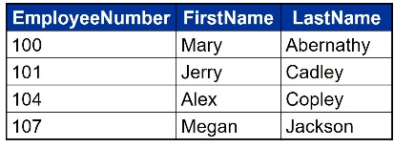
Entity
An entity is something of importance to a user that needs to be represented in a database.
An entity represents one theme or topic.
In an entity-relationship model (discussed in Chapter 4), entities are restricted to things that can be represented by a single table.

Slide 5
Relation
A relation is a two-dimensional table that has specific characteristics.
The table dimensions, like a matrix, consist of rows and columns.

Slide 6
Characteristics of a Relation
Rows contain data about an entity.
Columns contain data about attributes of the entity.
Cells of the table hold a single value.
All entries in a column are of the same kind.
Each column has a unique name.
The order of the columns is unimportant.
The order of the rows is unimportant.
No two rows may be identical.

Slide 7
A Sample Relation
EmployeeNumber | FirstName | LastName
100 | Mary | Abernathy
101 | Jerry | Cadley
104 | Alex | Copley
107 | Megan | Jackson

Slide 8
A Nonrelation Example
Cells of the table hold multiple values
EmployeeNumber | Phone | LastName
100 | 335-6421, 454-9744 | Abernathy
101 | 215-7789 | Cadley
104 | 610-9850 | Copley
107 | 299-9090 | Jackson

Slide 9
Example of a Nonrelational Table
No two rows may be identical
EmployeeNumber | Phone | LastName
100 | 335-6421 | Abernathy
101 | 215-7789 | Cadley
104 | 610-9850 | Copley
100 | 335-6421 | Abernathy
107 | 299-9090 | Jackson

Slide 10
Terminology
Synonyms…
Table | Row | Column
File | Record | Field
Relation | Tuple | Attribute
Figure 2-6: Equivalent Sets of Terms

Slide 11
A Key
A key is one (or more) column(s) of a relation that is (are) used to identify a row.

Slide 12
Uniqueness of Keys
Unique Key | Nonunique Key
Data value is unique for each row. Consequently, the key will uniquely identify a row. | Data value may be shared among several rows. Consequently, the key will identify a set of rows.

Slide 13
A Composite Key
A composite key is a key that contains two or more attributes.
For a key to be unique, it must often become a composite key.

Slide 14
Composite Key Characteristics
To identify a family member, you need to know a FamilyID, a FirstName, and a Suffix (e.g., Jr.).
The composite key is:
(FamilyID, FirstName, Suffix).
One needs to know the value of all three columns to uniquely identify an individual.
Notes:
John Jones, Sr. 아버지쪽의 존 존스. Smith, Sr. (같은 반 등에서) 나이가 많은 쪽의 스미스

Slide 15
A Candidate Key
A candidate key is called “candidate” because it is a candidate to become the primary key.
A candidate key is a unique key.

Slide 16
A Primary Key
A primary key is a candidate key chosen to be the main key for the relation.
If you know the value of the primary key, you will be able to uniquely identify a single row.

Slide 17
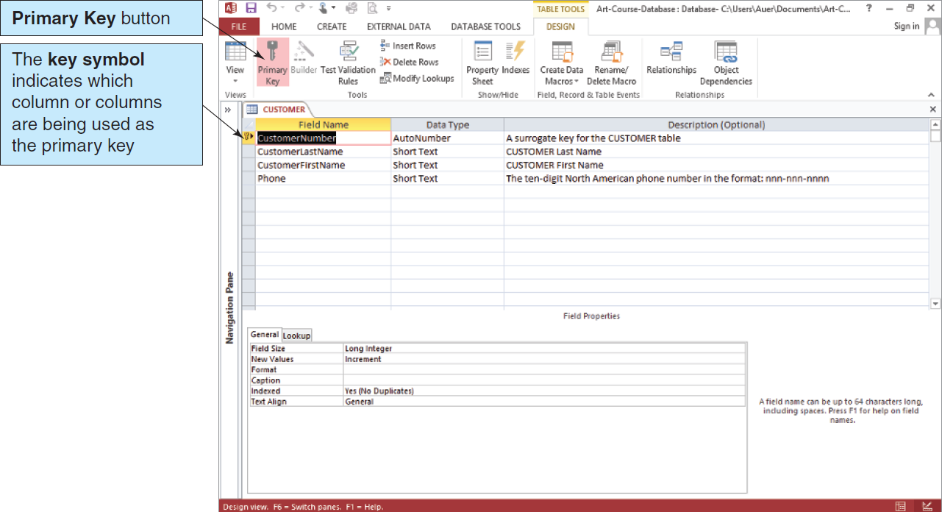
Defining the Primary Key in Microsoft Access
Figure 2.7: Defining a Primary Key in Microsoft Access 2013

Slide 18
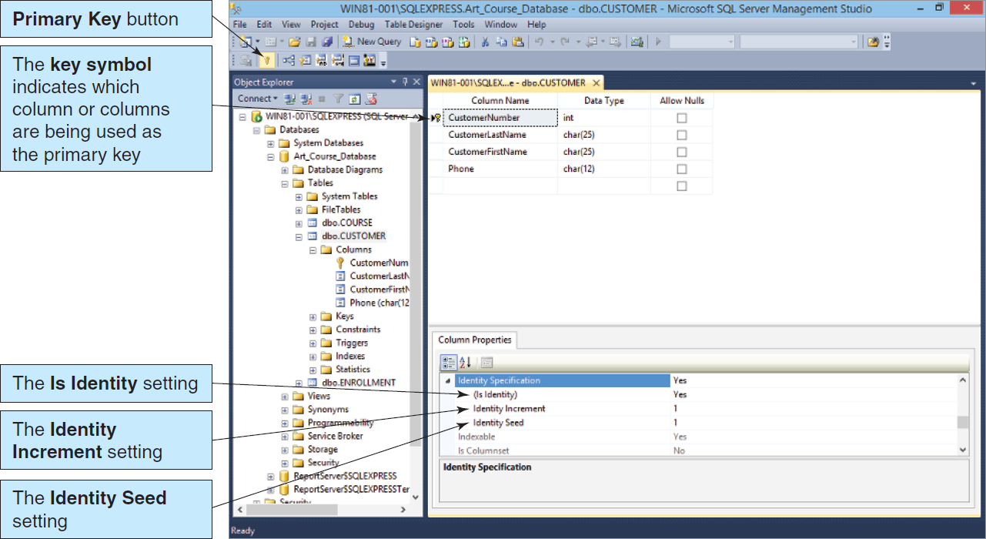
Defining the Primary Key in Microsoft SQL Server 2014
Figure 2.8: Defining a Primary Key in Microsoft SQL Server 2014

Slide 19
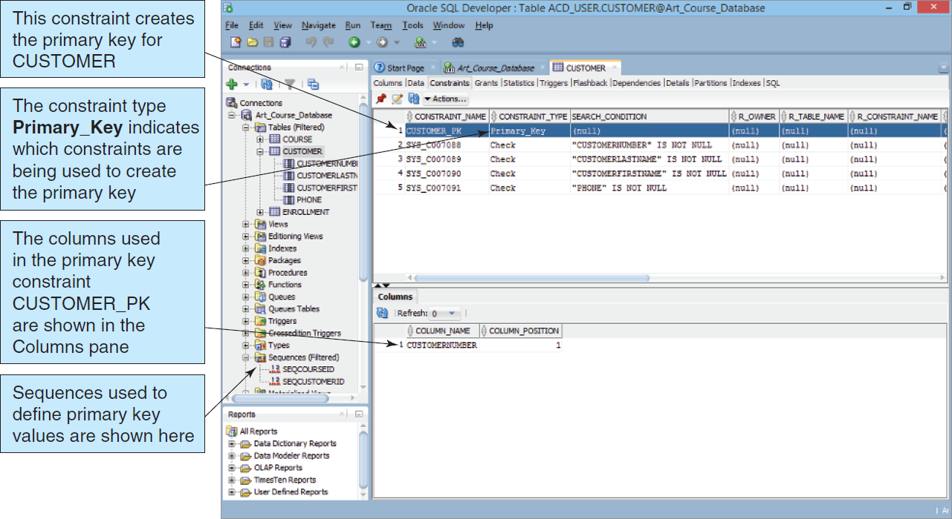
Defining the Primary Key in Oracle Database Express Edition 11g Release 2
Figure 2-9: Defining a Primary Key in Oracle Database Express Edition 11g Release 2

Slide 20
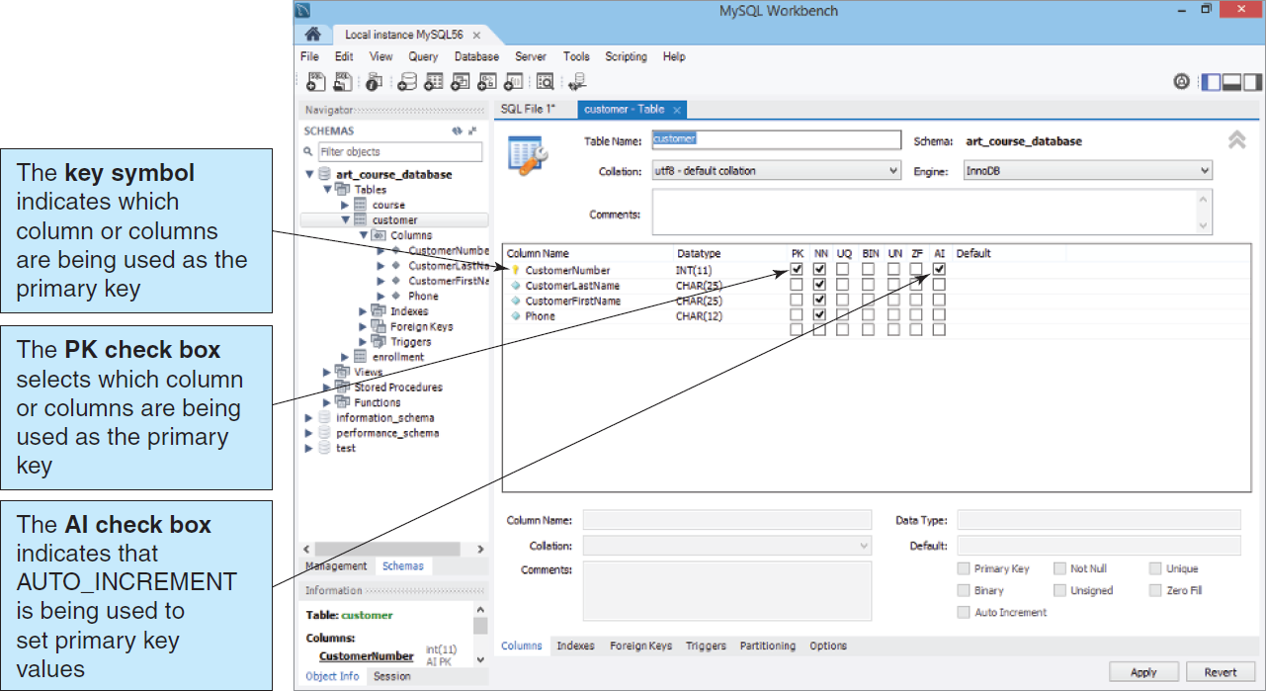
Defining the Primary Key in Oracle MySQL 5.6 Community Server
Figure 2-10: Defining a Primary Key in Oracle MySQL 5.6 Community Server

Slide 21
A Surrogate Key
A surrogate key is a unique, numeric value that is added to a relation to serve as the primary key.
Surrogate key values have no meaning to users and are usually hidden on forms, queries, and reports.
A surrogate key is often used in place of a composite primary key.
Notes:
surrogate [s£:regèit, -git|sr-] n. 1 대리(인), 대행자, (…의) 대용물<for, of ...>. the letter y as a ∼ for i i의 대용으로서의 y.
in place of …대신에(instead of). Use margarine in ∼ of butter. 버터 대신에 마가린을 쓰세요.

Slide 22
Surrogate Key Example
If the Family Member primary key is FamilyID, FirstName, Suffix, it would be easier to append and use a surrogate key of FamMemberID.
FamilyID, FirstName and Suffix remain in the relation.

Slide 23
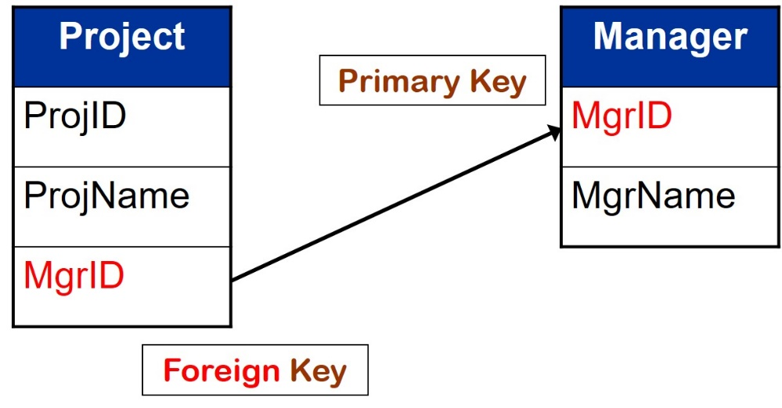
Relationships Between Tables
A table may be related to other tables.
For example
An Employee works in a Department
A Manager controls a Project

Slide 24
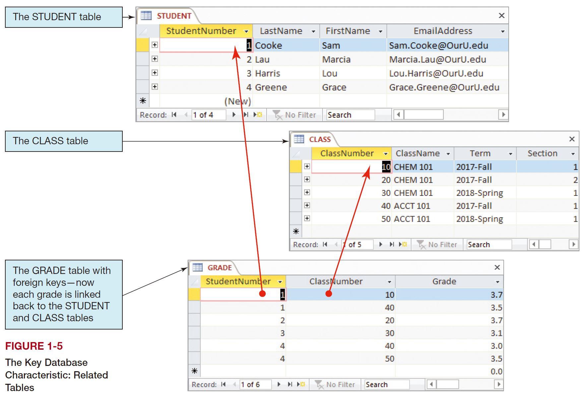
Foreign Key Example III

Slide 25
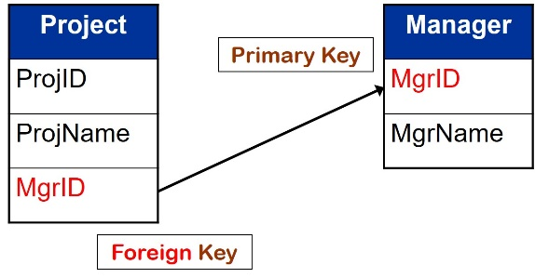
A Foreign Key
To preserve relationships, you may need to create a foreign key.
A foreign key is a primary key from one table placed into another table.
The key is called a foreign key in the table that received the key.
Notes:
Preserve 4.유지하다, 지속하다(maintain, retain). preserve appearances 체면을 유지하다. He has always preserved his innocence. 언제나 순진성을 잃지 않았다. She is well preserved. 용모가 시들지 않는다[언제나 젊다].

Slide 26
Foreign Key Example I
Project
ProjID
ProjName
MgrID
Manager
MgrID
MgrName
Primary Key
Foreign Key
A Manager controls a Project

Slide 27
Foreign Key Example II
Department
DeptID
DeptName
Location
Employee
EmpID
DeptID
EmpName
Primary Key
Foreign Key
An Employee works in a Department

Slide 28
Foreign Key Example III

Slide 29
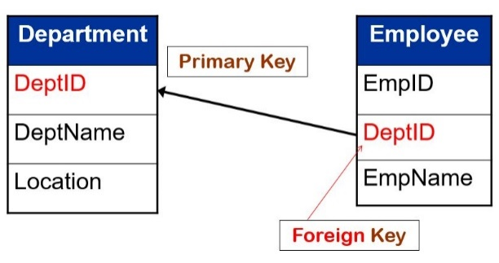
Referential Integrity
Referential integrity states that every value of a foreign key must match a value of an existing primary key.
Example (see previous slide):
If EmpID = 4 in EMPLOYEE has a DeptID = 7 (a foreign key), a Department with DeptID = 7 must exist in DEPARTMENT.
The primary key value must exist before the foreign key value is entered.
Notes:
integrity [intégreti] n. 1 정직, 성실, 고결, 청렴(honesty) ð HONOR[동의어]. a person of high ∼ 뛰어나게 성실한 사람(▷ 종종 인물 소개에 쓰임). 2 완전한 상태, 무결(성)(entirety); 본래의 상태, 흠없는 상태(soundness). territorial ∼ 영토보전. in its ∼ 고스란히 그대로, 원래대로.
<literally "untouched," from in- "not" (see in- (1)) + root of tangere "to touch," from PIE root *tag- "to touch, handle.“>
integrated [íntegrèitid] adj. 1 (인종R종교 등의) 차별을 하지 않는, 평등한(ó segregated). an ∼ neighborhood 융화적 지역(▷ 예컨대 백인과 흑인이 인종 차별을 하지 않으면서 사는 지역). 2 (조화된 전체를 구성하도록) 통합된; 조직화된; 일관 생산[판매]을 하는. 3 [心] <인격이> 융화된.
íntegrated círcuit n. [컴퓨터] 집적 회로(集積回路). 약자: IC
integrative [íntegrèitiv, -gret-] adj. 1 완전하게 하는, 집성적(集成的)인, 통합적인; 인종 차별 폐지의. 2 = integrant.
integrant [íntegrent] adj. 요소의; 불가결한, 긴요한. n. 불가결한 성분, (구성) 요소.
I3 Integrative – Innovative [ˈɪnəveɪtɪv] – Intensive

Slide 30
Referential Integrity (Cont’d)
Another perspective…
The value of the Foreign Key EmployeeID in EQUIPMENT
must exist in
The values of the Primary Key EmployeeID
in EMPLOYEE

Slide 31
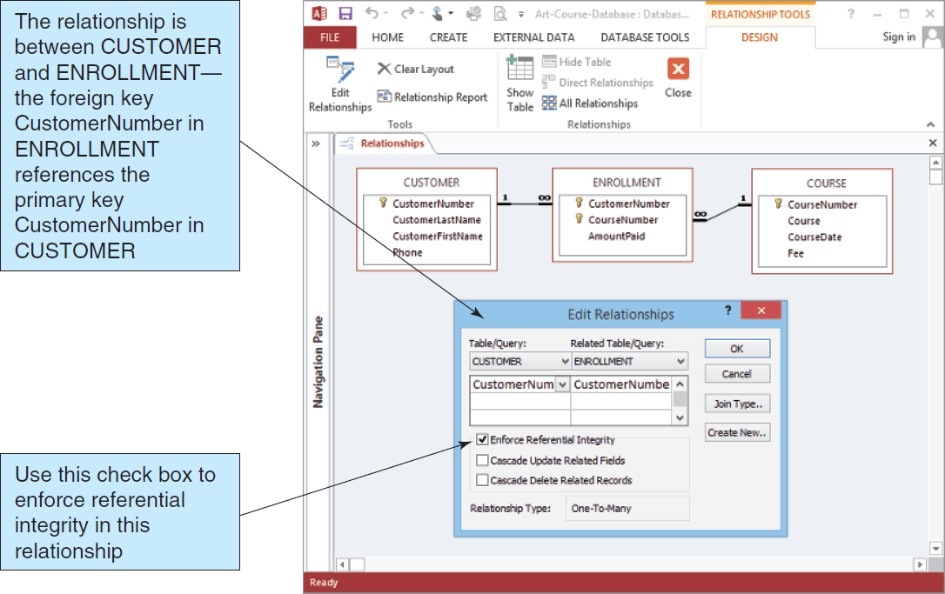
Foreign Keys in Microsoft Access 2013
Figure 2-11: Enforcing Referential Integrity in Microsoft Access 2013

Slide 32
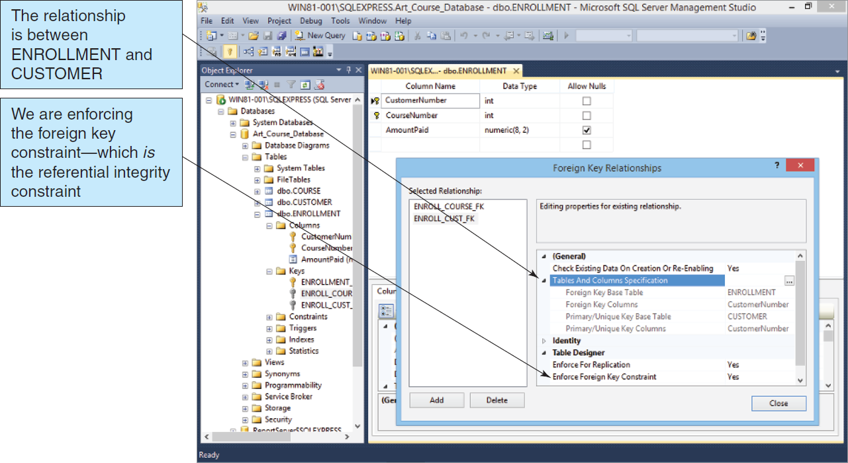
Foreign Keys in Microsoft SQL Server 2014
Figure 2-12: Enforcing Referential Integrity in Microsoft SQL Server 2014

Slide 33
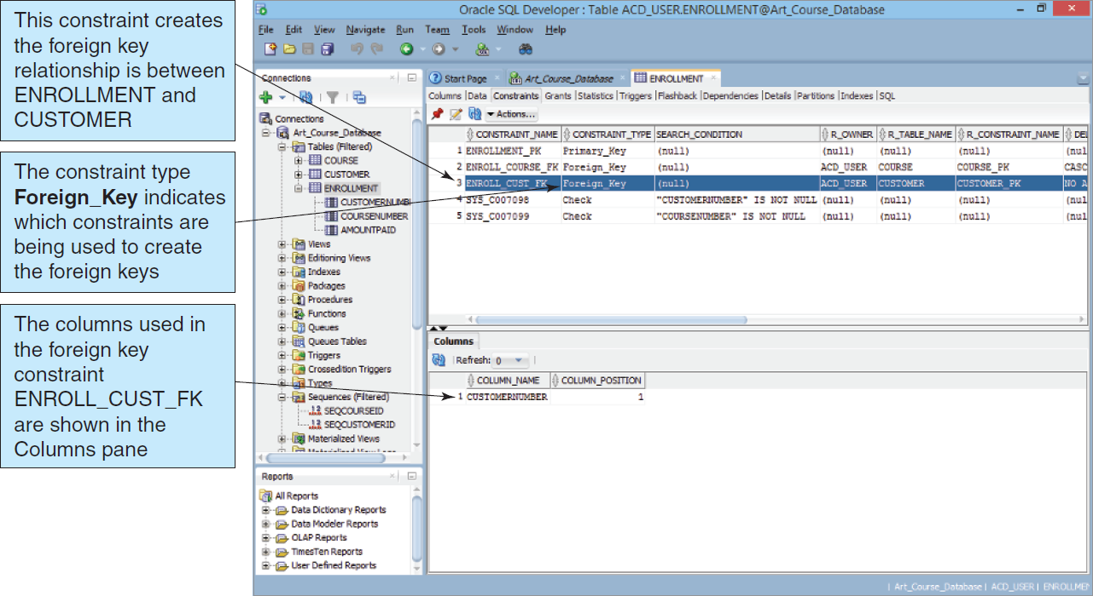
Foreign Keys in Oracle Database Express Edition 11g Release 2
Figure 2-13: Enforcing Referential Integrity in Oracle Database Express Edition 11g Release 2

Slide 34
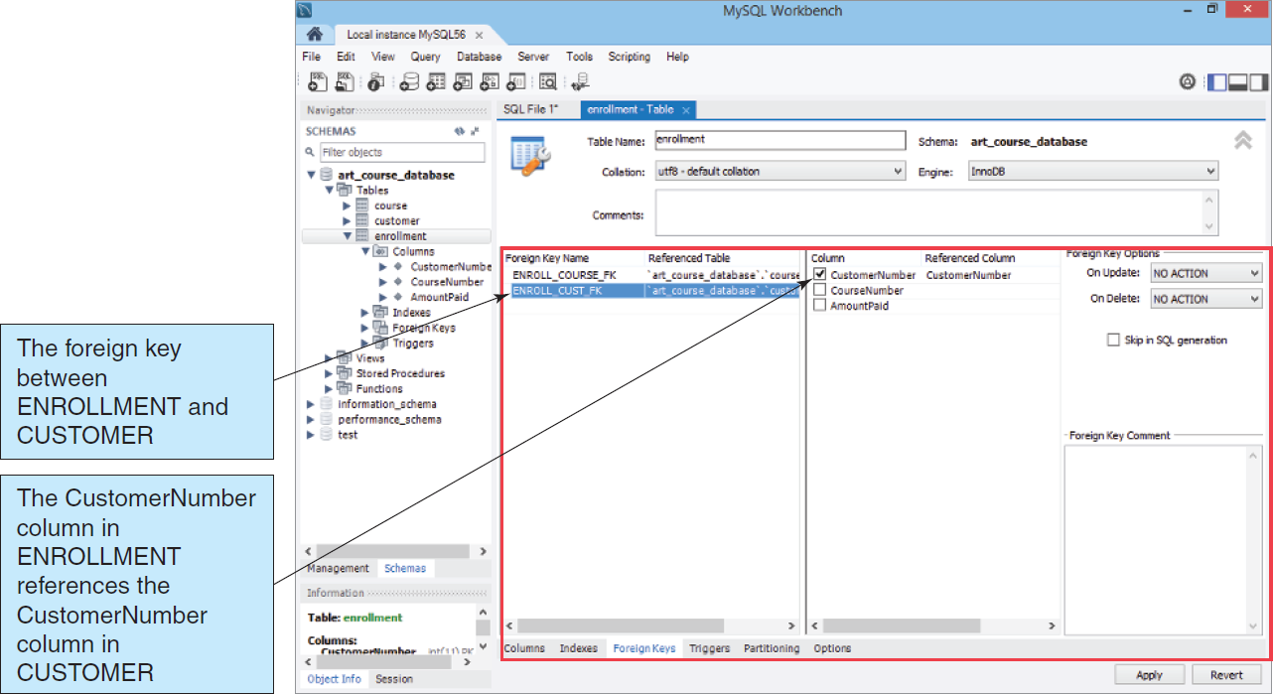
Foreign Keys in Oracle MySQL 5.6 Community Server
Figure 2-14: Enforcing Referential Integrity in Oracle MySQL 5.6 Community Server

Slide 35
The Null Value
A Null value means that no data was entered.
This is different from a zero, space character, or tab character.

Slide 36
The Problem of Null Values
A Null is often ambiguous. It could mean…
The column value is not appropriate for the specific row.
a null value for the column DateOfLastChildbirth in a PATIENT table
The column value is not decided.
The column value is unknown.
Each may have entirely different implications.
Notes:
Consider, for example, a null value for the column DateOfLastChildbirth in a PATIENT table. If a row represents a male patient, then the null occurs because the value is inappropriate; a male cannot give birth. Alternatively, if the patient is a female, but the patient has never been asked for the data, then the value is appropriate but unknown. Finally, the null value could also mean that a date value is appropriate and known, but no one has recorded it into the database. [Database Processing, 15/e - Kroenke, Auer, Vandenberg & Yoder]
First, it might mean that no value of Color is appropriate; Spring Hats do not come in different colors. Second, it might mean that the value is known to be blank; that is, Spring Hats have a color, but the color has not yet been decided. Maybe the color is established by placing ribbons around the hats, but this is not done until an order arrives. Finally, the null value might mean that the hats’ color is simply unknown; the hats have a color, but no one has checked yet to See what it is.

Slide 37
Functional Dependency
Functional Dependency—A relationship between attributes in which one attribute (or group of attributes) determines the value of another attribute in the same table
Illustration…
The price of one cookie can determine the price of a box of 12 cookies.
(CookiePrice, Qty)
BoxPrice

Slide 38
Determinants
The attribute (or attributes) that we use as the starting point (the variable on the left side of the equation) is called a determinant.
(CookiePrice, Qty)
BoxPrice
Determinant
Notes:
determinant [dɪ│tɜːrmɪnənt] [명사][격식] 결정 요인

Slide 39
Candidate/Primary Keys and Functional Dependency
By definition… A candidate key of a relation will functionally determine all other attributes in the row.
Likewise, by definition… A primary key of a relation will functionally determine all other attributes in the row.

Slide 40
Primary Key and Functional Dependency Example
(EmpLastName,
EmpPhone)
(EmployeeID)
(ProjectID)
(ProjectName,
StartDate)

Slide 41
Normalization
Normalization—A process of analyzing a relation to ensure that it is well formed
More specifically, if a relation is normalized (well formed), rows can be inserted, deleted, or modified without creating update anomalies.
Notes:
well-formed [wélf:rmd] adj. [言] 문법에 맞는, 적격의
well-founded [wélfáundid] adj. 기초가 단단한; 근거가 충분한(well-grounded). a ∼ economic theory 근거가 단단한 경제 이론.
Anomaly 1. 변칙, 예외 ; 이례, 변태(abnormality). 2. [문법] 파격. 3. 변태[이례]적인 일[것]. A wingless bird is an anomaly. 날개 없는 새는 변태다. 4. [천문] 근점이각(近點離角)(근일점 또는 근지점으로부터의 각<角>거리). the true anomaly 진(眞)근점거리. the mean anomaly 평균 근점거리.

Slide 42
Normalization Principles
Relational design principles for normalized relations:
To be a well-formed relation, every determinant must be a candidate key.
Any relation that is not well formed should be broken into two or more well-formed relations.

Slide 43
Modification Problems
Tables that are not normalized will experience issues known as modification problems.
Insertion problems
Difficulties inserting data into a relation
Modification problems
Difficulties modifying data into a relation
Deletion problems
Difficulties deleting data from a relation

Slide 44
Solving Modification Problems
Most modification problems are solved by breaking an existing table into two or more tables through a process known as normalization.

Slide 45
Definition Review
Functional dependency
The relationship (within the relation) that describes how the value of one attribute may be used to find the value of another attribute.
Determinant
The attribute that can be used to find the value of another attribute in the relation
The left-hand side of a functional dependency

Slide 46
Definition Review II
Candidate key
The value of a candidate key can be used to find the value of every other attribute in the table.
A simple candidate key consists of only one attribute.
A composite candidate key consists of more than one attribute.

Slide 47
Normal Forms
There are many defined normal forms:
First Normal Form (1NF)
Second Normal Form (2NF)
Third Normal Form (3NF)
Boyce-Codd Normal Form (BCNF)
Fourth Normal Form (4NF)
Fifth Normal Form (5NF)
Domain/Key Normal Form (DK/NF)

Slide 48
Normalization to BCNF
For our purposes, a relation is considered normalized when:
Every determinant is a candidate key.
This is Boyce-Codd Normal Form (BCNF)

Slide 49
Normalization Example
(StudentID)
(StudentName, DormName, DormCost)
However, if…
(DormName)
(DormCost)
Then DormCost should be placed into its own relation,
resulting in the relations:
(StudentID)
(StudentName,
DormName)
(DormName)
(DormCost)

Slide 50
Normalization Example (Cont’d)
(AttorneyID,ClientID)
(ClientName, MeetingDate, Duration)
However, if…
(ClientID)
(ClientName)
Then ClientName should be placed into its own relation,
resulting in the relations:
(AttorneyID,ClientID)
(MeetingDate, Duration)
(ClientID)
(ClientName)

Slide 51
The Relational Model and Database Normalization
DAVID M. KROENKE and DAVID J. AUER
DATABASE CONCEPTS, 7th Edition, Global Edition
End of Presentation on Chapter Two

