Slide 1
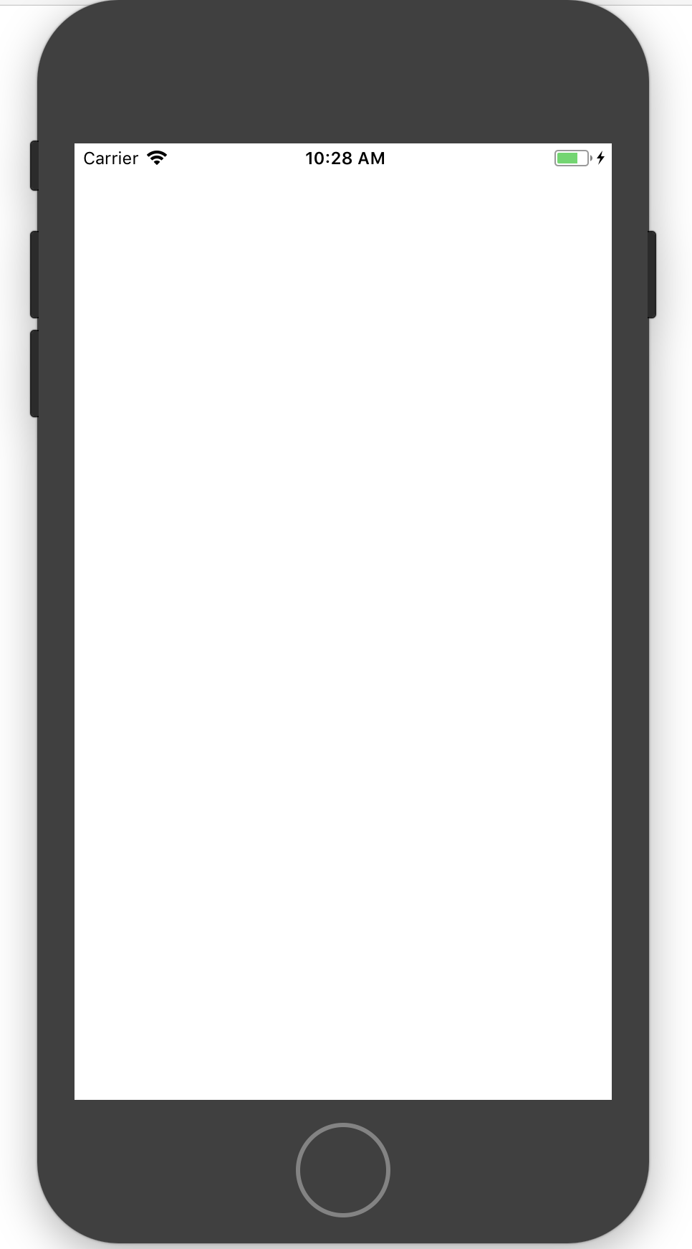
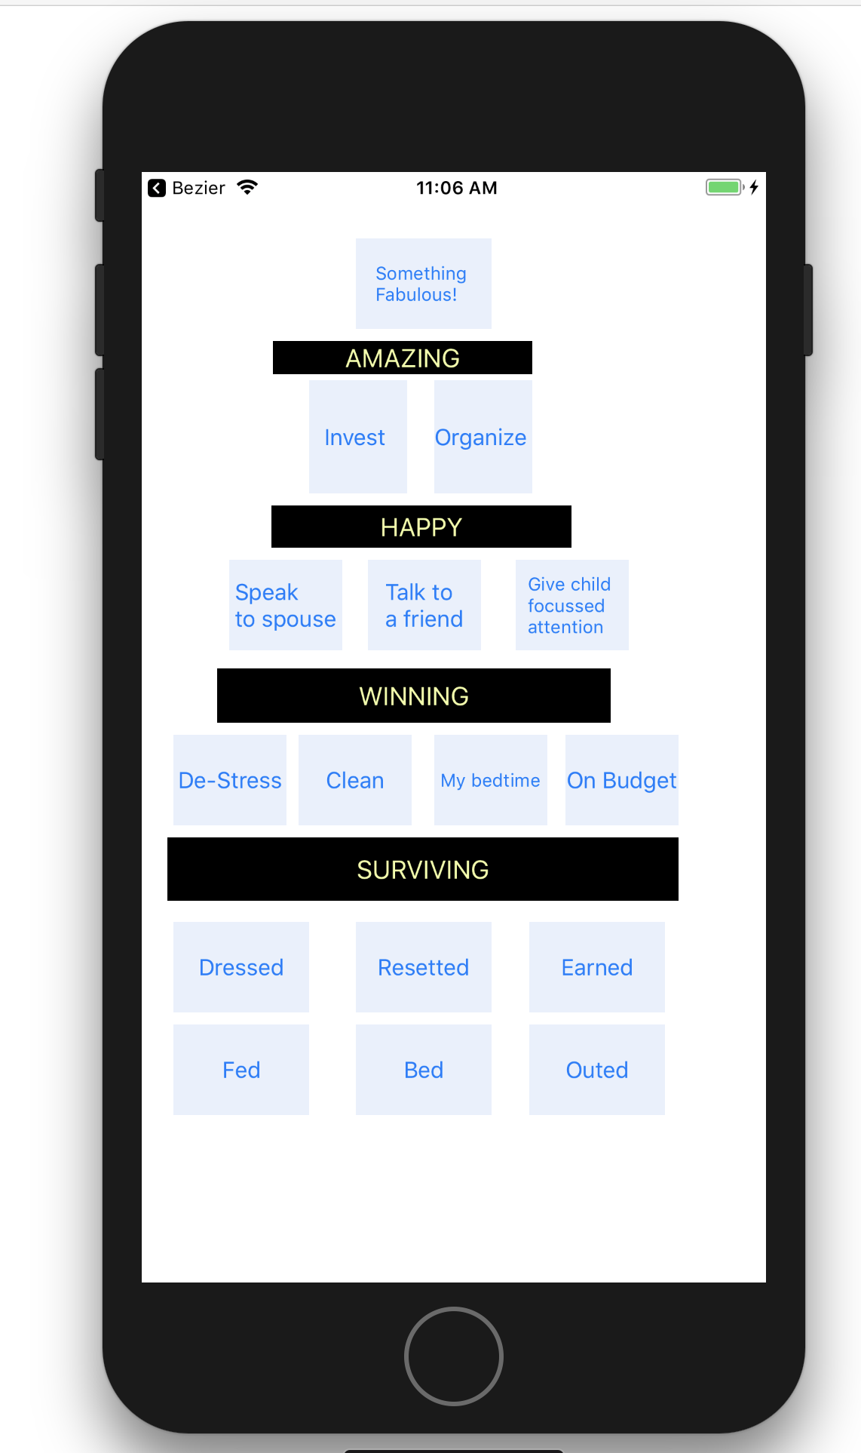
Very easy to code
Estimate 1 man day extra development time to use triangles
Something
Fab
Pretty bulletproof - know it works
Amazing
Invest
In
Self
Might be more challenging to fit text in evenly
Org-
anise
Happy
How much can this be beautified…?
1:1
Child
Speak
To
Spouse
Speak
To
Friend
Not even a pyramid!
Winning
De-stress
Bed
on
time
But does resonate more as a Maslow pyramid
On
budget
Clean
Surviving
Fed
Dress
Outed
Wiped
Fed
Reset
Earned
Bed

Slide 3
User sees their data? How do we lay it out? Do we store data and render graphics live, or do we store icons? Maybe have a ‘dictionary’ for all the permutations?
Splash Screen?
Segue to next view controller.
How?
Button on screen?
Swipe? Other?
Registration?
Login?
Onboarding?
What user sees before any input
User inputs what they have done by tapping triangles

Slide 4
Splash Screen?
Registration?
Login?
Onboarding?
What user sees before any input
User inputs what they have done by tapping triangles
U R
Fab!
Or maybe user gets a boosting message first?

Slide 6
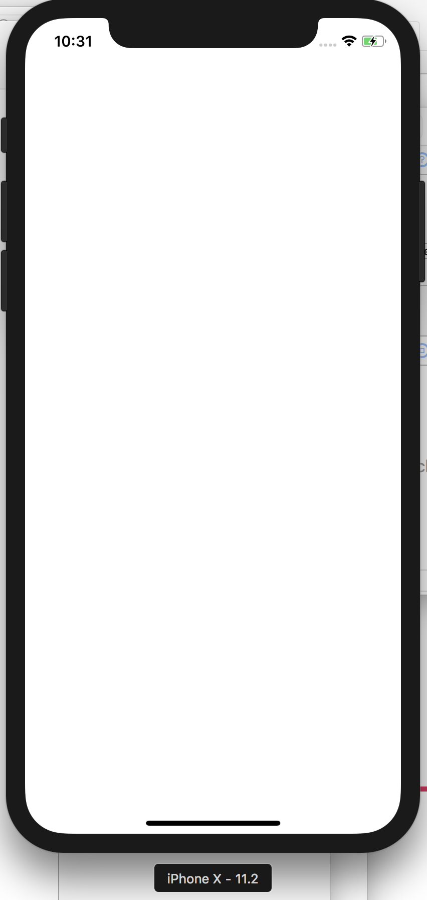

Slide 7
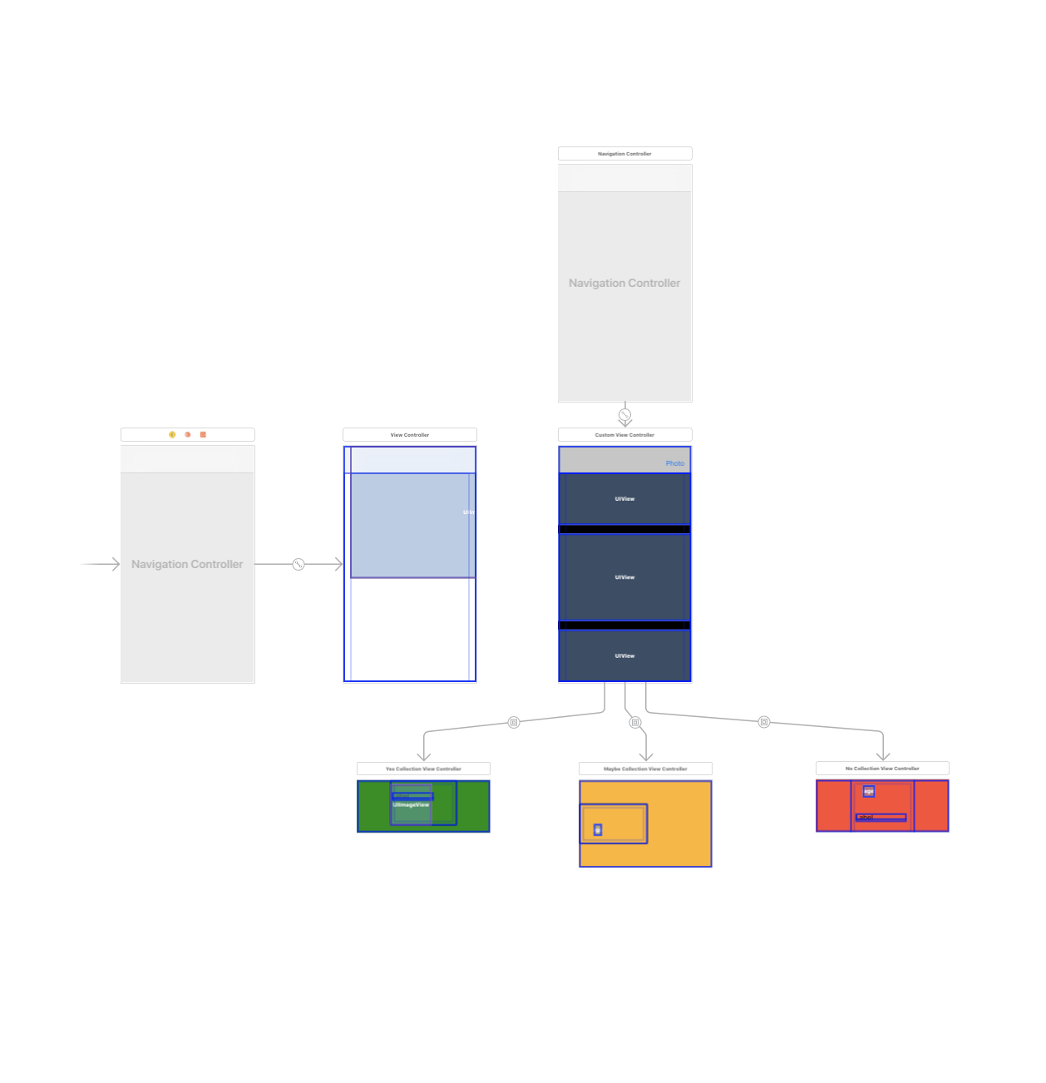
This is an example of how an Xcode storyboard is laid out. (This is my food app)
This is the navigation controller. You can custom build your own navigation - or things like ‘Tab’ and ‘back button’ come built into templates - which makes it quick to develop, and also predictable for the user
First screen
Second screen
My one happens to have three view controllers inside it - but normally you’d only have one, or just use the default layouts.

