Slide 1
IOT INTRUSION DETECTION [KEYLOGGING] BY SAYEED MOLLA - 2228057 SHOURJA DUTTA - 2228061 SHRISH S MAITI - 2228063

Slide 2
TABLE OF CONTENTS
INTRODUCTION
EXECUTIVE SUMMARY
VISUALIZATIONS/INTERPRETATION
CONCLUSION/ RECOMMENDATION

Slide 3
INTRODUCTION
This venture centers on creating a profound learning-based approach for recognizing keylogger action in arrange activity information. Keyloggers posture a critical security danger by subtly recording client keystrokes, possibly compromising touchy data such as passwords and budgetary data.
The strategy includes a few key steps:
Data Preprocessing
Feature Engineering
Model Architecture
Training and Evaluation
The comes about illustrate the challenges of keylogger discovery, with the demonstrate accomplishing an AUC of 0.527 on the test set. The preparing bends appear the advancement of misfortune and AUC measurements over ages, whereas the ROC bend gives visual representation of the model's segregation capability.
This execution grandstands the application of exchange learning (utilizing EfficientNetB0) for arrange security errands and highlights the complexities included in identifying advanced dangers like keyloggers in organize activity information.

Slide 4
EXECUTIVE SUMMARY
Information Preprocessing
Demonstrate Architecture
Approach:-
Information Preprocessing:
Cleaned & standardized arrange activity data
Converted names to parallel (0=Benign, 1=Keylogger)
Demonstrate Architecture:
Hybrid CNN with EfficientNetB0 (exchange learning)
Sigmoid yield for double classification
Training:
80/20 train-test split
Optimized with early halting & energetic LR
Results
AUC: 0.527 Direct discovery capability
Key Understanding: Demonstrate appears potential but needs refinement for higher accuracy.
Next Steps
Progress dataset adjust & highlight engineering
Test LSTM/Transformer models for successive activity analysis
Upgrade real-world deployability
Impact: Progresses AI-powered risk discovery against keylogging assaults..
Traning
Results
Next Steps

Slide 5
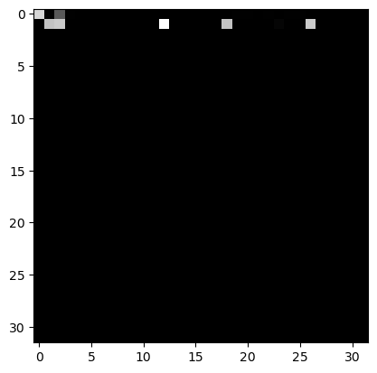
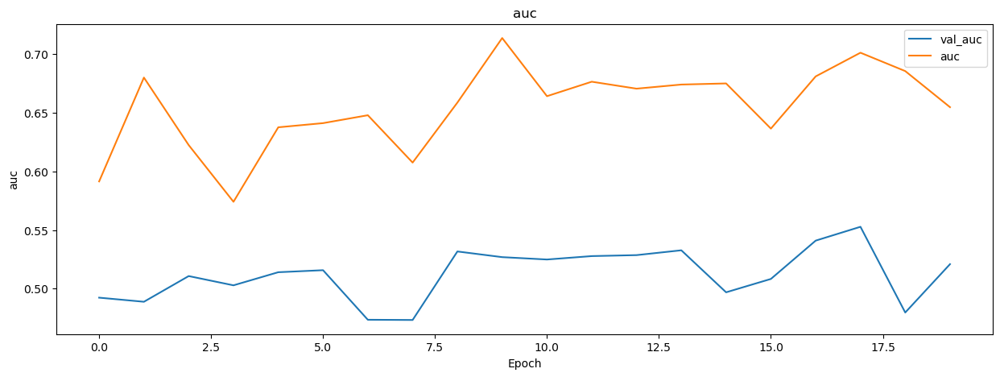
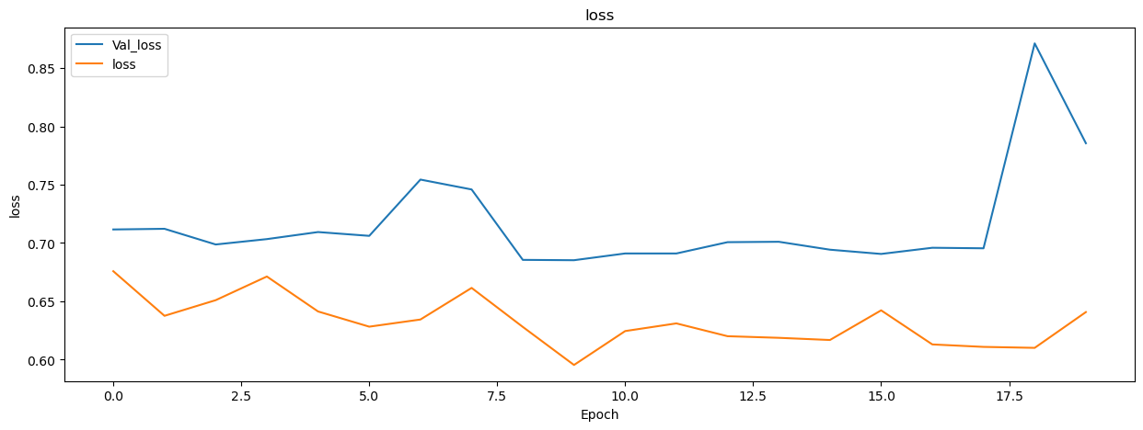
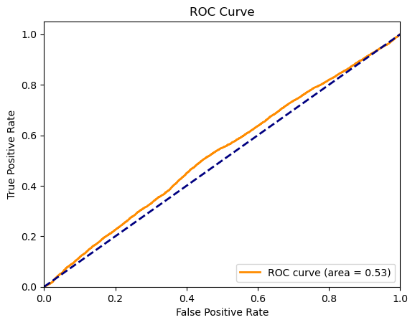
VISUALIZATIONS
Feature scaling visualization: Normalized network traffic features (0-30 range) after standardization, enabling consistent model training for keylogger detection.
Model performance comparison: Training metrics (M1-M6) showing AUC scores ranging from 0.5-0.9, with optimal detection at 0.9 (M3) and performance fluctuations in later epochs (1.2-1.8).
Training performance metrics showing model convergence - Loss (0.65+) and AUC (0.67+) trends during keylogger detection training, with fluctuations indicating optimization challenges.
Model evaluation ROC curve with 0.53 AUC score, showing moderate discrimination between benign and keylogger traffic - indicating need for improved feature engineering or architecture adjustments.

Slide 6
CONCLUSION/RECOMMENDATION
Key Takeaways
Accomplished direct location capability (AUC: 0.53) utilizing CNN with EfficientNetB0
Illustrated achievability of profound learning for keylogger location in organize traffic
Highlighted challenges in highlight representation and show optimization
Strategic Recommendations
Improve Information Quality
Balance dataset with engineered tests or ill-disposed examples
Incorporate more discriminative activity highlights (e.g., parcel timing, stream patterns)
Model Enhancements
Test LSTM/Transformer designs for successive activity analysis
Implement consideration instruments to center on key malevolent indicators
Evaluation Rigor
Expand testing with real-world assault simulations
Compare against conventional signature-based location methods
Next Stage: Create cross breed AI show combining CNN for spatial highlights and RNN for transient activity investigation.

Slide 7
THANK YOU!!!

