Slide 1

SotonShip 2026 · Southampton City track
Kerbside
Text a street problem on iMessage. Get one clear report and a private link back.
Team Krish Mathur · Aadil Sirajudeen · Anirudh Udupi Diggavi · [SID24555: name to confirm]
Notes:
Hi, we're the Kerbside team, on the Southampton City track. Kerbside lets a resident text a street problem on iMessage, the app that's already on their phone. It answers only from the council's own web pages, asks a few short questions, and saves one clear report that council staff can act on. The resident gets a private link to follow it. Here's why that matters.

Slide 2
THE PROBLEM
Reporting a problem is harder than it should be
~700
Which council?
Again and again
services run by Southampton City Council.
Some SO16, SO18 and SO19 addresses are outside the city. A postcode alone doesn't say.
“Residents report fly-tipping, potholes and broken street lights as photos and free text, often several times for the same problem.”
About Southampton City Council, checked 17 Oct 2026
Council's missed bin form, checked 17 Oct 2026
SotonShip 2026 Southampton City brief
Notes:
Southampton City Council runs around 700 services, by its own count. A resident with a pothole shouldn't need to know which team handles it, or even which council: the council itself says some SO16, SO18 and SO19 addresses are outside the city. And the track brief says residents report the same problem several times, as photos and free text. So the council gets repeated, messy reports.
Clicks: 3 (each click reveals the next part; the slide reads fine with no animation).

Slide 3
THE IDEA
Message it like a friend, in the app you already use
1
Nothing to install
Kerbside
It's a contact in Messages. Text it like anyone else.
Someone's dumped a mattress on Lawn Road
2
Words or a photo
Say what and where. It asks only for what's missing, in five messages at most.
Logged: fly-tipping, Lawn Road.
It hasn't gone to the council yet.
Follow it ›
3
A private link back
One report is saved, and the resident gets a link to follow it.
Real reply text, shortened
Notes:
Our idea: message it like a friend, in the app you already use. There's nothing to install: it's a contact in Messages. You say what and where, in words or a photo, and it asks only for what's missing, five messages at most. Then it saves one report and sends you a private link to follow it. The reply on the right is the agent's real wording.
Clicks: 3 (each click reveals the next part; the slide reads fine with no animation).

Slide 4
HOW IT WORKS
One message in, one report out
1
2
4
5
Resident
Agent
Reports
Dashboard
texts on iMessage
asks up to five follow-ups
one per problem, repeats checked
council staff filter and update
3
6
Verified facts
Private link
54, each with a source and date
resident sees only their report
link sent back in the chat
Notes:
Here's how it works. A resident texts on iMessage. The agent reads it, asks up to five short follow-ups, and checks 54 verified facts, each with a council source and a date. It saves one report to the database and checks for repeats. Staff see it on the council dashboard. The resident gets a private link back in the chat, showing only their own report.
Clicks: 6 (each click reveals the next part; the slide reads fine with no animation).

Slide 5
TRUST
It only says what the council's own pages say
Over 7.5cm
75%
023 8023 3344
Road potholes over 7.5cm: repaired within 24 hours.
Aim: 75% of urgent street cleaning requests dealt with in one working day. An aim, not a guarantee.
Council housing emergency repairs, out of office hours.
Council potholes page
checked 17 Oct 2026
Environmental issues page
checked 17 Oct 2026
Out of hours page
checked 17 Oct 2026
When the facts don't cover it
“I can't confirm who owns that road. Try the council's roads page or National Highways.”
Notes:
Trust is the core rule. The agent only states what the council's own pages say, and shows the source and the date we checked. Potholes over 7.5 centimetres: within 24 hours. The 75 percent street cleaning aim, which the council calls an aim, not a guarantee. The out-of-hours number. And when the facts don't cover it, it says so, in exactly these words.
Clicks: 4 (each click reveals the next part; the slide reads fine with no animation).

Slide 6
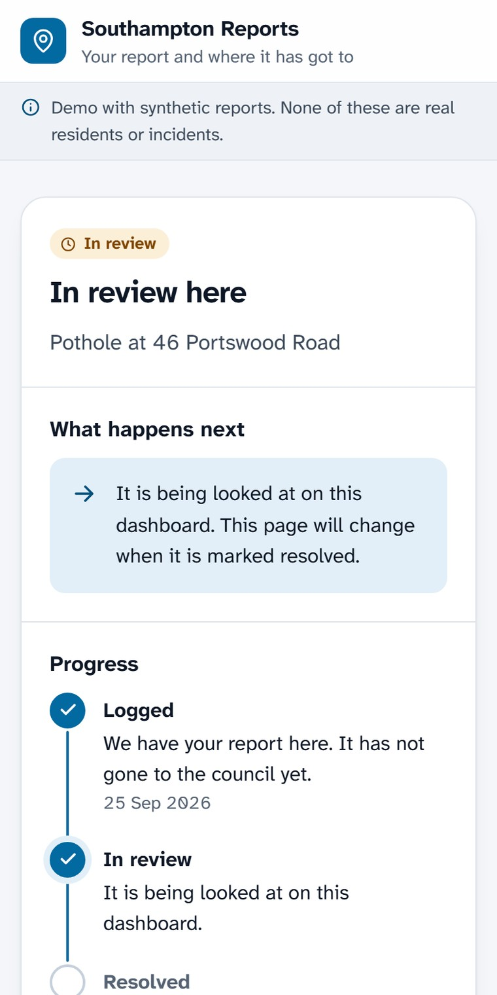
DEMO · RESIDENT
A conversation, then a private link
Messages · Kerbside
Tap the link
Massive pothole, nearly burst a tyre
Status, next step and progress, for this one report.
Logged: pothole.
Which road, and nearest house number or junction?
No report ID or name in the link.
46 Portswood Road
Thanks, added: pothole at Portswood Road.
It hasn't gone to the council yet.
Follow it ›
Real page,
synthetic data
The agent's real reply text, shortened
Notes:
Now the demo, from the resident's side. They text: massive pothole. The agent logs it and asks one thing: which road. They answer, and it confirms, says honestly that it hasn't gone to the council yet, and sends a link. The link opens this page: status, what happens next, and progress. It's a real page from our site; the report on it is synthetic.
Clicks: 3 (each click reveals the next part; the slide reads fine with no animation).

Slide 7
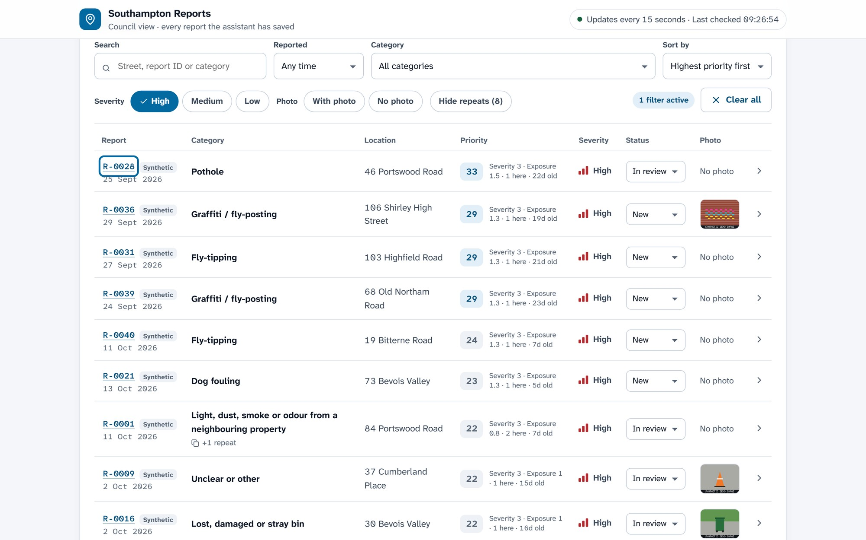
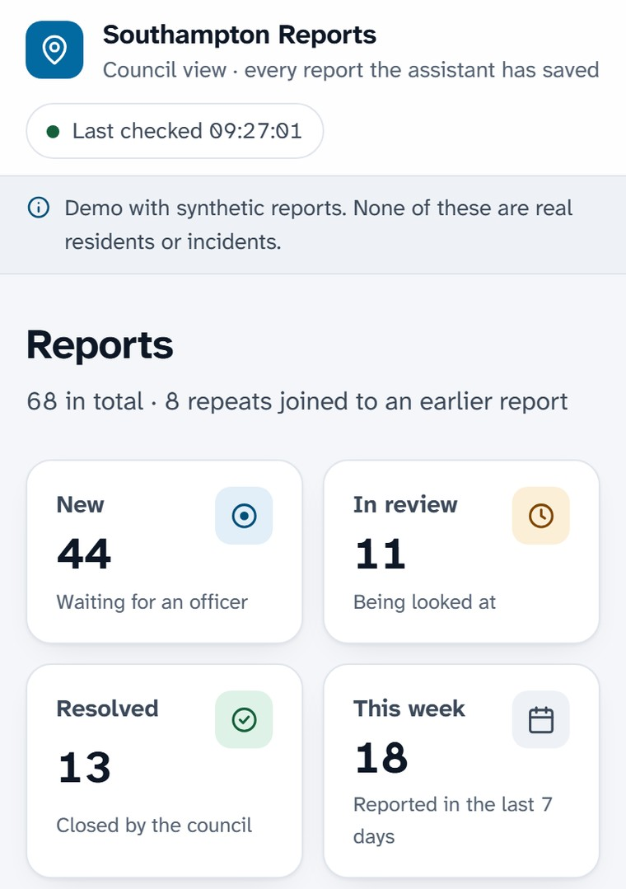
DEMO · COUNCIL
Every report on one dashboard
68 synthetic reports
Filters and search
Priority + reasons
Status in one click
Repeats joined up
Notes:
And the council side. Every saved report lands on one dashboard. Staff filter by time, category and severity, sort by priority with the reasons shown, and change status in one click. Repeats are joined to the earlier report. It works at phone width too. These are real screenshots of our running site, filled with 68 synthetic reports.
Clicks: 2 (each click reveals the next part; the slide reads fine with no animation).

Slide 8
SAFETY AND PRIVACY
Knows when to stop. Keeps almost nothing.
Points elsewhere, saves nothing
What a report keeps
Emergency “Call 999 now.”
Who a salted hash, not the number
Outside the city their own council
Link random 16-character token
Not council National Highways, utility
Where the street, no coordinates
Neighbour issues the council's own form
Dashboard staff only, password
Credits Facts: Southampton City Council web pages, checked 17 Oct 2026 · Testing only: FixMyStreet reports (mySociety), via Open311 · Streets and city boundary: © OpenStreetMap contributors, ODbL
Notes:
It knows when to stop. An emergency gets: call 999 now. A place outside the city gets pointed to its own council, using the real boundary, not a postcode guess. Trunk roads, utilities and neighbour issues go to the right place. None of those are saved. A report keeps a salted hash, never the phone number, and a random private link. Credits are on screen.
Clicks: 3 (each click reveals the next part; the slide reads fine with no animation).

Slide 9
RESULTS
What we measured: wins and losses
42%
Not measured yet
8 of 10
17 of 40
Keyword baseline: 20 of 48 categories right
Our agent's category accuracy
real repeats caught by the duplicate rule
non-repeats wrongly flagged as repeats
Wins
Where it fails
Fly-tipping: 6 of 6 right
Exact double submissions: 2 of 2
Look-alike pairs: 0 of 19 flagged
Services we don't handle: 0 of 17
Litter called fly-tipping: 4 of 6
Busy streets: new problems merged
Source: NUMBERS.md. 60 real Southampton FixMyStreet reports and 70 pairs, labelled by us; ambiguous cases left out. Fetched 17 Oct 2026.
Notes:
What we measured, honestly. On 60 real Southampton FixMyStreet reports, a keyword baseline got 20 of 48 right. We haven't measured our agent yet. The duplicate rule caught 8 of 10 real repeats, but wrongly flagged 17 of 40, all new problems on busy streets. Wins on the left, failures on the right. It's a small sample, labelled by us.
Clicks: 4 (each click reveals the next part; the slide reads fine with no animation).

Slide 10
WHAT'S NEXT
From a demo to a council pilot
1
Measure the agent
Team
Accuracy and cost per report, on the same test set.
Krish Mathur
Aadil Sirajudeen
Anirudh Udupi Diggavi
[SID24555: name to confirm]
2
Send reports to the council
Today they are saved here only. Next: the council's own forms.
3
Try it with one council team
“Every UK council handles the same kind of reports.” (track brief)
SotonShip 2026
Southampton City track
Notes:
Next: measure the agent, and its cost per report, on the same test set. Send reports into the council's own forms; today they're saved here only. Then try it with one council team. The brief says every UK council handles the same kind of reports, so this can travel. Thank you. We're happy to take questions.
Clicks: 3 (each click reveals the next part; the slide reads fine with no animation).

