Slide 1

AMEO Dataset
Exploratory Data Analysis

Slide 2

About me
I am Kranthi Kumar I have completed Masters of Technology in Power Systems. Even though, i am from Electrical background, Currently, I am expanding my skill set by undertaking a data science course. In my educational background in electrical engineering, provides me a strong foundation for analytical thinking and problem-solving, which can be valuable assets in the field of data science.
li
LinkedIn url : https://www.linkedin.com/in/kranthi-seelam
GitHub link: https://github.com/KRANTHI-8500/Data-science-internship-projects/tree/main/AMEO_EDA

Slide 3
Description about Data:
The dataset contains the employment outcomes of engineering graduates as dependent variables (Salary, Job Titles, and Job Locations) along with the standardized scores from three different areas – cognitive skills, technical skills and personality skills. The dataset also contains demographic features. The dataset contains around 40 independent variables and 4000 data points.

Slide 4
Exploratory Data Analysis:
Data cleaning steps:
First I checked the shape of the dataset and gained an understanding of the data by examining its description and information
Later after performing a check on the dataset, I found no null, duplicate or redundent values.

Slide 5
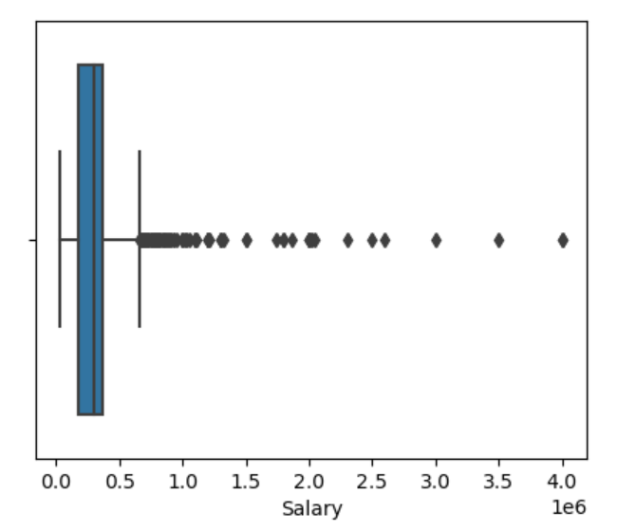
UNI VARIATE ANALYSIS:
SALARY:
It is a uni variate analysis.
As it is a numerical column, I used box plot to plot the values.
The average salary of a person is 3.076998e+05.

Slide 6
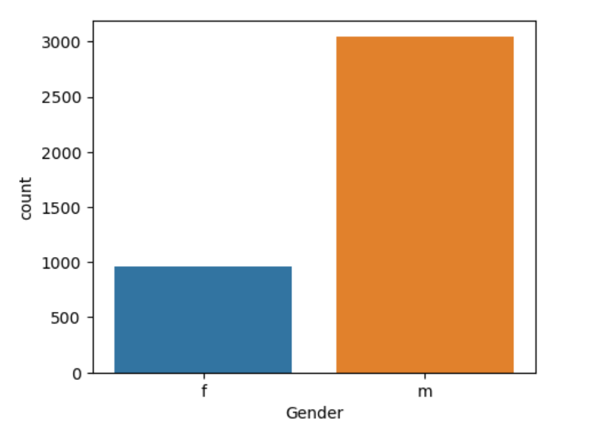
GENDER:
If we observe the graph, there are more number of males than females.

Slide 7
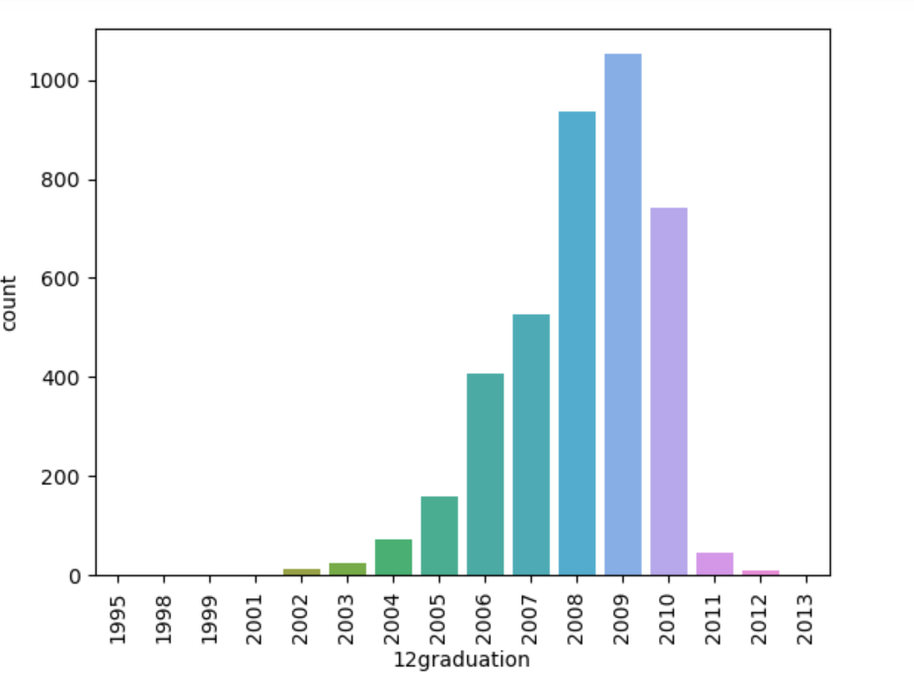
12 Graduation:
In 2009, there seems to be more pass percentage in the 12 graduation students.

Slide 8
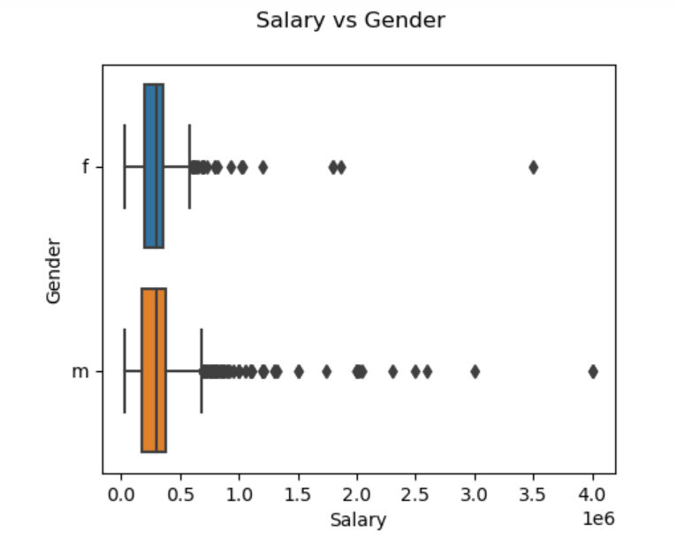
BI VARIATE ANALYSIS:
There is not much difference between median salary for both genders. We can also observe male have more outliers indicating they are more people getting higher pays in male than female category

Slide 9
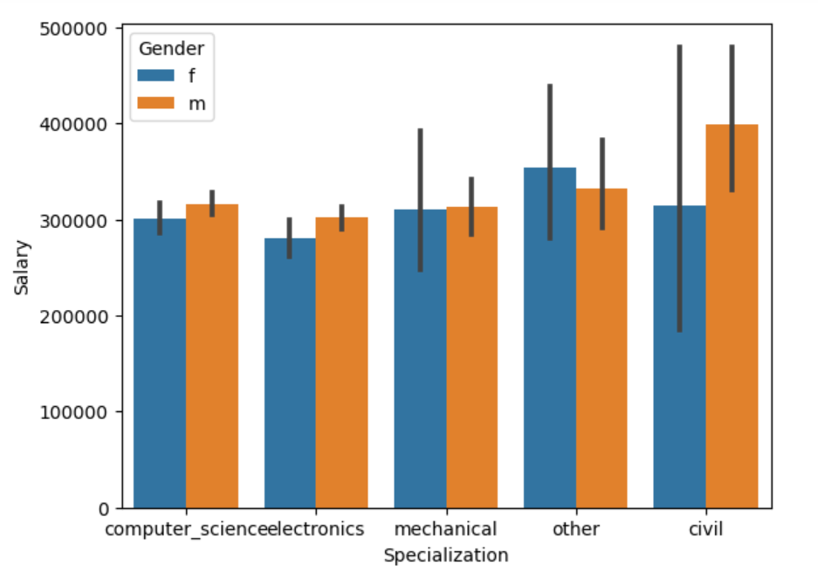
SALARY VS SPECIALIZATION VS GENDER
Males in civil specialization are earning more.
Females in other specialization are more.

Slide 10
CONCLUSION:
1. Most of Amcat Aspirants are male working in IT domain with an experience of around 5years with degree in B.tech and specialization in Computer Science/Information Technology from tier-2 college in uttar pradesh with an average salary around 300k.
2.Highpaying jobs taken up by amcat aspirants are mostly from 'IT' Domain.
3.Software Engineer and Software Developer are the most aimed profession for amcat aspirants.

Slide 11

THANK YOU

