Slide 1
Make Utility and Makefile
Compiling your source code files can be tedious, especially when you want to include several source files and have to type the compiling command every time you want to do it. Makefiles are special format files that together with the make utility will help you to automatically build and manage your projects.
The "make" utility automates the mundane aspects of building executable from source code. The make utility reads its instruction from Makefile (called the descriptor file) by default. The Makfile which contains rules on how to build the executables.
Use “make --help" to list the command-line options; or "man make" to display the man pages.
The make utility
To invoke make, simply type:
  $ make
  This program will look for a file named Makefile in your directory and execute it.
By default, when make looks for the makefile, it tries the following names, in order: GNUmakefile, makefile and Makefile.
If you want to use a nonstandard name for your makefile, you can specify the makefile name with the ‘-f’ or ‘--file’ option. The arguments ‘-f name’ or ‘--file=name’ tell make to read the file name as the makefile.
$ make -f MyMakefile
Makefile
Makefile sets a set of rules to determine which parts of a program need to be recompile, and issues command to recompile them.
Makefile is a way of automating software building procedure and other complex tasks with dependencies.

Slide 2
First Makefile By Example
/* main.c */
#include <stdio.h>
#include "functions.h"
int main()
{
int var=RVAL;
print_hello();
printf("\nThe factorial of 5 is %d", factorial(5));
printf("\nThe value of macro RVAL is %d\n", var);
return 0;
}
/* factorial.c */
int factorial(int n)
{
int i, fac = 1;
if(n!=1){
for(i=1; i<= n; i++)
fac *= i;
return fac;
}
else return 1;
}
/* hello.c */
#include <stdio.h>
void print_hello()
{
printf("Hello World!");
}
/* functions.h */
#if !defined(_FUNC_H_)
#define _FUNC_H_
void print_hello();
int factorial(int n);
#define RVAL 1000
#endif /* if !define(_FUNC_H_) */

Slide 3
First Makefile By Example
Command Line Approach to Compile
gcc -c hello.c main.c factorial.c
ls *.o
factorial.o hello.o main.o
gcc -o prog factorial.o hello.o main.o
./prog
Hello World!
The factorial of 5 is 120
The value of macro RVAL is 1000
Suppose we later modified hello.c, we need to:
gcc -c hello.c
gcc -o prog factorial.o hello.o main.o
Instead of typing compilation commands each time when source code gets modified, we can specify compilation rules into Makefile.
# Example Makefile
# This is a comment line
CC=gcc
# CFLAGS will be the options passed to the compiler.
CFLAGS= -c -Wall
all: prog
prog: main.o factorial.o hello.o
$(CC) main.o factorial.o hello.o -o prog
main.o: main.c
$(CC) $(CFLAGS) main.c
factorial.o: factorial.c
$(CC) $(CFLAGS) factorial.c
hello.o: hello.c
$(CC) $(CFLAGS) hello.c
clean:
rm -rf *.o prog

Slide 4
Makefile Rules
A makefile consists of a set of rules. A rule consists of 3 parts: one or more targets, zero or more dependencies (or pre-requisites) and zero or more commands:
OR
The target and pre-requisites are separated by a colon (:). The command must be preceded by a tab (NOT spaces).
When make is asked to evaluate a rule, it begins by finding the files in the prerequisites. If any of the prerequisites has an associated rule, make attempts to update those first.
In the above example, the rule "all" has a pre-requisite "prog". make cannot find the file "prog", so it looks for a rule to create it. The rule "prog" has a pre-requisite “main.o”, “factorial.o” and “hello.o”. Again, it does not exist, so make looks for a rule to create it. The rule "hello.o" has a pre-requisite "hello.c". make checks that "hello.c" exists and it is newer than the target (which does not exist). It runs the command "gcc -c hello.c". Similarly make checks pre-requisite of “main.o” and “factorial.o”. The rule "prog" then run its command "gcc -o prog factorial.o hello.o main.o". Finally, the rule "all" does nothing.
More importantly, if the pre-requisite is not newer than than target, the command will not be run. In other words, the command will be run only if the target is out-dated compared with its pre-requisite. For example, if we re-run the make command:
$ make
make: Nothing to be done for `all'.
You can also specify the target to be made in the make command e.i. “make <target-name>”. For example, the target "clean" removes the al object files and "hello.exe". You can then run the make without target, which is the same as "make all".
$ make clean
rm -rf *.o prog
$ make
gcc -c -Wall main.c
gcc -c -Wall factorial.c
gcc -c -Wall hello.c
gcc main.o factorial.o hello.o -o prog
target : dependencies
<tab> commands to make target
target : pre-req-1 pre-req-2 ...
<tab> commands to make target

Slide 5
Makefile Dependency Rules
A general syntax for the rules is:
target1 [target2 ...] : [pre-req-1 pre-req-2 ...]
<tab> [command1
<tab> command2
<tab> ......]
Dependency Rules
If the command is not preceded by a tab, you get an error message "makefile:4: *** missing separator. Stop."
If there is no makefile in the current directory, you get an error message "make: *** No targets specified and no makefile found. Stop."
<tab> character MUST NOT be replaced be spaces.
A “target” is usually the name of a file(e.g. executable or object files). It can also be the name of an action (e.g. clean)
“pre-requisites” or “dependencies” are files that are used as input to create the target.
Each “command” in a rule is interpreted by a shell to be executed. By default, make uses /bin/sh shell.
Typing “make target” will:
  Make sure all the dependencies are up to date
  If target is older than any dependency, recreate it using the specified commands.
By default, typing “make” creates first target in Makefile.
Since prog depends on main.o factorial.o hello.o, all of object files must exist and be up-to-date. make will check for them and
recreating them if necessary

Slide 6
Makefile Writing Rules
Phony Targets (or Artificial Targets)
A target that does not represent a file is called a phony target. For example, the "clean" in the aboveexample, which is just a label for a command. If the target is a file, it will be checked against its pre-requisite for out-of-date-ness. Phony target is always out-of-date and its command will be run.
A phony target is one that isn't really the name of a file. It will only have a list of commands and no dependencies.
The standard phony targets are: all, clean, install. Examples:
clean:
rm -rf *.o
Comment & Continuation
A comment begins with a # and lasts till the end of the line.
Long line can be broken and continued in several lines via a back-slash (\).
Using Wildcard Characters in File Names
A single file name can specify many files using wildcard characters. The wildcard characters in make are ‘*’, ‘?’ and ‘[…]’, the same as in the Bourne shell.
For example, *.c specifies a list of all the files (in the working directory) whose names end in ‘.c’. Example:
clean:
rm -f *.o
Pitfalls of Using Wildcards
Now here is an example of a naive way of using wildcard expansion, that does not do what you would intend. Suppose you would like to say that the executable file foo is made from all the object files in the directory, and you write this:
objects = *.o
foo : $(objects)
gcc -o foo $(CFLAGS) $(objects)
The value of objects is the actual string ‘*.o’.

Slide 7
Makefile Writing Rules
The Function wildcard
Wildcard expansion happens automatically in rules. But wildcard expansion does not normally take place when a variable is set, or inside the arguments of a function. If you want to do wildcard expansion in such places, you need to use the wildcard function, like this:
$(wildcard pattern…)
This string, used anywhere in a makefile, is replaced by a space-separated list of names of existing files that match one of the given file name patterns. If no existing file name matches a pattern, then that pattern is omitted from the output of the wildcard function.
Example
One use of the wildcard function is to get a list of all the C source files in a directory, like this:
$(wildcard *.c)
To set objects to the wildcard expansion, instead use
objects := $(wildcard *.o)
foo : $(objects)
gcc -o foo $(CFLAGS) $(objects)

Slide 8
Makefile Writing Rules
Searching Directories for Prerequisites
The directory search features of make facilitate this by searching several directories automatically to find a prerequisite
VPATH: Search Path for All Prerequisites
VPATH (uppercase) to specify the directory to search for dependencies and target files. For example
# Search for dependencies and targets from "src" and "include" directories
# The directories are separated by space
VPATH = src include
The vpath Directive
Similar to the VPATH variable, but more selective, is the vpath directive (note lower case), which allows you to specify a search path for a particular class of file names: those that match a particular pattern. A vpath pattern is a string containing a ‘%’ character. The string must match the file name of a prerequisite that is being searched for, the ‘%’ character matching any sequence of zero or more characters.
There are three forms of the vpath directive:
vpath pattern directories
Specify the search path directories for file names that match pattern. The search path, directories, is a list of directories to be searched, separated by colons or blanks, just like the search path used in the VPATH variable. Example vpath %.c src
vpath pattern
Clear out the search path associated with pattern.
vpath
Clear all search paths previously specified with vpath directives.

Slide 9
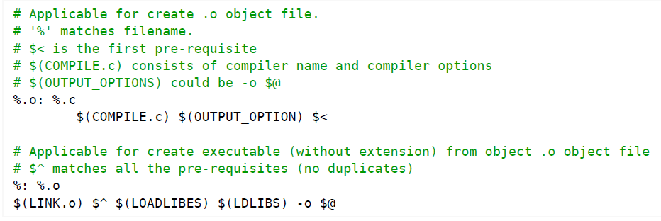
Makefile Writing Rules
Pattern Rules
A pattern rule, which uses pattern matching character '%' as the filename, can be applied to create a target, if there is no explicit rule. For example,
Implicit Pattern Rules
Make comes with a huge set of implicit pattern rules. You can list all the rule via -p or --print-data-base option.
$ make -p

Slide 10
Makefile Writing Rules
Suffix Rules
A way to define default rules or implicit rules that make can use to build a program. There are double-suffix and single-suffix.
Suffix rules are obsolete and are supported for compatibility. Use pattern rules (a rule contains character ‘%’) if possible.
Doubles-suffix is defined by the source suffix and the target suffix . E.g.
.c.o:
$(CC) $(CFLAGS) -c $<
  This rule tells make that .o files are made from .c files.
  $< is a special macro which in this case stands for a .c file that is used to produce a .o file.
This is equivalent to the pattern rule “%.o : %.c”
%.o : %.c
$(CC) $(CFLAGS) -c $<

Slide 11
Variables
Variables or Macros
A variable begins with a $ and is enclosed within parentheses (...) or braces {...}.
Single character variables do not need the parentheses. For example, $(CC), $(CC_FLAGS), $@, $^.
Internal or Conventional Macros
Internal or defaut macros are predefined in make. Use “make -p” to display a listing of all the macros, suffix rules and targets in effect for the current build.
These predefined variables, i.e., macros used in implicit rules fall into two classes. They are as follows
  Macros that are names of programs (such as CC)
  Macros that contain arguments of the programs (such as CFLAGS).
Below is a table of some of the common variables used as names of programs in built-in rules of makefiles
  Tabe 1 : Table of some of the common variables used as names of programs in built-in rules of makefiles
  Tabe 2 : Table of variables whose values are additional arguments for the programs above. The default values for all of these is the empty string

Slide 12
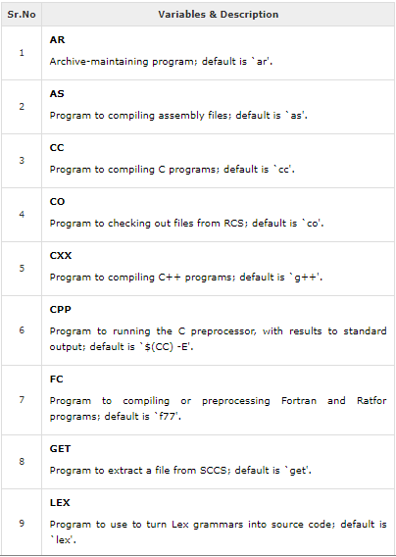
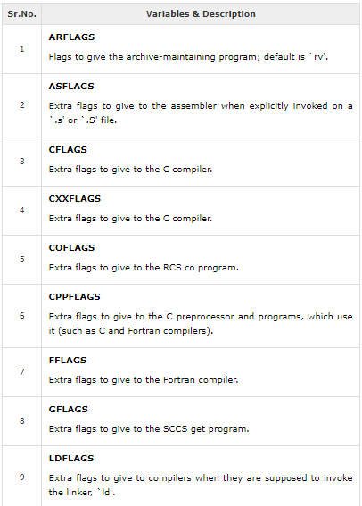
Variables
Internal or Conventional Macros
Table 1 Table 2

Slide 13
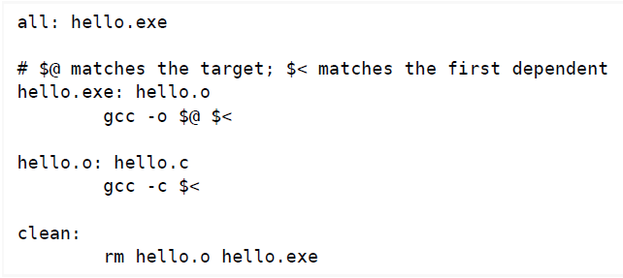
Variables
Special or Automatic macros
Automatic variables are set by make after a rule is matched. There include:
For example
$@ | the target filename.
$* | the target filename without the file extension.
$< | the first prerequisite filename.
$^ | the filenames of all the prerequisites, separated by spaces, discard duplicates.
$+ | similar to $^, but includes duplicates.
$? | the names of all prerequisites that are newer than the target, separated by spaces.

Slide 14
Makefile Examples
A new Makefile example
1. Using pattern rules 2. Using suffix rules and wildcard expansion
# Makefile Example using pattern rule and wildcard expansion
CC = gcc
# CFLAGS will be the options passed to the compiler
CFLAGS = -Wall
LDFLAGS = -lm
#src = main.c hello.c factorial.c
#obj = main.o hello.o factorial.o
src = $(wildcard *.c)
obj = $(src:.c=.o)
exe = prog
all: $(exe)
$(exe) : $(obj)
$(CC) $(LDFLAGS) $^ -o $@
.c.o:
$(CC) $(CFLAGS) -o $@ -c $<
.PHONY: all clean
clean:
@echo "removing object files"
rm -rf $(obj) $(exe)
# Makefile Example using pattern rule
# This is a comment line
CC = gcc
# CFLAGS will be the options passed to the compiler.
CFLAGS = -c -Wall
OBJECTS = main.o hello.o factorial.o
all: prog
prog: $(OBJECTS)
$(CC) $(OBJECTS) -o prog
%.o : %.c
$(CC) $(CFLAGS) $<
.PHONY: all clean
clean:
rm -rf *.o prog

Slide 15
Recompilation Rules
How Does Make Work?
The make utility compares the modification time of the target file with the modification times of the dependency files. Any dependency file that has a more recent modification time than its target file forces the target file to be recreated.
By default, the first target file is the one that is built. Other targets are checked only if they are dependencies for the first target.
The recompilation must be done if the source file or any of the header files named as prerequisites is more recent than object file OR if object file not already exists.
The make utility ignores the changes made in header files if header files name are not mentioned as prerequisites of target and hence does not recompile source files (.c, .cpp files) depedened on headers files.

Slide 16
Automatic Tracing Header Files Dependency
In case using above pattern rule, If .c file change then corresponding .o file will be out of date and will be rebuit automaticay. But if for example file foo.c incudes foo.h and bar.h then it might fail to rebuild foo.o if either of these files change and that will result in a potentially incorrect program and depending on nature of modifications, possibly memory corruption and segmentation faults at runtime.
Solution to This Issue
Make clean and rebuild again when header files modified.
2. Add header files on dependency list. For Example:
%.o : %.c
$(CC) $(CFLAGS) -o $@ -c $<
# $(CC) $(CFLAGS) -c $<
# Assuming CFAGS does not have -c option
CC = gcc
CFLAGS = -Wall
DEPS = functions.h
OBJ = main.o hello.o factorial.o
%.o : %.c $(DEPS)
$(CC) $(CFLAGS) -o $@ -c $<
prog : $(OBJ)
$(CC) $^ -o $@

Slide 17
Automatic Tracing Header Files Dependency
3. Create a file with extension .d (the dependency) that records which files are used to create the corresponding .o file.
The file .d can be generated using -MM option to gcc. Example :
# Makefile Example
# This is a comment line
CC = gcc
# CFLAGS will be the options passed to the compiler
CFLAGS = -Wall
LDFLAGS = -lm
#src = main.c hello.c factorial.c
#obj = main.o hello.o factorial.o
src = $(wildcard *.c)
obj = $(src:.c=.o)
exe = prog
all: $(exe)
$(exe) : $(obj)
$(CC) $(LDFLAGS) $^ -o $@
# pull in dependency info for existing .o files
-include $(obj:.o=.d)
# compile and generate dependency info
%.o:%.c
$(CC) $(CFLAGS) -o $@ -c $<
$(CC) -MM $(CFLAGS) $*.c > $*.d
.PHONY: all clean
clean:
@echo "removing object files"
rm -rf $(obj) $(exe) *.d

Slide 18
Automatic Tracing Header files Depedency
The .d files exist if and only if the corresponding .o file exists. This make sense, since if the .o file does not exist yet, we do not need a .d file to tell us it has to be rebuilt
-inclue $(obj : .o = .d)
  $(obj : .o = .d) take the value of $(obj) and replace all occurances of .o at the end of a name with .d.
  The leading hyphen (-) means that if some .d files do no exist, make should continue without complaining again. If the .d file doen not exist then neither will the .o file, so the .o file will be properly rebuilt.
File factorial.d would look like
factorial.o: factorial.c
File hello.d would look like
hello.o: hello.c
File main.d would look like
main.o: main.c functions.h

Slide 19
Makefile - Directives
Conditional Directives
The ifeq directive begins the conditional, and specifies the condition. It contains two arguments, separated by a comma and surrounded by parentheses. Variable substitution is performed on both arguments and then they are compared. The lines of the makefile following the ifeq are obeyed if the two arguments match; otherwise they are ignored.
The ifneq directive is similar to ifeq but condition is true when two arguments do not match.
The ifdef directive begins the conditional, and specifies the condition. It contains single argument. If the given argument is true then condition becomes true.
The ifndef directive begins the conditional, and specifies the condition. It contains single argument. If the given argument is false then condition becomes true.
The else directive causes the following lines to be obeyed if the previous conditional failed. In the example above this means the second alternative linking command is used whenever the first alternative is not used. It is optional to have an else in a conditional.
The endif directive ends the conditional. Every conditional must end with an endif.
Syntax of Conditionals Directives
ifneq 'arg1' 'arg2‘
text-if-true
endif
ifeq (arg1, arg2)
ifeq 'arg1' 'arg2'
ifeq "arg1" "arg2"
ifeq "arg1" 'arg2'
ifeq 'arg1' "arg2"
ifneq (arg1, arg2)
ifneq 'arg1' 'arg2'
ifneq "arg1" "arg2"
ifneq "arg1" 'arg2'
ifneq 'arg1' "arg2"
foo =
ifdef foo
frobozz = yes
else
frobozz = no
endif
ifeq (arg1, arg2)
text-if-true
else
text-if-false
endif

Slide 20
Makefile - Directives
Example of Conditionals Directives
Command line Variable
Variabes can be defined on the command line. For example:
$ make DEBUG=1
# Makefile using conditional directive
# This is a comment line
CC = gcc
# CFLAGS will be the options passed to the compiler
CFLAGS = -Wall
LDFLAGS = -lm
#src = main.c hello.c factorial.c
src = $(wildcard *.c)
obj = $(src:.c=.o)
exe = prog
ifeq (1, $(DEBUG))
CFLAGS = -g -Wall
endif
all: $(exe)
$(exe) : $(obj)
$(CC) $(LDFLAGS) $^ -o $@
# pull in dependency info for existing .o files
-include $(obj:.o=.d)
# compile and generate dependency info
%.o:%.c
$(CC) $(CFLAGS) -o $@ -c $<
$(CC) -MM $(CFLAGS) $*.c > $*.d
.PHONY: all clean
clean:
@echo "removing object files"
rm -rf $(obj) $(exe) *.d
libs_for_gcc = -lgnu
normal_libs =
foo: $(objects)
ifeq ($(CC),gcc)
$(CC) -o foo $(objects) $(libs_for_gcc)
else
$(CC) -o foo $(objects) $(normal_libs)
endif
DEBUG_FALG =
ifdef DEBUG_FAG
frobozz = yes
Else
frobozz = no
endif

Slide 21
Makefile - Directives
The include Directive
The include directive allows make to suspend reading the current makefile and read one or more other makefiles before continuing. The directive is a line in the makefile that looks follows:
include filenames...
The filenames can contain shell file name patterns. For example, if you have three `.mk' files, namely, `a.mk', `b.mk', and `c.mk', and $(bar) then it expands to bish bash, and then the following expression.
include foo *.mk $(bar)
is equivalent to:
include foo a.mk b.mk c.mk bish bash
When the make processes an include directive, it suspends reading of the makefile and reads from each listed file in turn. When that is finished, make resumes reading the makefile in which the directive appears.
The override Directive
If a variable has been set with a command argument, then ordinary assignments in the makefile are ignored. If you want to set the variable in the makefile even though it was set with a command argument, you can use an override directive, which is a line that looks follows−
override variable = value
or
override variable := value

Slide 22
Makefile - Functions
Functions for Transforming Text
Functions allow you to do text processing in the makefile to compute the files to operate on or the commands to use in recipes. You use a function in a function call, where you give the name of the function and some text (the arguments) for the function to operate on. The result of the function’s processing is substituted into the makefile at the point of the call, just as a variable might be substituted.
Function Call Syntax
A function call resembles a variable reference. A function call looks like this:
$(function arguments) OR ${function arguments}
Here function is a function name; The arguments are the arguments of the function. They are separated from the function name by one or more spaces or tabs, and if there is more than one argument, then they are separated by commas.
Functions for String Substitution and Analysis
Here are some functions that operate on strings:
$(subst from,to,text)
Performs a textual replacement on the text : each occurrence of from is replaced by to. For Example:
var=$(subst ee,EE,feet) statement will assign fEEt to var i.e. var=fEEt
$(patsubst pattern,replacement,text)
  Finds whitespace-separated words in text that match pattern and replaces them with replacement. Here pattern may contain a ‘%’ which acts as a wildcard, matching any number of any characters within a word. If replacement also contains a ‘%’, the ‘%’ is replaced by the text that matched the ‘%’ in pattern.
  For Example $(patsubst %.c,%.o,x.c.c bar.c) produces the value 'x.c.o bar.o'.
  $(var:pattern=replacement) is equivalent to $(patsubst pattern,replacement,$(var))
  $(var:suffix=replacement) is equivalent to $(patsubst %suffix,%replacement,$(var))

Slide 23
Makefile - Functions
Functions for Transforming Text
$(patsubst pattern,replacement,text)
Example:
objects = foo.o bar.o baz.o
  To get the list of corresponding source files, you could simply write:
  $(objects:.o=.c) instead of using the general form: $(patsubst %.o,%.c,$(objects))
$(strip string)
Removes leading and trailing whitespace from string and replaces each internal sequence of one or more whitespace characters with a single space.
$(findstring find,in)
Searches in for an occurrence of find. If it occurs, the value is find; otherwise, the value is empty.
For example: $(findstring a,a b c) and $(findstring a,b c) statement produce the values ‘a’ and ‘’ (the empty string), respectively.
$(filter pattern…,text)
Returns all whitespace-separated words in text that do match any of the pattern words, removing any words that do not match.
$(filter-out pattern…,text)
Returns all whitespace-separated words in text that do not match any of the pattern words, removing the words that do match one or more.
$(sort list)
Sorts the words of list in lexical order, removing duplicate words. The output is a list of words separated by single spaces.
For example: $(sort foo bar lose) returns the value ‘bar foo lose’.
$(word n,text)
Returns the nth word of text. The legitimate values of n start from 1. If n is bigger than the number of words in text, the value is empty.
For example: $(word 2, foo bar baz) returns ‘bar’.

Slide 24
Makefile - Functions
Functions for File Names
$(dir names)
Extracts the directory-part of each file name in names.
For example: $(dir src/foo.c hacks) produces the result ‘src/ ./’.
$(notdir names…)
Extracts all but the directory-part of each file name in names. If the file name contains no slash, it is left unchanged. Otherwise, everything through the last slash is removed from it. Example: $(notdir src/foo.c hacks) produces the result ‘foo.c hacks’.
$(suffix names…)
Extracts the suffix of each file name in names. Example: $(suffix src/foo.c src-1.0/bar.c hacks) produces the result ‘.c .c’.
$(basename names…)
Extracts all but the suffix of each file name in names. Example $(basename src/foo.c src-1.0/bar hacks) produces the result ‘src/foo src-1.0/bar hacks’.
$(addprefix prefix,names…)
The argument names is regarded as a series of names, separated by whitespace; prefix is used as a unit. The value of prefix is prepended to the front of each individual name and the resulting larger names are concatenated with single spaces between them. For example, $(addprefix src/, foo bar) produces the result ‘src/foo src/bar’.
$(wildcard pattern)
The argument pattern is a file name pattern, typically containing wildcard characters (as in shell file name patterns). The result of wildcard is a space-separated list of the names of existing files that match the pattern.
$(realpath names…)
For each file name in names return the canonical absolute name. A canonical name does not contain any . or .. components, nor any repeated path separators (/) or symlinks. In case of a failure the empty string is returned.
$(abspath names…)
For each file name in names return an absolute name that does not contain any . or .. components, nor any repeated path separators (/). Note that, in contrast to realpath function, abspath does not resolve symlinks and does not require the file names to refer to an existing file or directory.
$(join list1,list2)
Concatenates the two arguments word by word. For example, ‘$(join a b, .c .o)’ produces ‘a.c b.o’.

Slide 25
Makefile - Functions
Functions for File Names
$(dir names)
Extracts the directory-part of each file name in names.
For example: $(dir src/foo.c hacks) produces the result ‘src/ ./’.
$(notdir names…)
Extracts all but the directory-part of each file name in names. If the file name contains no slash, it is left unchanged. Otherwise, everything through the last slash is removed from it. Example: $(notdir src/foo.c hacks) produces the result ‘foo.c hacks’.
$(suffix names…)
Extracts the suffix of each file name in names. Example: $(suffix src/foo.c src-1.0/bar.c hacks) produces the result ‘.c .c’.
$(basename names…)
Extracts all but the suffix of each file name in names. Example $(basename src/foo.c src-1.0/bar hacks) produces the result ‘src/foo src-1.0/bar hacks’.
$(addprefix prefix,names…)
The argument names is regarded as a series of names, separated by whitespace; prefix is used as a unit. The value of prefix is prepended to the front of each individual name and the resulting larger names are concatenated with single spaces between them. For example, $(addprefix src/, foo bar) produces the result ‘src/foo src/bar’.
$(wildcard pattern)
The argument pattern is a file name pattern, typically containing wildcard characters (as in shell file name patterns). The result of wildcard is a space-separated list of the names of existing files that match the pattern.
$(realpath names…)
For each file name in names return the canonical absolute name. A canonical name does not contain any . or .. components, nor any repeated path separators (/) or symlinks. In case of a failure the empty string is returned.
$(abspath names…)
For each file name in names return an absolute name that does not contain any . or .. components, nor any repeated path separators (/). Note that, in contrast to realpath function, abspath does not resolve symlinks and does not require the file names to refer to an existing file or directory.
$(join list1,list2)
Concatenates the two arguments word by word. For example, ‘$(join a b, .c .o)’ produces ‘a.c b.o’.

Slide 26
Makefile - Functions
Functions for Conditionals
$(if condition,then-part[,else-part])
The if function provides support for conditional expansion in a functional context.
$(or condition1[,condition2[,condition3…]])
The or function provides a “short-circuiting” OR operation.
$(and condition1[,condition2[,condition3…]])
The and function provides a “short-circuiting” AND operation.
The call Function
The call function is unique in that it can be used to create new parameterized functions. You can write a complex expression as the value of a variable, then use call to expand it with different values.
The syntax of the call function is:
$(call variable,param,param,…)
When make expands this function, it assigns each param to temporary variables $(1), $(2), etc. The variable $(0) will contain variable. There is no maximum number of parameter arguments.
Example:
reverse = $(2) $(1)
foo = $(call reverse,a,b)
Here foo will contain ‘b a’.

Slide 27
Makefile - Functions
Functions for Error Message
$(error message)
To exit makefile by displaying error message. Here error is function and message is argument.

Slide 28
References
https://www.gnu.org/software/make/manual/html_node/index.html

