Slide 1
p-C @ 230 MeV
Izabela Ciepal
09. 08. 2017
17-1

Slide 2
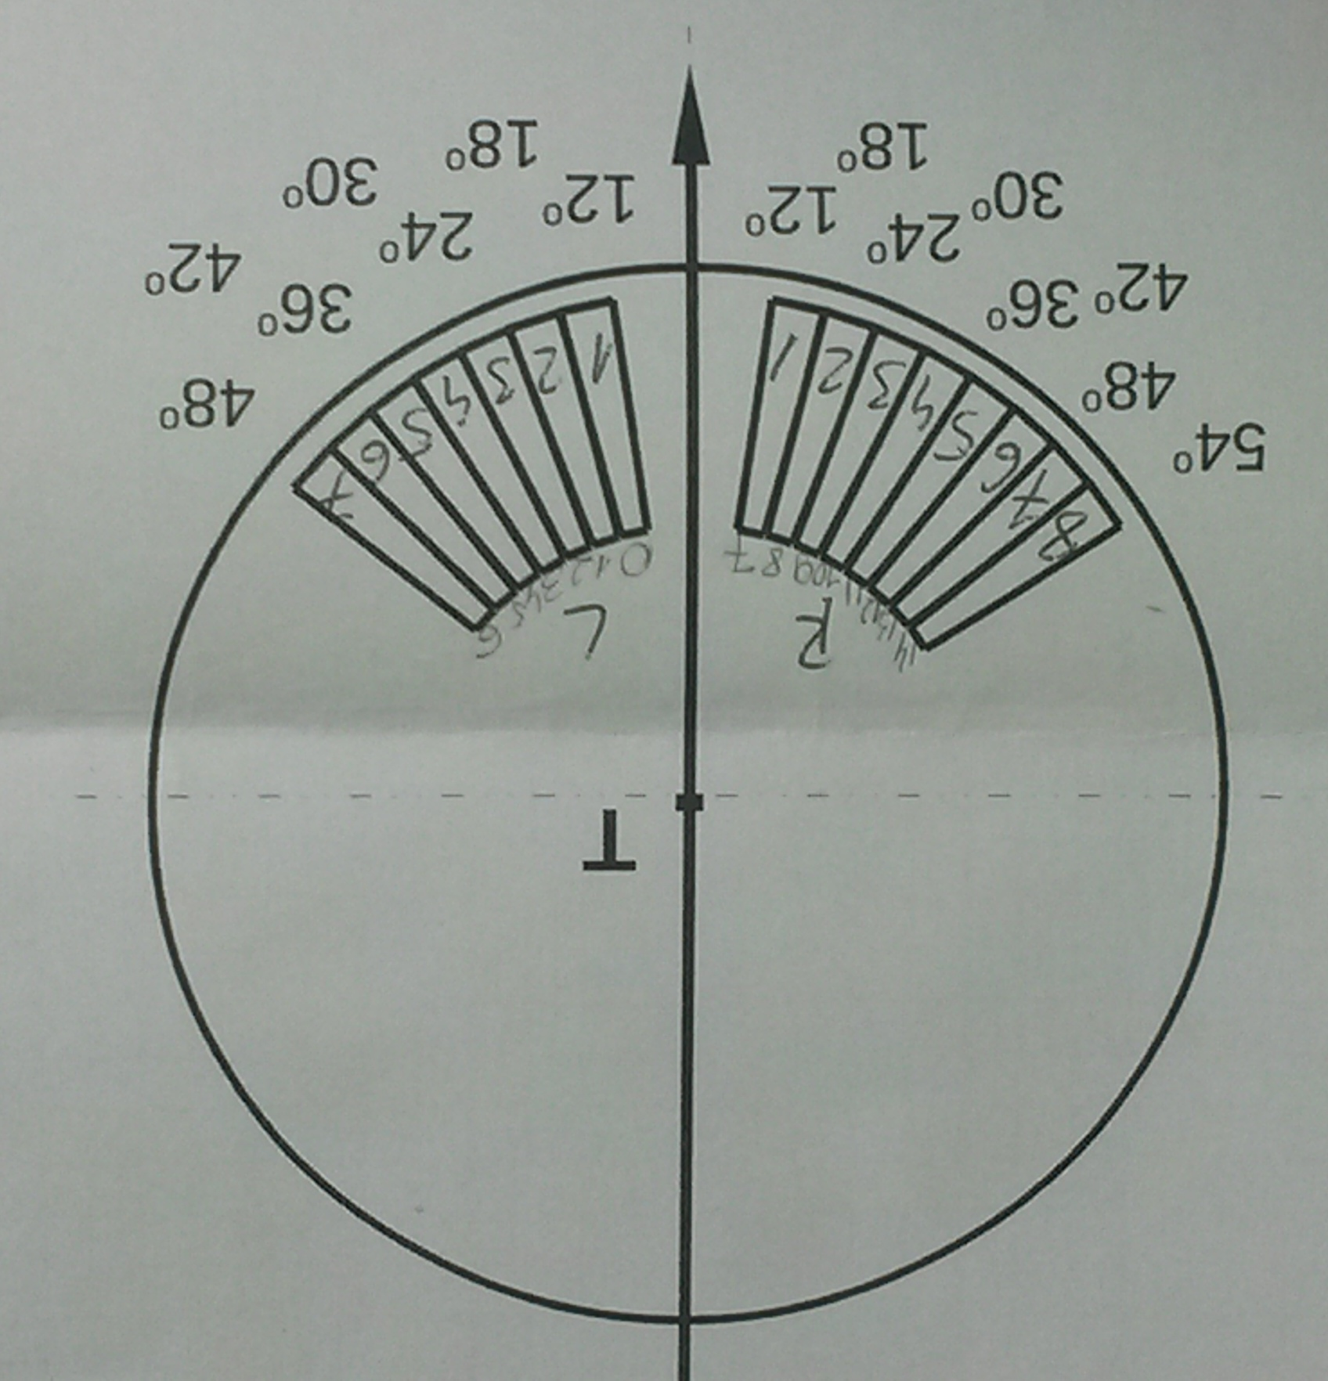
Detection system geometry:
17-3

Slide 3
- Energy calibration was performed for protons
- Number of files analyzed:
with 12C target : 105 (#7062-7167) – about 427 minutes of measurement
with no target @ 0.2: 21 (#7334-7349, 7389-7396)
– about 300 minutes of measurement (signal/bkg=427/300~1.42)
with no target @ 2 nA: 6 (#7043-7048) – about 40 minutes of measurement
17-3

Slide 4
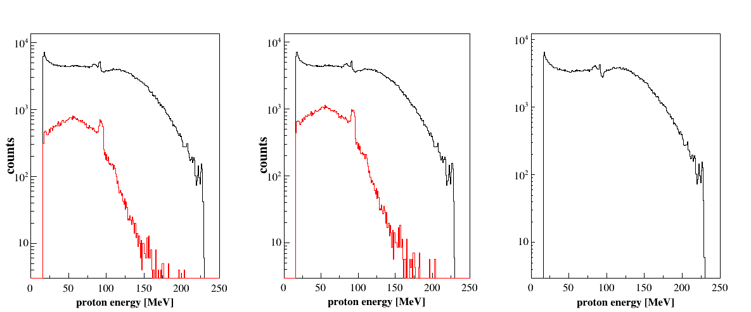
36 deg (Left) - mod 4
signal
background
~ 11.2
after background
subtraction
background scaled
to measurement time: x1.42
background - no target

Slide 5
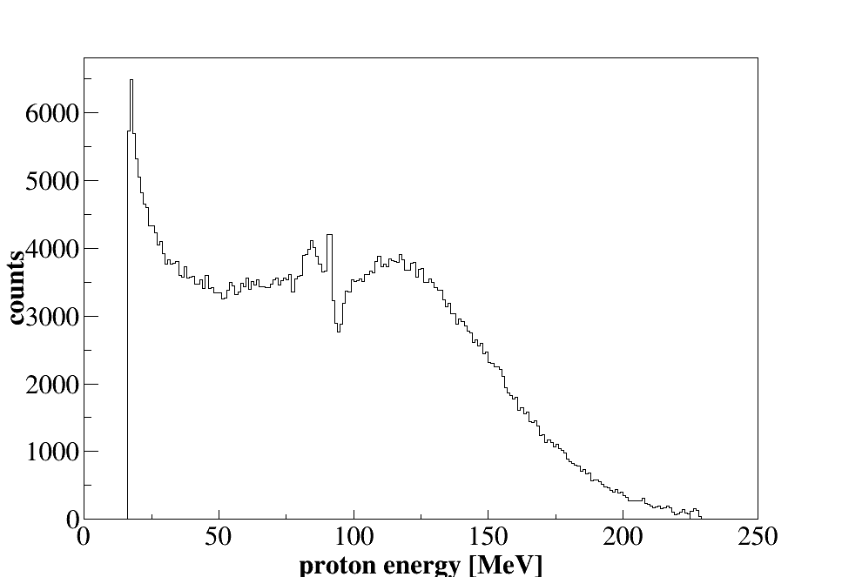
36 deg (Left) - mod 4
final spectrum-
after background
subtraction
17-3

Slide 6
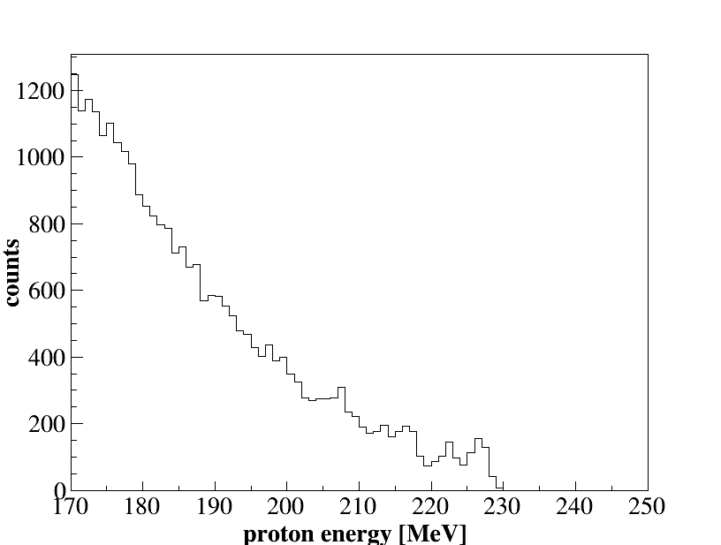
36 deg (Left) - mod 4
final spectrum-
after background
subtraction
17-3

Slide 7
36 deg (Right) mod 11
signal
background
~ 8.4
after background
subtraction
background scaled
to measurement time: x1.42
background - no target
17-3

Slide 8
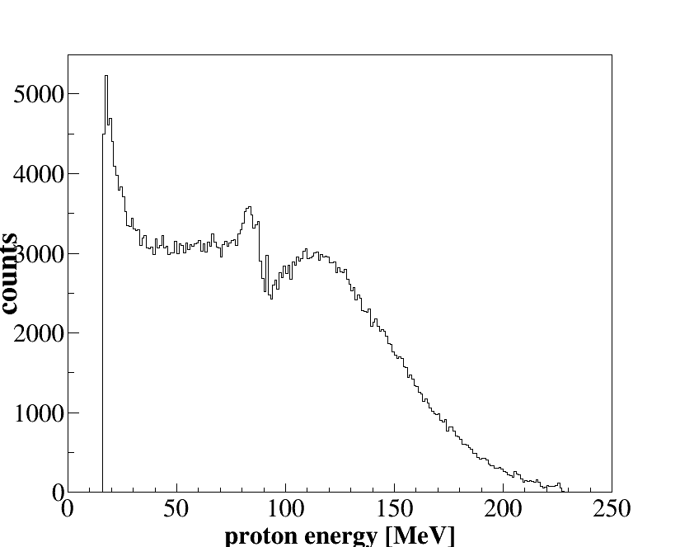
36 deg (Right) mod 11
final spectrum-
after background
subtraction
17-3

Slide 9
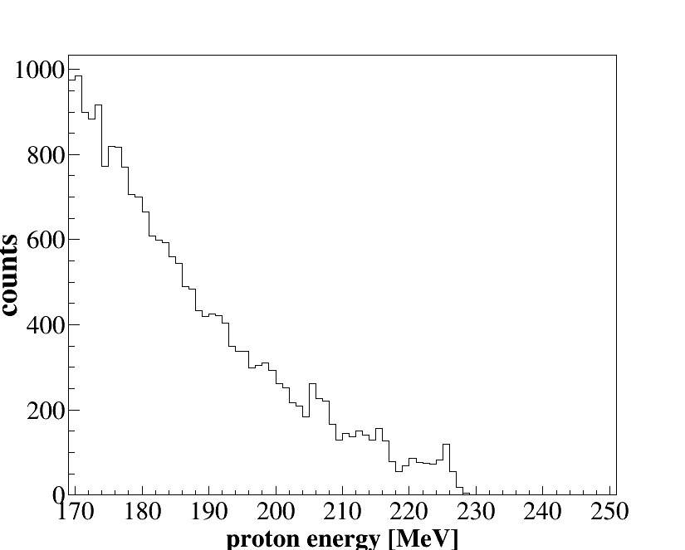
36 deg (Right) mod 11
final spectrum-
after background
subtraction
17-3

Slide 10
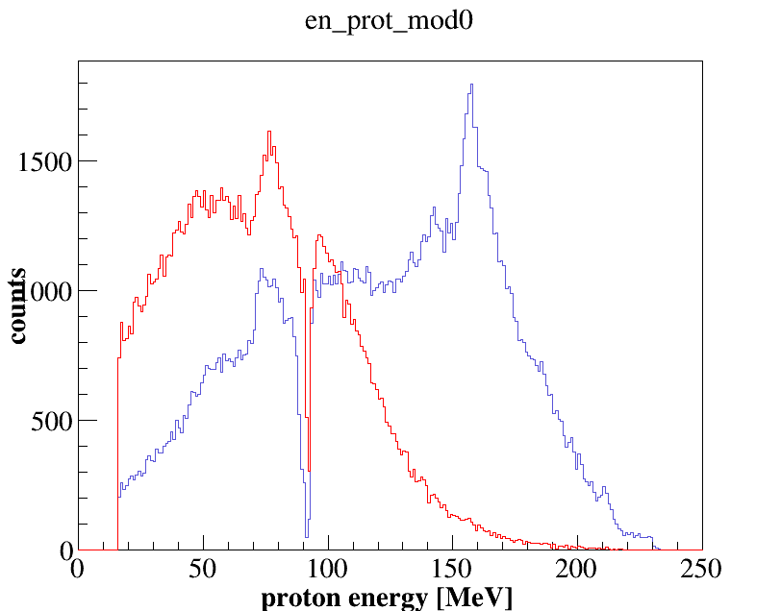
background @ 0.2 nA vs. background @ 2nA
(bkg: #7334-7345 ~40 minutes)
(bkg: #7043-7048 ~40 minutes)
mod 0
12 deg
17-3

Slide 11
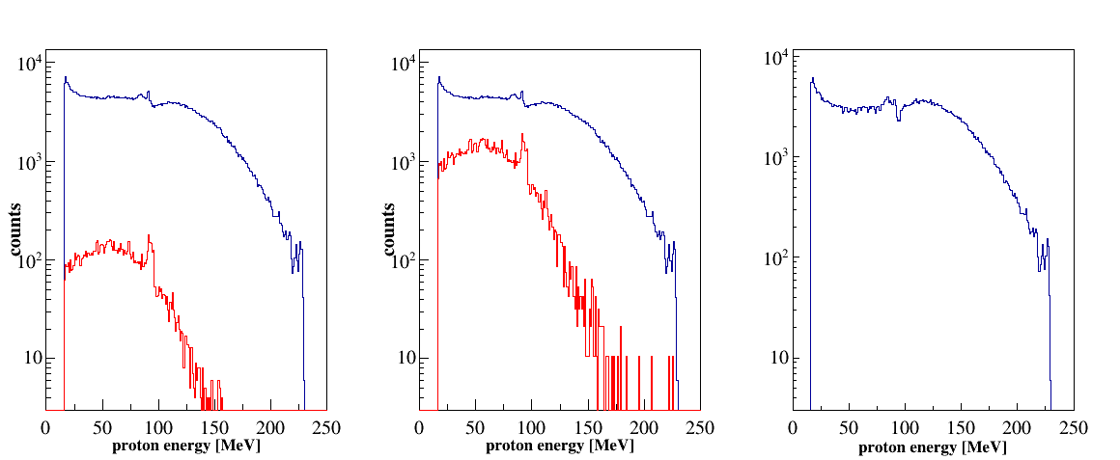
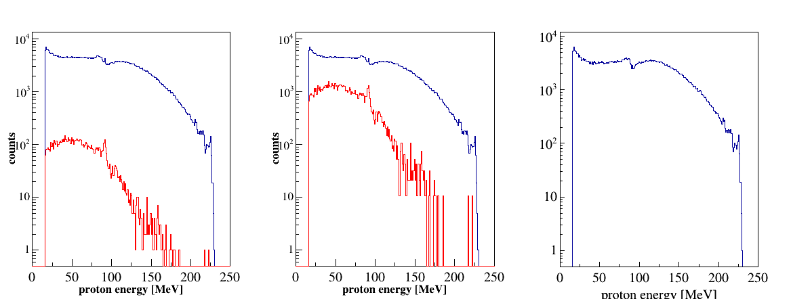
(bkg: #7043-7048 ~40 minutes)
Mod 4
36 deg
Mod 11
36 deg
17-3

Slide 12
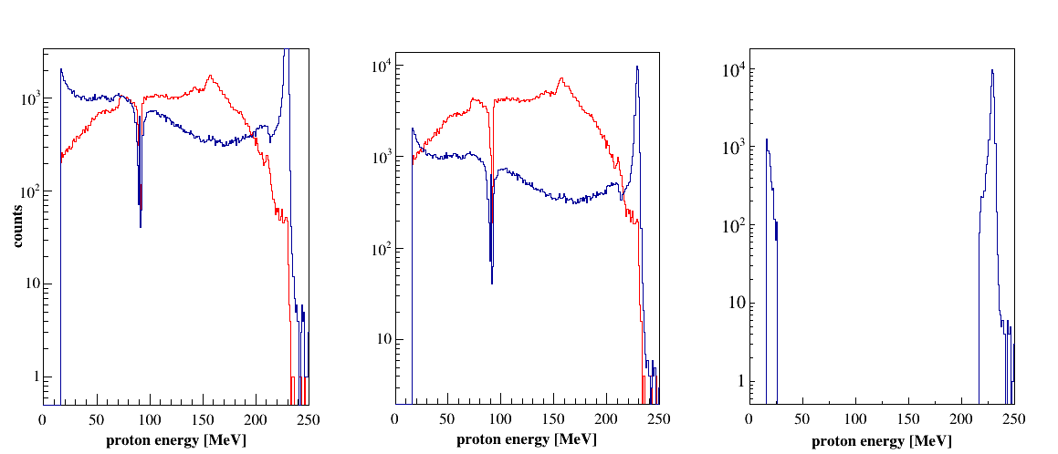
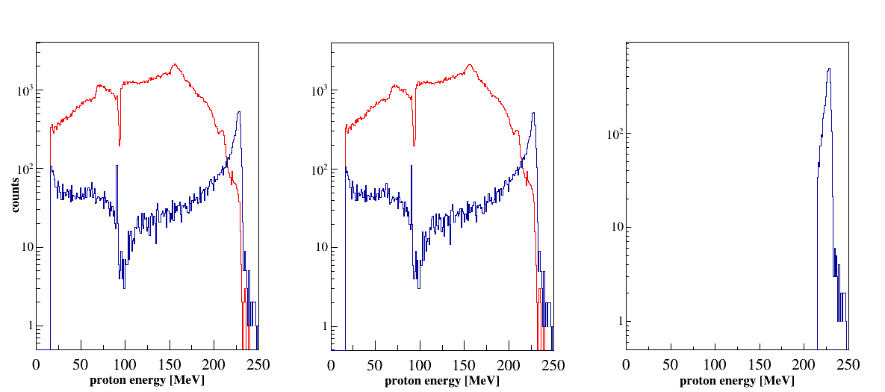
(bkg: #7043-7048 ~40 minutes)
Mod 0
12 deg
Mod 7
12 deg
17-3

Slide 13
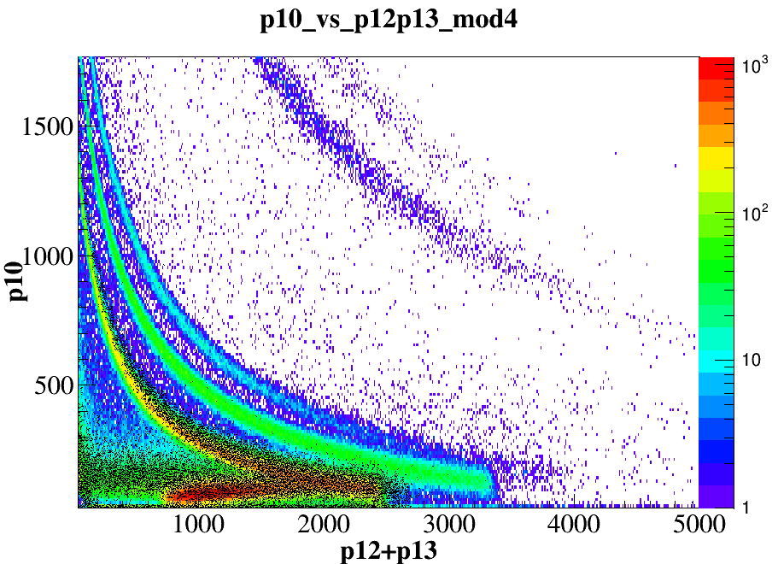
(bkg: #7043-7048 ~40 minutes)
17-3

Slide 14
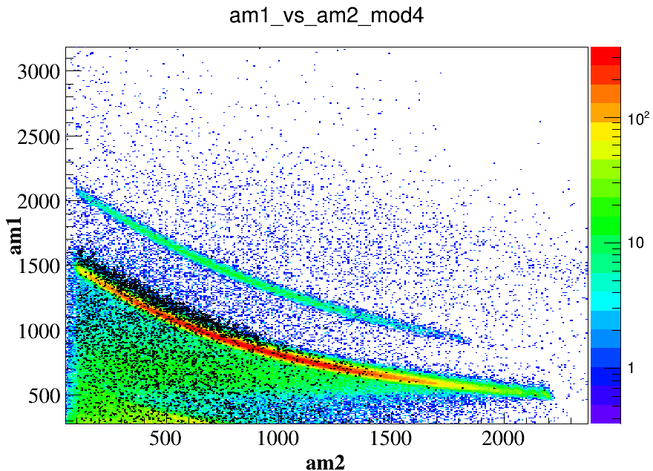
17-3

Slide 15
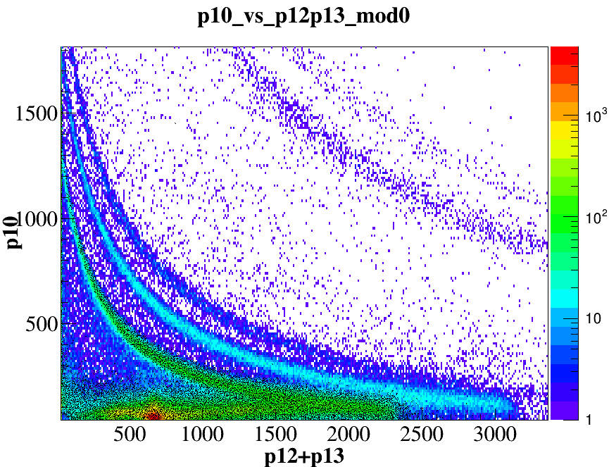
17-3

Slide 16
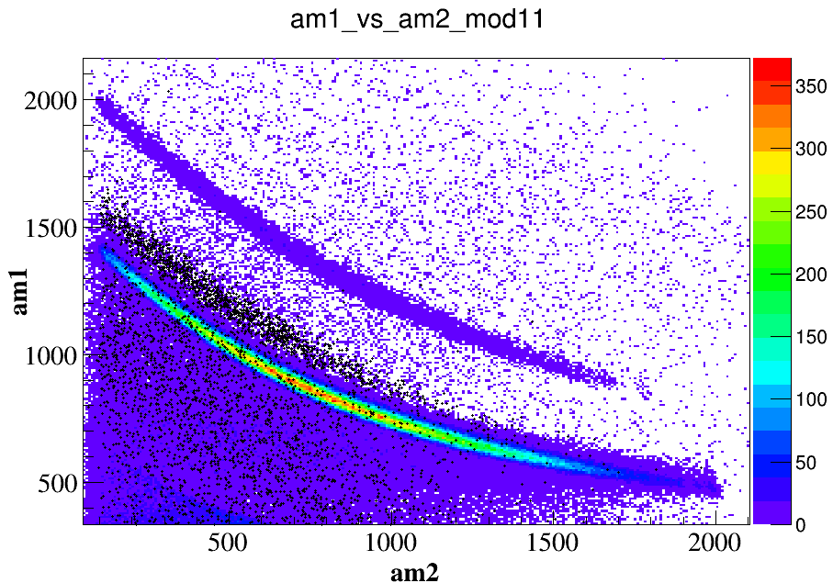
17-3

Slide 17
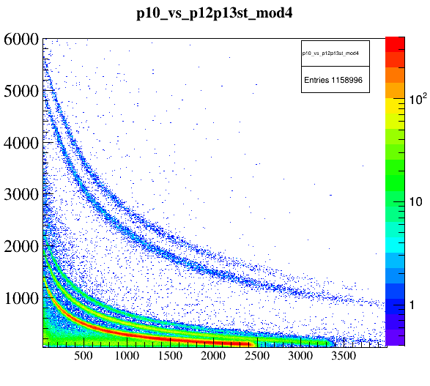
17-3

Slide 18
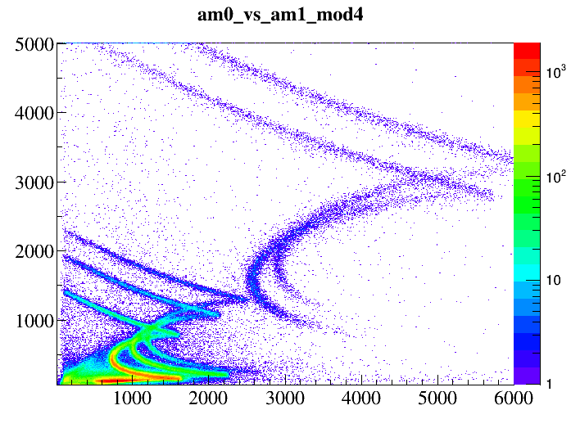
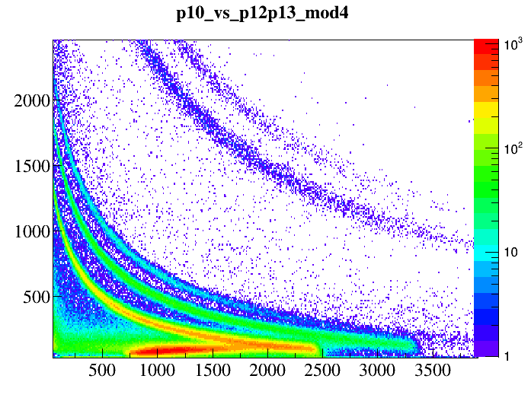
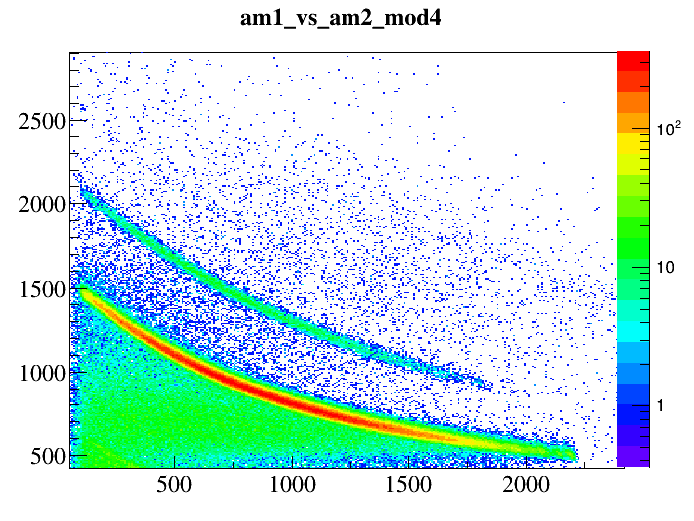
17-3

Slide 19
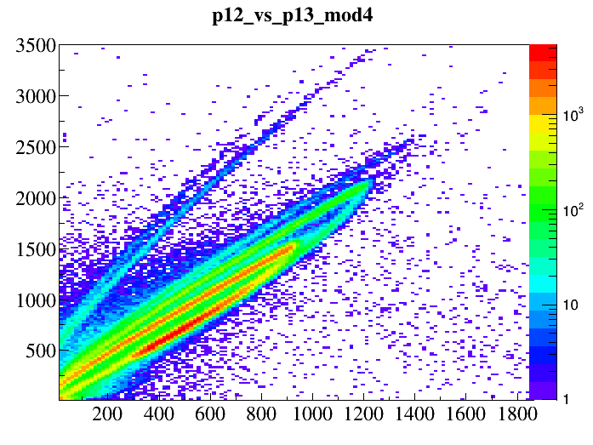
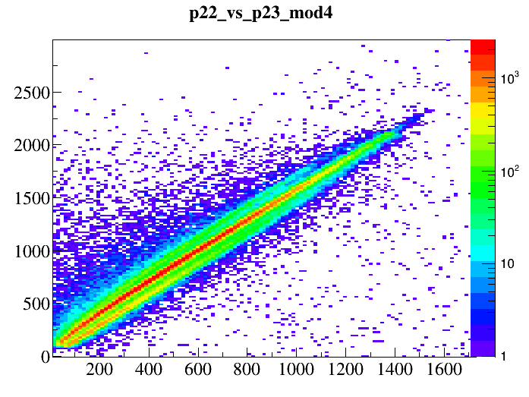
17-3

Slide 20
17-3

