Slide 1
p-12C @ 230 MeV
Izabela Ciepal
07. 08. 2017
17-1

Slide 2
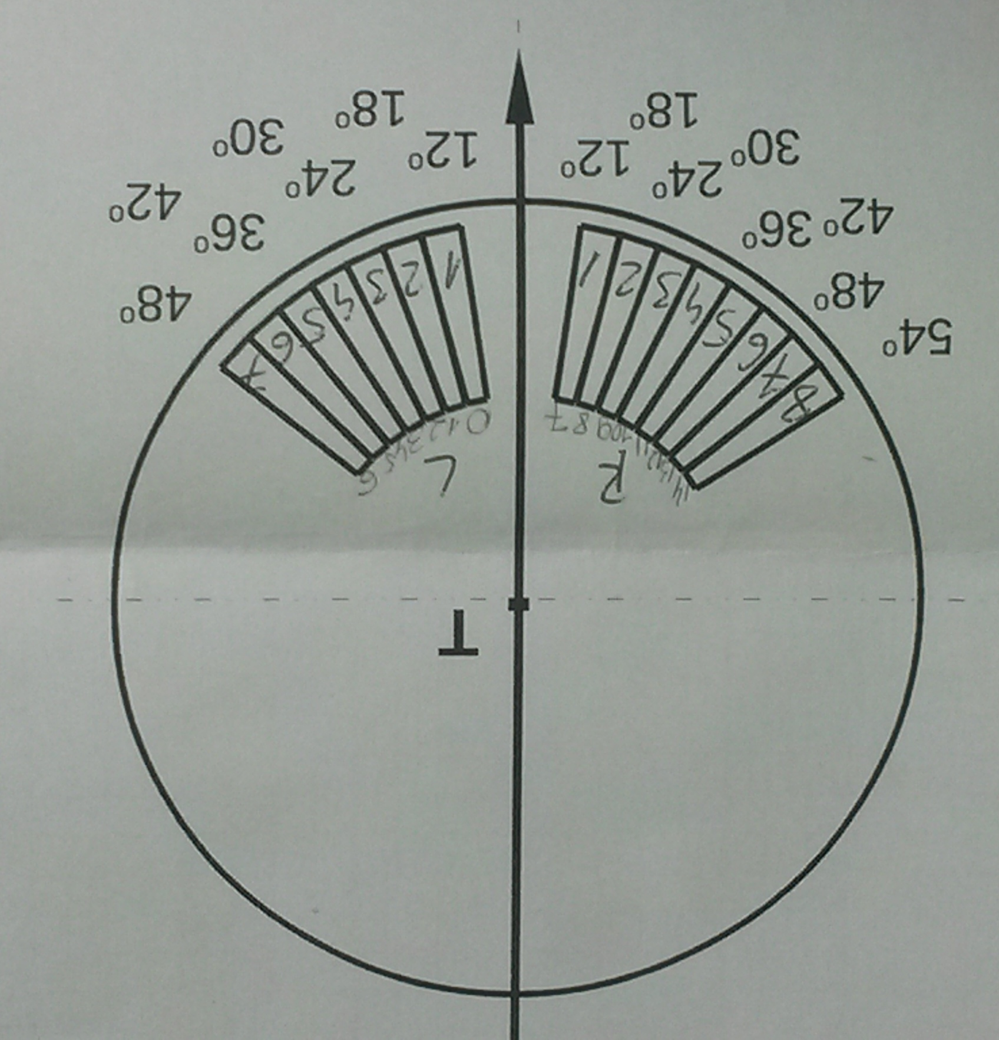
Detection system geometry:
17-3

Slide 3
- Energy calibration was performed for protons
- Number of files analyzed:
with 12C target : 105 (#7062-7167) – about 427 minutes of measurement
with no target: 21 (#7334-7349, 7389-7396)
– about 300 minutes of measurement
scaling factor for background component: 427/300 ~ 1.42
17-3

Slide 4
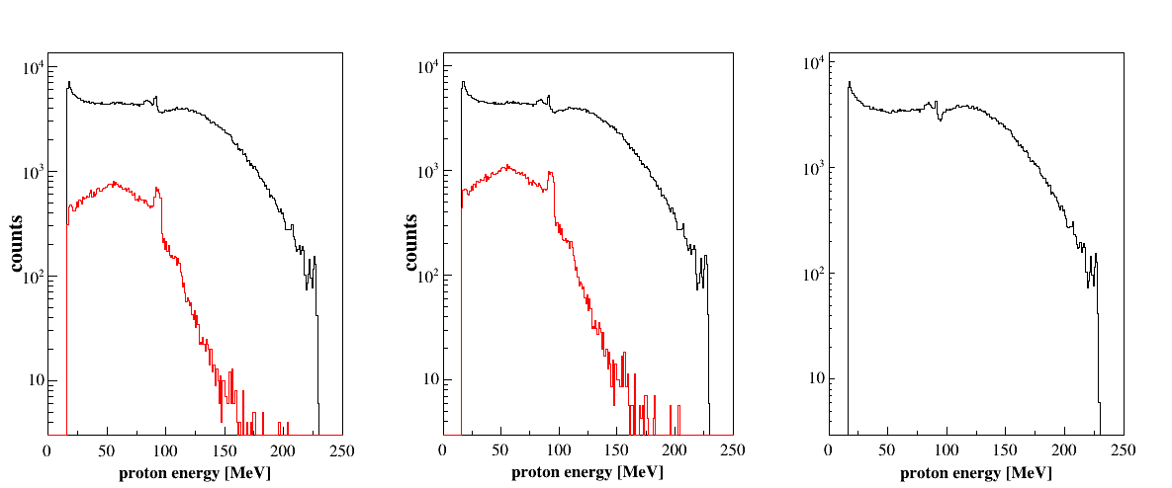
36 deg - Left
signal
background
~ 11.2
after background
subtraction
background scaled
to measurement time: x1.42
background - no target

Slide 5
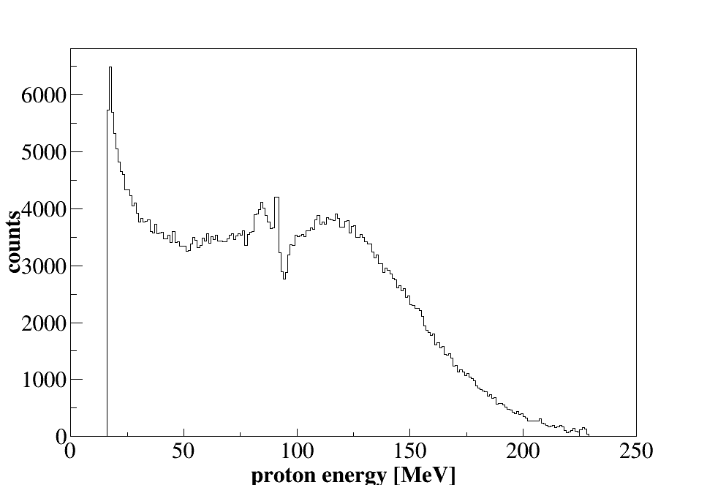
36 deg - Left
final spectrum-
after background
subtraction
17-3

Slide 6
36 deg - Right
signal
background
~ 8.4
after background
subtraction
background scaled
to measurement time: x1.42
background - no target
17-3

Slide 7
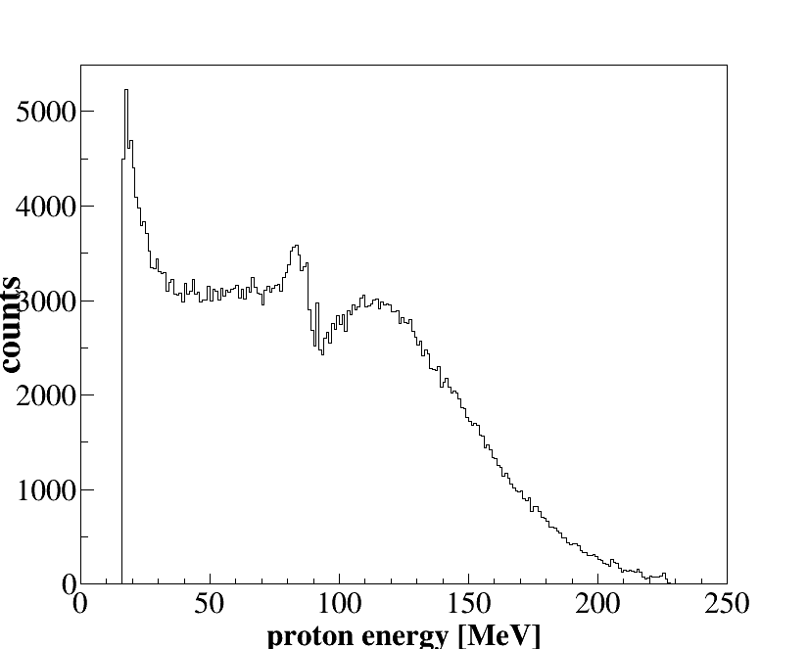
36 deg - Right
final spectrum-
after background
subtraction
17-3

Slide 8
17-3

