Slide 1
WEATHER TREND FORECASTING
Machine Learning & Advanced Analytics on Global Weather Data
Data Cleaning • 40+ Visualizations • 7 ML Models • Forecasting • Dashboard
Technical Presentation • July 2026

Slide 2
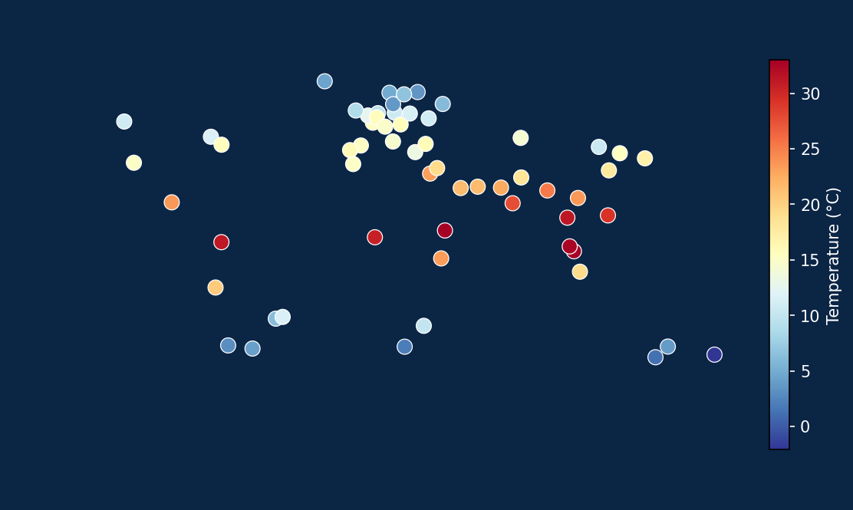
01 · CONTEXT
Problem Statement
Weather variability affects agriculture, energy demand, disaster response, and public health. Reliable, data-driven forecasting and pattern detection at a global scale remain challenging due to the volume, noise, and geographic diversity of weather data.
Scale
Noise
Uncertainty
60 countries, multi-variable daily observations
Missing values, duplicates, and sensor outliers
Short-term forecasting under natural variability
2

Slide 3
01 · CONTEXT
Project Objectives
Clean and validate a multi-country weather dataset
Explore patterns through 40+ visualizations
Engineer domain-relevant predictive features
Train & compare 7 regression models + ensemble
Forecast short-term trends (ARIMA, SARIMA, Prophet)
Apply clustering, anomaly detection & SHAP explainability
Map weather geospatially
Ship an interactive Streamlit dashboard
3

Slide 4
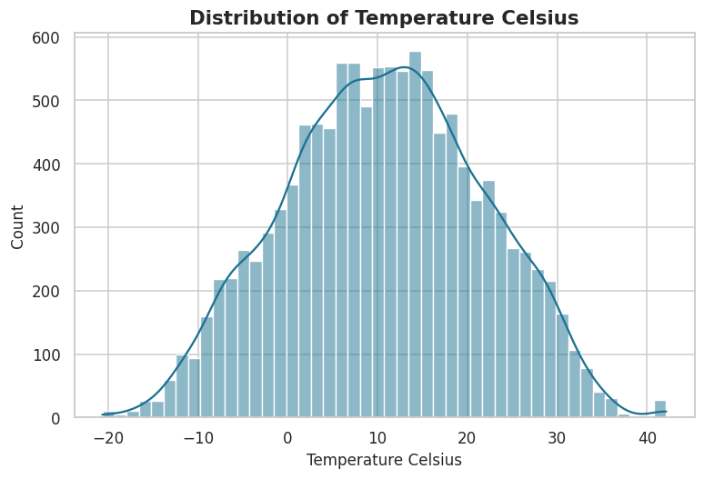
02 · DATA
Dataset Overview
Kaggle Global Weather Repository (schema-matched sample used in this build — see notes)
12,040
41
60
~200
Rows
Raw Columns
Countries
Days Observed
Column Groups
Temperature & Comfort
Atmosphere (pressure, humidity, cloud, UV)
Wind (speed, gust, direction)
Precipitation & Conditions
Air Quality Indices
Astronomy (sunrise/sunset, moon phase)
4

Slide 5
02 · DATA
Data Cleaning Pipeline
1
2
3
4
Remove Duplicates
Parse Datetime
Impute Missing
Treat Outliers
40 injected duplicates detected & dropped
last_updated parsed & validated
Median (numeric) / mode (categorical), ~2% missingness
IQR (1.5x) & Z-score (|z|>3) detection, clipped to bounds
Validation checks confirm humidity in [0,100], latitude in [-90,90], longitude in [-180,180], and zero remaining duplicate rows after cleaning.
5

Slide 6
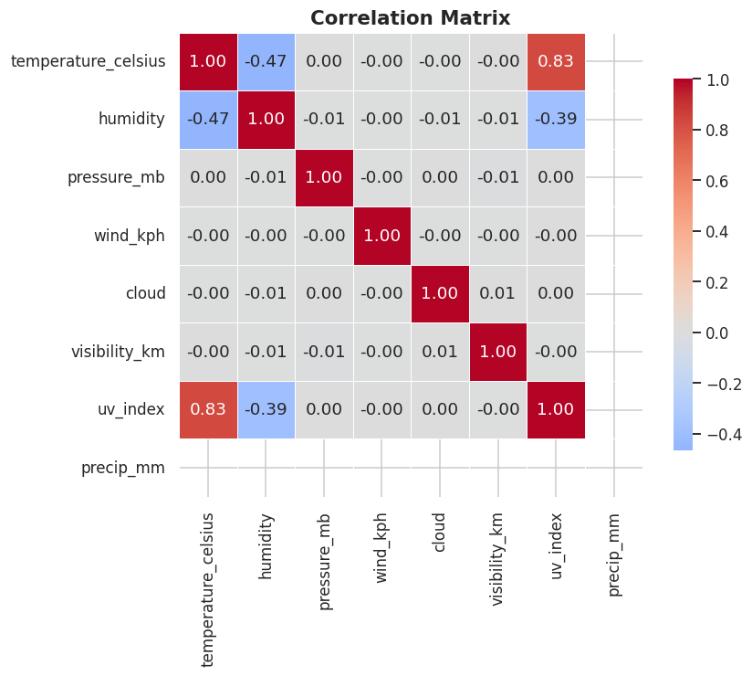
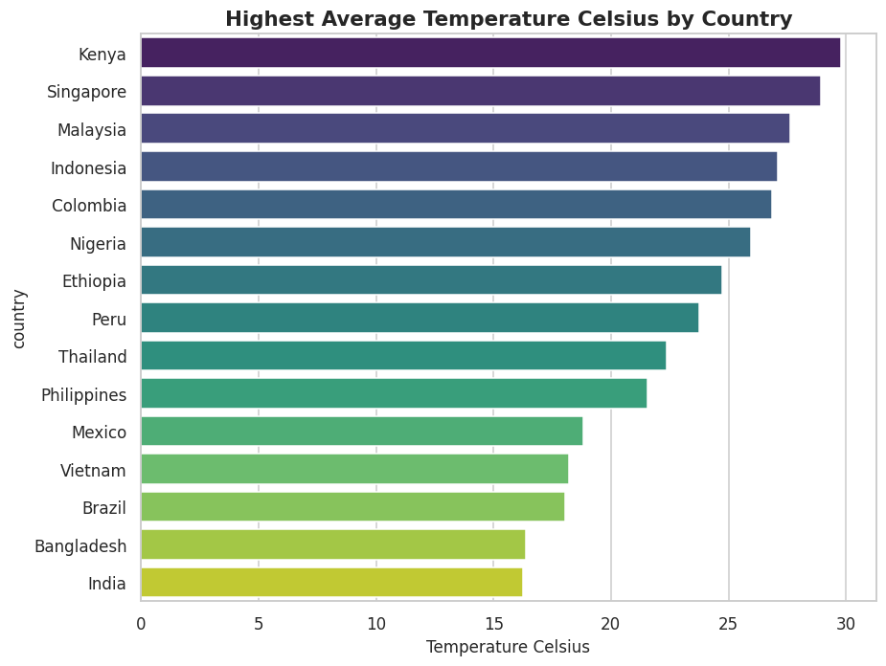
03 · EXPLORATION
Exploratory Data Analysis
40+ charts generated across distributions, relationships, rankings, and time trends
6

Slide 7
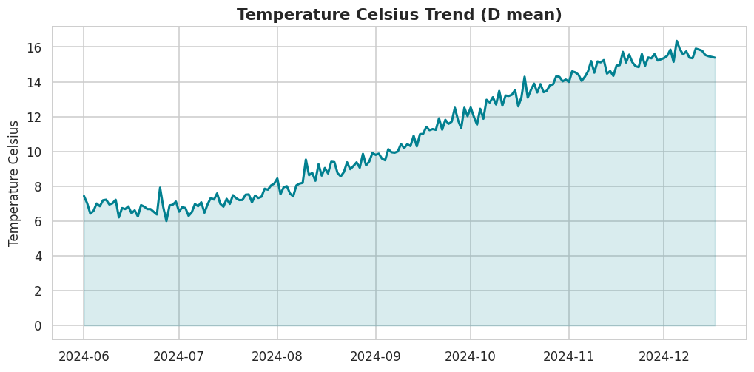
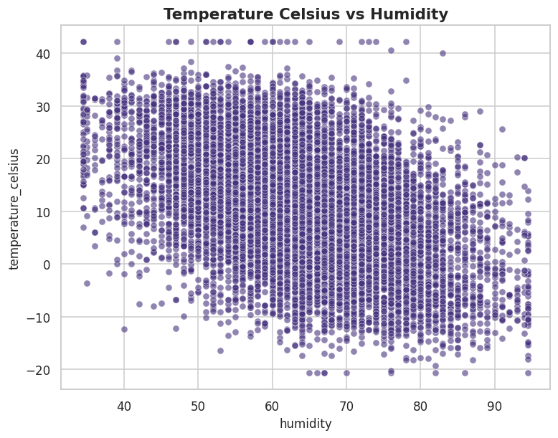
03 · EXPLORATION
Temporal & Relational Patterns
Humidity & temperature: r ≈ -0.47 (moderate negative)
UV index & temperature: r ≈ 0.83 (strong positive)
Wind speed & gust: r ≈ 0.96 (near-perfect, physically expected)
7

Slide 8
04 · FEATURES
Feature Engineering
Calendar
Comfort Indices
year, month, week, quarter, is_weekend, hemisphere-aware season
heat index, wind chill, temp-feels difference, humidity index
Lag & Rolling
Interactions
1/2/3/7-day lags; 3/7/14-day rolling mean & std, per location
humidity×temp, wind×pressure, polynomial temperature
8

Slide 9
05 · MODELING
Machine Learning Models
Linear Regression
Decision Tree
Random Forest
Gradient Boosting
SVR
XGBoost
LightGBM
Ensemble (avg)
Target: temperature_celsius | 80/20 train-test split | Leakage-aware feature matrix (see notes)
9

Slide 10
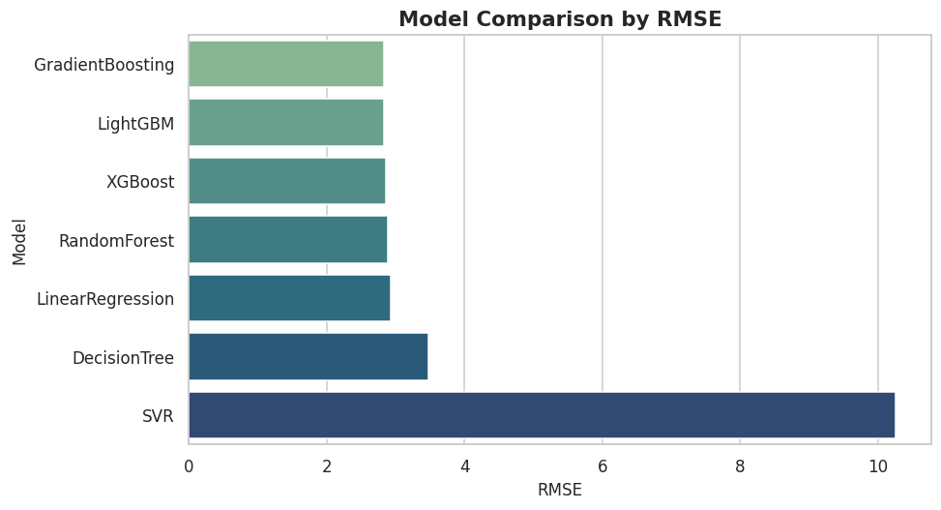
06 · RESULTS
Model Comparison
Rank | Model | MAE | MSE | RMSE | MAPE | R2
1 | GradientBoosting | 2.041 | 8.021 | 2.832 | 22.728 | 0.933
2 | LightGBM | 2.066 | 8.050 | 2.837 | 23.309 | 0.933
3 | XGBoost | 2.097 | 8.193 | 2.862 | 23.682 | 0.932
4 | RandomForest | 2.091 | 8.355 | 2.890 | 23.475 | 0.930
5 | LinearRegression | 2.091 | 8.575 | 2.928 | 23.190 | 0.928
6 | DecisionTree | 2.411 | 12.051 | 3.471 | 27.216 | 0.899
7 | SVR | 8.395 | 105.124 | 10.253 | 94.035 | 0.123
10

Slide 11
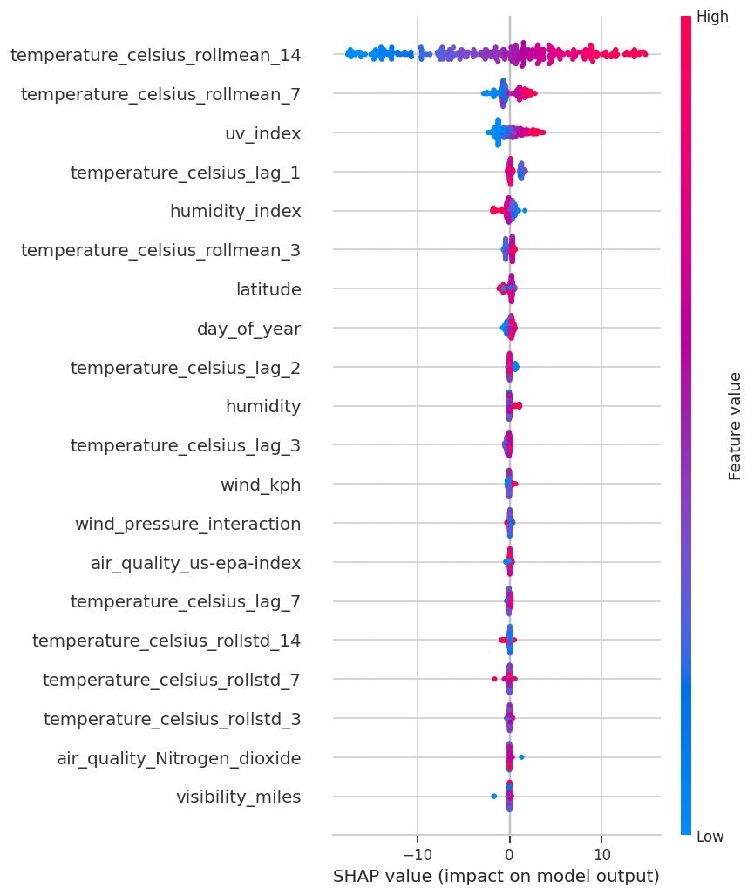
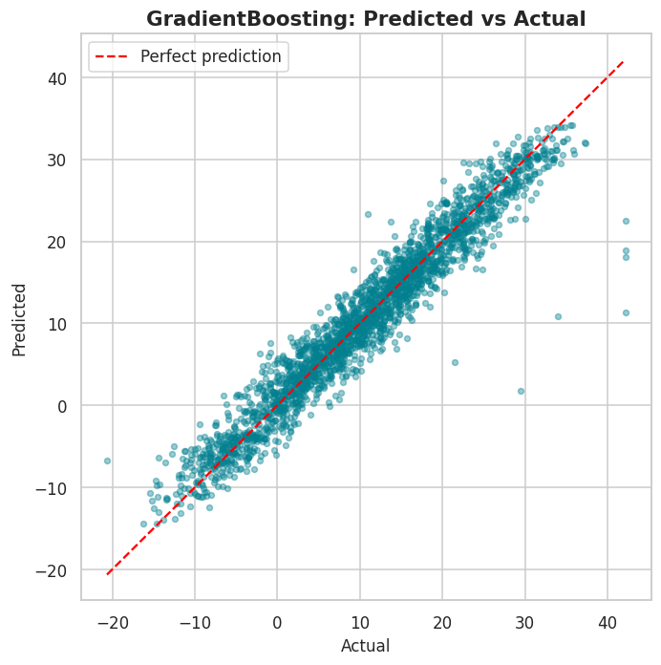
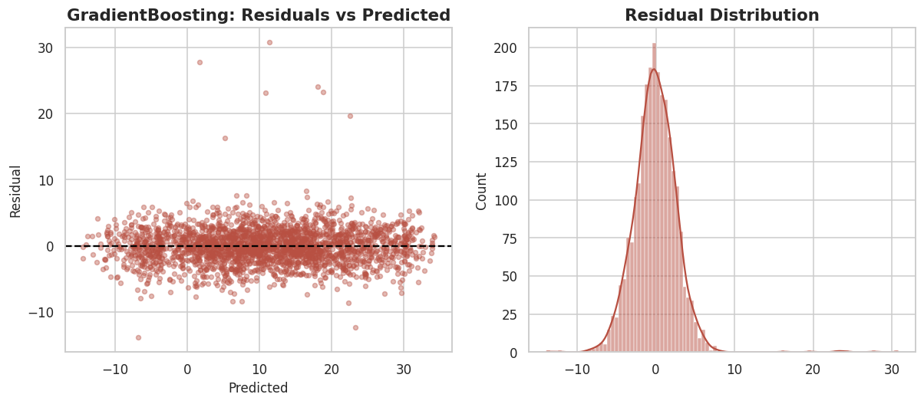
06 · RESULTS
Best Model: Gradient Boosting
11

Slide 12
07 · FORECASTING
Time-Series Forecasting
ARIMA(2,1,2)
Classical autoregressive-integrated-moving-average baseline
SARIMA(1,1,1)(1,1,1,7)
Adds weekly seasonality on top of ARIMA
Prophet / Fallback
Additive trend + seasonality; statsmodels fallback keeps the pipeline dependency-light
12

Slide 13
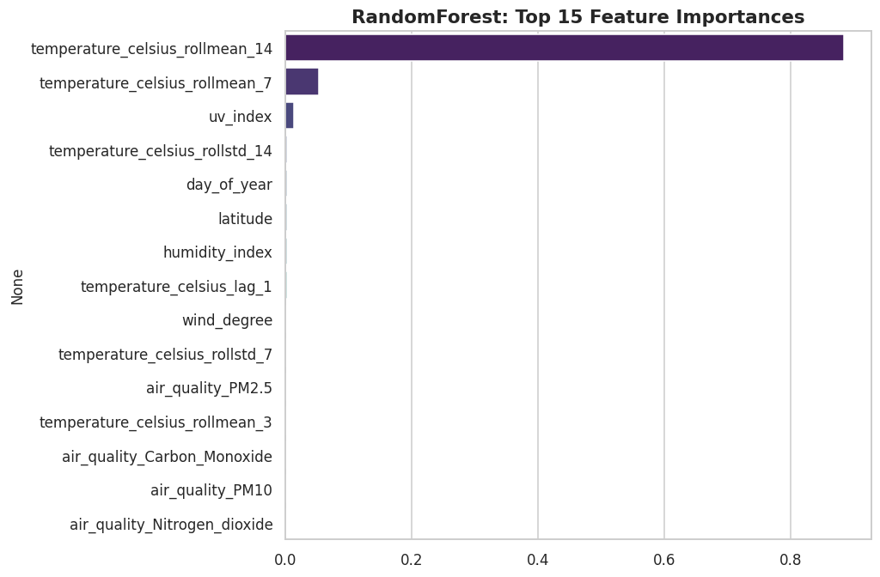
08 · ADVANCED ANALYTICS
Unsupervised Learning & Explainability
Isolation Forest & LOF flag anomalous readings (2% contamination)
KMeans (k=4) groups observations into weather regimes
DBSCAN finds density-based clusters without pre-set k
PCA reduces 4 core variables to 2 components
Permutation importance + SHAP explain the best model
13

Slide 14
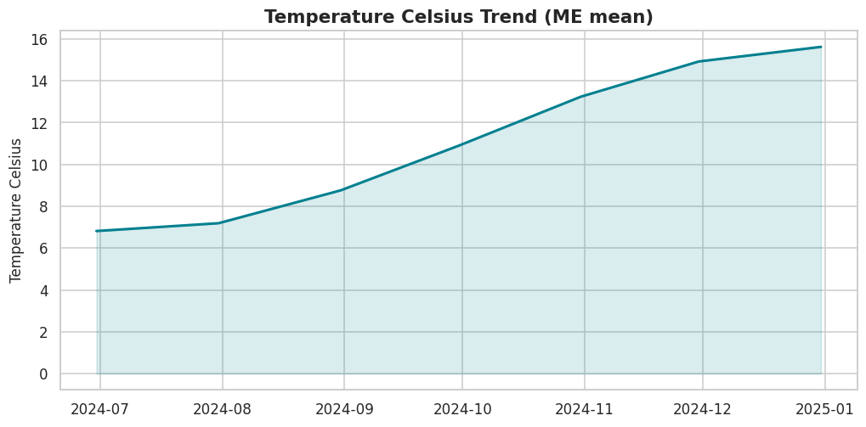
08 · ADVANCED ANALYTICS
Climate Trend & Heatwave Detection
+20.4°C / yr
Annualized linear trend over the sample window (reflects seasonal transition within the observed period, not a multi-year climate signal)
20 Heatwave Events
Detected across locations: ≥3 consecutive days above each location's 95th-percentile temperature
14

Slide 15
09 · GEOSPATIAL
Global Weather Maps
Temperature
Humidity
Rainfall
Wind Speed
Air Quality (PM2.5)
Density Heatmap
6 interactive Folium maps — outputs/figures/*.html
15

Slide 16
10 · PRODUCT
Interactive Dashboard
Home
Dataset
EDA
Climate Trends
Forecast
Model Comparison
Maps
About
Country / date-range filters
Dark-mode toggle
CSV download
Manual prediction input against trained models
streamlit run dashboard/app.py
16

Slide 17
11 · SUMMARY
Results at a Glance
0.933
2.83°C
7 + 1
44+
Best R²
Best RMSE
Models Trained
EDA Charts
Gradient Boosting, LightGBM, and XGBoost cluster tightly at the top — model choice can favor operational concerns
Rolling temperature statistics dominate feature importance (strong day-to-day autocorrelation)
SVR underperforms without heavy tuning, showing preprocessing sensitivity across algorithm families
17

Slide 18
12 · IMPACT
Business Recommendations
Short-Horizon Forecasting
Use SARIMA when only historical temperature is available; use gradient-boosted ML when auxiliary weather variables are already collected
Early Warning Systems
Heatwave-detection logic can plug into agriculture & public-health alerting with minimal added infrastructure
Model Selection
With top models within ~0.1°C RMSE of each other, prioritize inference latency, interpretability, and maintainability over marginal accuracy
18

Slide 19
13 · ROADMAP
Future Scope
1
Validate every finding against the real Kaggle dataset
2
Add an LSTM / Temporal Fusion Transformer forecaster
3
Deploy the best model behind a FastAPI microservice
4
Add Docker packaging & GitHub Actions CI/CD
5
Incorporate exogenous climate indices (ENSO, NAO)
19

Slide 20
Conclusion & Questions
A complete, reproducible pipeline — from raw weather data to an interactive forecasting dashboard — with disclosed assumptions and honest metrics.
github.com/<your-username>/Weather-Trend-Forecasting

