Slide 1


Summer Training Project Presentation
on
Skin Saathi
Under Supervision of
Dr. Vijay Kumar Dwivedi
Project Oriented Machine Learning
Kritika Chaurasia
Mahima Tripathi
2300100100209
2300100100218

Slide 2
Outline
Introduction
Objective
Data Flow Diagram
Future Scope
Conclusion
References

Slide 3
Introduction
Skin is the largest organ of the human body and serves as a vital barrier between the internal systems and the external environment. Understanding skin type is essential for maintaining skin health, preventing dermatological issues, and selecting appropriate skincare products.
With the advancement of artificial intelligence and data science, machine learning (ML) has emerged as a powerful tool for automating complex classification tasks. ML algorithms can learn patterns from data and make accurate predictions, offering a more objective and scalable approach to skin type analysis., oil secretion, sensitivity, pore size, and pigmentation levels.
This project demonstrates how machine learning can revolutionize dermatological diagnostics and skincare personalization. It lays the groundwork for future enhancements, including image-based analysis using deep learning and integration into mobile applications for real-time skin assessment.

Slide 4
Objectives
The primary objective of this project is to build and evaluate various supervised learning models that can accurately predict skin type categories: oily, dry, combination, sensitive, and normal.
Activities involved:
Automate skin type classification
Analyze structured skin data
Implement and compare multiple ML algorithms.
Apply data preprocessing techniques.

Slide 5
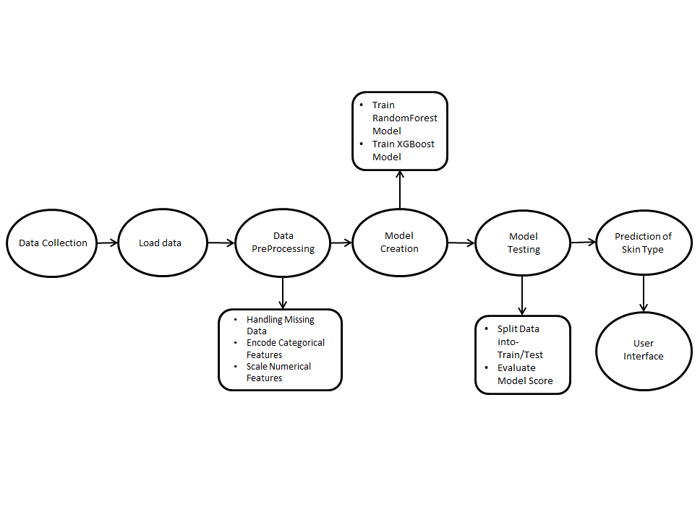
Data Flow Diagram

Slide 6
Future Work
1.Personalized SkinCare Recommendations.
2. Dermatological Diagnostics.
3. Predictive Modeling for Skin Aging.
4. Image-Based Skin Type Classification.
5.Intergration with Wearables and IOT.

Slide 7
Conclusion
Our project SkinSaathi successfully applies machine learning to classify skin types and deliver personalized skincare suggestions. The Python-based system is accurate, scalable, and user-friendly, making skin analysis more accessible.

Slide 8
References
Python Documentation: https://docs.python.org/3/
Tkinter Documentation: https://docs.python.org/3/library/tkinter
Scikit-learn Documentation
kaggle:https: //www.kaggle.com

Slide 9
Thank You

