Slide 1
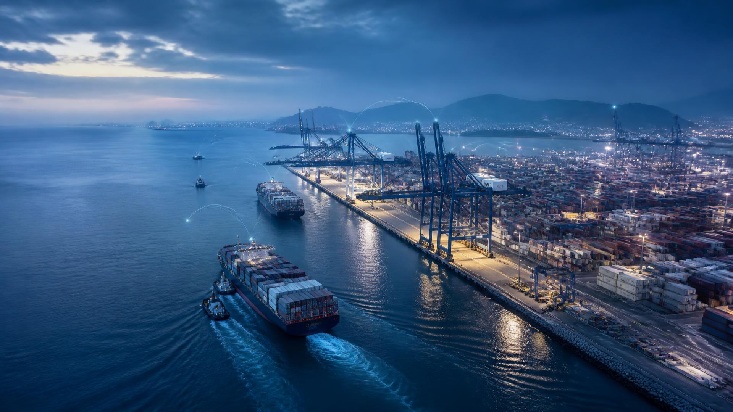
PortsPilot AI
Predict the bottleneck before the world feels it.
AI-powered decision intelligence for smarter maritime and port operations
SMART PORT OPERATIONS / DECISION SUPPORT

Slide 2
THE OPERATIONAL CHALLENGE
02
Ports don’t fail suddenly. Bottlenecks build quietly.
VESSEL
SURGE
BERTH
PRESSURE
CRANE
SHORTAGE
YARD
PRESSURE
WAITING
TIME
PORT
DISRUPTION
Uncertain arrivals • limited berth capacity • variable crane availability • yard congestion
The real problem is not detecting congestion.
It is preventing it before it spreads.
PortsPilot AI

Slide 3
THE SOLUTION
03
From monitoring to decision-making
PREDICT
EXPLAIN
OPTIMISE
SIMULATE
PLAN
ACT
Forecast congestion
and expose causes
Stress-test failures
and recovery
Generate an actionable
72-hour plan
Improve berth &
crane allocation
ADVISORY INTELLIGENCE — HUMAN OPERATORS REMAIN IN CONTROL
PortsPilot AI

Slide 4
PLATFORM ARCHITECTURE
04
Inside the Port Digital Twin
DATA SOURCES
Vessels • Berths • Cranes • Yard • Routes • Alerts • Events
VALIDATE + TRANSFORM
Quality checks • Normalisation • Operational event model
PORT DIGITAL TWIN
One continuously updated operational state
INTELLIGENCE ENGINES
ML Prediction • OR-Tools • Simulation • 72h Planning • Routes • Gemini
DECISION LAYER
Prioritise • Compare • Recommend • Explain • Approve
OPERATIONS DASHBOARD
Command Center • Planner • Alerts • Copilot
PortsPilot AI

Slide 5
COMMAND CENTER
05
What needs attention now?
See the port before the bottleneck arrives
CONGESTION RISK
VESSEL QUEUE
CRANES AVAILABLE
CRITICAL ALERT
HIGH
07
12 / 15
B04 capacity threshold
within 12 hours
B04 projected 94%
+3 in next 12h
C03 maintenance risk
LIVE PORT STATE
RECOMMENDED NEXT ACTION
Review B04 allocation
Berths B01—B06
Vessel queues, berth utilisation and crane availability share one operational view. Forecast overlays surface the next constraint—not just the current state.
Ocean Star can shift to B02; add one crane to reduce expected wait.
CONFIDENCE 86%
PortsPilot AI

Slide 6
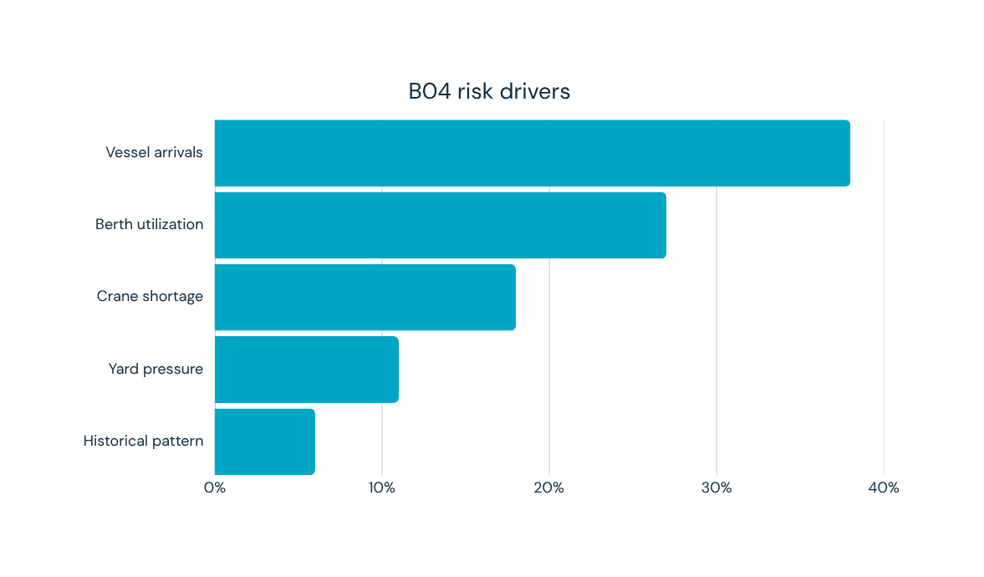
ML CONGESTION PREDICTION
06
Predict congestion before it becomes disruption
BERTH B04 / 24H FORECAST
82%
94%
CURRENT UTILISATION
PREDICTED UTILISATION
7 vessels
11.4 hours
ACTIVE QUEUE
AVERAGE WAIT
6h 12h 24h 48h 72h
PortsPilot AI

Slide 7
EXPLAINABLE DECISION INTELLIGENCE
07
Prediction is useful. Understanding it is better.
ML
OR-TOOLS
SIMULATION
GEMINI
Predicts congestion
Optimises operations
Calculates scenarios
Explains & compares
Arrivals • utilisation • queue
Berths • cranes • constraints
Failure • impact • recovery
Grounded operational context
B04 RISK / 86
Driven by vessel arrivals, berth utilisation, crane availability and yard pressure.
Gemini explains the evidence. It does not predict or optimise.
PortsPilot AI

Slide 8
OR-TOOLS OPERATIONS OPTIMISER
08
Turn prediction into operational decisions
BEFORE
AFTER / RECOMMENDED
OCEAN STAR
OCEAN STAR
BERTH B04
BERTH B02
CRANES 3 cranes
CRANES 4 cranes
11.4h avg wait
6.8h avg wait
Constraint-aware suggestion — operator approval required
PortsPilot AI

Slide 9
WHAT-IF SIMULATION
09
What happens if something breaks?
BASELINE
FAILURE
IMPACT
RECOVERY
7 vessels
C03 offline
11 vessels
Move C05
11.4h wait
8 hours
17.8h wait
Ocean Star → B02
82% B04
capacity lost
94% B04
12.1h wait
RECOVERY ACTIONS / Move C05 to B04 • Reassign Ocean Star • Delay low-priority vessel
PortsPilot AI

Slide 10
72-HOUR PLANNER
10
Don’t just react. Plan the next 72 hours.
06–14
14–22
22–06
06–14
14–22
22–06
BERTH B04
OCEAN STAR
CRANE C05
SHIFT TEAM B
RECOVERY
Conflicts surface in context. Approved decisions become time-structured schedules across berths, vessels, cranes and shifts.
PortsPilot AI

Slide 11
ROUTE INTELLIGENCE
11
When one port slows down, should the vessel wait?
PORT A
PORT B / RECOMMENDED
PORT C
31h
18h
23h
$100k cost
$110k cost
$96k cost
CRITICAL RISK
MEDIUM RISK
HIGH RISK
Port B costs slightly more—but removes 13 hours of delay. The platform compares; the operator decides.
PortsPilot AI

Slide 12
GEMINI AI COPILOT
12
Ask the port what is happening
OPERATIONS
CONTEXT
GROUNDED OPERATIONAL COPILOT
Why is B04 at risk?
STRUCTURED
DATA
B04 is projected at 94% utilisation. The largest drivers are incoming vessel arrivals (38%) and current berth utilisation (27%).
GEMINI
What changed after the recovery plan?
GROUNDED
RESPONSE
Average wait returns from 17.8h to 12.1h after C05 coverage and the Ocean Star reassignment. If data is unavailable, I will say so.
TEXT • METRICS
TABLES • ACTIONS
PortsPilot AI

Slide 13
SHIP AGENT PORTAL
13
Port intelligence doesn’t stop at the port gate
SHIP AGENT
AGENT WORKSPACE
Vessels & berth requests
VESSEL / ETA /
BERTH REQUEST
Add vessels and cargo details
Update ETA and schedules
Submit berth requests
Receive vessel-specific alerts
Ask operational questions
PORT OPERATIONS
PREDICT +
OPTIMISE
ACCESS BOUNDARY
UPDATED DECISION
No crane reassignment • no other-company data
SHIP AGENT
PortsPilot AI

Slide 14
IMPLEMENTED ARCHITECTURE
14
Built as a real operational system
REACT FRONTEND
TypeScript • Vite • Tailwind • shadcn/ui • Recharts • Lucide
FASTAPI BACKEND
Python • Pydantic • SQLAlchemy
OPERATIONAL SERVICES
Vessels • Berths • Cranes • Planning • Routes
INTELLIGENCE
scikit-learn • OR-Tools • Simulation • Pandas • NumPy
DATA + AI LAYER
SQLite • Google Gemini API
PortsPilot AI

Slide 15
END-TO-END DEMO
15
From first signal to final decision
1 NORMAL OPERATIONS
6 OPERATOR APPLIES PLAN
2 VESSEL SURGE
7 CRANE FAILURE SIMULATED
3 B04 RISK DETECTED
8 RECOVERY GENERATED
4 ML EXPLAINS DRIVERS
9 72-HOUR PLAN UPDATED
5 OR-TOOLS RECOMMENDS
10 GEMINI EXPLAINS
One operational state. Multiple intelligence layers. One informed decision.
PortsPilot AI

Slide 16
IMPACT + FUTURE POSSIBILITIES
16
Building ports that adapt before disruption arrives
IMPACT TODAY
FUTURE POSSIBILITIES
Earlier intervention.
Better decisions.
Expand the digital twin
More real-time maritime data
Weather and external events
Larger-scale optimisation
Advanced predictive models
Multi-port coordination
Deeper automation—with human approval
PORT OPERATORS / operational foresight
SHIPPING COMPANIES / fewer delays
TERMINAL OPS / improved utilisation
PORT MANAGEMENT / resilient planning
PortsPilot AI

Slide 17
SEE THE BOTTLENECK
BEFORE IT HAPPENS.
Change the plan. Prevent the disruption.
PortsPilot AI

