Slide 1




SAI VIDYA INSTITUTE OF TECHNOLOGY
RAJANUKUNTE, BENGALURU - 560064
DEPARTMENT OF COMPUTER SCIENCE AND ENGINEERING
Final year Major Project Phase-II Stage-1
Presentation On
“Explainable AI-Driven Intrusion Detection for Cloud Security: A Hybrid LSTM-Based Approach”
Presented By
Bhuvan M 1VA22CS022
Krishnakant Bhushan 1VA22CS053
Manoj L Bhat 1VA22CS070
Thrisha N S 1VA22CS119
Under the guidance of
Guide: Dr. Vinod Desai
Assoc Prof.
Dept. of CSE
Co-Guide: Ramanjinamma G
Asst Prof.
Dept. of CSE

Slide 2
PRESENTATION OUTLINE
Overview of project
Proposed System
Problem statement and Objectives
Design
Methodology
Progress of Implementation
Conclusion
References

Slide 3
OVERVIEW
The project introduces an advanced Intrusion Detection System for cloud security, where sensitive data and applications are at constant risk from cyber-attacks. By combining Conv1D and BiLSTM deep learning models, the system learns both spatial and temporal patterns in network traffic, enabling accurate detection of malicious activities. To overcome the lack of transparency in traditional IDS, Explainable AI (SHAP) is integrated, ensuring that predictions are supported by clear reasoning and feature importance. The approach enhances detection performance, improves interpretability, and ensures scalability for real-world cloud deployment.

Slide 4
PROPOSED SYSTEM
The proposed system is built around a hybrid deep learning model combining Conv1D and BiLSTM layers, which enables the effective learning of both spatial and temporal patterns in network traffic data. Before feeding data into the model, a robust preprocessing pipeline cleans and prepares the raw network traffic, ensuring high-quality input for accurate predictions. To make the system’s decisions interpretable, Explainable AI techniques, specifically SHAP, are integrated to highlight the most important features contributing to each detection. The overall design is scalable, allowing seamless deployment in cloud environments to provide real-time intrusion detection with reliable and explainable results.

Slide 5
PROBLEM STATEMENT
Existing cloud security systems struggle to effectively detect increasingly sophisticated cyber threats, largely due to the lack of transparency and interpretability in traditional ML-based intrusion detection systems. To address this challenge, develop an explainable AI-driven intrusion detection system for cloud security, leveraging a hybrid LSTM-based deep learning approach that not only accurately identifies potential threats but also provides clear explanations for its detection decisions.

Slide 6
OBJECTIVES
To Detect AI-driven cyber threats
To Enable real-time anomaly detection
To Incorporate Explainable AI (XAI) techniques
Enhancement in detection accuracy and Minimizing false positives

Slide 7
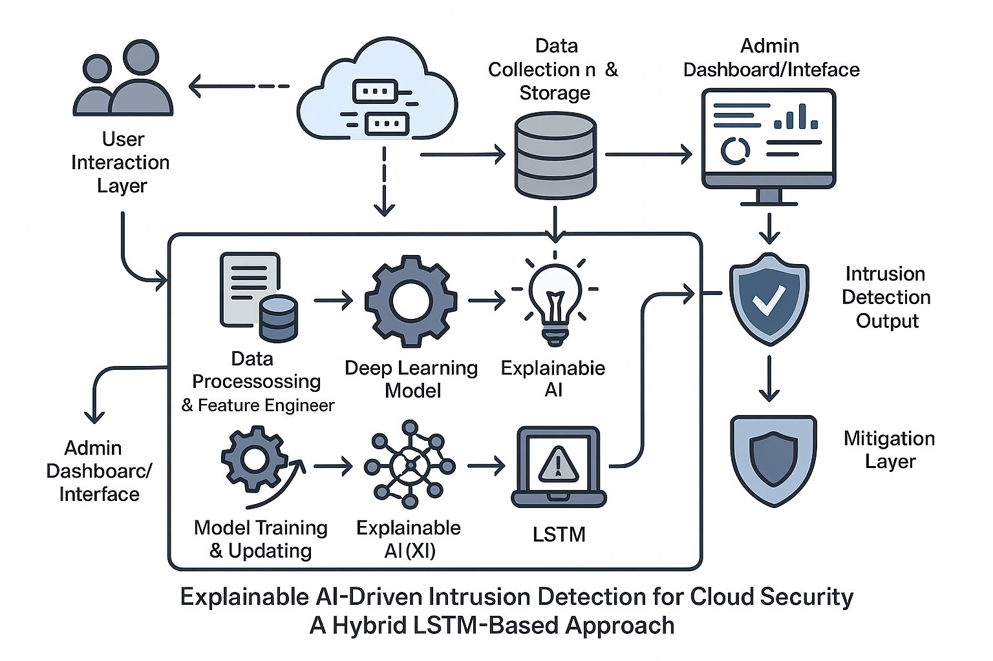
DESIGN

Slide 8
METHODOLOGY
Step 1: Dataset Collection
The first step involves gathering diverse network traffic datasets including NSL-KDD, CIC-IDS, and BoT-IoT. These datasets contain both normal and malicious traffic, providing a rich source of data for training the intrusion detection system.
Step 2: Data Preprocessing
Raw data is often noisy, inconsistent, or contains non-numeric values. Preprocessing includes cleaning, scaling, and encoding the data to ensure it is in a suitable format for deep learning models and improves the reliability of the training process.
Step 3: Hybrid Model Training
A hybrid deep learning model combining Conv1D and BiLSTM layers is trained on the preprocessed data. Conv1D layers capture spatial patterns in network features, while BiLSTM layers model temporal dependencies, enabling effective detection of complex attack behaviors.

Slide 9
METHODOLOGY
Step 4: Model Evaluation
The trained model is evaluated using metrics such as Accuracy, Precision, Recall, and F1-score. This ensures that the model not only correctly identifies attacks but also minimizes false positives and negatives, providing robust performance across different attack types.
Step 5: Testing Phase
After evaluation, the model undergoes a rigorous testing phase using unseen network traffic data to validate its generalization capabilities. This phase assesses how well the system can detect new or evolving attack patterns in real-world scenarios.
Step 5: Explainability with SHAP
SHAP values are used to interpret the model’s predictions and understand feature importance. This step provides transparency by showing which features contribute most to the detection of intrusions, making the system explainable and trustworthy.
Step 6: Deployment
The final trained model is deployed for real-time intrusion detection with explainability.

Slide 10
PROGRESS OF IMPLEMENTATION
1. Completed Research & Dataset Collection Completed gathering and understanding datasets like NSL-KDD, CIC-IDS 2017 V2, BoT_IoT and ToN_IoT.
2. Model Architecture has been Designed Conv1D + BiLSTM hybrid model structure finalized and ready for training.
3. Preprocessing Pipeline Cleaning, scaling, and encoding steps have been implemented successfully.
4. Training in Progress (50% Completed) Model is currently being trained on the preprocessed datasets to achieve optimal performance. Completed training with two datasets (NDL-KDD and CIC-IDS 2017 V2) and one more dataset training in progress.

Slide 11
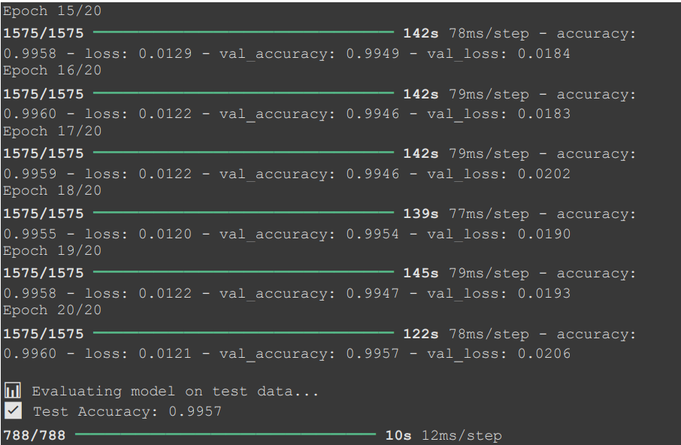
PROGRESS OF IMPLEMENTATION SNAPSHOTS
Figure: Training of NSL-KDD Dataset

Slide 12
CONCLUSION
The project demonstrates the development of an AI-driven intrusion detection system using a hybrid Conv1D + BiLSTM model. Through robust preprocessing, effective model training, and explainability with SHAP, the system can accurately detect various types of cyber attacks. The system ensures both high performance and transparency, while the planned deployment enables real-time monitoring of network traffic. Overall, this work highlights the potential of deep learning combined with explainable AI for enhancing cloud security in practical scenarios.

Slide 13
REFERENCES
Shifa Shoukat, Tianhan Gao, Danish Javeed, Muhammad Shahid Saeed, Muhammad Adil, “Trust my IDS: An explainable AI integrated deep learning-based transparent threat detection system for industrial networks”, Computers & Security, Volume 149, Article Number 104191, 2025.
Will Serrano, “CyberAIBot: Artificial Intelligence in an intrusion detection system for CyberSecurity in the IoT”, Future Generation Computer Systems, Volume 166, Article Number 107543, 2025
Ramkumar Devendiran, Anil V Turukmane, “Dugat-LSTM: Deep learning based network intrusion detection system using chaotic optimization strategy”, Expert Systems With Applications, Volume 245, Article Number 123027, 2024.
Amol D. Vibhute, Vikram Nakum, “Deep learning-based network anomaly detection and classification in an imbalanced cloud environment”, Procedia Computer Science, Volume 232, pp. 1636–1645, 2024
Fatimah Alhayan, Nuha Alruwais, Mohammad Alamgeer, Abdullah M. Alashjaee, Monir Abdullah, Alaa O. Khadidos, Fouad Shoie Alallah, Abdulrhman Alshareef, “Design of advanced intrusion detection in cybersecurity using ensemble of deep learning models with an improved beluga whale optimization algorithm”, Alexandria Engineering Journal, Volume 121, pp. 90–102, 2025

Slide 14
REFERENCES
Prasanth, B. Karthikeyan, S. R. Gupta, “An Intrusion Detection System over IoT Data Streams Using Explainable Deep Learning”, Sensors, vol. 25, no. 3, pp. 847, 2025.
Ahmed, J. Lee, M. Hassan, “Explainable Deep Learning Approach for Advanced Persistent Threats Detection”, Artificial Intelligence Review, vol. 37, no. 2, pp. 211-228, 2024.
L. Chen, Y. Wang, X. Li, “A Scalable Network Intrusion Detection System Using Bi-LSTM and CNN”, IEEE Conference on Cybersecurity, pp. 119-130, 2025.
Muhammad Sajid, Kaleem Razzaq Malik, Ahmad Almogren, Tauqeer Safdar Malik, Ali Haider Khan, Jawad Tanveer, Ateeq Ur Rehman, “Enhancing intrusion detection: a hybrid machine and deep learning approach”, Journal of Cloud Computing: Advances, Systems and Applications, Volume 13, Article Number 123, 2024
Okechukwu Clement Agomuo, Agomuo Kingsley Uzoma, Zohaib Khan, Agomuo Ijeoma Otuomasirichi, Junaid Hussain Muzamal, “Transparent AI for Adaptive Fraud Detection”, Proceedings of the 19th International Conference on Ubiquitous Information Management and Communication (IMCOM), 2025.

Slide 15
Thank You

