Slide 1

Offline Facial Recognition & Liveness Detection
- NHAI Hackathon 7.0

Slide 2
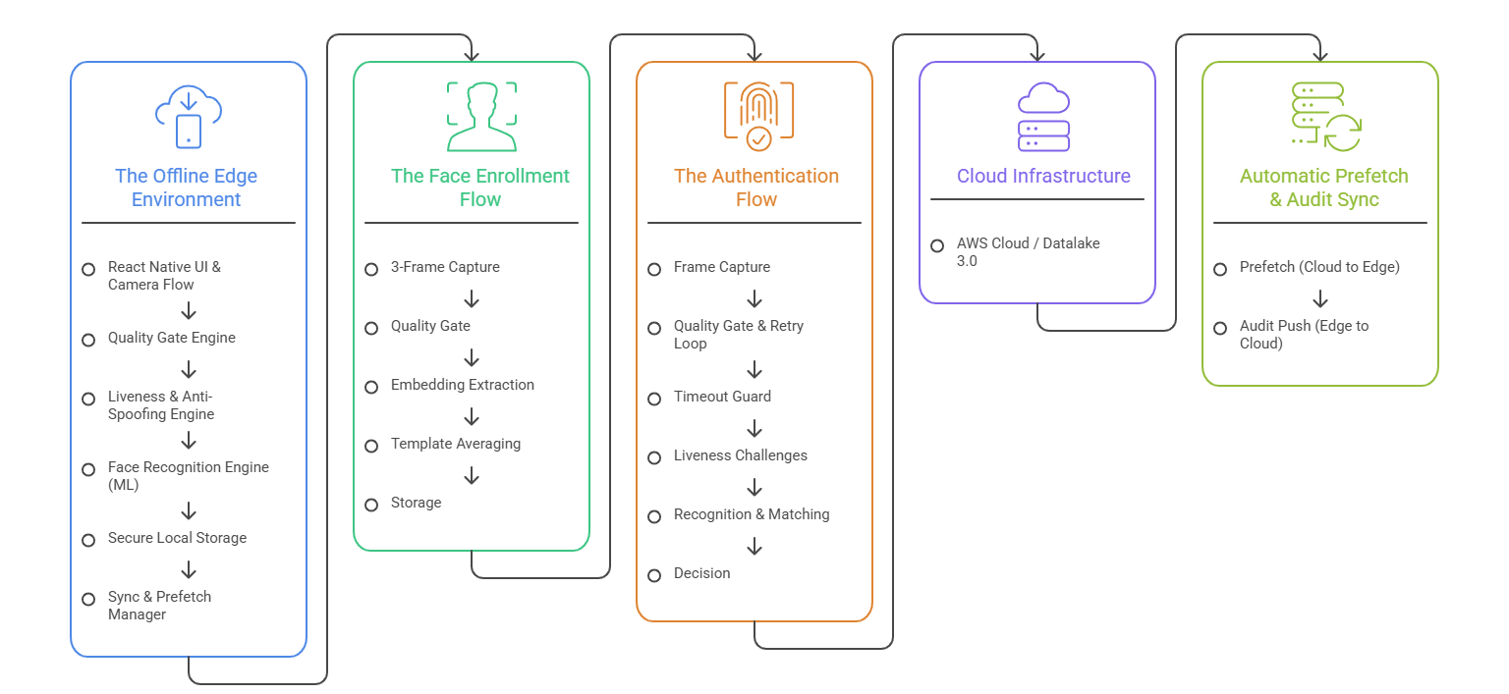
System Architecture

Slide 3
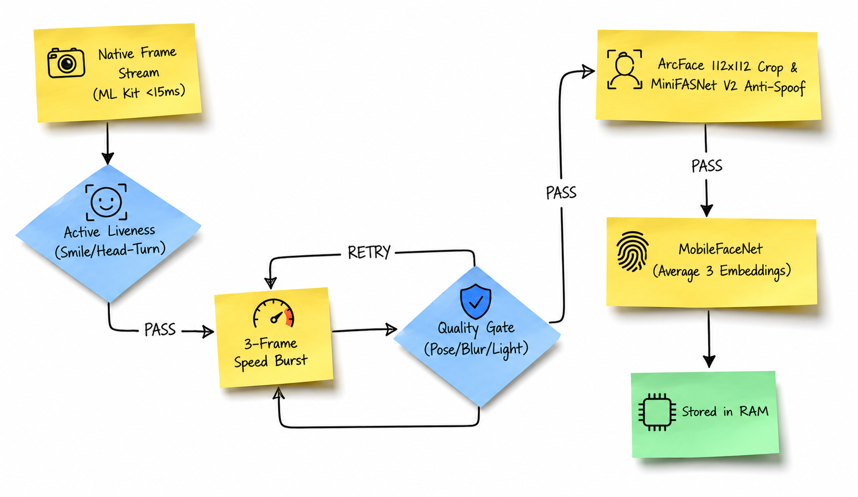
Face Enrollment Flow

Slide 4
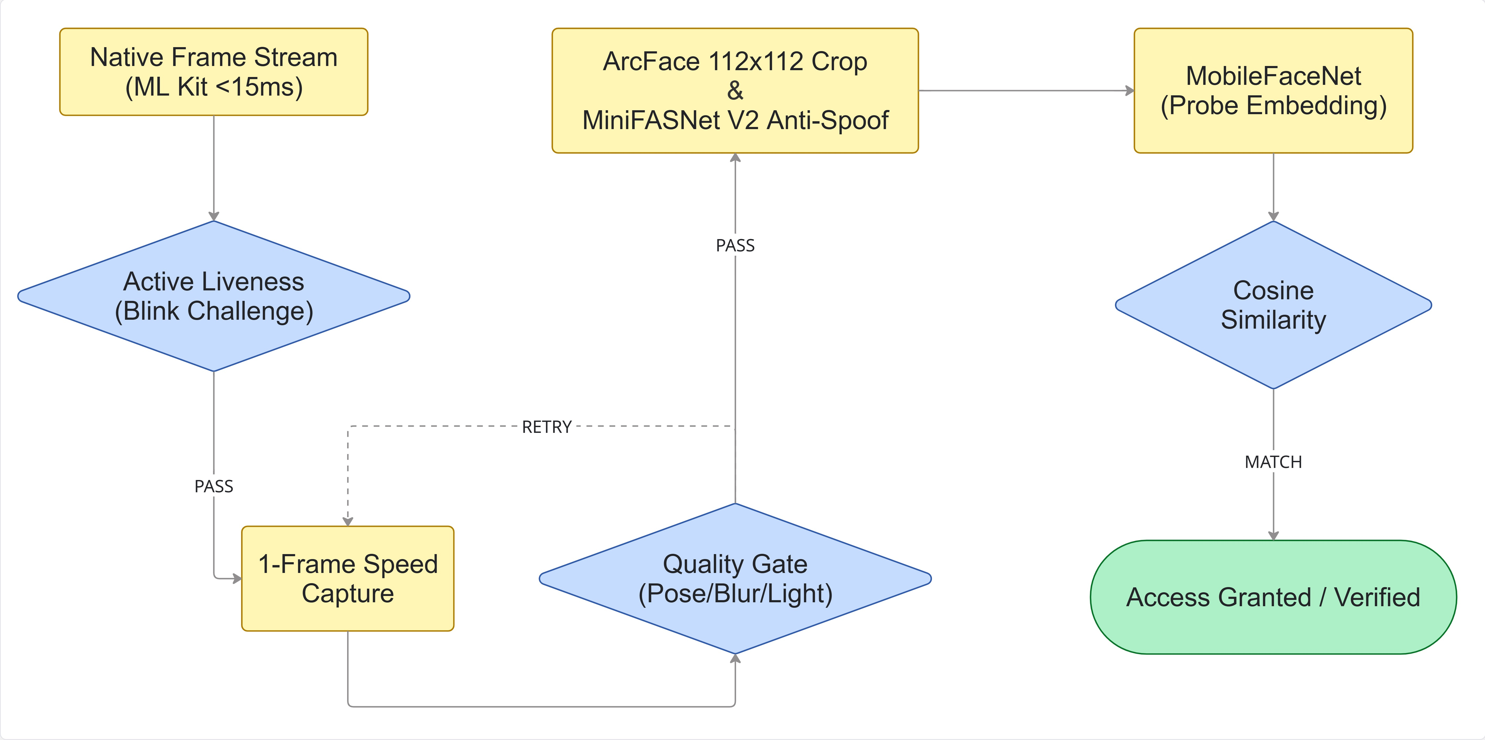
Face Enrollment Flow

Slide 5
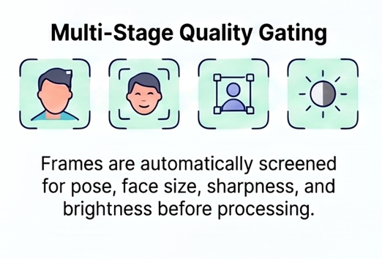
Quality Gate
Geometry Check: Filters extreme head pose (yaw / pitch > 35 deg) & small face bounding box ratio.
Pixel Diagnostics: Calculates Laplacian variance for sharpness (>= 8.0) to filter motion blur.
Light Bounds: Rejects under-exposed darkness and harsh directional glare/shadows.
Auto-Retry Loop: Triggers fresh frame capture on failure without corrupting template pipeline.
Timeout Protection: Each challenge stage enforces strict timeouts to fail-close safely if gestures are incomplete.

Slide 6
Liveness Detection
Native Frame Stream: Evaluated via ML Kit fast mode (<15ms / frame at 30 FPS) directly on camera stream with zero image-decoding overhead.
MiniFASNet-V2-CNN: Enrollment requires gesture sequence (Smile -> Turn Left -> Turn Right) and Verification requires Blink.
Liveness Backstop: Measures eye-open probability transitions (open -> closed -> open) rather than single closed-eye frames for high reliability.
Face Validity Gate: Enforces located eye/mouth landmark requirements per frame so non-face objects cannot advance the state machine.

Slide 7
ArcFace alignment and Anti-spoof
ArcFace Alignment: Warps face via ML Kit eye landmarks to canonical 112x112 geometry.
MiniFASNet V2 CNN: Lightweight ~1.75 MB passive anti-spoof neural model (TFLite).
Liveness Backstop: Classifies 112x112 crops to detect 2D photo prints, screen replays & masks.
Single-Pass Execution: Runs once on first valid frame to maintain sub-second latency.
Multi-frame retry logic: If score is lower/noisy, it checks up to 3 subsequent frames (maxChecks = 3) to prevent false spoof flags from single blurry frames.

Slide 8
MobileFaceNet Embedding
Edge Biometric Model: ~5.2 MB TFLite neural model extracting 128-D L2-normalized vector.
Verification Match: Generates probe embedding; matched vs local SecureStore.
Enrollment Averaging: Extracts 3 frame embeddings and computes element-wise master average.

Slide 9
TFLite (TensorFlow Lite): This is a lightweight tool made by Google. It shrinks massive AI models so they can fit and run on mobile phones without draining the battery.
Hardware Delegates: Think of these as smart translators. Instead of making the phone's main brain (CPU) do all the heavy lifting, a delegate hands the AI task over to specialized chips inside the phone.
Core ML (iOS): This is Apple's built-in AI framework. The TFLite delegate passes the AI work to Apple's Neural Engine chip inside iPhones.
NNAPI (Android): This stands for Neural Networks API. It is Google's system that lets Android apps talk directly to specialized AI chips (like GPUs and NPUs) built by Samsung, Qualcomm, or Google.
MiniFASNet V2 outputs raw neural network logits for 3 classes:
• Class 0: Print Spoof (2D photo on paper)
• Class 1: Live Face (real human face)
• Class 2: Screen Replay Spoof (phone/laptop screen)
Softmax converts raw model output logits into normalized probabilities [p0, p1, p2] summing to 1.0 (100%).
Code checks probs[1] (Live score): face is confirmed live if p1 is the highest probability or p1 >= 0.35.

Slide 10
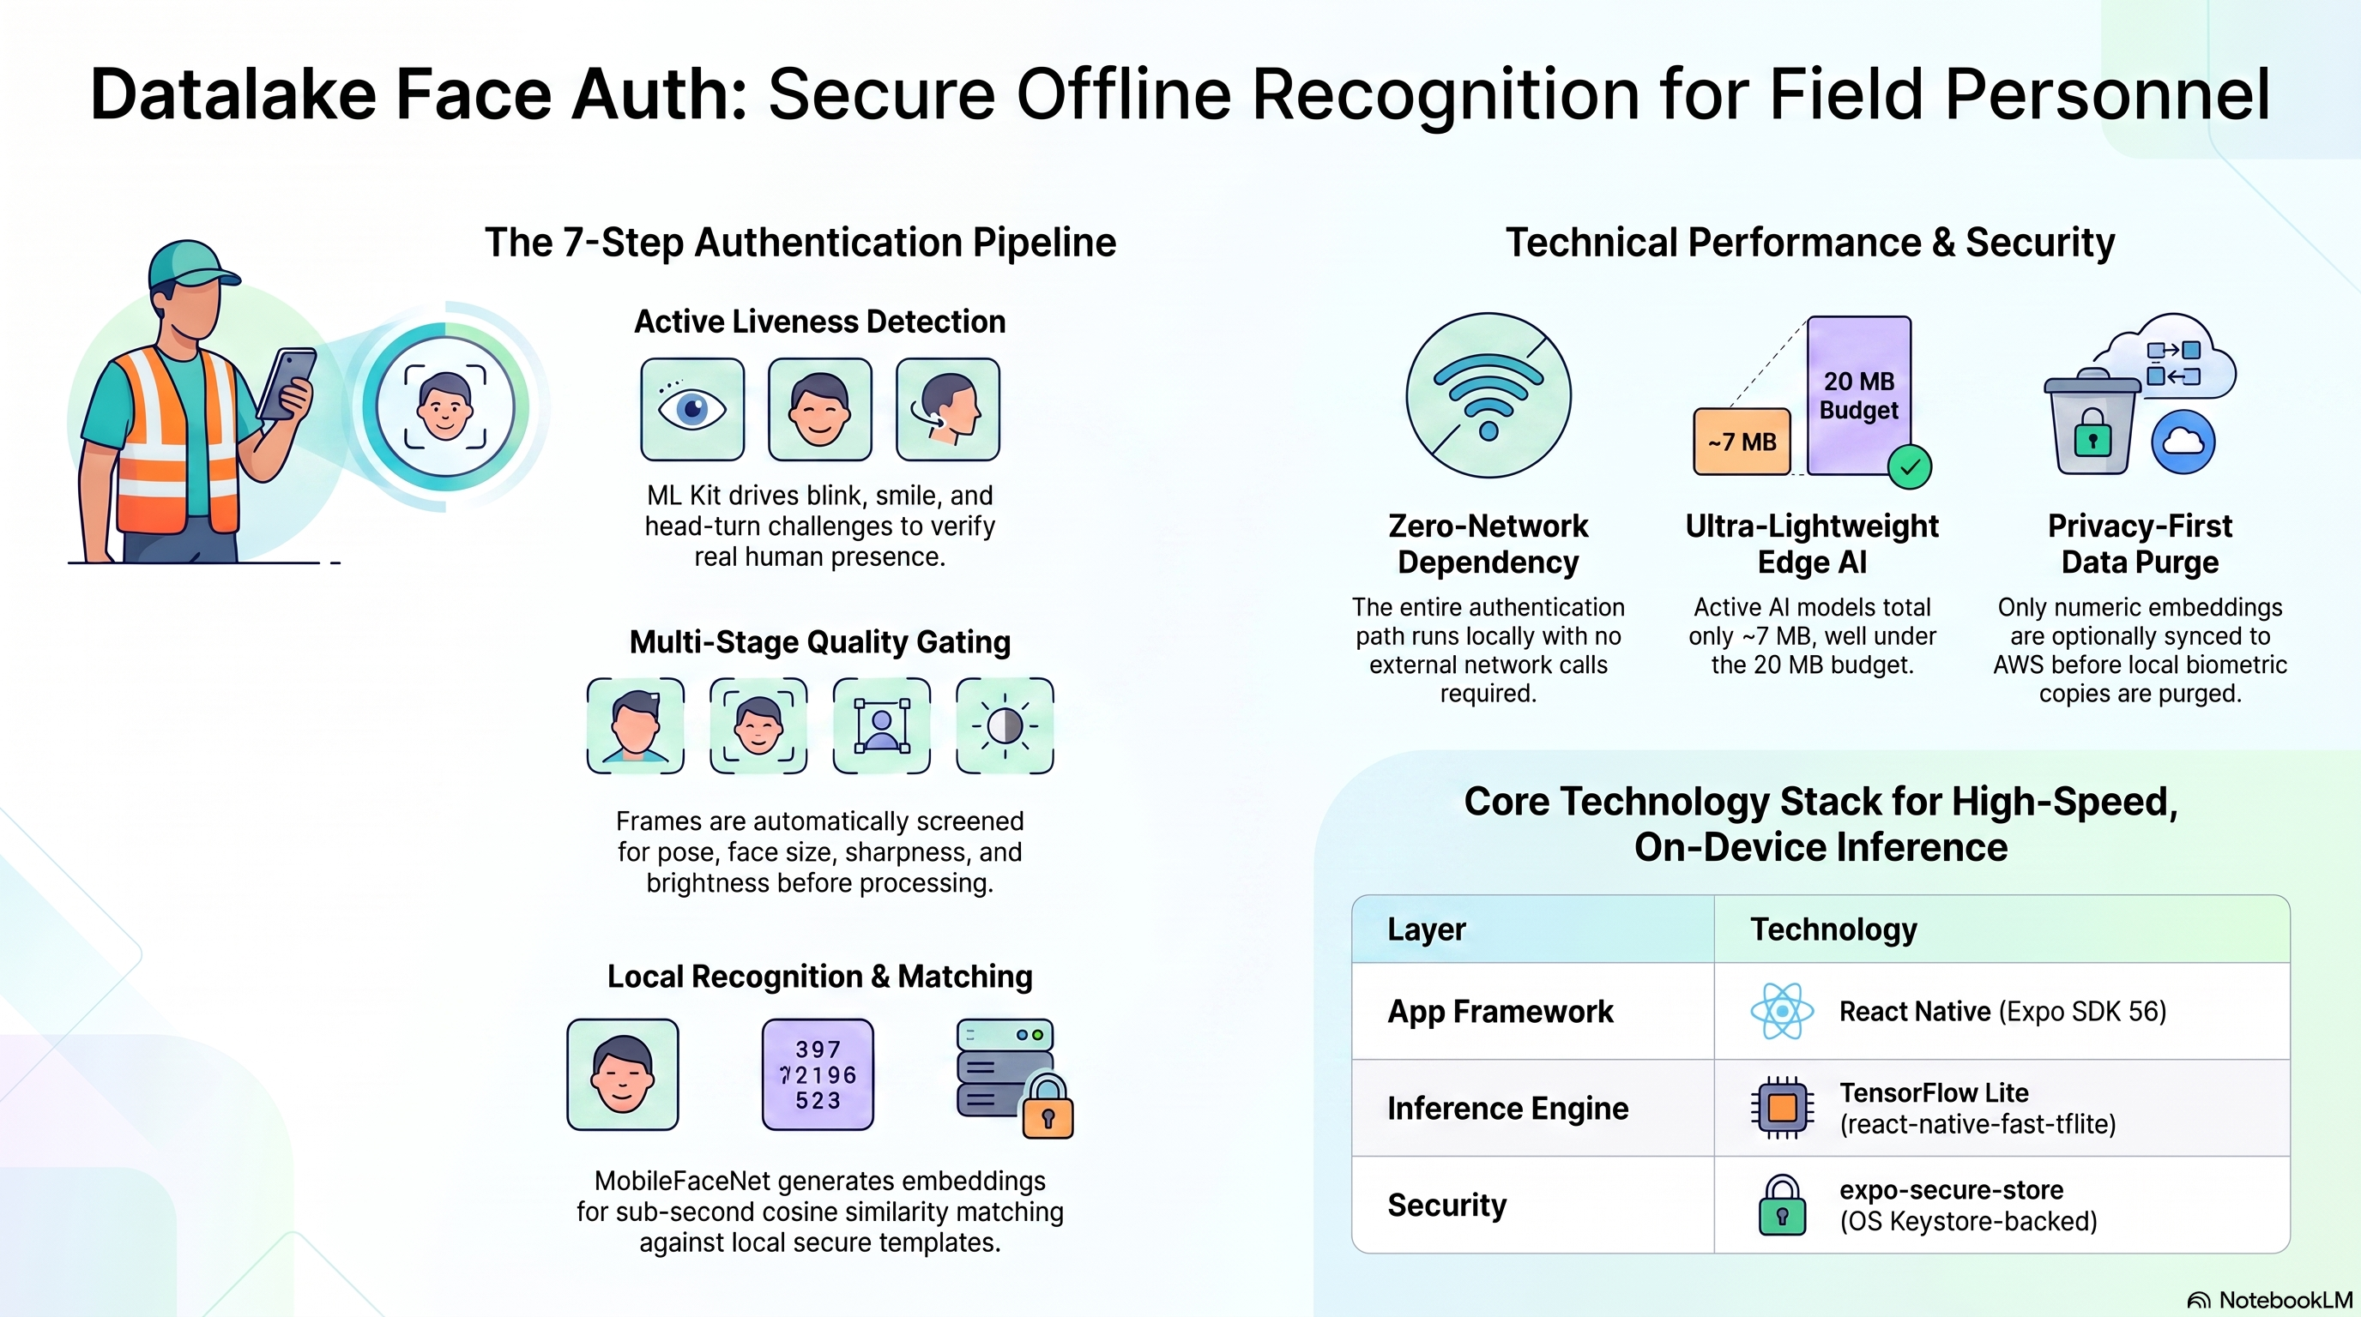
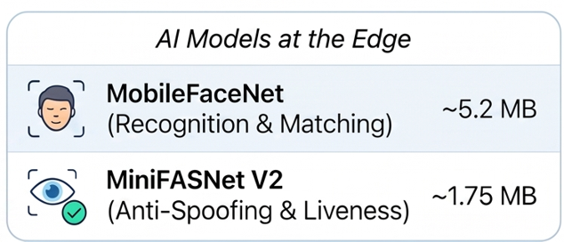

Slide 11
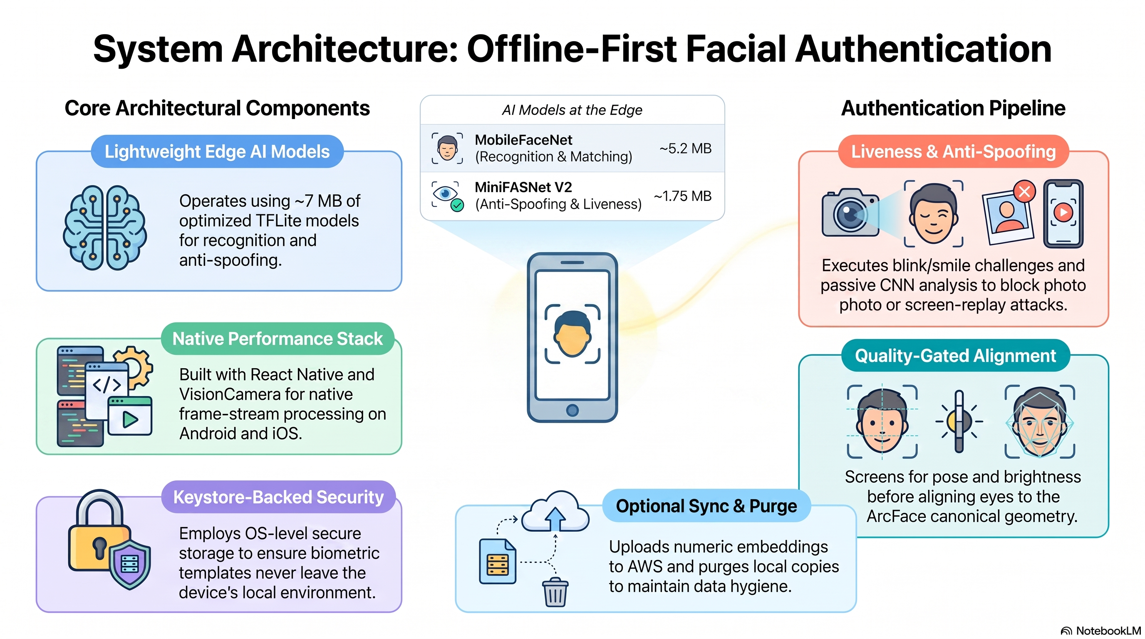

Slide 12
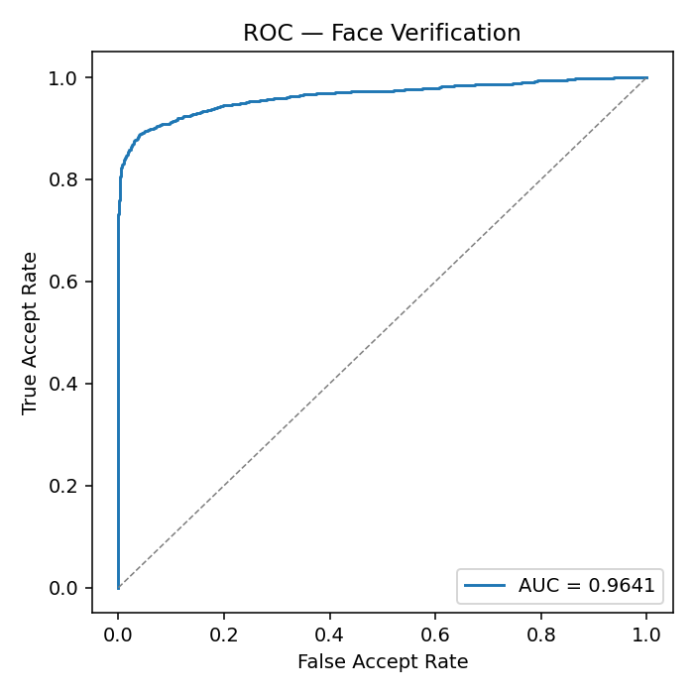
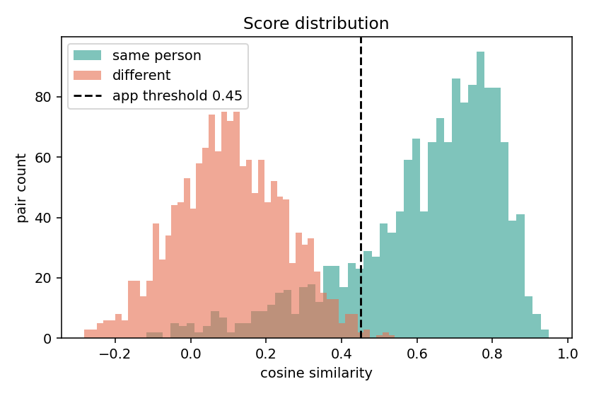
Model Performance & Score Distribution
(Indian Faces Dataset)
High Precision & Robustness
Clear separation between match and non-match

Slide 13
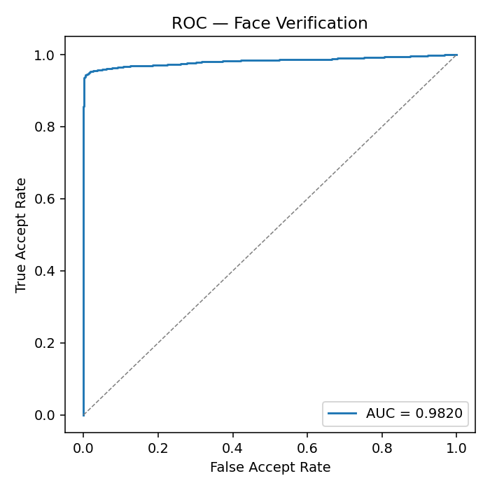
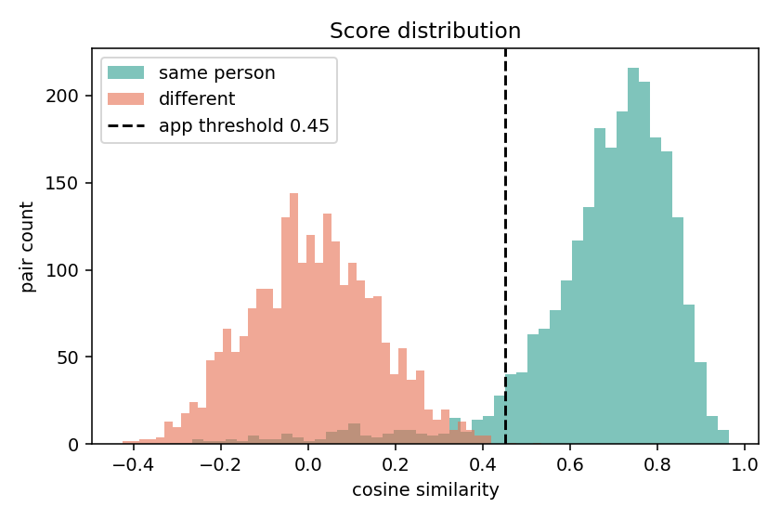
Model Performance & Score Distribution
(LFW Dataset)
High Precision & Robustness
Clear separation between match and non-match

Slide 14
Live Demonstration
Cross-platform prototype (Android + iOS)

