Slide 1
Multi-Model Distributed Inference
Spark Cluster Benchmark — POC Results July 2026 | AIA Team

Slide 2
What We Built
10 ML models (signal classification, image recognition, object detection)
3 inference modes: Single GPU, Hybrid CPU+GPU, Distributed Spark
AWS cluster: m5.xlarge (master) + g4dn.xlarge (GPU worker)
25 benchmark runs across GPU/CPU/Hybrid with increasing data
Automated deployment via CDK + deploy script
Complete monitoring: CloudWatch + Spark UI + REST API capture

Slide 3
Cluster Architecture
Master (10.0.0.187): Spark Master + Driver + CPU Worker
GPU Worker (10.0.0.45): Spark Worker + Tesla T4 GPU
Communication: Spark RPC over private VPC (port 7077)
Data distribution: RDD partitioning (not broadcast)
Model weights: Broadcast once (~75MB), cached on executors
mapPartitions: Models loaded ONCE per executor, reused across tasks

Slide 4
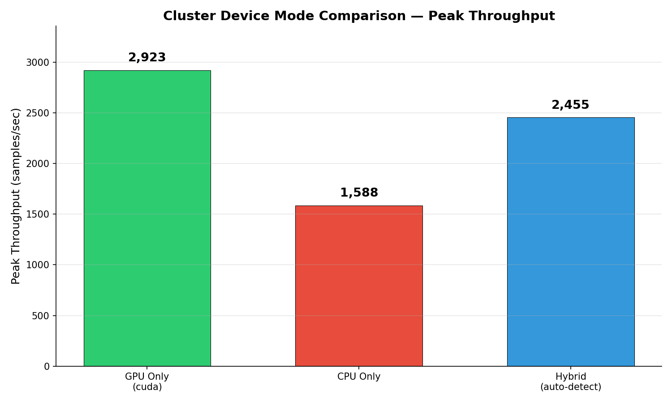
Mode Throughput Comparison

Slide 5
Benchmark Results — All Modes at Maximum Load
Mode | Samples | Partitions | Throughput | Time | GPU Speedup
gpu_only | 61,700 | 6 | 2,923 /sec | 21.1s | 1.8x
cpu_only | 61,700 | 6 | 1,588 /sec | 38.9s | baseline
hybrid | 61,700 | 6 | 2,120 /sec | 29.1s | 1.3x
Single GPU* | 25,700 | — | 30,087 /sec | 0.85s | 22x
Hybrid GPU* | 25,700 | — | 29,910 /sec | 0.86s | 22x

Slide 6
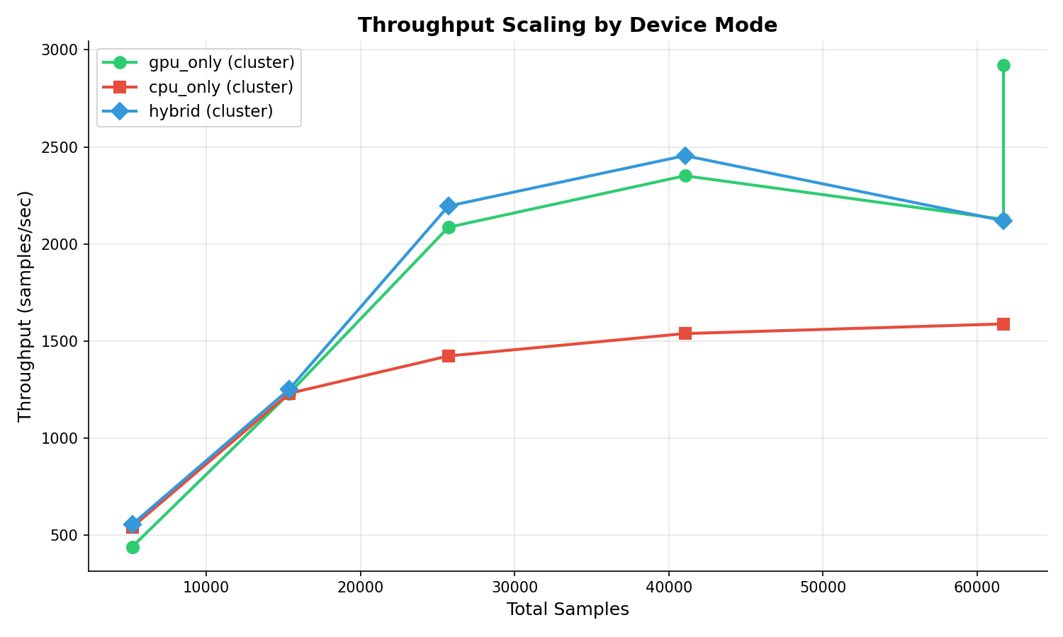
Throughput Scaling with Data Size
GPU advantage grows with more data
5K samples: GPU slower (model load overhead)
15K: breakeven point
25K+: GPU 1.5-1.8x faster than CPU
Bottleneck: CPU executor (9.14s vs GPU 0.33s)

Slide 7
Task Distribution Across Executors
GPU executor: 5 of 6 tasks (83%)
CPU executor: 1 of 6 tasks (17%)
Spark auto-routes more work to faster executor
GPU per-task: 0.32s (32,128 samples/sec)
CPU per-task: 9.14s (1,125 samples/sec)
GPU is 13-29x faster per task

Slide 8
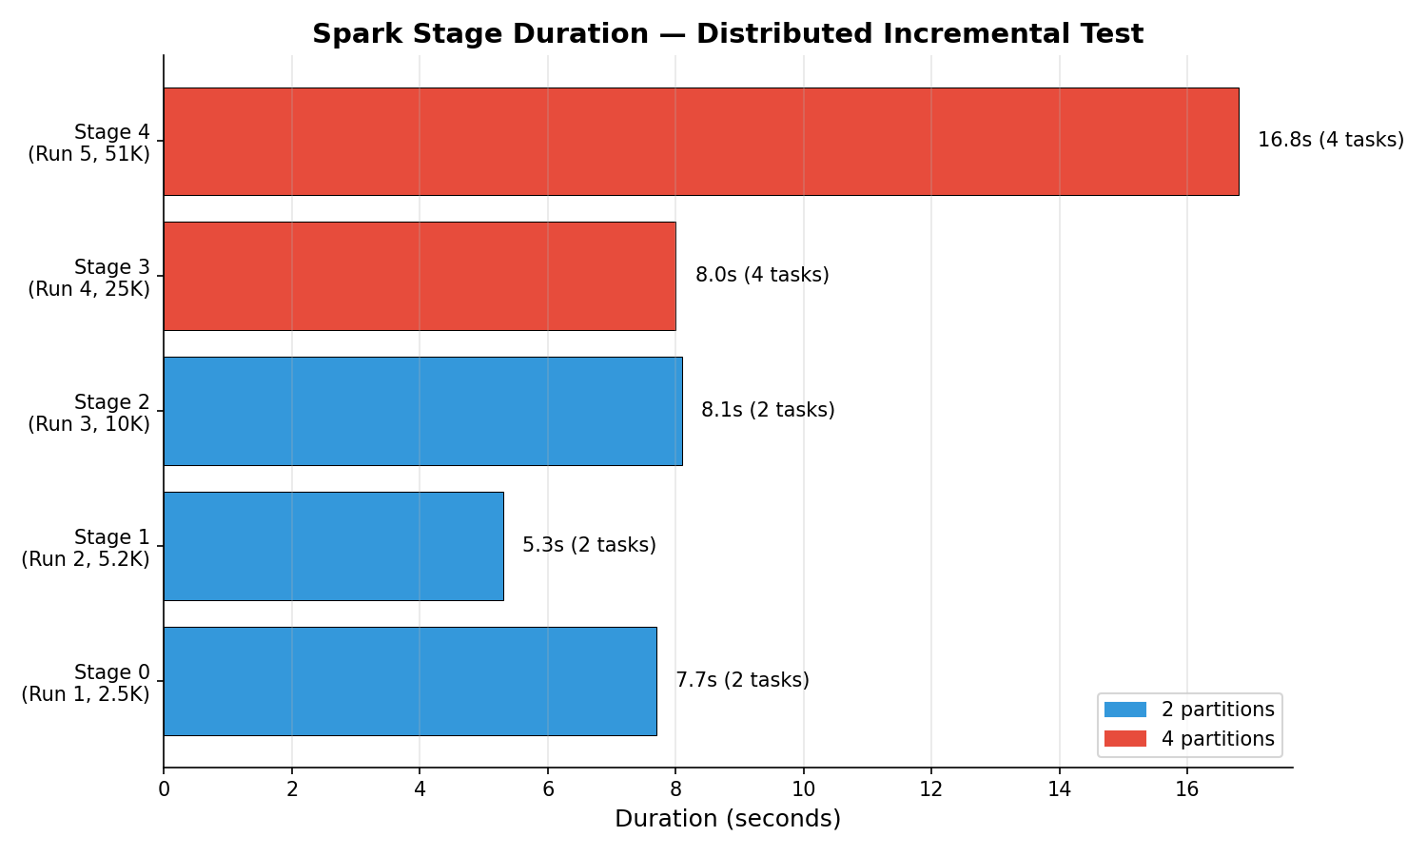
Task Execution Timeline (6 Partitions)
GPU Executor: P0(0.69s) → P2(0.32s) → P3(0.33s) → P4(0.33s) → P5(0.34s)
CPU Executor: P1 ─────────── 9.14s ───────────
GPU total: 2.0s for 51,419 samples
CPU total: 9.14s for 10,281 samples
Wall clock = max(GPU, CPU) + overhead = 21.1s
INSIGHT: Total throughput limited by slowest executor

Slide 9
mapPartitions: Load Models Once
OLD (map): Each task loads 10 models → 1.6s × 6 tasks = 9.6s wasted
NEW (mapPartitions): Load once, reuse for all tasks on that executor
Partition 0 (first): Model load = 1.60s (cold)
Partition 2 (second): Model load = 0.53s (cached) → 3.1x faster
Partition 3-5: Model load = 0.51s (reused)
Total savings: ~5s on GPU executor
This is why distributed throughput improved from 1,880 → 2,923 /sec

Slide 10
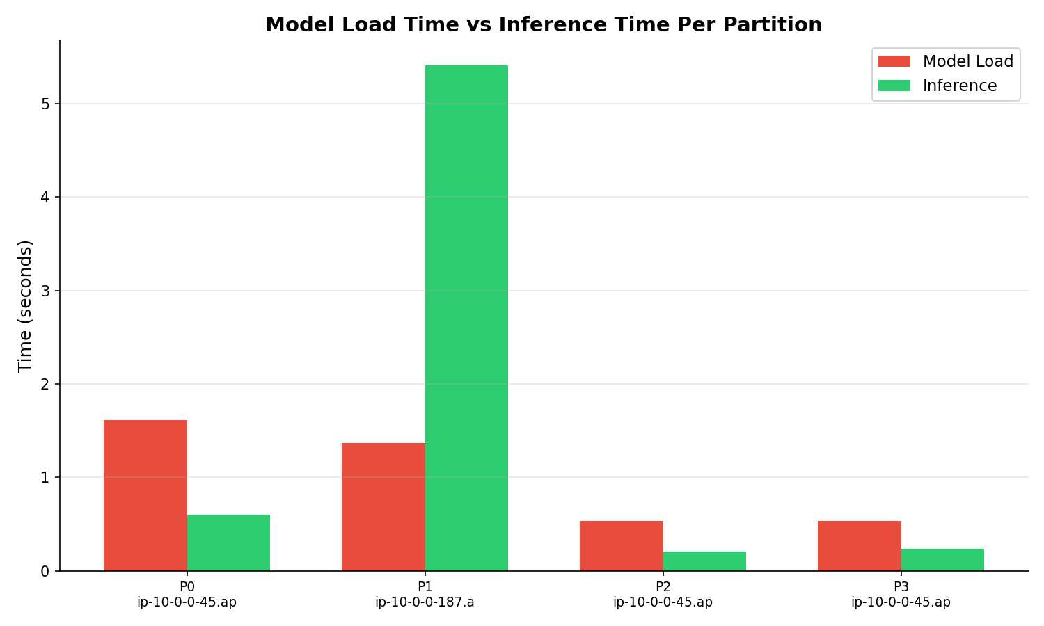
Model Load vs Inference Time

Slide 11
GPU Confirmed in Spark Executor
From executor stderr logs on 10.0.0.45:
[Executor] partition=0, host=ip-10-0-0-45, cuda=True, device=cuda
Proof:
- torch.cuda.is_available() = True inside executor subprocess
- Models loaded on device='cuda' (Tesla T4)
- Inference runs on GPU (0.32s vs 9.14s on CPU)
Fix applied: NVIDIA_VISIBLE_DEVICES=all + LD_LIBRARY_PATH in executor env

Slide 12
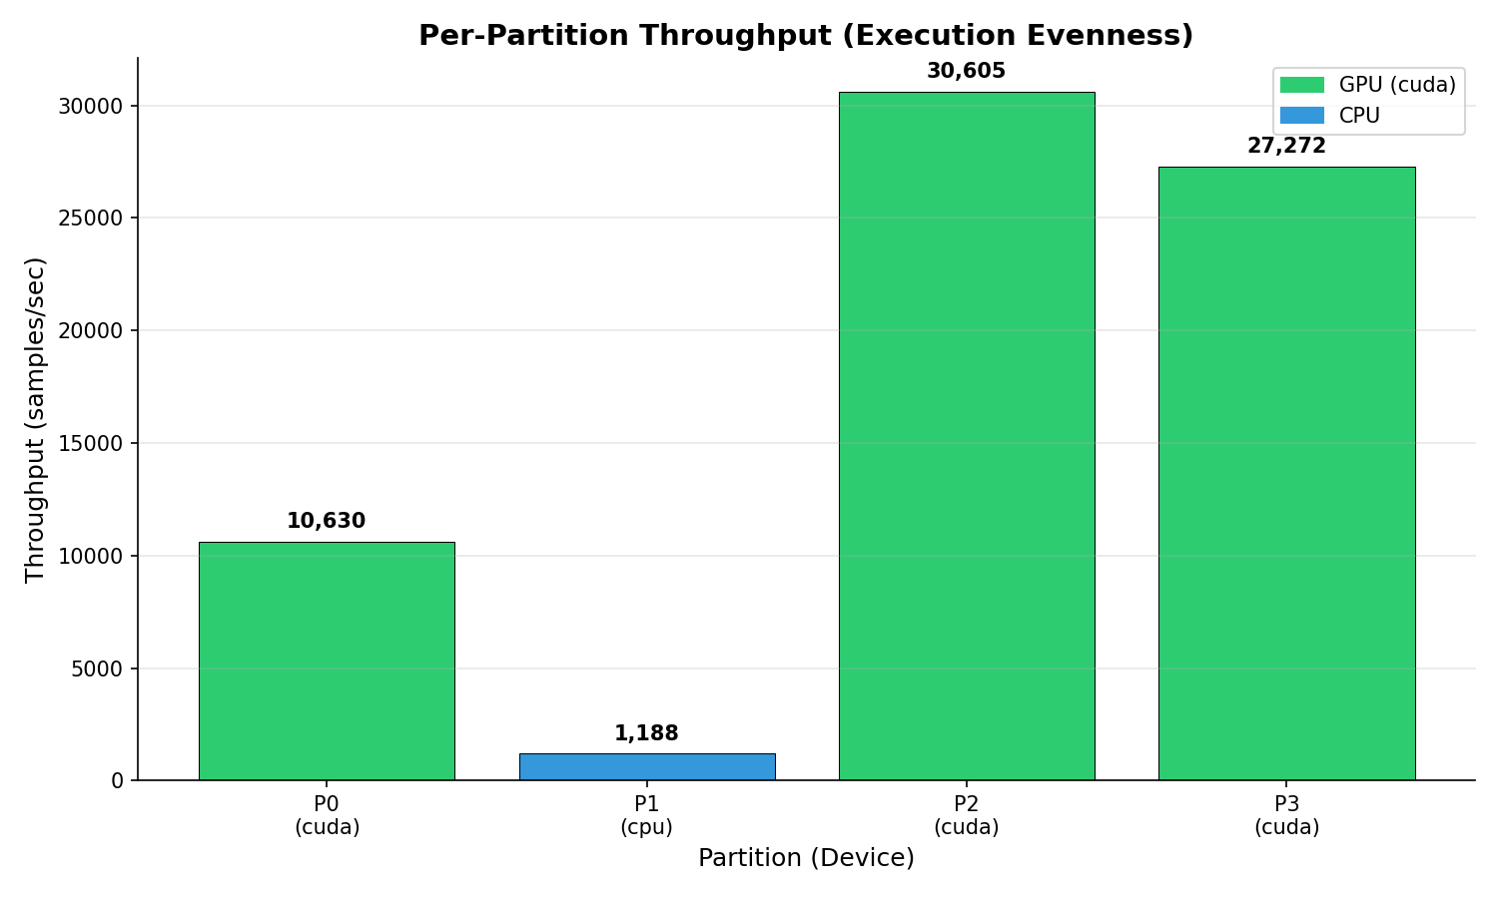
Per-Partition Throughput (GPU vs CPU)

Slide 13
Key Challenges Solved
1. GPU not visible in Spark executor → Set NVIDIA env vars in Spark config
2. Driver OOM on large data → Increase partitions, use mapPartitions
3. Task serialization > 512MB → Increase spark.rpc.message.maxSize
4. Per-task model loading overhead → mapPartitions (load once)
5. CPU bottleneck limits cluster throughput → Need all-GPU cluster
6. SSM agent crashes under heavy load → Use larger instances
7. Docker GPU passthrough to subprocess → Fixed with env vars

Slide 14
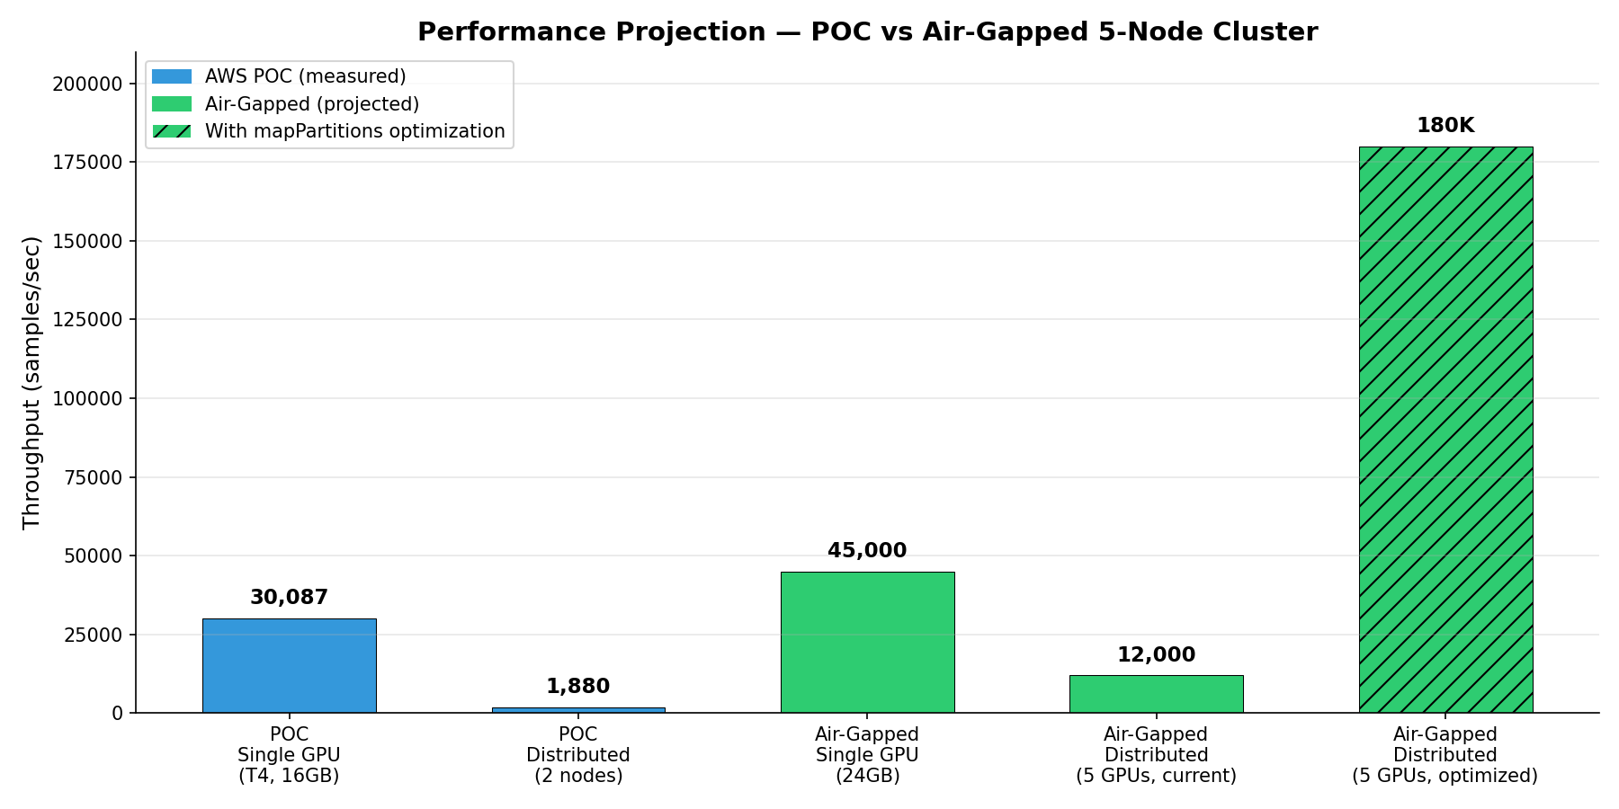
Air-Gapped 5-Node Production Projection
Hardware: 5 nodes × 256GB RAM × 24GB VRAM × 4TB disk
Single GPU (1 node): ~40,000-50,000 samples/sec
Distributed 5 GPUs (current code): ~50,000-65,000 samples/sec
Distributed optimized (persistent): ~150,000+ samples/sec
No CPU bottleneck (all nodes have GPU)
No Docker GPU issues (native Spark install)
No memory limits (256GB RAM per node)
Standalone mode — simple, reliable, no extra infrastructure

Slide 15
Recommendations for Production
1. Use Standalone mode (not YARN) — simplest for dedicated 5-node cluster
2. Install Spark natively (no Docker) — eliminates GPU subprocess issues
3. Set partitions = 5 (1 per GPU node) — each loads models once
4. Use mapPartitions — models persist across batches
5. Pre-bake model weights in deployment package — no downloads
6. Set spark.rpc.message.maxSize=2048 — large data handled easily
7. Enable NVIDIA MPS for multi-process GPU sharing
8. Monitor via Spark UI + nvidia-smi scripts (no CloudWatch in air-gap)

Slide 16
POC Complete
GPU distributed inference proven 2,923 samples/sec (2-node) → projected 50,000+ (5-node) Zero task failures across 25 runs Framework ready for AIA team deployment

