Slide 1

AI-Driven Web Data Analysis System
Subtitle: An Automated, Secure and Self-Healing Framework for Web Data Analytics
High-level flow (visual): Natural Language Query → Web Data → Controlled Dataset → Statistical Analysis → AI Code Generation → Secure Execution → Visualizations → Automated Report
PYTHON
BRIGHT DATA
DUCKDB
GEMINI 3.6 FLASH
STATISTICAL AUDITING
DOCKER
SELF-HEALING
Theme: professional dark AI / data-engineering. Minimal, high-impact overview; emphasize engineered architecture (not an LLM wrapper) and Bright Data record-budget integration.

Slide 2
Why Automated Web Data Analysis Is Difficult
Natural-Language Requirements
Dynamic, Unstructured Sources
Users express analysis needs in free text — system must accurately structure tasks.
Web pages change shape and include noisy, adversarial content (prompt-injection risk).
Dataset Control
Reliability & Security
Scrapers can return far more or fewer records than required; exact record-count cannot be assumed at scrape-creation time.
Generated code can fail; raw rows must not be exposed to the model; deterministic computations should ground statistics.
Comparison (visual): NAIVE SYSTEM: Web → Raw Data → LLM → Code → Result —vs— OUR SYSTEM: Web → Controlled Data → Deterministic Computation → Audited Task → Gemini 3.6 Flash → Sandbox → Verified Result

Slide 3




Architecture Around the Model
Core principle: Gemini 3.6 Flash performs reasoning where AI is valuable; deterministic components handle computation, validation, security and execution.
Data Minimization
Deterministic Auditing
DuckDB aggregates and profiles data before model reasoning; model sees summaries, not raw rows.
Statistical assumptions and validations are executed by deterministic logic (rules & tests).
Secure Execution
Self-Healing
Generated Python runs inside isolated Docker sandboxes with read-only snapshots and network disabled.
Execution failures feed back to Gemini 3.6 Flash for targeted code correction and adaptive retry.

Slide 4
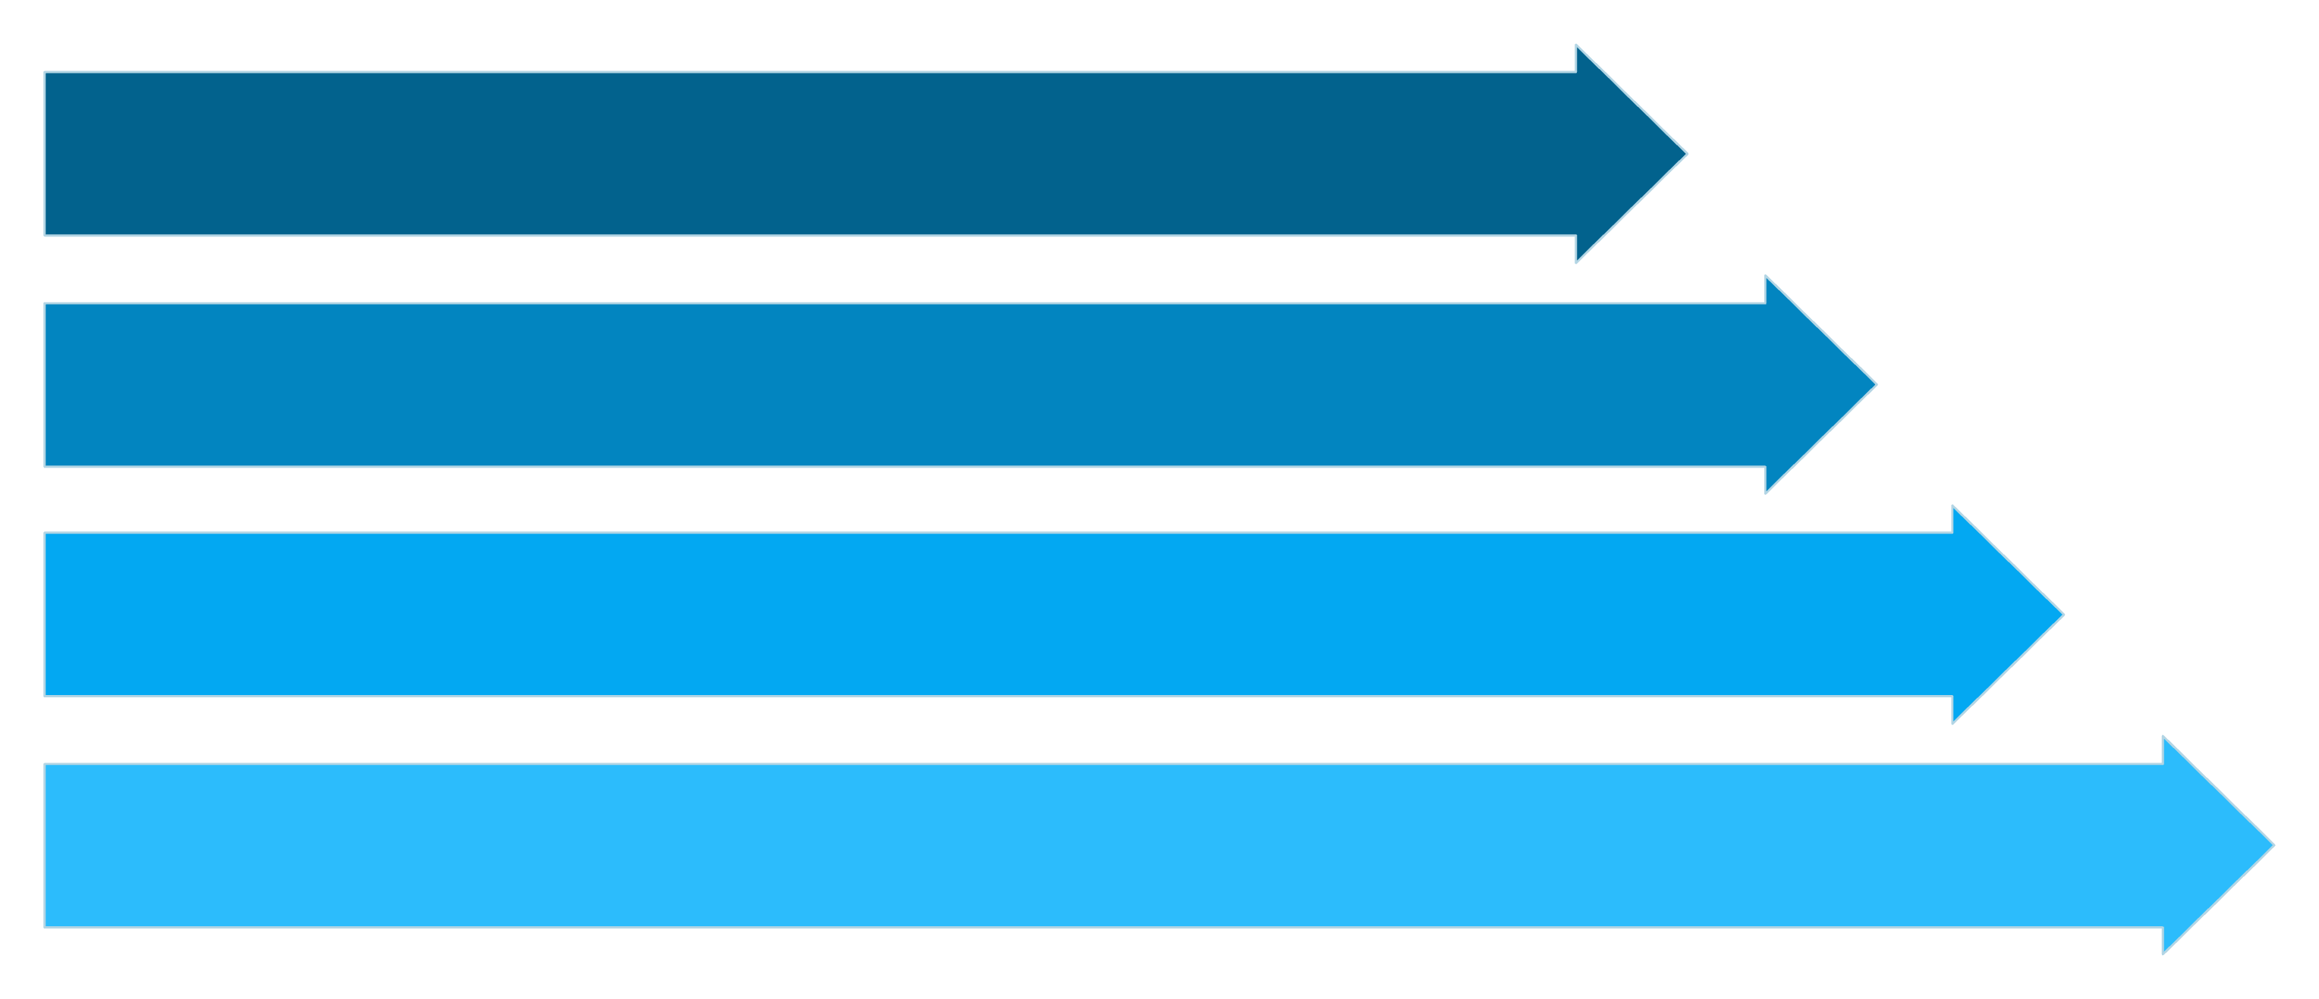
End-to-End System Architecture
MAIN ARCHITECTURE DIAGRAM (primary slide)
Orchestrator
Task Understanding
Gemini 3.6 Flash
Execution & Reporting
Callouts: Orchestrator controls pipeline; DuckDB enforces privacy boundary; Docker isolates execution; Bright Data used at scraping layer under record-budget controller.

Slide 5
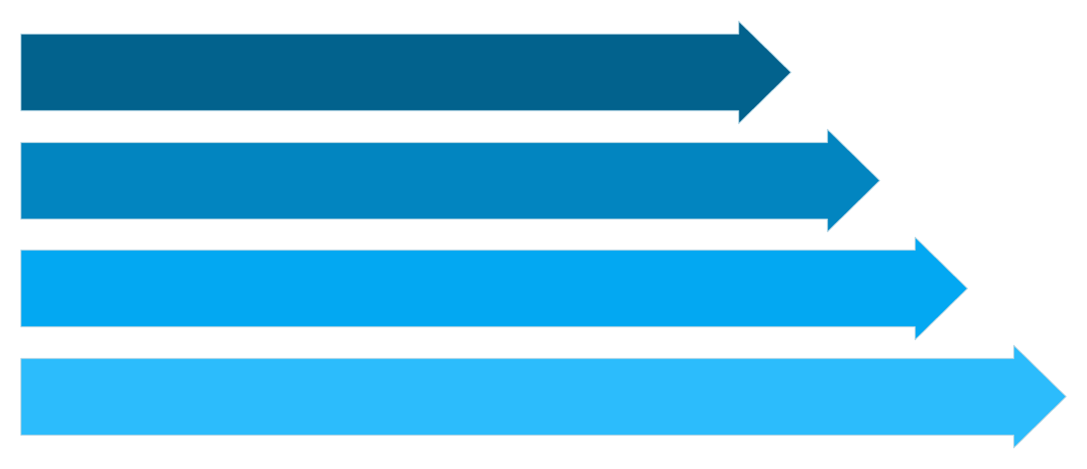
Solving the Exact-Record Scraping Constraint
Key innovation: Execution-Level Record-Budget Controller — dataset size is controlled at execution time via throughput estimation, smart cancellation, validation, and adaptive retry. Scraper creation does NOT promise exact record counts.
Scraper Setup
Start & Estimate
Compute Runtime
Run & Validate
Conceptual formula (illustrative): Scraping Rate = Retrieved Records / Execution Time. Estimated Runtime = Required Records / Scraping Rate × Safety Factor. This is adaptive control with validation and retry — not a guaranteed exact-count mechanism.

Slide 6



Security Is Structural
Privacy Boundary
Prompt-Injection Defense
RAW WEB DATA → DUCKDB BROKER → AGGREGATE STATISTICS → GEMINI 3.6 FLASH
RAW ROWS ✕ → AI MODEL (blocked)
Sandbox receives read-only, sanitized snapshots only
Scan & Detect
Detect suspicious instructions embedded in pages.
Neutralize
Strip or transform untrusted content before extraction.
Extract
Produce structured fields for downstream processing.
Principle: Model reasons over sanitized structured summaries, not raw page instructions.

Slide 7
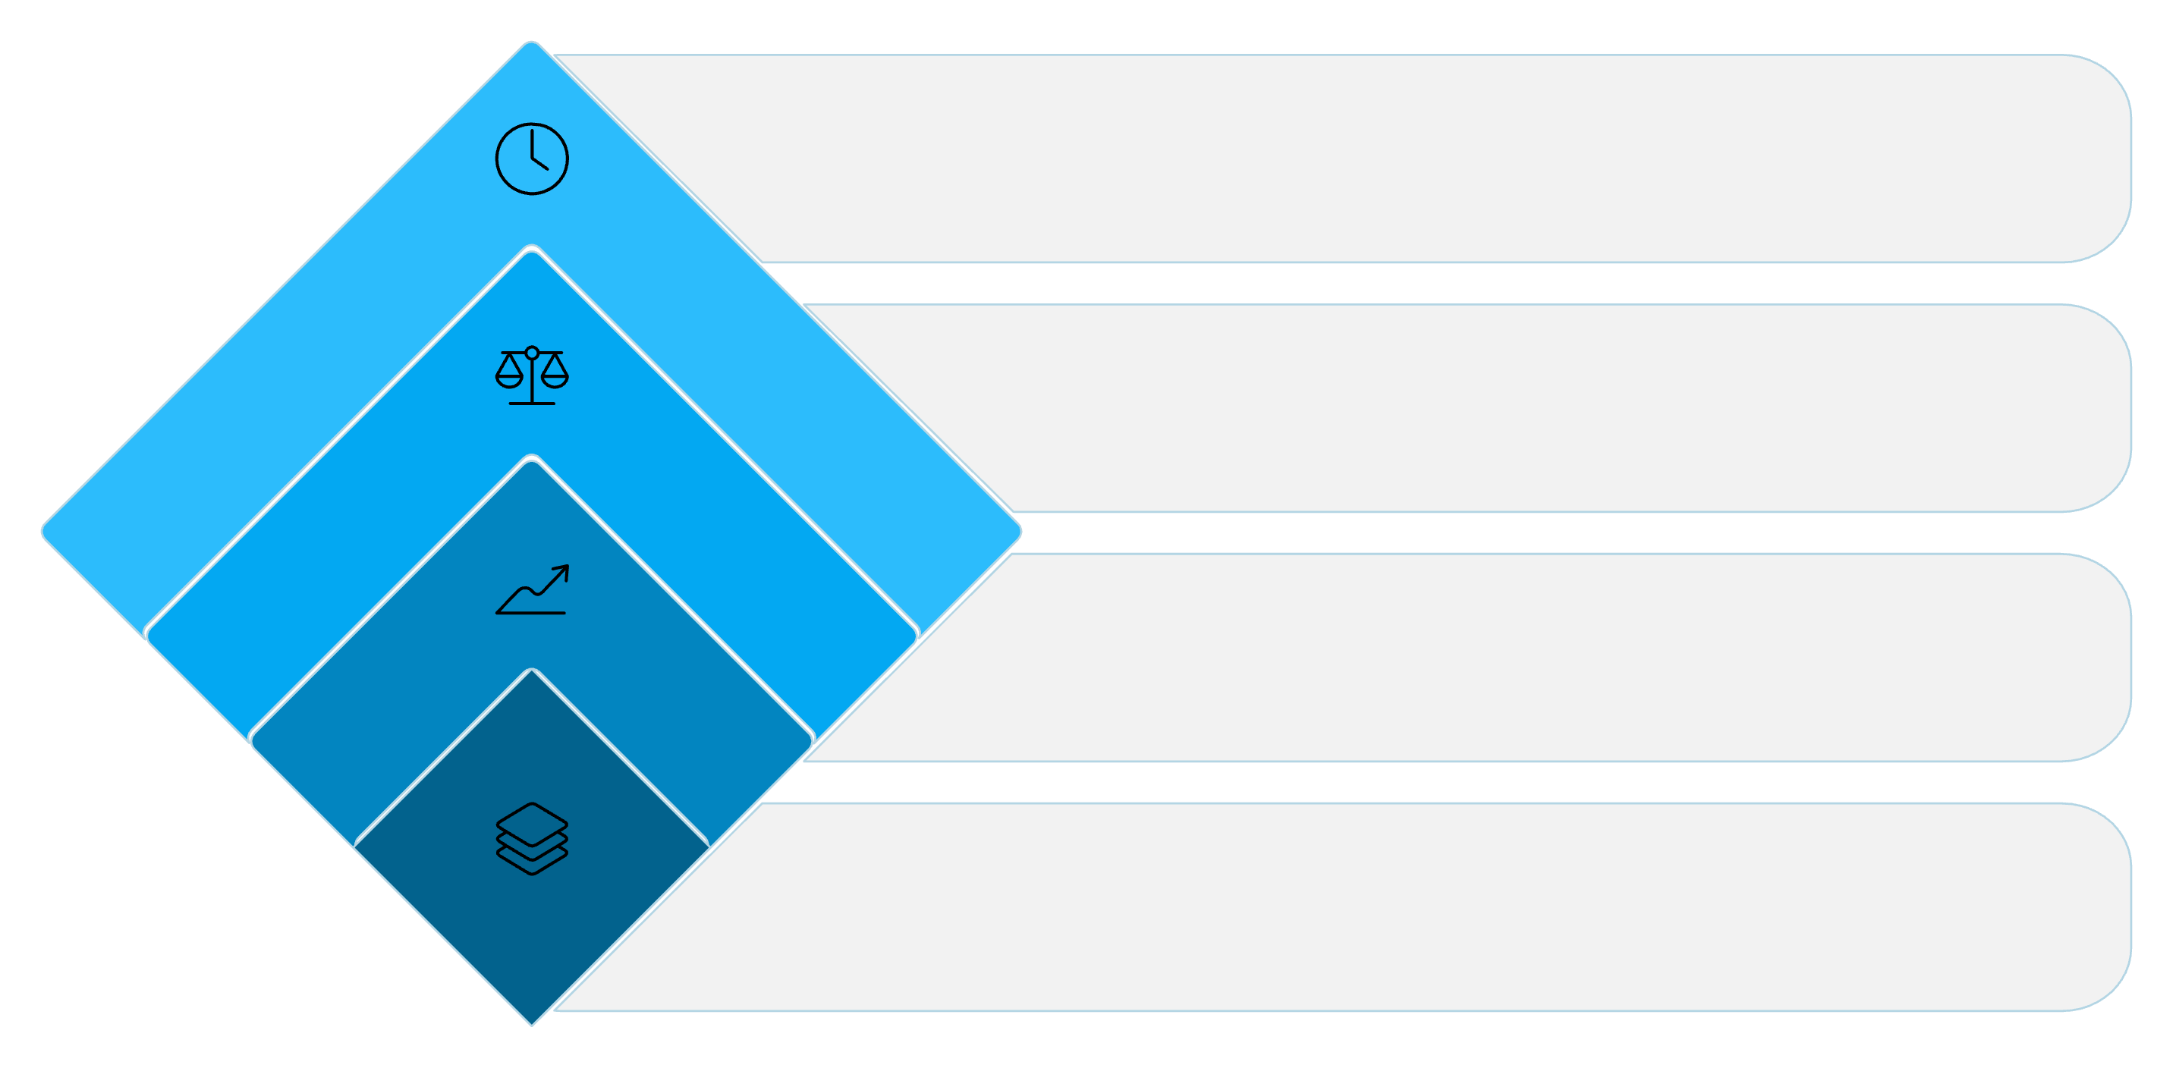
Deterministic Statistical Assumption Audit
Statistical validity is determined by deterministic audit logic prior to model-driven analysis recommendations.
Time Series / Group
Autocorr or distribution tests
Classification
Check class imbalance
Regression
Check target skew & VIF
Identify Type
Determine analysis category
Example audit outcome: CATEGORY × PRICE → Non-normality & small groups → KRUSKAL-WALLIS recommended (deterministic decision, not guessed by LLM).

Slide 8
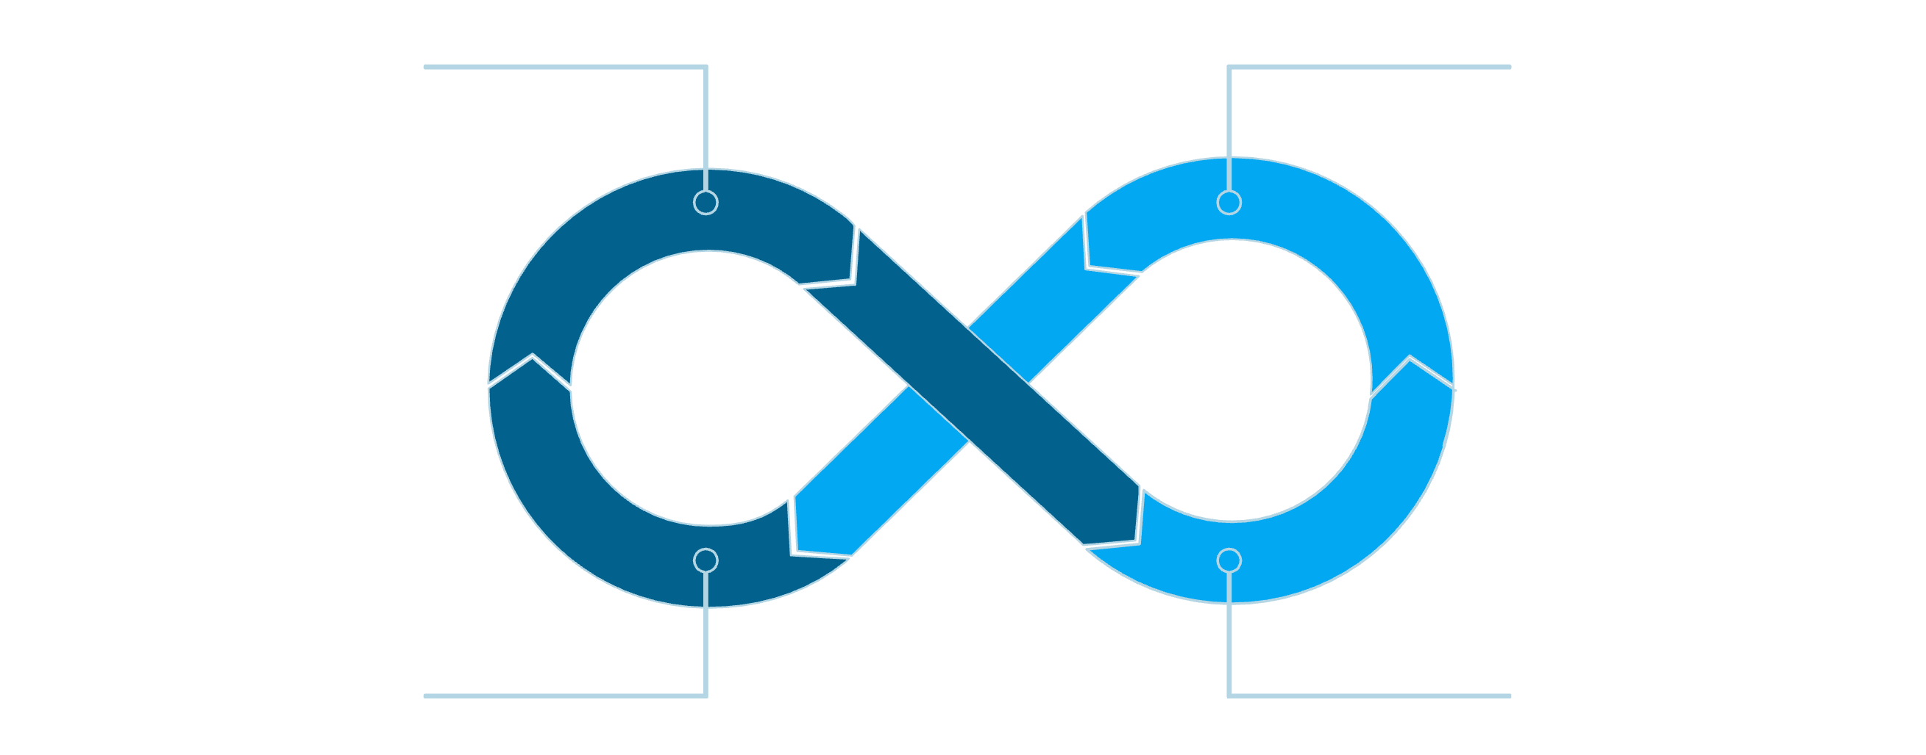
From Natural Language to Verified Executable Code
Generate → Execute → Diagnose → Repair → Execute Again
Structured Task & Specs
Gemini 3.6 Flash
Diagnose & Repair
Generate & Execute
Sandbox Characteristics
Isolated execution
Read-only data snapshot
Network disabled
Controlled runtime & sanitized stdout/stderr

Slide 9




End-to-End Demonstration (Worked Example)
2–5. Structuring, Scraper Creation & Record-Budget
1. Natural-Language Request
Task structuring → Scraper creation (URL, fields) → Estimate throughput → Run with smart cancellation → Validate count → Adaptive retry if needed.
“Analyze relationship between smartphone price and customer rating; produce labeled visualizations.”
9–12. Code Generation → Execution → Self-Healing → Output
6–8. Ingest, Profile, Audit
DuckDB ingestion → data profiling (price distribution, rating distribution, missingness) → deterministic assumption audit → visualization plan.
Gemini 3.6 Flash generates Python → Docker executes → on failure produce trace & corrective iteration → final output: Python script + charts + metrics + Markdown report.
Visualization cards (examples): Price distribution, Rating distribution, Price vs Rating scatter, Price-range vs Rating comparison. No numeric claims presented without experiment data.

Slide 10
What Makes Our System Different?
01 — SINGLE FLASH MODEL
Gemini 3.6 Flash is the single AI reasoning layer; architecture supplies the rest.
02 — INTELLIGENT RECORD-BUDGET CONTROL
Dataset size controlled during execution via estimation, cancellation, validation and adaptive retry; Bright Data used for scraping under this controller.
03 — STRUCTURAL DATA PRIVACY
Model receives aggregates and sanitized snapshots only; DuckDB enforces privacy boundary.
04 — DETERMINISTIC STATISTICAL AUDIT
Audit logic determines statistical validity before model-driven decisions.
05 — SELF-HEALING CODE EXECUTION
Automatic diagnose-and-repair loop uses execution artifacts to correct generated code.
06 — SECURE & USER-CONTROLLED PIPELINE
Prompt-injection defenses, sandbox isolation, modular execution and interactive control preserve safety and traceability.
THE INTELLIGENCE IS NOT ONLY IN THE MODEL — IT IS IN THE ARCHITECTURE AROUND THE MODEL.
Final pipeline: Natural Language → Intelligent Scraping → Data Minimization → Statistical Audit → Gemini 3.6 Flash → Secure Execution → Self-Healing → Verified Visualization → Automated Report

