Slide 1
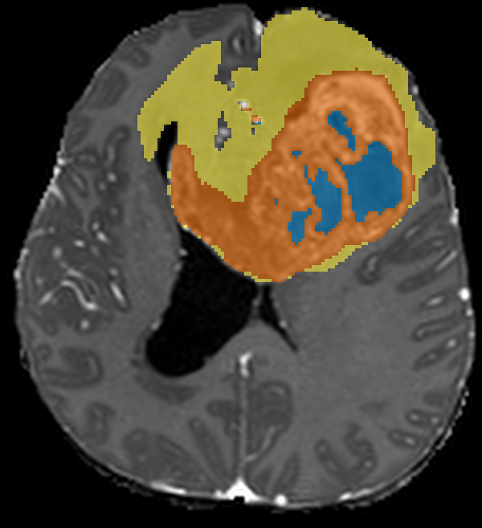
Teaching a computer to see brain tumours
MEDTWIN · THE MACHINE LEARNING INSIDE
How MedTwin's 3D U-Net learns to outline a glioma on MRI, from the basics to the hard lessons
For 1st and 2nd year students · about 17 minutes + questions
Necrotic core
Oedema
Enhancing tumour
[Your name] · [Date]
Expert label on a BraTS test scan (00449)
Notes:
[About 0:20]
Hello everyone. Today I will show you the machine-learning part of our project, MedTwin. MedTwin takes a brain MRI scan and automatically outlines a brain tumour called a glioma, in 3D.
We will go step by step: from "what is machine learning?" up to the problems that real researchers worry about. You do not need any ML background. The picture on the right is the kind of output you will fully understand by the end: each colour is a different part of the tumour.

Slide 2




Why teach a computer to outline tumours?
THE PROBLEM
Glioma
A tumour that grows from the brain's support (glial) cells: a dead core, an active rim and swelling around it.
Slow by hand
An expert outlines it slice by slice through a 3D scan. A BraTS scan has 155 slices.
Experts disagree
Two experts often draw slightly different outlines of the same tumour.
Doctors need numbers
Tumour volume, and how it changes between scans, helps guide treatment.
MedTwin's ML job: MRI in → 3D tumour map + volumes out, in about half a minute, for a doctor to check and approve.
Goal: give every voxel a tumour label (expert outline, test scan 00449)
Notes:
[About 0:50]
First, the problem. A glioma is a tumour that grows from the brain's own support cells, called glial cells. On MRI it has different parts: a dead centre called the necrotic core, an active rim that lights up when the patient gets contrast dye (the enhancing tumour), and swelling around it, called oedema.
Doctors want to know how big each part is, and whether it grows or shrinks between scans. Doing this by hand means drawing on every slice of a 3D scan. A BraTS scan has 155 slices, so it is slow, and two experts often draw slightly different outlines.
So our goal is: give the computer the MRI, and get back a coloured 3D map plus the volumes in about half a minute. A doctor then checks it and approves it.

Slide 3

What is machine learning?
LEVEL 1 · BASICS
Normal programming
Rules
(you write them)
+
Data
Computer
Answers
In MedTwin
EXAMPLE (INPUT)
One MRI scan: four images of the brain
Machine learning
Data
+
Answers
(labels)
Computer learns
Rules
= the model
ANSWER (LABEL)
An expert's tumour outline, voxel by voxel
WHAT IT LEARNS
A rule for "which tumour part is this voxel?"
Like studying for an exam with solved examples
Study many solved problems, then solve new ones you have never seen. This is supervised learning: every training example comes with its correct answer.
STUDY MATERIAL
875 labelled scans
Notes:
[About 1:10]
So what is machine learning? In normal programming, you write the rules. For example: "if the brightness is above 200, call it tumour". That breaks quickly, because every scanner and every tumour is different.
In machine learning we flip it around. We give the computer the data AND the correct answers, and it finds the rules by itself. The rules it learns are what we call the model.
This is called supervised learning, because every example comes with the correct answer, like a teacher supervising. Think of preparing for an exam: you study many solved problems, and then you can solve new ones. In MedTwin the solved examples are 875 MRI scans, each with an expert's outline of the tumour.
[Ask the room] Can anyone think of another example of supervised learning? (Spam filters, face unlock, handwriting recognition.)

Slide 4
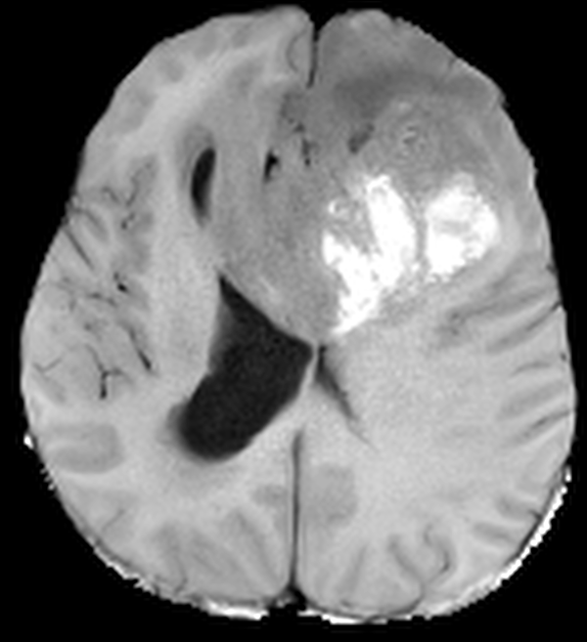
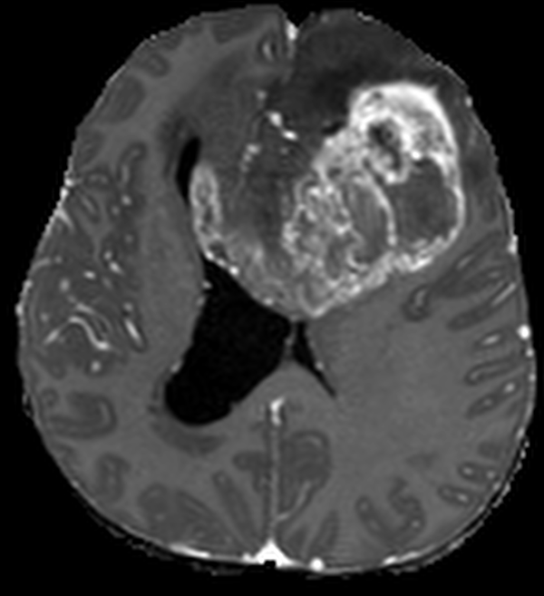
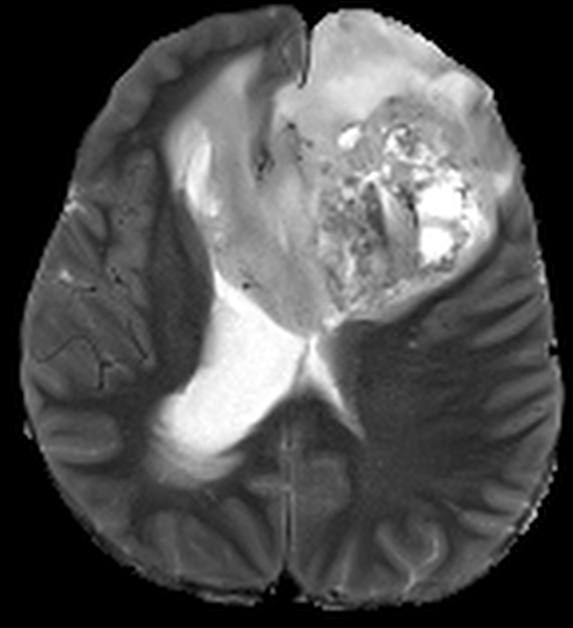
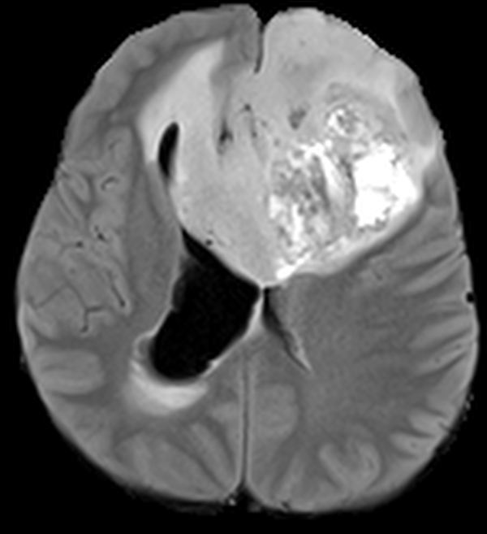


The input: one patient, four MRI images
LEVEL 1 · BASICS
T1
Anatomy
T1c (with contrast dye)
Active tumour rim glows
T2
Fluid is bright
FLAIR
Swelling (oedema) is bright
4 images = 4 channels, like a colour photo has 3 (red, green, blue)
Voxel = a 3D pixel (1 mm cube). One training scan: 128 × 168 × 136 ≈ 2.9 million voxels per channel
Notes:
[About 0:55]
Let's look at the input. For each patient we get four MRI images of the same brain, taken with different scanner settings.
T1 shows the anatomy. T1c is T1 after contrast dye is injected: the active tumour rim glows bright. T2 shows fluid as bright. FLAIR is like T2 but it darkens normal fluid, so swelling stands out.
Each sequence shows a different part of the tumour best, so we give all four to the model, stacked together as four channels, just like a colour photo has three channels: red, green and blue.
And these are 3D, so instead of pixels we have voxels: 3D pixels, each a 1-millimetre cube. One cropped scan in training was 128 by 168 by 136 voxels. That is about 2.9 million voxels for each channel.

Slide 5
The answer key: expert labels for every voxel
LEVEL 1 · BASICS
0
Background · healthy brain and empty space
1
Necrotic core · dead tissue in the centre
2
Oedema · swelling around the tumour
3
Enhancing tumour · active rim, bright on T1c
BraTS 2023 adult glioma: 1,251 labelled scans
Train · 875
Val · 188
Test · 188
Train = study material · Validation = practice tests to choose the best model · Test = the final exam, used once at the end
Expert label on T1c, test scan 00449
Notes:
[About 0:55]
Now the answers. For each training scan, experts gave every voxel a number: 0 for background, 1 for necrotic core, 2 for oedema and 3 for enhancing tumour. That is the answer key the model learns from.
The data comes from BraTS 2023, a public research challenge dataset with 1,251 labelled adult glioma scans. We split it into three parts: 875 scans for training (the study material), 188 for validation (practice tests that we use to choose the best version of the model), and 188 for testing (the final exam, used only once at the end).
Remember this split. It comes back in the advanced part.

Slide 6
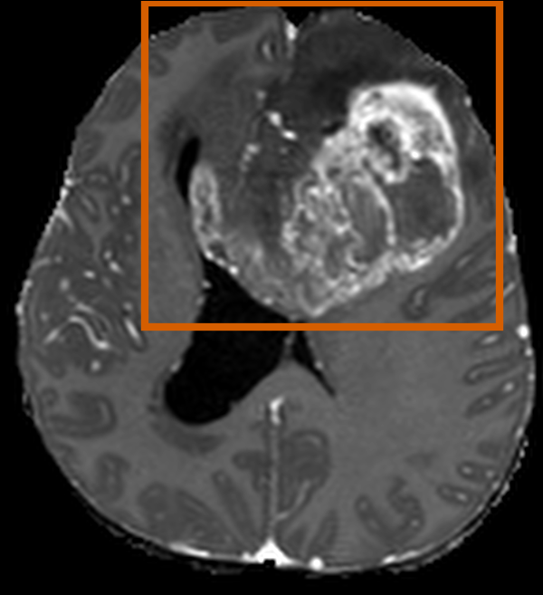
Three ways to "see" a tumour
LEVEL 1 · BASICS
Classification
Detection
Segmentation
MedTwin
Is there a tumour?
Where is it, roughly?
Which voxels are tumour, and which part?
YES: tumour
Output: one answer per scan
Output: a box
Output: a label for every voxel
Segmentation = classification done for every voxel: millions of tiny decisions per scan.
Notes:
[About 0:40]
There are three common vision tasks. Classification answers one question for the whole image: is there a tumour, yes or no. Detection draws a box around it. Segmentation goes further: it labels every single voxel. That is what MedTwin does.
You can think of segmentation as classification done millions of times, once for every voxel. That is why the output gives exact shapes and volumes, not just a box.

Slide 7





Preprocessing: make every scan speak the same language
LEVEL 2 · THE MODEL
STEP 1
STEP 2
STEP 3
STEP 4
STEP 5
Orient
Resample
Normalise
Crop
Pad
Turn every scan to the same direction: RAS (Right, Anterior, Superior).
Make every voxel exactly 1 mm, whatever slice thickness the hospital used.
Fix brightness differences, per channel, inside the head:
z = (x − mean) / std
Cut away the empty black background to save memory.
Grow each side to a multiple of 8, because the U-Net halves the size 3 times (2 × 2 × 2 = 8).
Why bother? Scanners differ in angle, brightness and slice thickness. Without this step the model can end up learning the scanner instead of the tumour.
Notes:
[About 0:55]
Before the model sees a scan, we clean it up so that every scan "speaks the same language".
One: orient. Rotate every scan to the same standard direction, called RAS: right, anterior, superior.
Two: resample. Make every voxel exactly 1 millimetre, because hospitals scan with different slice thicknesses.
Three: normalise. Scanners give different brightness numbers, so inside the head we subtract the mean and divide by the standard deviation, for each channel. That is the z-score from statistics.
Four: crop away the empty black background to save memory.
Five: pad each side to a multiple of 8, because the U-Net halves the size three times, and 2 × 2 × 2 is 8.
If we skip this, the model can end up learning the scanner instead of the tumour. In the full app there are also earlier steps: converting hospital DICOM files, aligning the four scans to each other, and removing the skull.

Slide 8
Convolution: a small filter sliding over the image
LEVEL 2 · THE MODEL
Input patch (6 × 6)
Stacking layers
Feature map: edge found!
Early layers
edges and bright spots
Filter (learned)
1
−1
0
+1
×
−1
0
+1
Middle layers
textures, rims, blobs
2
−1
0
+1
3
Deep layers
"this looks like enhancing tumour"
Multiply each filter number by the pixel under it, add them up → one output number. Slide and repeat.
In MedTwin: 3D filters (3 × 3 × 3) that also look at the slices above and below.
Nobody writes the filter numbers: the network learns them from the examples.
Notes:
[About 1:10]
Now the core idea behind image models: convolution. Take a small grid of numbers, called a filter or kernel; here it is 3 by 3. Slide it over the image. At each position, multiply each filter number by the pixel under it, add everything up, and write one number into the output.
This filter has minus ones on the left and plus ones on the right, so it gives a big number exactly where dark changes to bright: an edge. The output is called a feature map. You can see the orange columns where the edge was found.
The important part: in a CNN, a convolutional neural network, nobody writes these numbers. The network learns them during training. Early layers learn simple things like edges, middle layers combine them into textures and rims, and deep layers respond to things like "this looks like enhancing tumour".
Because MRI is 3D, MedTwin uses 3D filters, 3 by 3 by 3, so the model also looks at the slices above and below.

Slide 9
The 3D U-Net: squeeze to understand, expand to locate
LEVEL 2 · THE MODEL
MRI in
4 channels
16
16
Labels out
4 classes
MedTwin's network
skip connections: copy fine detail across
MONAI 3D U-Net
4 channels in → 4 classes out
16 → 32 → 64 → 128 feature channels
1.19 million parameters (learned numbers)
Residual units: shortcut paths that make training easier
Batch norm: keeps values in a stable range
32
32
64
64
ENCODER
What is in the scan?
Halve the size, double the channels
DECODER
Where exactly is it?
Double the size back up
128
Notes:
[About 1:20]
The model is a 3D U-Net, named after its U shape.
The left side is the encoder. At each step it halves the size of the image and doubles the number of feature channels: 16, 32, 64, 128. Smaller image, richer description. It learns WHAT is in the scan, but it loses exact positions.
The right side is the decoder. It doubles the size back, step by step, to the original resolution, to work out WHERE exactly each part is.
The dashed lines are skip connections. They copy fine detail from the encoder straight across to the decoder, so the tumour edges stay sharp.
MedTwin's network takes 4 channels in and gives 4 classes out, and it has about 1.19 million learnable numbers, called parameters. It also uses residual units, which are shortcut paths that make training easier, and batch normalisation, which keeps the numbers in a stable range.
[Advanced] 1.19 million parameters is small for a 3D segmentation model. That is one reason it can run on a laptop GPU.

Slide 10
From raw scores to a label: softmax and argmax
LEVEL 2 · THE MODEL
Raw scores (one voxel)
Label 3
Enhancing tumour
Confidence = 0.69
(the highest probability)
Background
0.0
softmax
argmax
Necrotic
0.7
Oedema
1.1
Enhancing
2.6
Toy numbers for one voxel. MedTwin does this for every voxel and shows the top probability as a "confidence" map. But high confidence is not the same as correct: we come back to this in Level 5.
Notes:
[About 0:40]
At the end, the network gives four raw scores for every voxel, one per class. Softmax turns these scores into probabilities that add up to 1.
In this made-up example voxel: 5% background, 10% necrotic, 15% oedema, 69% enhancing. Argmax just picks the biggest, so this voxel gets label 3, enhancing tumour.
The highest probability, 0.69, is what MedTwin shows as the "confidence" for that voxel. Keep that word, confidence, in mind. We will question it later.

Slide 11


The loss: one number that says how wrong we are
LEVEL 3 · TRAINING
93%
of all voxels are background
0.5%
necrotic core
Cross-entropy loss
Checks every voxel: is the probability for the right class high? It punishes confident mistakes the most.
Dice loss
Measures the overlap between the predicted and the true tumour, so a tiny region counts as much as a big one.
One test scan with a big tumour (00449). A lazy model that always says "background" would be 93% accurate, and useless.
MedTwin trains with DiceCE = Dice loss + cross-entropy
Notes:
[About 0:55]
To learn, the model needs a score for how wrong it is. That score is called the loss. But there is a trap.
In this test scan, which has a big tumour, 93% of all voxels are background, and the necrotic core is only half a percent. A lazy model that says "background" everywhere would be 93% accurate, and completely useless. This is called class imbalance.
So MedTwin uses two losses together. Cross-entropy looks at every voxel and punishes it when the probability for the correct class is low, especially when the model was confident and wrong. Dice loss measures the overlap between the predicted tumour and the true tumour, so a small region counts just as much as a big one. The combination is called DiceCE loss.

Slide 12

Training: guess, check, adjust, thousands of times
LEVEL 3 · TRAINING
1
Forward pass
Training settings
scan in → prediction out
Optimiser
Adam
43,750
updates
875 scans × 50 epochs
Learning rate
0.0001, slowly lowered (cosine)
4
Update (Adam)
2
Loss
nudge all 1.19 M weights a little
compare with the expert's answer
Weight decay
0.00001 (keeps weights small)
Epochs
50
Batch size
1 whole 3D scan at a time
3
Backpropagation
Augmentation
none
find each weight's share of the error
Hardware
RTX 5050 laptop GPU
One epoch = one pass over all 875 training scans.
Time
42.8 hours
Notes:
[About 0:55]
Training is a loop. One, forward pass: feed in a scan and get a prediction. Two, loss: compare it with the expert's answer. Three, backpropagation: use calculus (the chain rule) to find how much each of the 1.19 million weights contributed to the error. Four, update: the Adam optimiser nudges every weight a tiny bit in the direction that reduces the error.
The size of that nudge is the learning rate, 0.0001, and a cosine schedule slowly lowers it towards zero so the model settles down at the end.
One full pass over all 875 training scans is called an epoch. We trained for 50 epochs, one whole 3D scan at a time because each scan is big. That is 43,750 updates. On a laptop RTX 5050 GPU it took about 43 hours.
One honest note: no data augmentation was used. We will come back to that.

Slide 13
Watching it learn: training vs validation
LEVEL 3 · TRAINING
Training loss keeps falling; validation loss stops improving after about epoch 30. A widening gap is the start of overfitting: memorising, not learning.
0.8011
Best validation Dice, at epoch 44.
That checkpoint is saved and is the one the app uses.
Notes:
[About 0:55]
How do we know it is learning? We watch two kinds of curves.
On the left is the loss: blue is training, orange is validation. Both fall fast at first. After about epoch 30, the validation loss stops improving while the training loss keeps going down. That widening gap is the start of overfitting: the model gets better at its study material without getting better at new scans.
On the right is the validation Dice score, which I will define on the next slide. Higher is better. It climbs from 0.54 to about 0.80 and then flattens.
We saved the model from the best epoch: epoch 44, with validation Dice 0.8011. That checkpoint is the one used in the app. This is why we need a validation set: to choose the model without touching the test set.

Slide 14
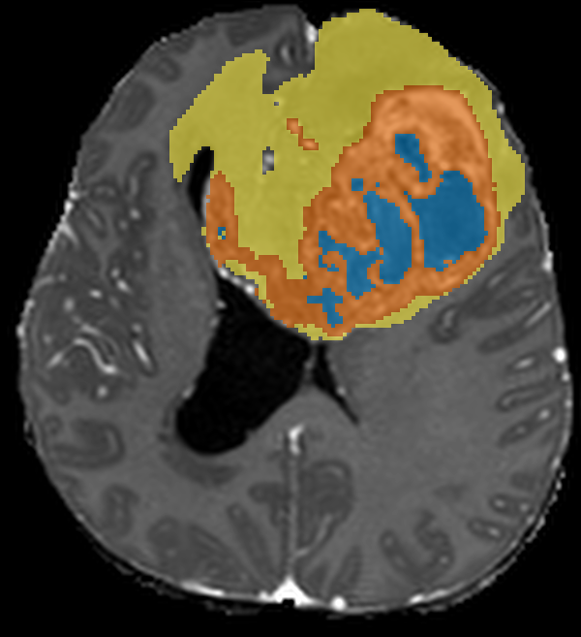
Measuring success: Dice and IoU
LEVEL 4 · EVALUATION AND USE
1 = perfect
0 = no overlap
The huge background is ignored, so the 93% trap disappears.
Expert
overlap
AI
Dice = 2 × overlap ÷ (expert + AI)
IoU = overlap ÷ area covered by either
Expert
MedTwin AI
Toy example: expert 100 voxels, AI 100 voxels, overlap 80
Dice = 160 ÷ 200 = 0.80 · IoU = 80 ÷ 120 = 0.67
Test scan 00449 · whole-tumour Dice 0.97 on this scan
0.78
0.69
0.98
mean Dice, 188 test scans
mean IoU, 188 test scans
whole-tumour volume agreement (ICC)
Notes:
[About 1:20]
Now, how good is it? Imagine the expert's outline and the AI's outline as two circles. Dice is two times the overlap, divided by the two sizes added together. IoU, intersection over union, is the overlap divided by everything covered by either one.
Toy example: the expert marks 100 voxels, the AI marks 100, and 80 overlap. Dice is 160 over 200, which is 0.80. IoU is 80 over 120, which is 0.67. Both are 1 for perfect and 0 for no overlap, and unlike accuracy they ignore the huge background.
On the 188 test scans, MedTwin got a mean Dice of 0.7822 and a mean IoU of 0.6939, averaged over the three tumour labels. For doctors, volume matters a lot: for whole-tumour volume, the agreement with the experts (ICC) was 0.98, where 1 is perfect. The images show a good case: the expert on the left and MedTwin on the right are almost the same.
[Advanced] BraTS research papers report scores on overlapping regions (whole tumour, tumour core, enhancing tumour), so our 0.78 over separate labels is not directly comparable with their numbers.

Slide 15



Running on a small GPU: sliding-window inference
LEVEL 4 · EVALUATION AND USE
The limit
96³ cube
The app must run on an ordinary laptop GPU. It was tested on an NVIDIA MX550 with 2 GB of memory.
Cut into cubes
Predict 96 × 96 × 96-voxel cubes that overlap by half, one at a time.
Blend back
Stitch the cubes together. In the overlaps, a cube's centre counts more than its edges (Gaussian weighting).
Result: about 20–35 s per prepared scan on that laptop (from the project README; not a formal benchmark).
Nine overlapping cubes cover this slice
Notes:
[About 0:40]
One practical problem: the app must run on a hospital laptop. Ours was tested on an NVIDIA MX550 with only 2 GB of GPU memory.
So instead of the whole scan at once, MedTwin cuts it into cubes of 96 by 96 by 96 voxels that overlap by half, predicts each cube, and blends the results back together. In the overlaps, the centre of each cube gets more weight than its edges (Gaussian weighting), because predictions near a cube's edge have less context.
[Advanced] The test score was measured with one pass over the whole volume, but the app uses windows. A complete evaluation would also score the exact setting the app uses.

Slide 16


Data leakage: when the exam has seen the answers
LEVEL 5 · ADVANCED LESSONS
28 / 188
test scans came from patients who also had a scan in training or validation
= 14.9% of the test set
Scan A
Training set (study)
Scan B
Test set (final exam)
One patient
The split was made per scan, not per patient, so the same tumour can sit on both sides.
Tumour centres of same-patient pairs: median 8.8 mm apart. Unrelated cases: 61.4 mm.
The fix
Split by patient: all scans of one person go into the same set. Then re-test on the 160 clean test scans. A score only counts if the test set is truly unseen.
So the test score may be optimistic, by an amount we don't know yet.
Notes:
[About 0:55]
Now the advanced lessons: the things that matter in real research. First, data leakage.
Our split was done per scan, not per patient, and some patients have two scans. When we checked afterwards, 28 of the 188 test scans (about 15%) came from patients who also had a scan in training or validation. Same patient, same tumour: the tumour centres of these pairs were a median of 8.8 mm apart, against 61.4 mm for unrelated cases.
So for those 28 scans, the exam had partly seen the answers, and the test score may be optimistic. We do not know by how much yet.
The fix is simple: split by patient, so all scans of one person stay in one set, and report results on the 160 clean test scans. The lesson: a high score means nothing if the test set is not truly unseen.

Slide 17
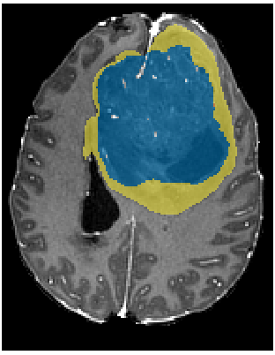
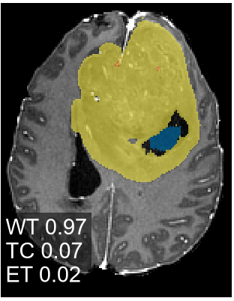
Where it fails, and why confidence can lie
LEVEL 5 · ADVANCED LESSONS
Expert
MedTwin AI
Test scan 00012: the expert's necrotic core is 172 cm³ (blue). MedTwin found 6 cm³ and called the rest oedema (yellow). Tumour-core Dice 0.07.
ICC: 1 = perfect agreement. The weak spot is the necrotic core. 10 test scans with large cores (> 50 cm³) were under-segmented: the model found a median of only 31% of the core.
Confidence ≠ correct. The softmax confidence is not calibrated, so a doctor reviews every result.
Notes:
[About 1:05]
Second lesson: always look at where the model fails, not only at the average.
This chart shows the volume agreement with the experts for each tumour part. Whole tumour and enhancing tumour are excellent, about 0.98. But the necrotic core is only 0.52. Why?
Look at this test scan on the right. The expert marked a huge necrotic core, 172 cubic centimetres, in blue. MedTwin found only 6 and called most of it oedema, in yellow. Its whole-tumour outline is still very good (Dice 0.97), but the tumour-core Dice is 0.07. In fact, 10 test scans with large necrotic cores were under-segmented like this: the model found a median of only 31% of the core.
Third lesson: the confidence number from softmax is not calibrated. A model can be confident and still wrong; in this scan the uncertainty stayed low over most of the missed core. That is why in MedTwin a doctor reviews, edits and approves every result.
[Ask the room] Why might the model be bad at very large necrotic cores? (Only about 1 in 20 test scans has one, so the model probably saw few such examples in training.)

Slide 18




How to make it better: ideas for your projects
LEVEL 5 · ADVANCED LESSONS
Data augmentation
Better splits
Strong baseline: nnU-Net
Randomly flip, rotate and change the brightness of training scans so the model sees more variety. MedTwin used none.
Split by patient and use cross-validation: train and test on several splits, then report the average and the spread.
A self-configuring U-Net that is a standard benchmark in medical image segmentation. Always compare with it.
Transformers
TTA and ensembles
Calibration
Models such as Swin UNETR use attention to relate distant parts of the scan; CNN filters look locally.
Average several predictions (flipped inputs, or several models). Usually more accurate, with better uncertainty.
Make "70% confident" mean right 70% of the time, for example with temperature scaling.
Each idea is a good mini-project for a 1st or 2nd year student.
Notes:
[About 0:55]
How could we do better? These are great project ideas for you.
One, data augmentation: randomly flip, rotate and change the brightness of training scans, so the model sees more variety. MedTwin used none.
Two, better splits: split by patient and use cross-validation, which means training and testing several times on different splits and reporting the average and the spread.
Three, compare with nnU-Net, a self-configuring U-Net that is a standard strong baseline in medical segmentation.
Four, try Transformers such as Swin UNETR. Attention lets the model relate distant parts of the scan, while a CNN filter only looks locally.
Five, test-time augmentation and ensembles: average several predictions. This usually improves accuracy and gives better uncertainty.
Six, calibration: make sure that "70% confident" really means right 70% of the time, for example with temperature scaling.

Slide 19
Five things
to remember
1
ML learns rules from labelled examples; segmentation gives every voxel a label.
WRAP-UP
2
A 3D U-Net encodes what, decodes where, and skip connections keep the detail.
3
With imbalanced data, choose the right loss (DiceCE) and metric (Dice, not accuracy).
Thank you! Questions?
Validation chooses the model; the test set must stay truly unseen: split by patient.
4
5
Study the failures, don't trust confidence blindly, and keep a doctor in the loop.
Built with Python, PyTorch and MONAI · data: BraTS 2023 adult glioma
Notes:
[About 0:40]
To wrap up, five things to remember. [Read the five points briefly.]
If you remember only one thing: a good ML project is not just a high score. It is honest data splits, the right metric, looking at the failures, and keeping a human in the loop.
Thank you. Questions?

