Slide 1
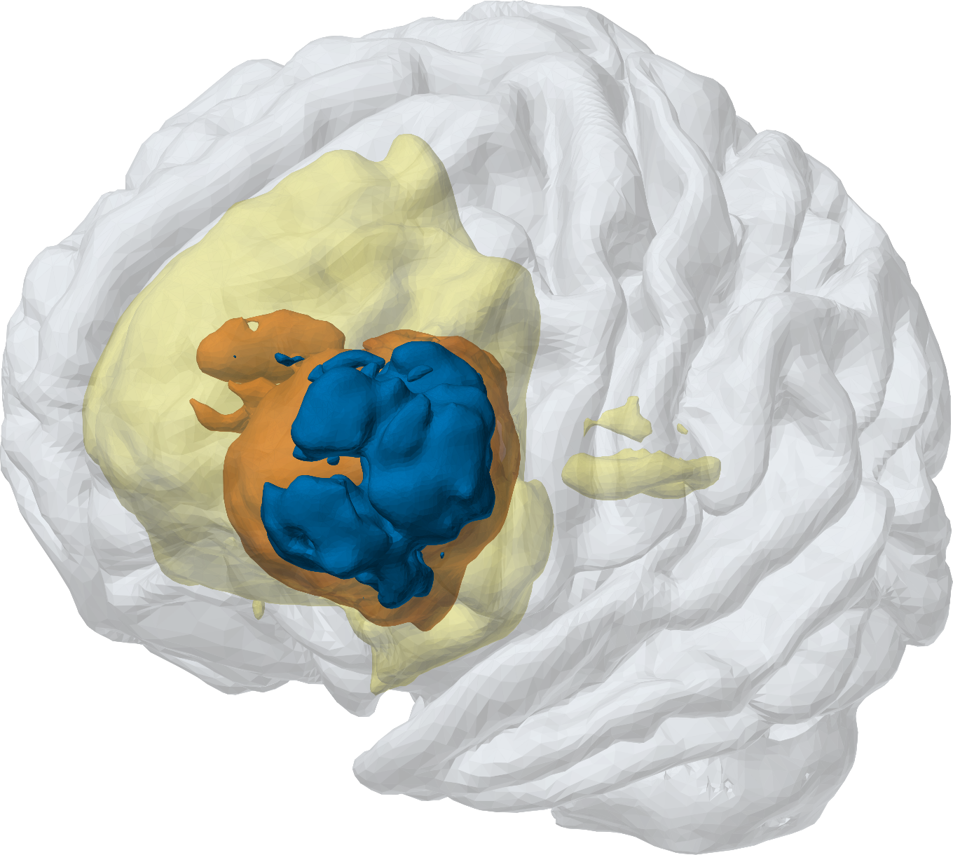
MedTwin
PROJECT PRESENTATION
AI that turns a brain MRI into a 3D digital twin, measured by AI and signed by the doctor
WORKING SYSTEM · 62 TESTS PASSING
[Your name / team] · Mentor: [Mentor's name]
[Department] · [College] · [Date]
MedTwin's 3D twin of test scan 00449: fitted cortex with the AI's tumour regions
Notes:
[About 0:30]
Good morning, sir and madam. Our project is MedTwin. MedTwin takes a patient's brain MRI, uses a 3D AI model to find the brain tumour, measures it, and builds a 3D model of that patient's brain, which we call a digital twin. The doctor checks it, corrects it if needed, and signs the report.
It is a working system with 62 automated tests passing. I will explain the problem, how our solution works, why we chose a U-Net, what the doctor sees, and, most importantly, how it can be implemented in any hospital.

Slide 2



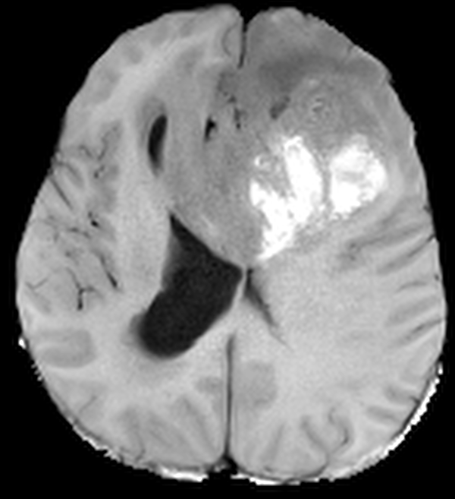
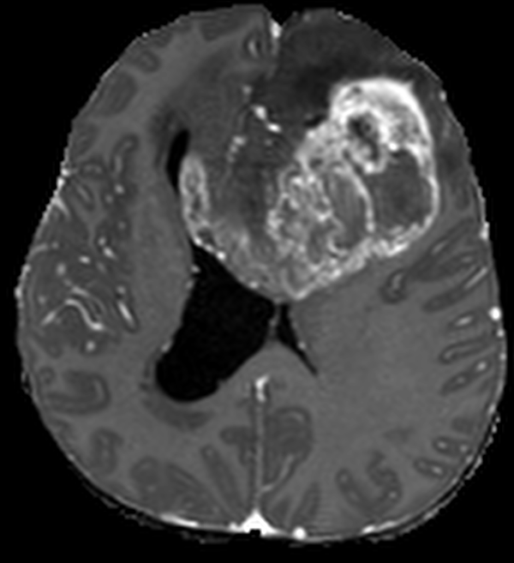

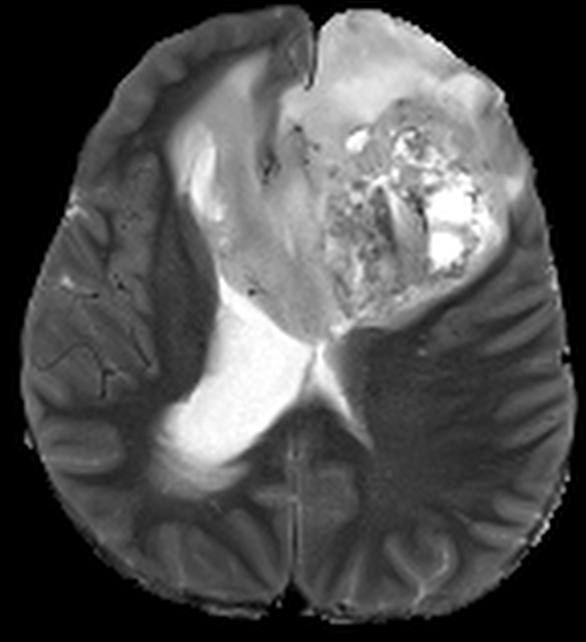
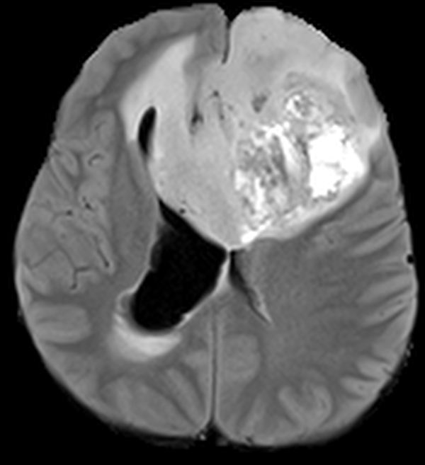
The problem: brain tumours are measured slowly and by hand
01 · THE PROBLEM
PROBLEM
SOLUTION
AI
PRODUCT
HOSPITALS
FUTURE
620
MRI images to read for one patient
4 sequences × 155 slices
Slow
Inconsistent
Hard to follow up
An expert outlines the tumour by hand, slice by slice.
Two experts often draw different outlines, so volumes vary.
"Is it growing?" needs exact, repeatable volumes across scans.
The gap
AI models for tumour segmentation exist, but they stay in research code: they need clean research files, give no numbers a doctor uses, and offer no way for a doctor to check, correct or sign the result.
Notes:
[About 0:55]
Glioma is a serious brain tumour. To plan treatment and follow-up, doctors need the size of each part of the tumour.
For one patient the MRI has four sequences of 155 slices each: 620 images. Outlining the tumour by hand on these is slow, two experts often draw different outlines, and so the most important follow-up question, 'is the tumour growing?', is hard to answer with exact numbers.
AI models for this exist, but they stay in research code. They need clean research files, they do not give the measurements doctors use, and a doctor cannot check, correct or sign their output. That is the gap MedTwin fills.

Slide 3
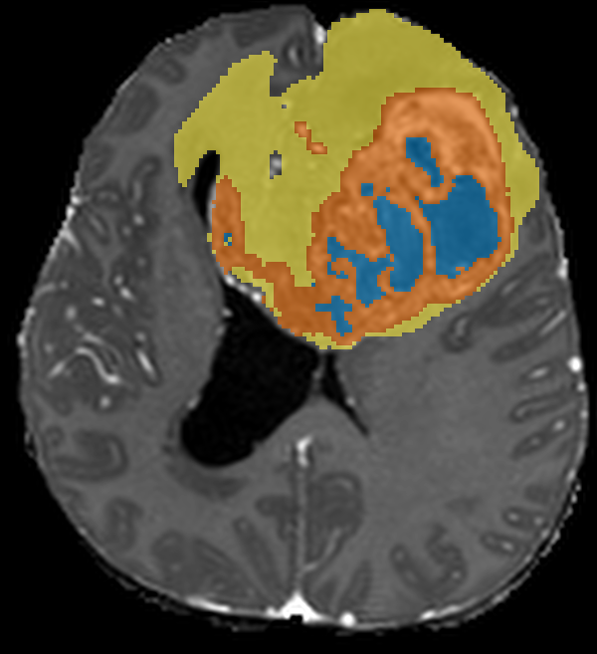

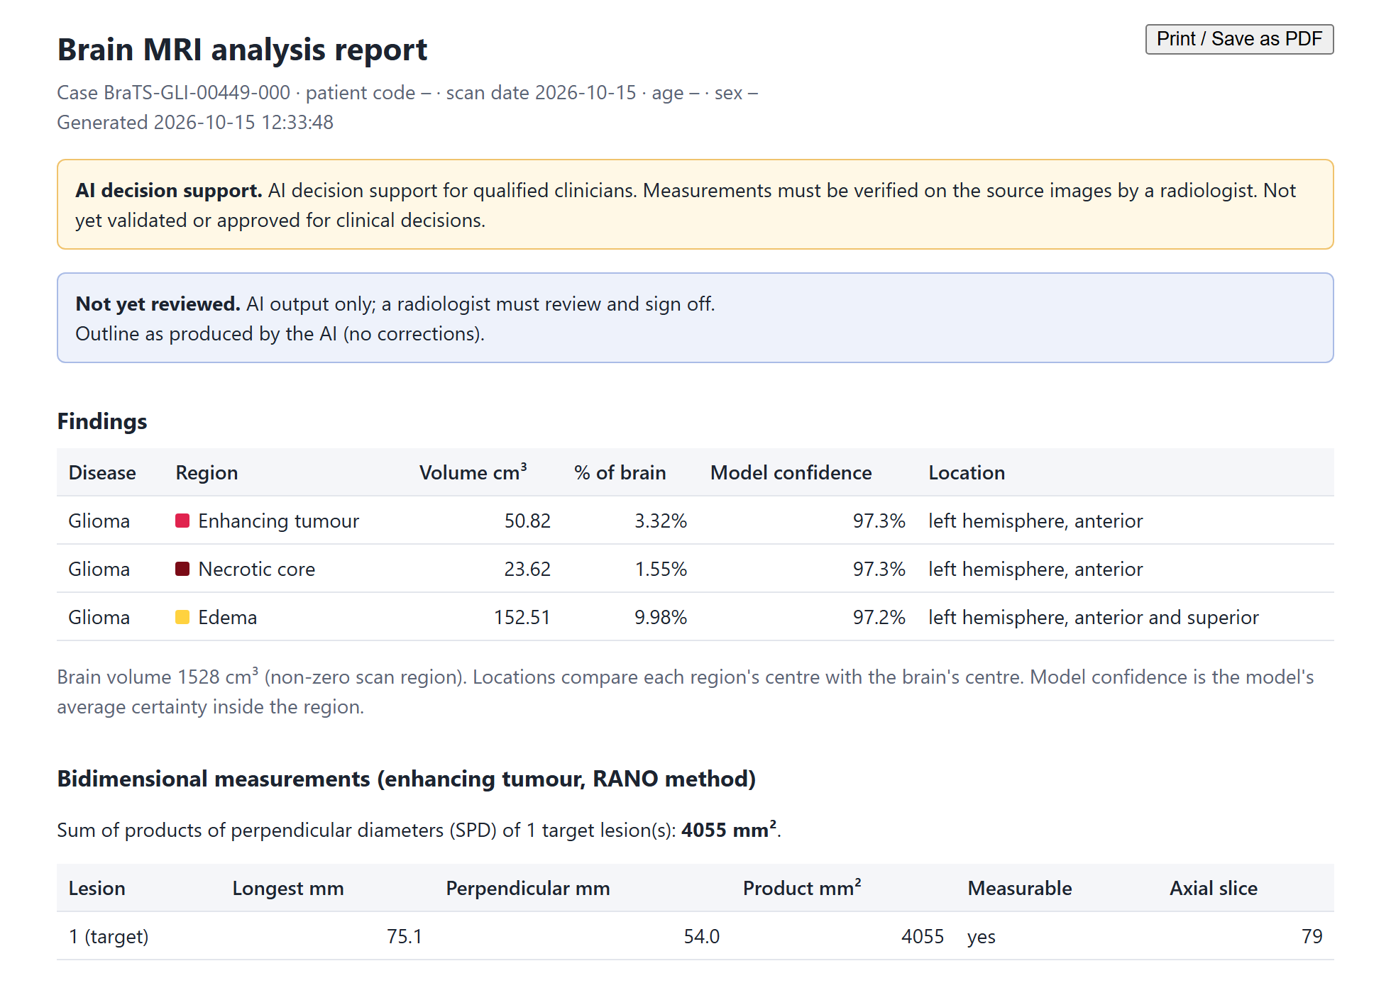
Our solution in one picture
02 · OUR SOLUTION
PROBLEM
SOLUTION
AI
PRODUCT
HOSPITALS
FUTURE
INPUT
4 MRI sequences
DICOM from the scanner, or NIfTI
MedTwin
3D digital twin
Tumour map on every slice
AI segmentation
3D reconstruction
Measurements
Report
Numbers doctors use
Enhancing 50.8 cm³
Necrotic 23.6 cm³
Oedema 152.5 cm³
RANO SPD 4,055 mm²
≈ 20–35 s per prepared case
Printable report
AI suggests, the doctor decides: the doctor reviews, corrects and signs before anything is final.
Notes:
[About 0:55]
Here is the whole idea in one picture. The input is the patient's four MRI sequences, straight from the scanner as DICOM, or as NIfTI files.
MedTwin then does four things: the AI segments the tumour, it reconstructs the brain and tumour in 3D, it measures everything, and it writes a report. For a prepared case this takes about 20 to 35 seconds on a small laptop GPU.
The outputs are a 3D digital twin, the tumour map on every slice, a printable report, and the numbers doctors use. For this test patient: enhancing tumour 50.8 cubic centimetres, necrotic core 23.6, oedema 152.5, and a RANO measurement of 4,055 square millimetres.
Our principle: AI suggests, the doctor decides. Nothing is final until the doctor signs.

Slide 4






Where MedTwin fits in the hospital's flow
02 · OUR SOLUTION
PROBLEM
SOLUTION
AI
PRODUCT
HOSPITALS
FUTURE
Patient
comes for an MRI
MRI scanner
4 sequences
PACS
stores the DICOM study
MedTwin
AI outline, 3D, numbers, report
Radiologist
reviews, corrects, signs
Clinician
gets the signed report
Follow-up
next scan, same flow
follow-up scans run through the same flow: "is it growing?"
TODAY
The radiologist reads every slice and measures by hand; comparing with the previous scan is manual.
WITH MEDTWIN
Outline, volumes, RANO and 3D are ready when the radiologist opens the case; they check, correct and sign.
Notes:
[About 0:55]
This is the normal hospital flow, and where MedTwin fits into it. The patient is scanned, the MRI scanner produces four sequences, and the study is stored in the PACS, the hospital's image archive.
MedTwin sits right after the PACS. It prepares the outline, the 3D model, the numbers and a draft report. The radiologist then reviews, corrects and signs, and the clinician receives the signed report. When the patient comes back for a follow-up scan, it goes through the same flow, and MedTwin compares it with the earlier scans.
So we do not change how the hospital works. Today the radiologist reads every slice and measures by hand. With MedTwin, the work is ready when they open the case; their job becomes checking and signing.

Slide 5



System architecture: three parts working together
02 · OUR SOLUTION
PROBLEM
SOLUTION
AI
PRODUCT
HOSPITALS
FUTURE
DOCTOR'S BROWSER
FASTAPI SERVER
MEDTWIN PIPELINE (GPU)
Upload: DICOM zip, NIfTI or demo case
REST API
1 Check
5 Build 3D brain
HTTPS
3D viewer (Three.js)
Accounts and roles
2 Align + strip skull
6 Measure + RANO
Slices + correction brush
Job queue: one GPU job at a time
3 Preprocess
7 Lesion meshes
Review · sign-off · follow-up
Audit trail + security log
4 Segment (3D U-Net)
8 Report
Printable report + STL files
HTTPS on the hospital network
after DICOM import and de-identification
Stored per case: results · meshes · slices · review · audit · report
Python · PyTorch · MONAI · SimpleITK · HD-BET · trimesh · FastAPI · Three.js
Notes:
[About 0:55]
Technically, MedTwin has three parts. On the left, the doctor's browser: nothing to install. The doctor uploads a study, watches the progress, works in the 3D and slice viewers, corrects with a brush, signs off and prints the report.
In the middle, a FastAPI server. It provides the API, accounts and roles, the audit trail and security log, and a queue so only one analysis uses the GPU at a time.
On the right, the MedTwin pipeline, our Python package, which does the real work in eight steps on the GPU. Everything for a case is stored together. The main open-source libraries are listed at the bottom.

Slide 6
How it works: from scanner files to a signed report
02 · OUR SOLUTION
PROBLEM
SOLUTION
AI
PRODUCT
HOSPITALS
FUTURE
0
1
2
3
4
DICOM import
Check
Align + strip skull
Preprocess
Segment
find MR series, suggest roles, de-identify
four readable 3D sequences
rigid registration; HD-BET when needed
RAS, 1 mm, z-score, crop, pad
3D U-Net, 96³ windows + confidence
8
7
6
5
Doctor review
Report
Lesion meshes
Measure
Build 3D brain
brush corrections rerun steps 6–8 in about 3 s; then sign off
results, slices, printable report
marching cubes, smoothing, GLB / STL
volumes, location, lesions, RANO, checks
exact surface + fitted cortex
≈ 20–35 s per prepared case on a 2 GB MX550 laptop GPU
≈ 5 min for a raw DICOM study that needs skull stripping (CPU)
Notes:
[About 1:00]
Here is the pipeline after one click. Step 0 reads the DICOM study, finds the MRI series, suggests which is T1, T1 contrast, T2 and FLAIR, and never reads patient identifiers. Step 1 checks the four sequences. Step 2 aligns them and removes the skull with HD-BET when needed. Step 3 applies exactly the preprocessing used in training. Step 4 is the AI: the 3D U-Net segments the tumour and gives a confidence map.
Along the bottom row: step 5 builds the 3D brain, step 6 measures volumes, location, separate lesions and RANO diameters, with safety checks, step 7 builds the tumour meshes and step 8 writes the report. If the doctor corrects the outline, steps 6 to 8 rerun in about 3 seconds.
A prepared case takes about 20 to 35 seconds on a 2 GB laptop GPU; a raw hospital study that needs skull stripping takes about 5 minutes on the CPU.

Slide 7
How we built the AI: the training flow
03 · THE AI
PROBLEM
SOLUTION
AI
PRODUCT
HOSPITALS
FUTURE
1
Data BraTS 2023 adult glioma: 1,251 scans, 4 sequences + expert labels
2
Check 6,255 files checked: shape, orientation, labels
3
Preprocess RAS orientation, 1 mm voxels, z-score, crop, pad
4
Split 875 train · 188 validation · 188 test scans
5
Train 3D U-Net, Dice + cross-entropy loss, Adam 1e-4, 50 epochs
6
Validate score every epoch; keep the best: 0.8011 at epoch 44
7
Test 188 held-out scans: mean Dice 0.78
42.8 hours of training on an RTX 5050 laptop GPU. The score levelled off near 0.80 after epoch 31.
8
Deploy model bundle (4.6 MB weights + settings) loaded by the app
Notes:
[About 1:00]
This is how we built the AI, step by step. We used the BraTS 2023 adult glioma dataset: 1,251 scans, each with four sequences and an expert's label for every voxel. We checked all 6,255 files, then preprocessed them the same way every time: same orientation, 1-millimetre voxels, normalised brightness, cropped and padded.
We split the scans into 875 for training, 188 for validation and 188 for testing. The 3D U-Net trained for 50 epochs with a Dice plus cross-entropy loss and the Adam optimiser. After every epoch we scored it on the validation set and kept the best: 0.8011 at epoch 44. That model scored a mean Dice of 0.78 on the 188 test scans, and it is packed into a model bundle, 4.6 megabytes of weights plus settings, which the app loads.
Training took 42.8 hours on a laptop GPU, and the curve shows the score levelling off near 0.80.

Slide 8






Why we chose a 3D U-Net
03 · THE AI
PROBLEM
SOLUTION
AI
PRODUCT
HOSPITALS
FUTURE
MedTwin's 3D U-Net: 4 MRI channels → 4 classes
Built for medical images
Exact outlines
MRI
4 ch
16
skip connections keep the detail
16
Labels
4 classes
Designed for biomedical segmentation; works with a limited number of labelled scans (we had 875 to train on).
Skip connections carry fine detail from the encoder to the decoder, so tumour edges stay sharp.
32
32
Sees in 3D
Small and fast
3D filters use the slices above and below: the tumour is a 3D object, not a set of pictures.
1.19 million parameters: fits a 2 GB laptop GPU; a prepared case in about 20–35 s.
64
64
128
Proven in BraTS
Ready and upgradable
ENCODER
what is in the scan?
DECODER
where exactly is it?
U-Net-style encoder–decoders underpin most top BraTS methods, including nnU-Net.
MONAI provides a tested 3D U-Net; the pipeline can later swap in nnU-Net or a Transformer.
Notes:
[About 1:05]
Why did we choose a U-Net? The diagram shows its U shape. The encoder on the left shrinks the scan step by step and learns WHAT is in it; the decoder on the right grows it back and works out WHERE exactly each part is. The dashed skip connections copy fine detail across, so the tumour edges stay sharp.
Six reasons. One, U-Net was designed for biomedical segmentation and works with a limited number of labelled scans; we had 875 to train on. Two, exact outlines, thanks to the skip connections, and we need exact outlines to measure volume. Three, the 3D version uses the slices above and below. Four, it is small: 1.19 million parameters, so it runs on a 2 GB laptop GPU. Five, it is proven: most top BraTS methods, including nnU-Net, are U-Net-style networks. Six, MONAI gives a tested implementation, and we can upgrade later to nnU-Net or a Transformer without changing the rest of the system.

Slide 9
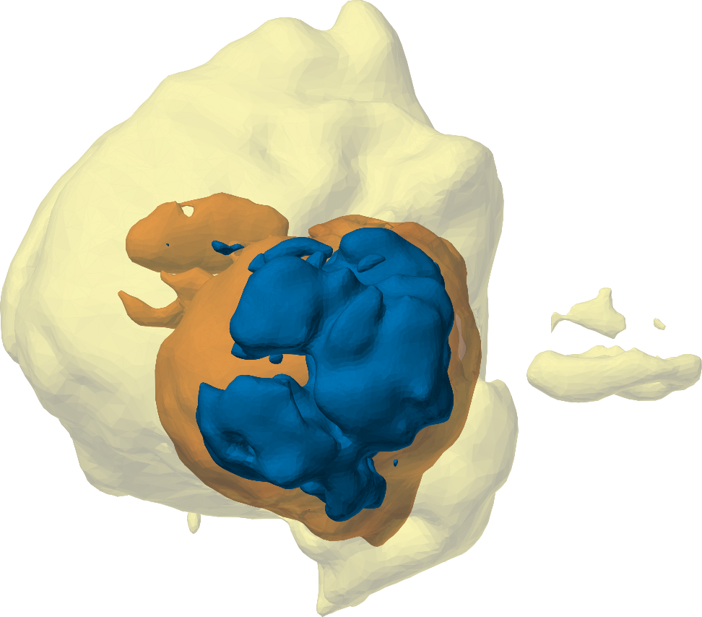
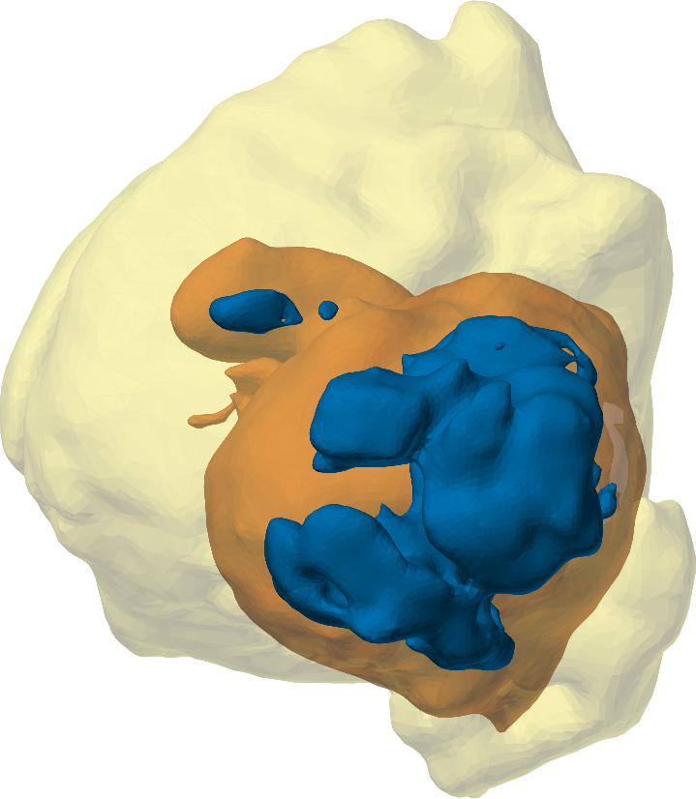
Results: accurate tumour outlines and volumes
03 · THE AI
PROBLEM
SOLUTION
AI
PRODUCT
HOSPITALS
FUTURE
0.78
mean Dice
188 held-out test scans
0.69
mean IoU
188 held-out test scans
0.98
whole-tumour volume
agreement with experts (ICC)
0.97
whole-lesion Dice
example test scan 00449
MedTwin AI
Expert
Notes:
[About 1:00]
The results. On the 188 held-out test scans, the mean Dice score is 0.78 and the mean IoU is 0.69. Dice measures how much the AI's outline overlaps the expert's, where 1 is perfect. For doctors, volume matters most: whole-tumour volume agrees with the experts with an ICC of 0.98.
On the left is one test patient in 3D, our AI next to the expert's outline. For this scan the whole-lesion Dice is 0.97.
The chart is honest about our weak spot: the necrotic core agrees less, 0.52, mainly because of a few scans with very large necrotic cores. A stronger model and more training examples are the fix, which I will show in the future plan.

Slide 10
The 3D digital twin of every patient
04 · THE PRODUCT
PROBLEM
SOLUTION
AI
PRODUCT
HOSPITALS
FUTURE
How the twin is built
1
Template FreeSurfer fsaverage folded cortex (41k vertices per hemisphere)
2
Fit scale and ICP alignment to the patient's brain
3
Warp pull the gyral crowns onto the patient's outline: 7.08 → 3.81 mm
4
Complete cerebellum and brainstem from the scan; tumour meshes added
Cut planes
Opacity
Hover details
Expert wireframes
Auto-rotate
STL download
Necrotic core
Oedema
Enhancing tumour
Fitted cortex
Folds come from the template, not the patient; an "Exact (from scan)" view is also available.
Notes:
[About 0:50]
This is the digital twin of one test patient. MRI scans are too coarse to show the brain's folds, so MedTwin takes a standard folded brain, FreeSurfer's fsaverage template, and fits it to the patient: it scales and aligns it, then warps the gyral crowns onto the patient's own brain outline. For this patient the average distance dropped from 7.08 to 3.81 millimetres. The cerebellum and brainstem come from the scan, and the tumour regions are added as colour-coded meshes in real millimetres.
The doctor can cut through it, change opacity, hover for details and download STL files, for example for 3D printing or surgical planning. The folds are the template's, so there is also an exact view straight from the scan.

Slide 11
The doctor's workflow: who does what
04 · THE PRODUCT
PROBLEM
SOLUTION
AI
PRODUCT
HOSPITALS
FUTURE
DOCTOR
Sign in
role-based account
Upload
DICOM zip + patient code
Confirm
check the four series
Inspect + correct
3D, slices, brush
Approve or reject
name, role, reason
MEDTWIN
Detect series
suggest T1, T1c, T2, FLAIR; thumbnails
Analyse
8-step pipeline, live progress
Recalculate
volumes, meshes, report in about 3 s
Record
audit trail + follow-up timeline
Print the signed report → the clinician receives it; the next scan of this patient appears on the follow-up timeline with % change and a RANO-based category.
Notes:
[About 1:00]
This swimlane shows who does what. The top lane is the doctor, the bottom lane is MedTwin.
The doctor signs in with their own account and uploads the DICOM zip with a patient code. MedTwin detects the series and suggests which is which, with thumbnails. The doctor confirms, and MedTwin runs the eight-step analysis with live progress. The doctor inspects the result in 3D and on the slices and corrects anything with the brush; MedTwin recalculates volumes, meshes and the report in about 3 seconds. Finally the doctor approves, or rejects with a reason, and MedTwin records everything in the audit trail and on the patient's follow-up timeline.
In our follow-up test, the enhancing tumour grew from 12.3 to 50.8 cubic centimetres, and MedTwin reported radiographic progression automatically.

Slide 12






What the doctor receives: a clear, printable report
04 · THE PRODUCT
PROBLEM
SOLUTION
AI
PRODUCT
HOSPITALS
FUTURE
Volumes
per region, AI vs corrected, % of brain
Location in words
"left hemisphere, anterior", checked against the raw scan
Model confidence
average certainty inside each region
RANO measurement
75.1 × 54.0 mm; SPD 4,055 mm²
Separate lesions
count, size and location of each
Review status
not reviewed, approved or rejected, with signature
Real MedTwin report for test scan 00449 (AI output, not yet reviewed)
Notes:
[About 0:50]
This is a real report produced by MedTwin for a test patient, before review. The top clearly says it is AI decision support and not yet reviewed.
It gives the volume of each region and its share of the brain, the location in plain words, the model's confidence, and the RANO measurement: 75.1 by 54.0 millimetres, product 4,055 square millimetres, the standard measurement in neuro-oncology. It lists separate lesions, and after review it shows who approved it, with a signature block.
While testing we found that the original research code reported the tumour side inverted, left for right. We fixed it in the app and checked the location against the raw scan.

Slide 13




Inside the hospital: deployment architecture
05 · IN EVERY HOSPITAL
PROBLEM
SOLUTION
AI
PRODUCT
HOSPITALS
FUTURE
HOSPITAL NETWORK (LAN): NOTHING LEAVES THE HOSPITAL
Security built in
DICOM identifiers never read or stored
MRI scanner
Passwords hashed (PBKDF2-SHA256); lockout after 5 wrong tries
Radiologist
review, correct, sign
results back (next)
Recovery codes or admin reset: no email needed
DICOM
Secure sessions, CSRF protection, security headers
Clinician
read-only
MedTwin server
NVIDIA GPU PC · HTTPS :8443
Audit trail of every action; revision check between doctors
study (zip today)
Runs on the hospital LAN: no cloud upload
PACS archive
hospital login / SSO (next)
Administrator
accounts
works today
next step
Notes:
[About 1:00]
This is how MedTwin sits inside a hospital. Everything stays on the hospital's own network; nothing goes to the cloud.
The MRI scanner sends DICOM to the PACS archive, as it does today. One PC with an NVIDIA GPU runs the MedTwin server. Today, the study is exported from the PACS as a zip and uploaded; the next step is automatic sending from the PACS to MedTwin, and sending the results back to the PACS. Doctors use their existing workstations: radiologists review, correct and sign, clinicians view, and an administrator manages accounts, all through the browser over HTTPS.
Security is built in: identifiers are never read, passwords are hashed with lockout, recovery works without email, sessions are protected, every action is audited, and a revision check stops one doctor from overwriting another's work.

Slide 14








How to implement it in any hospital: step by step
05 · IN EVERY HOSPITAL
PROBLEM
SOLUTION
AI
PRODUCT
HOSPITALS
FUTURE
STEP 1
STEP 2
STEP 3
STEP 4
STEP 5
STEP 6
Install
Silent pilot
Local validation
Train the team
Connect
Go live + monitor
One GPU PC in radiology; start_network.bat (HTTPS); create admin and doctor accounts
Runs alongside normal reporting; radiologists compare AI with their own reads; no clinical decisions
Hospital scans vs radiologist outlines on local scanners; ethics committee approval
Radiologists: review and sign · clinicians: view · admin: accounts and backups
PACS auto-send, results back to PACS, hospital login (single sign-on)
Doctor signs every case; audit trail; regular accuracy checks; feedback to improve the model
Before clinical use: ethics approval for the pilot and regulatory clearance (CDSCO) before AI results guide decisions.
Scale: big hospitals run their own server; smaller hospitals can share one regional server over a secure network (hub and spoke).
Notes:
[About 1:05]
How would a hospital actually adopt MedTwin? In six steps, the traditional way new tools enter radiology.
Step one, install: one GPU PC in the radiology department, run the network start script, create the administrator and doctor accounts. This already works today. Step two, a silent pilot: MedTwin runs alongside normal reporting and radiologists compare its results with their own, with no clinical decisions based on it. Step three, local validation: test on the hospital's own scanners against radiologists' outlines, with ethics committee approval. Step four, train the team. Step five, connect it to the PACS and the hospital login. Step six, go live and keep monitoring: the doctor signs every case, everything is audited, and feedback improves the model.
Before AI results guide clinical decisions, regulatory clearance from CDSCO is needed. To reach every hospital: large hospitals run their own server, and smaller ones can share a regional server, hub and spoke.

Slide 15


Why it matters: the impact
06 · WHAT'S NEXT
PROBLEM
SOLUTION
AI
PRODUCT
HOSPITALS
FUTURE
Fast, consistent tumour measurements and a 3D view the doctor can trust, on a low-cost laptop GPU, inside the hospital.
For doctors
For patients
For hospitals
Review and correct instead of outlining from scratch. Standard RANO numbers and volumes in one report.
Consistent follow-up: "is it growing?" answered with numbers. A 3D view that helps explain the treatment.
Runs on a 2 GB GPU on the hospital network. No cloud upload, so data stays inside. Built on open-source libraries.
Notes:
[About 0:40]
So why does it matter? MedTwin gives fast, consistent tumour measurements and a 3D view a doctor can trust, on a low-cost laptop GPU, inside the hospital.
Doctors review and correct instead of outlining from scratch. Patients get consistent follow-up and a 3D view that helps them understand their treatment. Hospitals can run it on modest hardware on their own network, with no cloud upload, which protects privacy and suits hospitals with limited budgets.

Slide 16


Questions?
THANK YOU
What we need to take it to a hospital
01
A pilot hospital: a radiology department willing to run the silent pilot
Happy to show MedTwin live: upload, 3D twin, correction and signed report.
02
Local scans with radiologist outlines, with ethics approval, to validate and fine-tune
LIVE DEMO READY
03
A stronger GPU to train nnU-Net and larger models
[Your name / team] · Mentor: [Mentor's name]
Notes:
[About 0:30]
To summarise: MedTwin is a working, tested system that takes a brain MRI to a measured 3D digital twin and a signed report, and it fits into the normal hospital flow.
To take it into a hospital we need three things: a pilot hospital willing to run the silent pilot, local scans with radiologist outlines to validate and fine-tune the model, and a stronger GPU for the next models. With your support, sir and madam, we would like to start with a pilot.
Thank you. We are happy to take questions or show MedTwin live.

