Slide 1
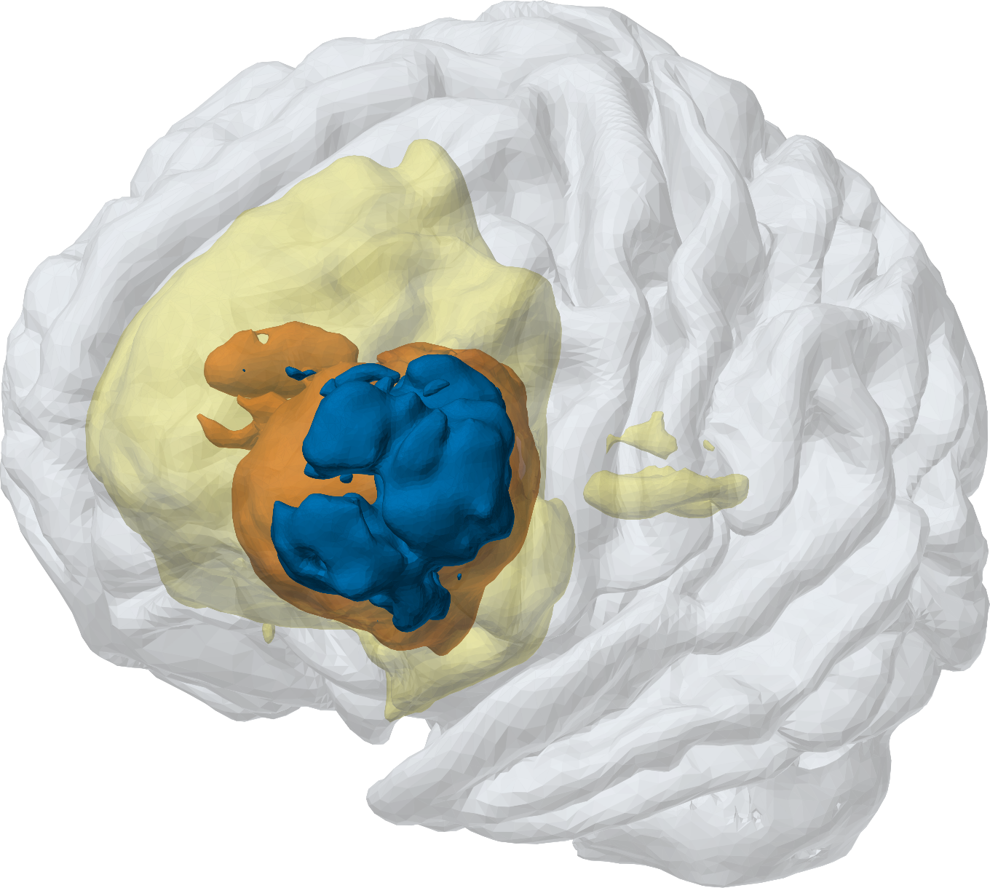
MedTwin
PROJECT REVIEW
From a brain MRI to a 3D digital twin a doctor can trust
SYSTEM COMPLETE · PAPER DRAFT READY
[Your name] · Guide: [Guide's name]
[Department] · [College] · [Date]
MedTwin's 3D twin of test scan 00449: fitted cortex with the AI's tumour regions
Notes:
[About 0:30]
Good morning, sir/madam. Today I will present my project, MedTwin. In one line: MedTwin takes a patient's brain MRI, finds the glioma tumour with a 3D AI model, measures it, and builds a 3D model of that patient's brain, which we call a digital twin. A doctor can then check it, correct it and sign it off.
The system itself is complete and tested, and the research paper draft is ready. I will cover four things: why I chose this problem, what I built, what it delivers, and what comes next.

Slide 2



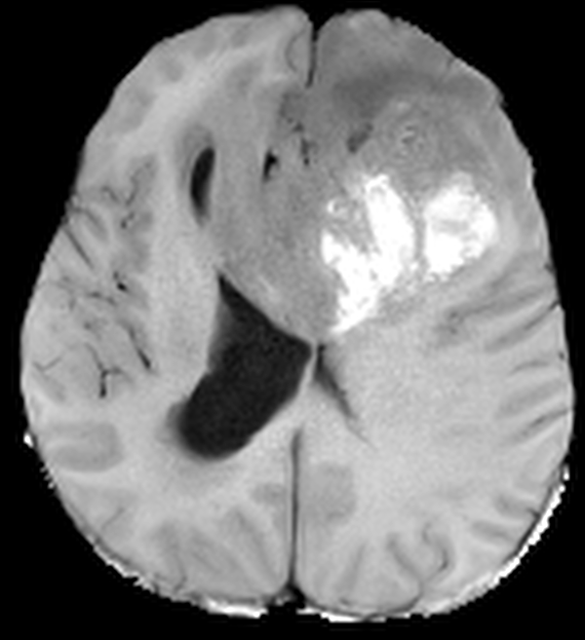
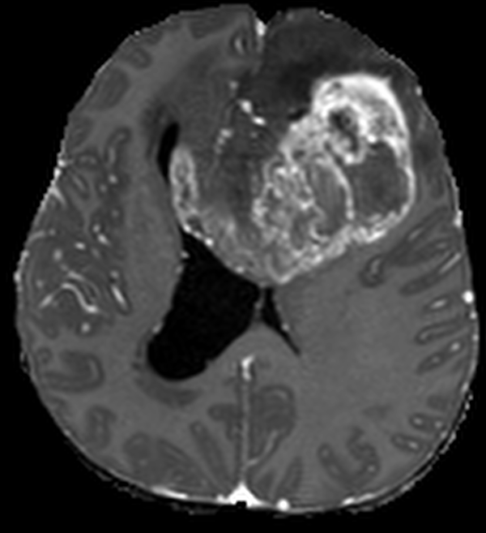

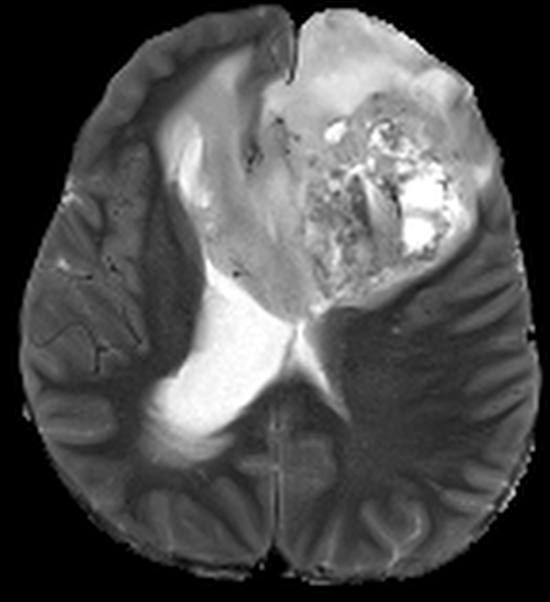
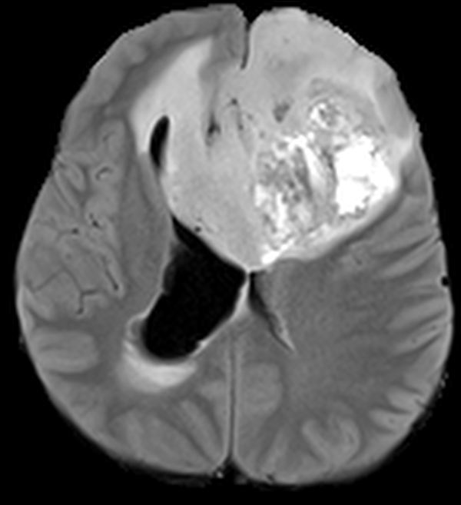
The problem: brain tumours are measured slowly and by hand
01 · WHY THIS PROJECT
WHY
BUILT
DELIVERS
NEXT
620
MRI images to read for one patient
4 sequences × 155 slices
Slow
Inconsistent
Hard to follow up
An expert outlines the tumour by hand, slice by slice.
Two experts often draw different outlines, so volumes vary.
"Is it growing?" needs exact, repeatable volumes across scans.
The gap I targeted
Research AI models stop in a notebook. They need clean research files, give no numbers a doctor uses, and offer no way for a doctor to check, correct or sign the result. MedTwin turns the model into a tool doctors can actually use.
Notes:
[About 1:00]
Glioma is the brain tumour this project covers. To plan treatment and follow-up, doctors need the size of each part of the tumour: the active enhancing part, the dead necrotic core and the swelling around it.
For one patient there are four MRI sequences, each with 155 slices: 620 images. Outlining the tumour by hand on these is slow, and two experts often draw different outlines, so the volumes vary. That makes it hard to answer the key follow-up question: is the tumour growing?
Many AI papers solve the segmentation part, but the model stays in a notebook. It needs clean research data, gives no clinical measurements, and has no way for a doctor to check or sign the result. That gap, from research model to a doctor's tool, is what I targeted.

Slide 3






Objectives: what I set out to build
01 · WHY THIS PROJECT
WHY
BUILT
DELIVERS
NEXT
01
DONE
02
DONE
03
DONE
AI segmentation
Clinical measurements
3D digital twin
Train a 3D model that outlines the three glioma regions on MRI (BraTS 2023).
Volumes, % of brain, location in plain words, RANO diameters.
A patient-specific 3D brain with colour-coded tumour regions.
04
DONE
05
DONE
06
DRAFT READY
Doctor web app
Hospital-ready
Research paper
Upload → progress → review and correct → signed, printable report.
DICOM input, multi-doctor accounts and a secure HTTPS network mode.
Honest evaluation, literature review and a journal-ready draft.
5 of 6 objectives complete; the paper draft is ready for its final experiments and submission.
Notes:
[About 0:55]
I set six objectives. One: train a 3D AI model that outlines the three glioma regions. Two: turn the outline into the measurements doctors use: volumes, percentage of the brain, location in plain words, and RANO diameters, which are the standard measurement in neuro-oncology. Three: build a patient-specific 3D brain, the digital twin. Four: a web app a doctor can use from upload to signed report. Five: make it hospital-ready: DICOM files straight from the scanner, accounts for several doctors, and a secure network mode. Six: evaluate it honestly and write a research paper.
The first five are complete. The paper draft is ready; it needs a few final experiments before submission, which I will show at the end.

Slide 4
The journey: from research notebook to a doctor's tool
02 · WHAT I BUILT
WHY
BUILT
DELIVERS
NEXT
DONE
Explore the data
1,251 scans, 6,255 files checked
DONE
Measure
volumes and location on all 188 test scans
DONE
Web app
FastAPI + Three.js, one-click pipeline
DONE
Multi-doctor + security
roles, HTTPS, password recovery
1
2
3
4
5
6
7
8
DONE
Train the 3D U-Net
50 epochs, 42.8 h on a laptop GPU
DONE
3D reconstruction
lesion meshes in real millimetres
DONE
Clinical tools
DICOM, review, RANO, follow-up
DRAFT READY
Research paper
62-paper review, full draft
4 research notebooks → one tested Python package + doctor web app → a research paper
Notes:
[About 1:00]
This is how the project grew, in eight milestones. First I explored the BraTS 2023 dataset: 1,251 scans and 6,255 files, checked for shape, orientation and label problems. Then I trained the 3D U-Net for 50 epochs, which took 42.8 hours on my laptop GPU. Third, I wrote the measurement step and ran it on all 188 test scans. Fourth, the 3D reconstruction.
Then the bigger engineering part: the notebooks became one tested Python package and a web app, and I added the clinical tools, DICOM import, review, RANO and follow-up, and then multi-doctor accounts and security. The last milestone is the research paper, which is drafted. Green means done; yellow means draft ready.

Slide 5



System architecture: three parts working together
02 · WHAT I BUILT
WHY
BUILT
DELIVERS
NEXT
DOCTOR'S BROWSER
FASTAPI SERVER
MEDTWIN PIPELINE (GPU)
Upload: DICOM zip, NIfTI or demo case
REST API
1 Check
5 Build 3D brain
HTTPS
3D viewer (Three.js)
Accounts and roles
2 Align + strip skull
6 Measure + RANO
Slices + correction brush
Job queue: one GPU job at a time
3 Preprocess
7 Lesion meshes
Review · sign-off · follow-up
Audit trail + security log
4 Segment (3D U-Net)
8 Report
Printable report + STL files
HTTPS on the hospital network
after DICOM import and de-identification
Stored per case: results · meshes · slices · review · audit · report
Python · PyTorch · MONAI · SimpleITK · HD-BET · trimesh · FastAPI · Three.js
Notes:
[About 1:00]
The system has three parts. On the left is the doctor's browser: no installation, just a web page. The doctor uploads a DICOM zip or NIfTI files, watches the progress, then works in the 3D viewer and the slice viewer, corrects with a brush, reviews, signs off and prints the report.
In the middle is the FastAPI server. It provides the REST API, handles accounts and roles, keeps an audit trail and a security log, and runs a job queue so only one analysis uses the GPU at a time.
On the right is the MedTwin pipeline, my Python package that does the real work in eight steps. Everything for a case is stored together: results, meshes, slices, review status, audit trail and the report. The main libraries are listed at the bottom.

Slide 6

One click: from scanner files to a signed report
02 · WHAT I BUILT
WHY
BUILT
DELIVERS
NEXT
0
1
2
3
4
DICOM import
Check
Align + strip skull
Preprocess
Segment
find MR series, suggest roles, de-identify
four readable 3D sequences
rigid registration; HD-BET when needed
RAS, 1 mm, z-score, crop, pad
3D U-Net, 96³ windows + confidence
8
7
6
5
Doctor review
Report
Lesion meshes
Measure
Build 3D brain
brush corrections rerun steps 6–8 in about 3 s; then sign off
results, slices, printable report
marching cubes, smoothing, GLB / STL
volumes, location, lesions, RANO, checks
exact surface + fitted cortex
≈ 20–35 s per prepared case on a 2 GB MX550 laptop GPU
≈ 5 min for a raw DICOM study that needs skull stripping (CPU)
Notes:
[About 1:00]
Here is what happens after one click. Step 0 reads the DICOM study from the scanner, finds the MRI series, suggests which is T1, T1 contrast, T2 and FLAIR, and never reads patient identifiers. Step 1 checks the four sequences. Step 2 aligns them and removes the skull with HD-BET when needed. Step 3 applies exactly the preprocessing used in training. Step 4, the AI step, segments the tumour with the 3D U-Net and also produces a confidence map.
Then, coming back along the bottom row: step 5 builds the 3D brain, step 6 measures volumes, location, separate lesions and RANO diameters with safety checks, step 7 builds the tumour meshes and step 8 writes the report. If the doctor corrects the outline, steps 6 to 8 rerun in about 3 seconds.
A prepared case takes about 20 to 35 seconds on a 2 GB laptop GPU; a raw hospital study that needs skull stripping takes about 5 minutes on the CPU.

Slide 7
The AI model: a compact 3D U-Net trained on BraTS 2023
02 · WHAT I BUILT
WHY
BUILT
DELIVERS
NEXT
3D U-Net (MONAI)
1.19 M
parameters
4 → 4
MRI channels → classes
DiceCE
Dice + cross-entropy loss
Adam
lr 1e-4, cosine schedule
50
epochs
42.8 h
on an RTX 5050 laptop GPU
Data split · BraTS 2023 adult glioma · 1,251 scans
Train 875
Val 188
Test 188
Best: 0.8011 at epoch 44 → this checkpoint runs in the app. Validation Dice levelled off near 0.80 after epoch 31.
Notes:
[About 1:00]
The AI core is a 3D U-Net from the MONAI library. It takes the four MRI sequences as four input channels and labels every voxel as background, necrotic core, oedema or enhancing tumour. It is deliberately compact, 1.19 million parameters, so it can run on a small laptop GPU.
I trained it on BraTS 2023 adult glioma data: 875 scans for training, 188 for validation and 188 for testing. The loss is Dice plus cross-entropy, which handles the fact that most voxels are background. Training took 50 epochs and 42.8 hours on an RTX 5050 laptop GPU.
The chart shows validation Dice rising from 0.54 to about 0.80 and levelling off after epoch 31. The best value, 0.8011 at epoch 44, is the checkpoint the app uses. Because it levelled off, more epochs alone will not help; a stronger model or augmentation would.

Slide 8
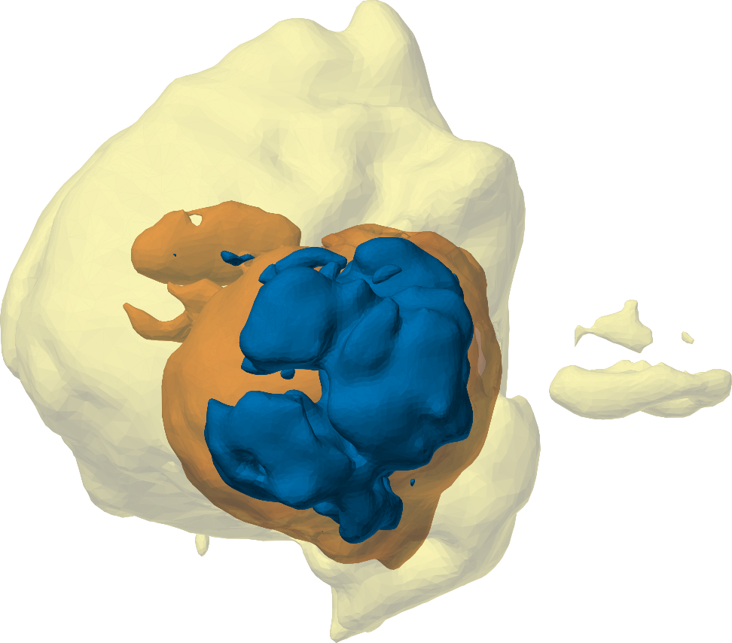
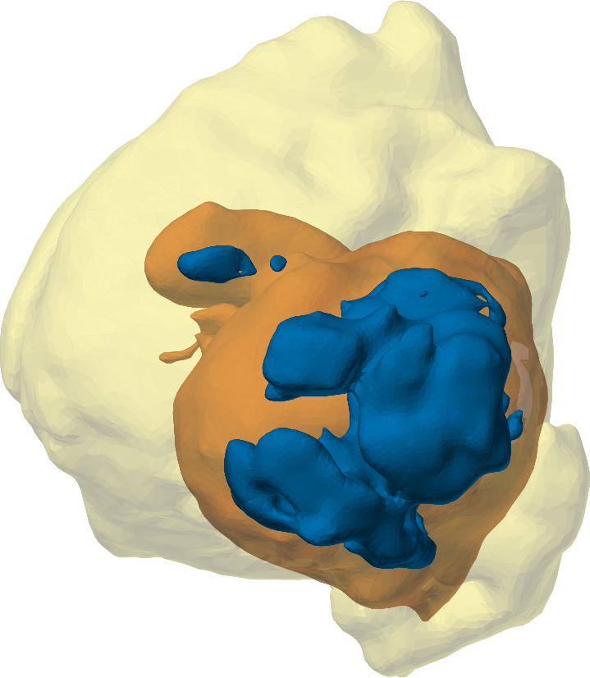
Results: accurate tumour outlines and volumes
03 · WHAT IT DELIVERS
WHY
BUILT
DELIVERS
NEXT
0.78
mean Dice
188 test scans
0.69
mean IoU
188 test scans
0.98
whole-tumour volume
agreement with experts (ICC)
0.97
whole-lesion Dice
example test scan 00449
MedTwin AI
Expert
Notes:
[About 1:05]
Now the results. On the 188 test scans the mean Dice score is 0.78 and the mean IoU is 0.69. Dice measures the overlap between the AI's outline and the expert's, where 1 is perfect. For doctors, volume matters most: whole-tumour volume agrees with the experts with an ICC of 0.98, and enhancing tumour 0.98 as well.
On the left you can see one test patient in 3D: the AI's result next to the expert's. The whole-lesion Dice for this scan is 0.97.
The chart on the right is honest about the weak spot: the necrotic core agrees much less, ICC 0.52, mainly because of a few scans with very large necrotic cores. I come back to this under limitations. One more point: 0.78 is averaged over separate labels, so it is not directly comparable with the region-based scores in BraTS papers.

Slide 9
The 3D digital twin of every patient
03 · WHAT IT DELIVERS
WHY
BUILT
DELIVERS
NEXT
How the twin is built
1
Template FreeSurfer fsaverage folded cortex (41k vertices per hemisphere)
2
Fit scale and ICP alignment to the patient's brain
3
Warp pull the gyral crowns onto the patient's outline: 7.08 → 3.81 mm
4
Complete cerebellum and brainstem from the scan; tumour meshes added
Cut planes
Opacity
Hover details
Expert wireframes
Auto-rotate
STL download
Necrotic core
Oedema
Enhancing tumour
Fitted cortex
Folds come from the template, not the patient; an "Exact (from scan)" view is also available.
Notes:
[About 0:55]
This is the digital twin of one test patient. The scans are too coarse to show the brain's folds, so MedTwin takes a standard folded brain, FreeSurfer's fsaverage template, and fits it to the patient: it scales and aligns it, then warps the gyral crowns onto the patient's own brain outline. For this patient the average crown-to-surface distance dropped from 7.08 to 3.81 millimetres. The cerebellum and brainstem come from the scan itself, and the tumour regions are added as colour-coded meshes in real millimetres.
In the browser the doctor can cut through it, change opacity, hover for details, compare with expert wireframes and download STL files, for example for 3D printing. To be honest about it: the folds are the template's, not the patient's, so there is also an exact view straight from the scan.

Slide 10
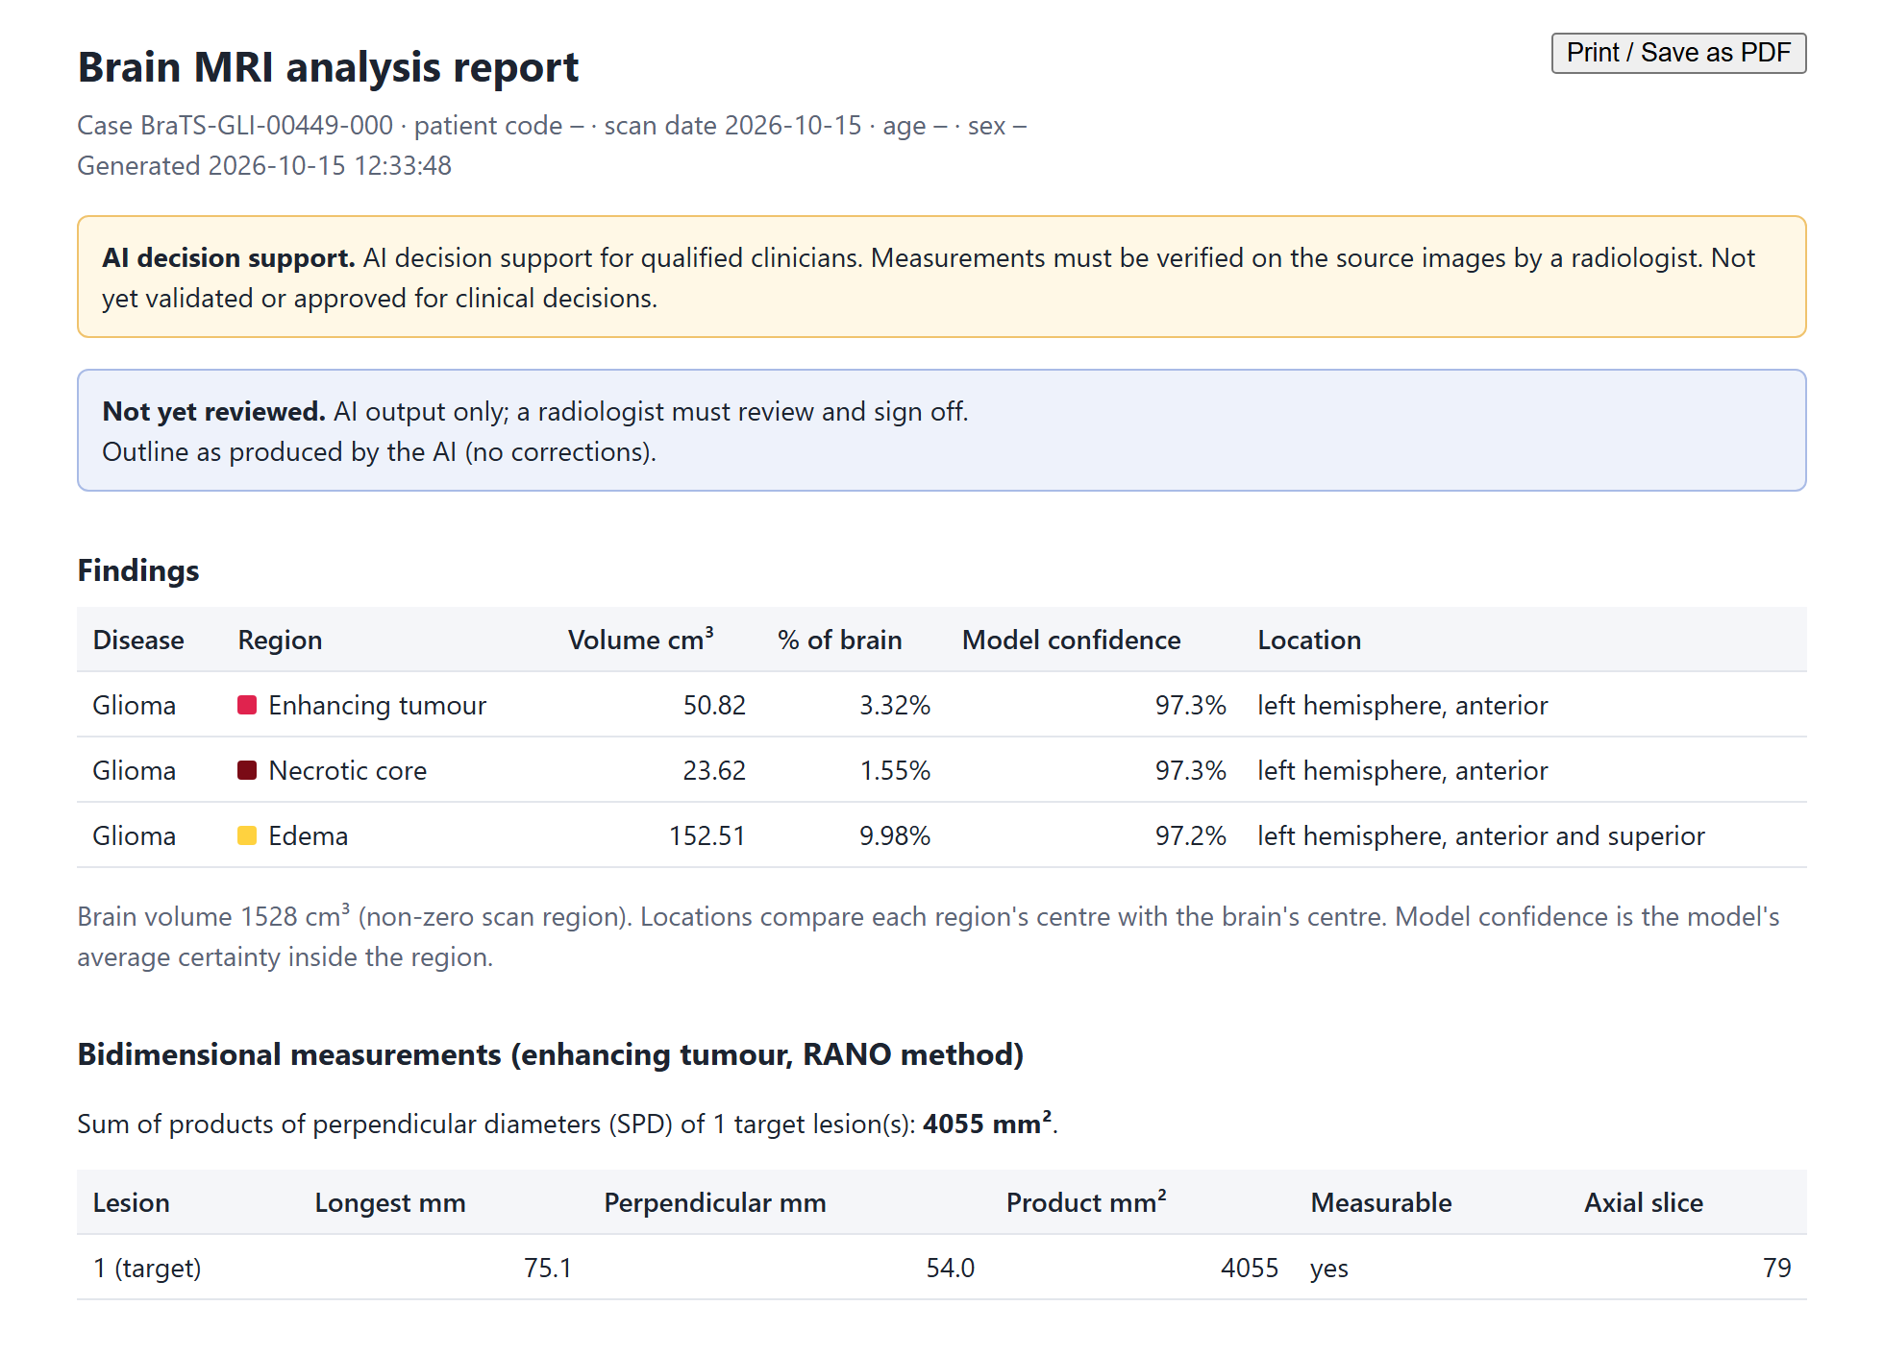





What the doctor receives: a clear, printable report
03 · WHAT IT DELIVERS
WHY
BUILT
DELIVERS
NEXT
Volumes
per region, AI vs corrected, % of brain
Location in words
"left hemisphere, anterior" (side bug fixed)
Model confidence
average certainty inside each region
RANO measurement
75.1 × 54.0 mm; SPD 4,055 mm²
Separate lesions
count, size and location of each
Review status
not reviewed, approved or rejected, with signature
Real MedTwin report for test scan 00449 (AI output, not yet reviewed)
Notes:
[About 0:55]
This is a real report produced by MedTwin for a test patient, before any doctor has reviewed it. At the top it says clearly that this is AI decision support and not yet reviewed.
It lists the volume of each tumour region and its percentage of the brain, the location in plain words, and the model's average confidence. It gives the RANO bidimensional measurement: here 75.1 by 54.0 millimetres, a product of 4,055 square millimetres. It lists separate lesions, and after review it shows who approved or rejected the case, with a signature block.
One important fix: the original notebooks reported the tumour side and position inverted, left for right. The app computes the location in millimetres from the brain centre, and I checked it against the raw scan.

Slide 11




The doctor stays in control
03 · WHAT IT DELIVERS
WHY
BUILT
DELIVERS
NEXT
Correct
Sign off
Audit trail
Follow-up
Brush and eraser for each region on any slice. Everything recalculates in about 3 s.
Approve with name, role and time; reject with a reason. Any edit reopens the case.
Append-only log of every analysis, correction (voxels changed) and decision.
Timeline per patient with SPD, % change and a RANO-based category.
Follow-up test
Enhancing tumour 12.3 → 50.8 cm³ between two scans: MedTwin reports "Progression (radiographic)", +313% volume, +195% SPD.
Safety checks caught a real problem
A test study still had its skull, and the model outlined 1,315 cm³ of "oedema". Skull detection now catches this, and any outline over 40% of the brain shows "do not use".
Notes:
[About 1:00]
A key design principle: the AI suggests, the doctor decides. The doctor can correct the outline with a brush and eraser on any slice, and all measurements, meshes and the report recalculate in about 3 seconds. The doctor approves with name, role and time, or rejects with a reason, and any later edit reopens the case. Every analysis, correction and decision goes into an append-only audit trail.
For follow-up, scans are grouped by patient code. In my test with two scans, enhancing tumour went from 12.3 to 50.8 cubic centimetres, and MedTwin reported radiographic progression: plus 313% volume and plus 195% SPD.
Safety checks matter too. In one test the skull had not been removed, and the model outlined 1,315 cubic centimetres of 'oedema'. Now the skull is detected, and any outline over 40% of the brain gets a 'do not use' warning.

Slide 12



Built for a real hospital network
03 · WHAT IT DELIVERS
WHY
BUILT
DELIVERS
NEXT
Security and data protection
DICOM identifiers never read or stored; DICOM files deleted after conversion
Radiologist
review, correct, sign
Clinician
read-only
Passwords: PBKDF2-SHA256, 260,000 iterations; 5 wrong tries lock for 5 min
Forgot password without email: one-time recovery codes or an administrator reset
Secure sessions (HttpOnly cookies, 12-hour idle timeout) and CSRF protection
Revision check: no doctor overwrites a colleague's newer work
MedTwin computer
GPU · HTTPS :8443
Runs inside the hospital network: no cloud upload
Administrator
manages accounts
Any browser
nothing to install
Hospital-style DICOM test: all four series recognised; volumes 12.26 / 4.61 / 23.38 cm³ vs 12.30 / 4.47 / 21.77 from the clean files.
Notes:
[About 0:55]
MedTwin is designed for a hospital network. One computer with the GPU runs MedTwin; doctors open it from any browser over HTTPS on port 8443, with nothing to install. There are three roles: radiologists review, correct and sign; clinicians can view but not change; administrators manage accounts.
On security: patient identifiers in DICOM files are never read, and the DICOM files are deleted after conversion. Passwords are hashed with PBKDF2 and 260,000 iterations, and wrong attempts lock the account. Forgotten passwords work without email, through recovery codes or an administrator reset. Sessions and requests are protected, a revision check stops one doctor from overwriting another's work, and nothing leaves the hospital network.
I tested the DICOM path with a synthetic hospital-style study: all four series were recognised and the volumes matched the clean files closely.

Slide 13


Tested, not just built
03 · WHAT IT DELIVERS
WHY
BUILT
DELIVERS
NEXT
62
automated tests pass
unit · clinical · accounts · password recovery · regression on a real patient · isolated from real data
Side bug found and fixed
Skull stripping checked
The notebooks reported left/right, front/back and up/down inverted. Checked on the raw scan: 15.7 mm left, 42.0 mm anterior, 10.4 mm superior.
HD-BET brain mask Dice 0.97 against the BraTS brain region.
Runs on a 2 GB laptop GPU
Three roles tested in the browser
About 20–35 s per prepared case on an NVIDIA MX550 (not a formal benchmark).
Setup, forced password change, radiologist sign-off, clinician read-only (API refuses with 403).
Notes:
[About 0:50]
I did not want a demo that only works once, so the project has 62 automated tests: unit tests, clinical tests such as RANO diameters and brush strokes landing on the right voxel, account and password-recovery tests, and a regression test on a real patient. They run in their own data folder, so they never touch real accounts or cases.
Testing found real bugs. The biggest: the original notebooks reported the tumour side inverted. I fixed it and confirmed the position against the raw scan. HD-BET skull stripping was checked at Dice 0.97. The app runs on a 2 GB laptop GPU, and I tested all three roles in the browser, including that the clinician cannot change anything even through the API.

Slide 14
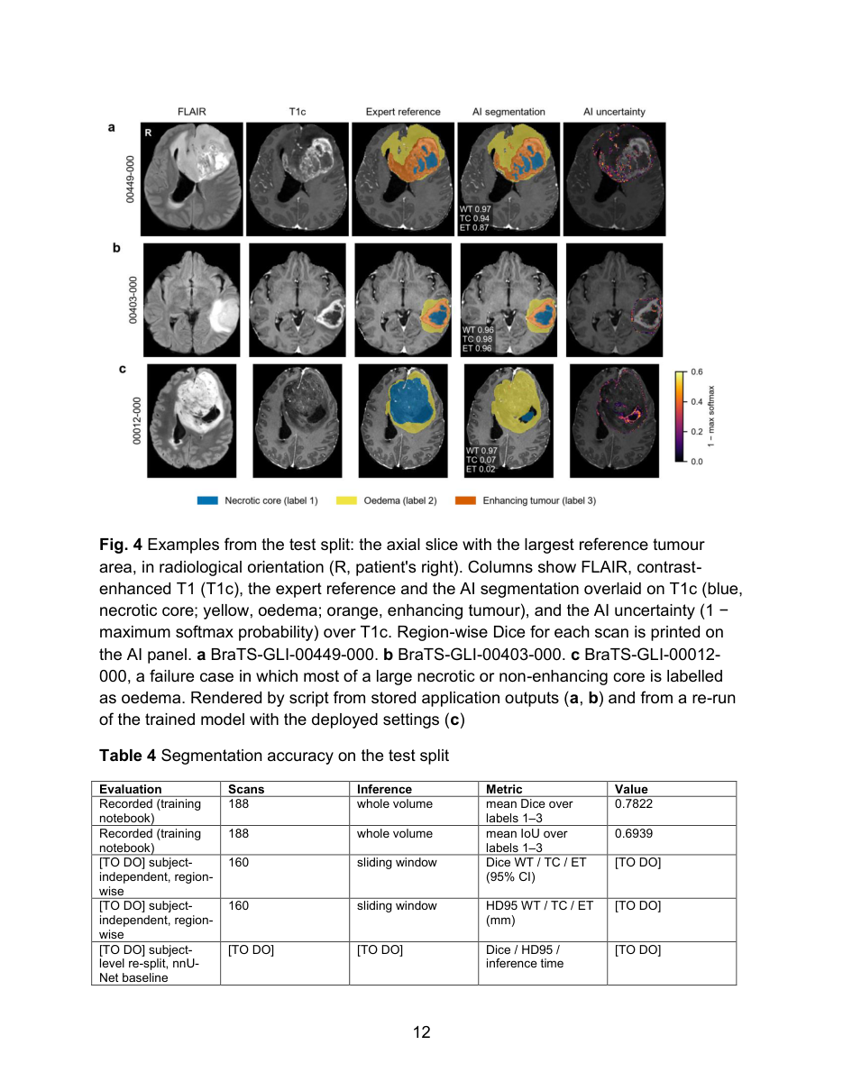
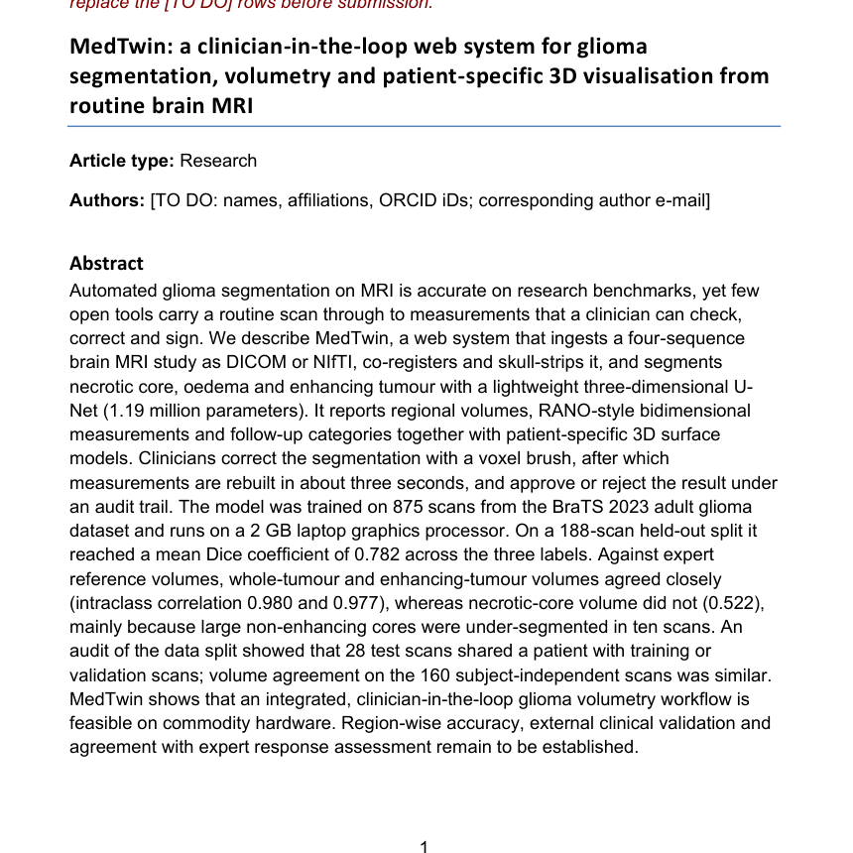
Research contribution: the paper draft is ready
03 · WHAT IT DELIVERS
WHY
BUILT
DELIVERS
NEXT
Target journal: Discover Artificial Intelligence (Springer Nature)
62
papers reviewed in detail
86
verified references
24
pages, 5 colour figures
New analyses for the paper
Audit of the data split (patient overlap)
Volume agreement with experts (ICC, Bland–Altman)
Failure analysis: large necrotic cores
Contribution: an open, clinician-in-the-loop workflow from DICOM to signed report on a 2 GB GPU, not a new segmentation method.
Drafted with AI assistance from my project files; I will verify every number and rewrite Results and Discussion in my own words, as Springer Nature's policy requires.
Draft manuscript: title page and Fig. 4
Notes:
[About 1:00]
The research side. The paper is drafted for Discover Artificial Intelligence, a Springer Nature journal. It is backed by a literature review of 62 papers and 86 references, each checked against Crossref, PubMed or arXiv records. The manuscript is 24 pages with five colour figures; you can see the title page and Figure 4 here.
I also added new analyses: an audit of the data split, volume agreement with the experts, and a failure analysis.
I position the contribution honestly: it is not a new segmentation algorithm. It is an open, clinician-in-the-loop workflow from DICOM to a signed report that runs on a 2 GB GPU. I should also tell you that the draft was prepared with AI assistance from my project files. Before submission I will verify every number, rewrite the Results and Discussion in my own words, and keep the AI declaration, as the journal's policy requires.

Slide 15

Honest limitations, and how I will fix each one
04 · WHAT'S NEXT
WHY
BUILT
DELIVERS
NEXT
Research data only
Scan-level split
Necrotic-core weak spot
Accuracy shown on BraTS; the DICOM path was tested on one synthetic study.
28 of 188 test scans share a patient with training or validation.
Very large necrotic cores are under-segmented (ICC 0.52).
Fix → retrospective study on hospital scans
Fix → re-split by patient; report the 160 clean scans
Fix → augmentation, nnU-Net, more such examples
Metrics incomplete
Glioma only
Not clinically approved
Only label-wise mean Dice; no region-wise Dice, HD95 or confidence intervals.
One disease model so far: adult glioma.
Decision support only; HD-BET weights are non-commercial (CC BY-NC).
Fix → full BraTS-style evaluation
Fix → meningioma, metastases, stroke, MS models
Fix → regulatory pathway (CDSCO); SynthStrip
Notes:
[About 1:00]
I want to be clear about what is not done yet, and how I plan to fix each item.
First, accuracy is shown only on BraTS research data, and the DICOM path was tested on one synthetic study, so a study on real hospital scans is needed. Second, my own audit found that the split was made per scan, not per patient: 28 of the 188 test scans come from patients who also had a scan in training or validation. I will re-split by patient. Third, very large necrotic cores are under-segmented. Fourth, I report only the mean Dice over labels, so I need region-wise Dice, HD95 and confidence intervals. Fifth, it covers only glioma. And sixth, it is decision support, not a clinically approved device, and the HD-BET weights are for non-commercial use only.

Slide 16



Future scope: from prototype to hospital tool
04 · WHAT'S NEXT
WHY
BUILT
DELIVERS
NEXT
STEP 1 · FINISH THE RESEARCH
STEP 2 · HOSPITAL PILOT
STEP 3 · GROW THE PLATFORM
Patient-level re-split and re-test
nnU-Net baseline comparison
Region-wise Dice, HD95, 95% confidence intervals
Runtime benchmark and RANO agreement
Submit to Discover Artificial Intelligence
Partner hospital and ethics approval
Retrospective study with radiologist outlines
PACS export: DICOM SEG and structured report
Hospital single sign-on, trusted certificate
More diseases: meningioma, metastases (BraTS 2023), stroke (ISLES 2022), MS lesions
Personal anatomy: lobes, distance to eloquent areas (SynthSeg)
Predictive twin: model tumour growth from follow-up scans
Licence-safe tools and quality work (ISO 13485, IEC 62304, CDSCO)
Notes:
[About 1:05]
Here is the future plan in three steps.
Step 1 is finishing the research: re-split the data by patient and re-test, compare against nnU-Net, which is the standard strong baseline, report region-wise Dice and HD95 with confidence intervals, benchmark the runtime and check agreement with RANO measurements, and then submit the paper.
Step 2 is a hospital pilot: find a partner hospital, get ethics approval, and run a retrospective study against radiologists' outlines. For daily use it must also export to PACS, as DICOM SEG and structured reports, and connect to the hospital login.
Step 3 grows the platform: more diseases such as meningioma, metastases, stroke and multiple sclerosis; personal anatomy such as which lobe the tumour is in and its distance to critical areas; and a predictive twin that models tumour growth from follow-up scans. Commercial use would need licence-safe tools and the medical-device quality standards.

Slide 17

Why it matters: the purpose behind MedTwin
04 · WHAT'S NEXT
WHY
BUILT
DELIVERS
NEXT
Fast, consistent tumour measurements and a 3D view the doctor can trust, on a low-cost laptop GPU, inside the hospital.
For doctors
For patients
For hospitals
Review and correct instead of outlining from scratch. Standard RANO numbers and volumes in one report.
Consistent follow-up: "is it growing?" answered with numbers. A 3D view that helps explain the treatment.
Runs on a 2 GB GPU on the hospital network. No cloud upload, so data stays inside. Built on open-source libraries.
Notes:
[About 0:45]
So what is the purpose? MedTwin aims to give fast, consistent tumour measurements and a 3D view a doctor can trust, on a low-cost laptop GPU and inside the hospital.
For doctors, it means reviewing and correcting instead of outlining from scratch, with standard RANO numbers in the report. For patients, follow-up becomes consistent, and the 3D view helps explain the treatment. For hospitals, it runs on modest hardware on their own network, with no cloud upload, which matters for patient privacy and for hospitals with limited budgets.

Slide 18


Questions?
THANK YOU
Where I would value your guidance
01
Review the paper draft and plan the submission timeline
Thank you for your guidance throughout this project.
02
Help to reach a partner hospital and the ethics committee
5 OF 6 OBJECTIVES DONE · PAPER DRAFT READY
03
Access to a stronger GPU for nnU-Net and the patient-level re-split
[Your name] · Guide: [Guide's name]
Notes:
[About 0:30]
To summarise: the MedTwin system is complete and tested, from DICOM to a signed report with a 3D digital twin, and the paper draft is ready.
There are three things where your guidance would help most: reviewing the paper and planning the submission, helping me reach a partner hospital and the ethics committee for real-world validation, and access to a stronger GPU for the nnU-Net and re-split experiments.
Thank you. I am happy to take questions, or to show the app live.

