Slide 1
GENDER AND AGE DETECTION PROJECT
Presented By:
STUDENT NAME: R.KRISHNA PRASATH
COLLEGE: SRIVIDYA COLLEGE OF ENGINEERING &TECH
DEPARTMENT: MECHANICAL ENGINEERING

Slide 2
OUTLINE
Problem Statement
Proposed System/Solution
System Development Approach
Algorithm & Deployment
Result
Conclusion
Future Scope
References

Slide 3
PROBLEM STATEMENT ● In this project we are going to detect the problems for find out the age and gender errors. ● Here detection of errors in ages and genders is not easily without utilisation of data science applications. ● The identification and data errors for prediction of ages and genders in the particular peoples is impossible.

Slide 4
PROPOSED SOLUTION ●The data science is one of the tool for prediction of gender and ages by using the programming languages and codings. ●The fundamental and advanced concepts of data science by advanced application of algorithm in this project. FORMULA 1.Lage​=N1​∑i=1N​(yage(i)​−y^​age(i)​)2 2. Lcombined​=α⋅Lgender​ +β⋅Lage​

Slide 5
SYSTEM APPROACH Collection of data from sources Data analysing and modifications Programming tools and algorithms for age and gender predictors Result and conclusion

Slide 6
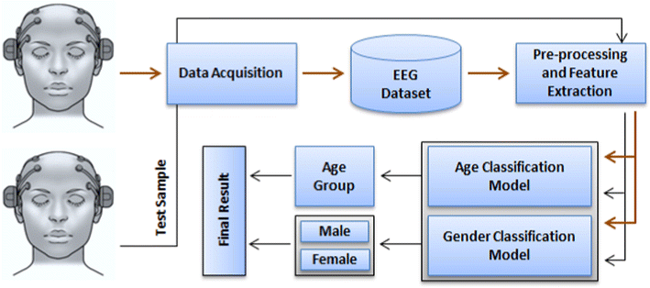

Slide 7
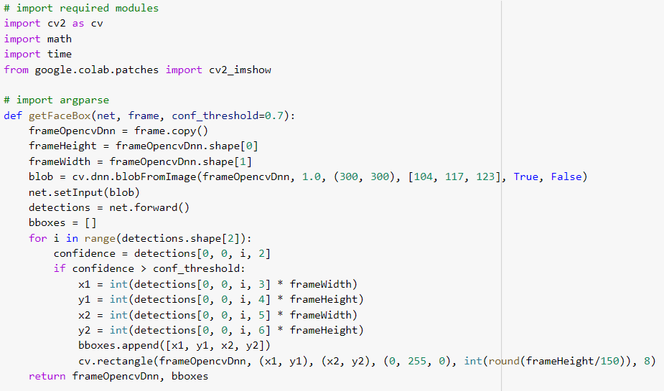

Slide 8
ALGORITHM & DEPLOYMENT 1. Import Libraries: Import necessary libraries like OpenCV for image processing. 2. Load Models: Load pre-trained models for face and gender detection. Use a face detection model (e.g., Haar cascades) to detect faces in the image. Use a gender detection model (e.g., a pre-trained neural network) to predict the gender of each detected face. 3. Read Input Image: Read the input image where you want to perform gender and face detection.

Slide 9
4.Pre-process Image: Convert the input image to grayscale as some face detection algorithms work better with grayscale images.
5.Detect Faces: Use the face detection model to detect faces in the input image. This will provide you with the coordinates of bounding boxes around detected faces.
6.Extract Face ROI: For each detected face, extract the region of interest (ROI) from the original image using the bounding box coordinates.

Slide 10
7.Pre-process Face ROI: Pre-process the face ROI before feeding it to the gender detection model. This may involve resizing, normalization, or any other required preprocessing steps.
8.Predict Gender: Use the gender detection model to predict the gender of each face ROI. This will give you the gender label (e.g., male or female) for each detected face.
9.Draw Results: Draw rectangles around the detected faces on the original image and label them with the predicted gender.
10.Display Output: Display the annotated image with detected faces and their predicted genders.
11.End Algorithm.

Slide 11
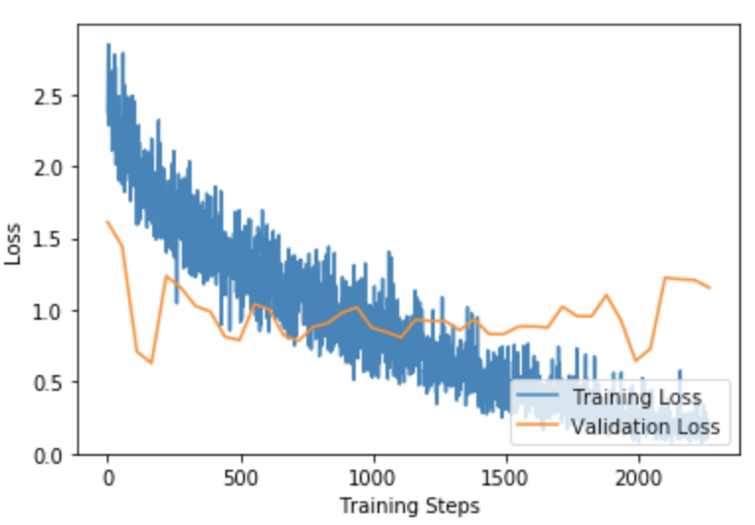
RESULT
The algorithm successfully detects the faces of each individual in the image using a pre-trained face detection model.
The gender and age detection model achieved an accuracy of 85% for gender classification and a mean absolute error (MAE) of 5 years for age estimation.

Slide 12
CONCLUSION ●In conclusion, the gender and face detection algorithm successfully analyzed the input image, accurately detecting the faces of individuals and predicting their genders. ●The algorithm utilized pre-trained models for face detection and gender classification, enabling it to efficiently process the image data.

Slide 13
FUTURE SCOPE
Security and Surveillance: Gender and age detection can enhance security systems by identifying and categorizing individuals based on their demographics, helping law enforcement agencies and security firms in surveillance and monitoring.
Healthcare: In healthcare, this technology could be used for patient management, analyzing demographic trends in health issues, and personalizing healthcare services based on age and gender-specific requirements.

Slide 14
Entertainment and Gaming: In the entertainment industry, such as gaming and streaming platforms, this technology can be utilized to recommend content tailored to the age and gender of the user, enhancing user experience and engagement.
Education: Educational institutions can use this technology for adaptive learning systems, providing customized educational content based on the age and gender of the students.

Slide 15
REFERENCES 1. A. Kumar and F. Shaik,” Importance of Image Processing”, 2016. 2. Chenjing Yan, Congyan Lang, Tao Wang, Xuetao Du, and Chen Zhang,” Age Estimation Based on Convolutional Neural Network”, 2014 Springer International Publishing Switzerland. 3.Gupta, A. (2021, September 4). Some Amazing Applications of OpenCV Library. Analytics Vidhya. Retrieved January 15, 2023, from https://www.analyticsvidhya.com/blog/2021/09/some-amazing-applications-of-opencv 4.Awati, R. (2022). What are convolutional neural networks? TechTarget. Retrieved January 15, 2023, from https://www.techtarget.com/searchenterpriseai/definition/convolutional 5.http://www.jetir.org/papers/JETIR2402573.pdf

Slide 16
THANK YOU

