Slide 1
MOBILE APP
SUCCESS ANALYTICS
Data Analytics Internship Project | Python & Google Play Store Dataset
pandas
numpy
matplotlib
seaborn
EDA
2025 – 2026
1

Slide 2
AGENDA
What We'll Cover
01
Abstract & Introduction
06
20 Analytical Queries
02
Dataset & Objectives
07
Visualizations & Insights
03
Software Requirements
08
Advantages
04
Libraries Used
09
Conclusion & References
05
Data Cleaning & Processing
2

Slide 3
ABSTRACT
Project Overview
Exploratory Data Analysis (EDA) on the Google Play Store dataset using Python.
Goal: identify key factors contributing to mobile app success — ratings, installs, reviews, pricing, and categories.
Tools used: Pandas, NumPy, Matplotlib, and Seaborn across a complete data pipeline.
7 visualizations produced; 20 analytical queries answered; full data cleaning applied.
Insights help developers and businesses understand market trends and user preferences.
3

Slide 4
INTRODUCTION
Why Analyze the Google Play Store?
3M+
2.5B+
~95%
4.0+
Apps on Play Store
Android Users
Apps are FREE
Avg Rating Goal
Problem Statement
Many mobile apps fail to achieve traction. Developers lack data-driven insights when designing or marketing applications. This project addresses that gap using real Play Store data to answer 7 key research questions.
4

Slide 5
DATASET
Google Play Store Dataset
Dataset Snapshot
13 Key Columns
Source
Kaggle
App
Category
Rows
~10,000+ apps
Rating
Reviews
Columns
13 attributes
Size
Installs
Format
CSV
Type
Price
After Cleaning
~9,000 rows
Content Rating
Genres
Last Updated
Current Ver
5
Android Ver

Slide 6
Research Objectives
7 Questions This Project Answers
Q1
Which categories contain the most apps on the Play Store?
Q2
How are user ratings distributed across applications?
Q3
What proportion of apps are free versus paid?
Q4
Which categories receive the highest total install counts?
Q5
Is there a relationship between reviews and installs?
Q6
Which categories achieve the highest average user ratings?
Q7
Which individual apps have the most user reviews?
6

Slide 7
SYSTEM REQUIREMENTS
Software & Hardware Stack
💻
Operating System
🛠
Software
⚙️
Hardware
Windows 10 / 11 (64-bit)
Python 3.10+
Intel Core i3+ CPU
Ubuntu 20.04 LTS
Jupyter Notebook 6.x
4 GB RAM (8 GB rec.)
macOS Ventura 13+
Anaconda 2023
256 GB SSD
pip 23.x
1080p Display
7

Slide 8
LIBRARIES
Python Libraries Used
pandas
Data loading, cleaning, groupby, aggregation, filtering
numpy
Numerical operations, statistical calculations, array support
matplotlib
Bar charts, histogram plots, figure configuration
seaborn
Advanced stat plots: histplot, countplot, scatterplot
os
File system navigation, dataset verification before loading
8

Slide 9
Data Analysis Pipeline
01
02
03
04
05
06
07
Load
Clean
Explore
Filter
Aggregate
Visualize
Insight
pd.read_csv()
dropna(), type cast
shape, info, describe
Conditional queries
groupby, sort, stats
7 chart types
Conclusions
df = pd.read_csv("google_play_store.csv") → df = df.dropna() → df["Installs"] = df["Installs"].str.replace("+","").astype(int)
9

Slide 10
DATA CLEANING
Cleaning & Preprocessing Steps
Missing Values
Before: ~1,400 null rows
df = df.dropna()
After: 0 nulls (dropna)
Reviews Column
Before: Object / string
df['Reviews'] = pd.to_numeric(df['Reviews'])
After: int64 numeric
Installs Column
Before: '10,000+' string
df['Installs'].str.replace('+','').str.replace(',','').astype(int)
After: 10000 integer
Price Column
Before: '$4.99' string
df['Price'].str.replace('$','').astype(float)
After: 4.99 float
10

Slide 11
ANALYTICAL QUERIES
20 Queries — Part 1 (Q1–Q10)
Q1
Total apps in dataset
Q2
Unique categories
df.shape[0]
df['Category'].nunique()
Q3
Top 5 categories by count
Q4
Average rating of all apps
df['Category'].value_counts().head()
df['Rating'].mean()
Q5
App with maximum reviews
Q6
Total installs across all apps
df.loc[df['Reviews'].idxmax(), 'App']
df['Installs'].sum()
Q7
Free vs paid app count
Q8
Average installs for free apps
df['Type'].value_counts()
df[df['Type']=='Free']['Installs'].mean()
Q9
Average installs for paid apps
Q10
Category with highest avg rating
df[df['Type']=='Paid']['Installs'].mean()
df.groupby('Category')['Rating'].mean().idxmax()
11

Slide 12
ANALYTICAL QUERIES
20 Queries — Part 2 (Q11–Q20)
Q11
Category with lowest avg rating
Q12
Category with most total installs
df.groupby('Category')['Rating'].mean().idxmin()
df.groupby('Category')['Installs'].sum().idxmax()
Q13
Apps rated above 4.8
Q14
Most expensive app & price
len(df[df['Rating'] > 4.8])
df.loc[df['Price'].idxmax(), ['App','Price']]
Q15
Average price of paid apps
Q16
Top 3 most installed apps
df[df['Type']=='Paid']['Price'].mean()
df.nlargest(3,'Installs')[['App','Installs']]
Q17
Count of content rating groups
Q18
Apps with over 1M installs
df['Content Rating'].value_counts()
len(df[df['Installs'] >= 1000000])
Q19
Correlation: Reviews vs Installs
Q20
Variance of ratings per category
df['Reviews'].corr(df['Installs'])
df.groupby('Category')['Rating'].var()
12

Slide 13
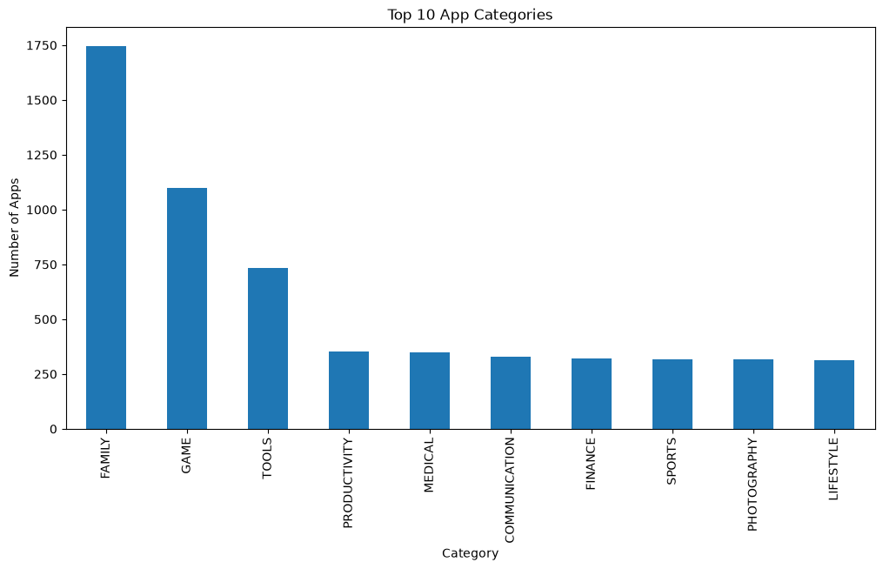
VISUALIZATION 1
Top 10 App Categories
💡 Key Insight
FAMILY is the dominant category with nearly 2,000 apps — almost double the next category (GAME). Entertainment and utility apps together represent the majority of the marketplace.
Code Used:
df['Category']
.value_counts()
.head(10)
.plot(kind='bar')
13

Slide 14
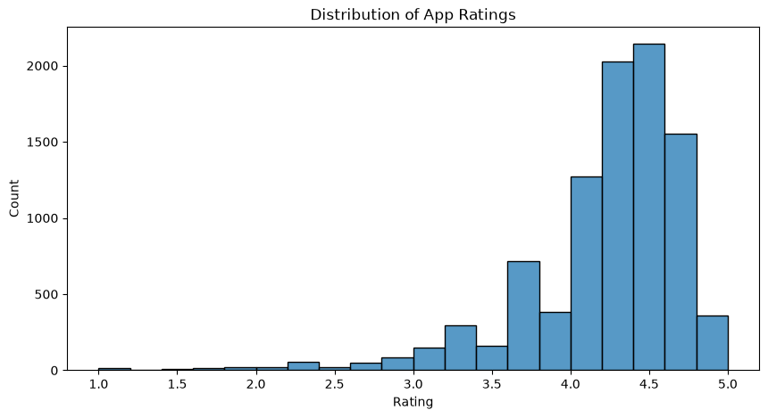
VISUALIZATION 2
Distribution of App Ratings
4.19
Mean Rating
4.5
Mode Rating
~0.21
Variance
Most apps cluster between 4.0–4.8 ✦ Low-rated apps are comparatively rare
14

Slide 15
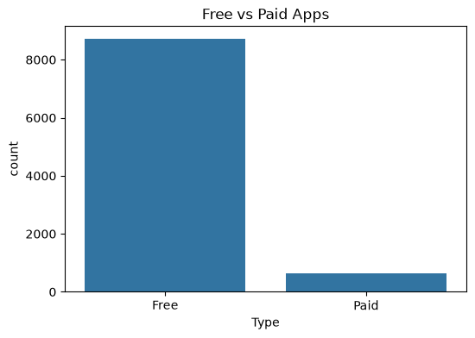
VISUALIZATION 3
Free vs Paid Apps
Insight
~92% of all apps are FREE
Only ~8% of apps are paid
Freemium & ad-supported models dominate
Paid apps have lower total install counts on average
Free apps rely on in-app purchases & ads
15

Slide 16
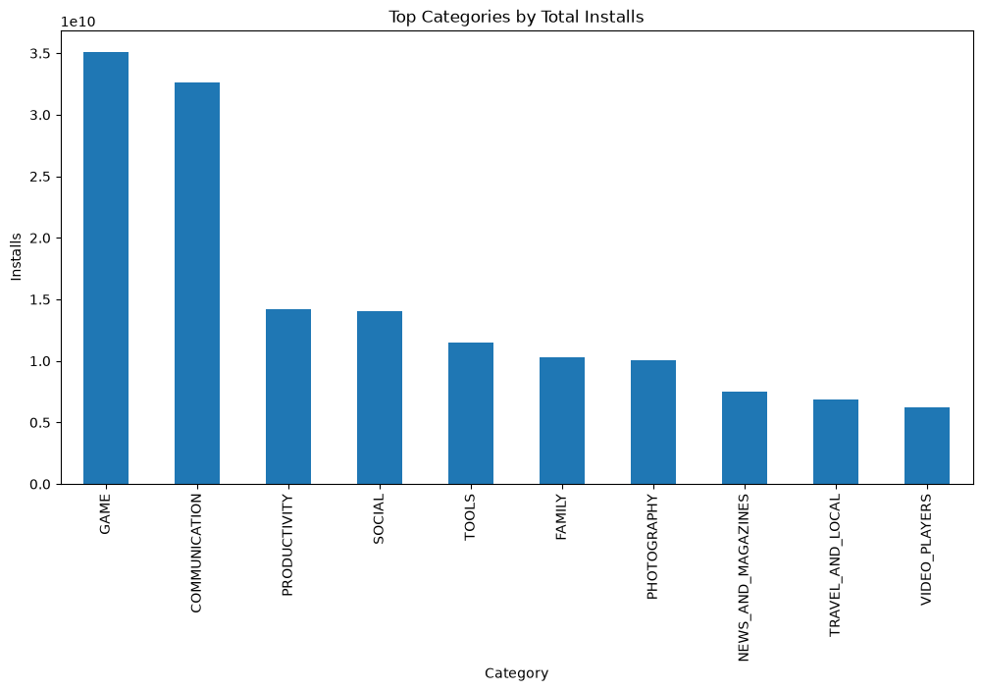
VISUALIZATION 4
Top Categories by Total Installs
GAME & COMMUNICATION dominate — together accounting for nearly 40% of all Play Store installs
16

Slide 17
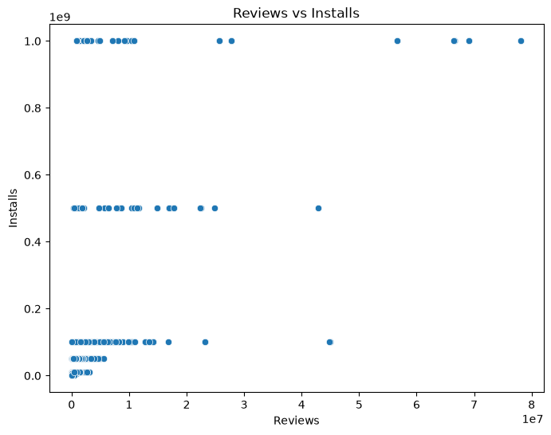
VISUALIZATION 5
Reviews vs Installs — Correlation
0.64
Pearson Correlation
What This Means
A correlation of 0.64 indicates a strong positive relationship — apps with more user reviews consistently show higher install counts, confirming that social proof drives adoption.
17

Slide 18
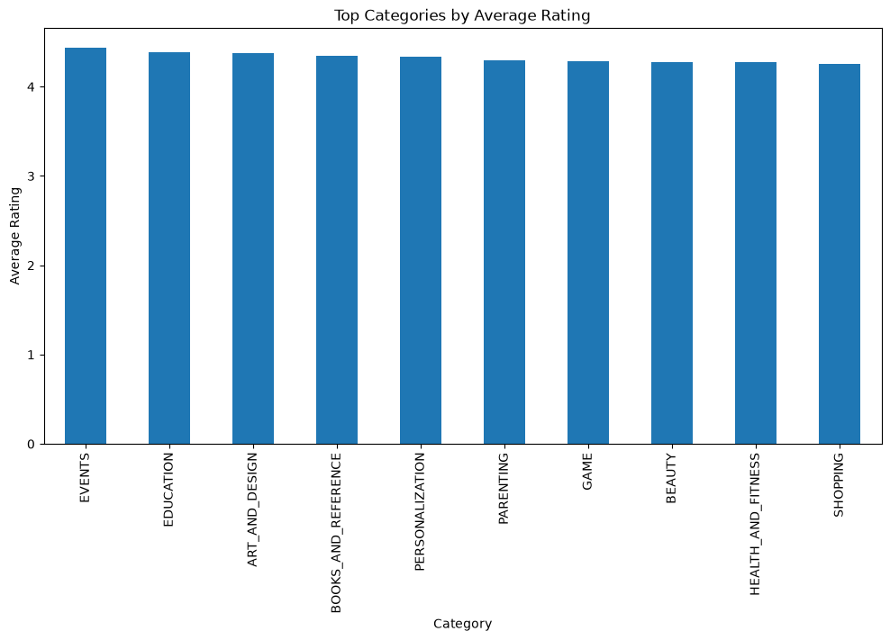
VISUALIZATION 6 & 7
Ratings by Category & Most Reviewed Apps
Most Reviewed Apps
#1
Facebook
78M+
#2
WhatsApp
69M+
#3
Instagram
54M+
#4
Messenger
52M+
#5
Google Maps
36M+
18

Slide 19
Key Insights
What the data tells us
01
FAMILY has the most apps (~1,972) followed by GAME & TOOLS
05
Reviews & Installs have a 0.64 positive correlation
02
Most apps are rated between 4.0–4.8 out of 5.0
06
EVENTS category achieves the highest average user rating (4.44)
03
07
~92% of Play Store apps are FREE
Facebook, WhatsApp, Instagram lead with 50M+ reviews each
04
GAME & COMMUNICATION categories dominate total install counts
19

Slide 20
ADVANTAGES
Project Advantages
⚙️
📊
🎓
Technical
Business
Educational
End-to-end data pipeline
Identify high-value categories
Real-world dirty data experience
Open-source Python tools
Free-vs-paid market guidance
Full EDA lifecycle practice
Scalable to larger datasets
Rating benchmarks for KPIs
Multiple library exposure
Fully reproducible results
Data-driven decisions
Internship-level project scope
20

Slide 21
CONCLUSION
What This Project Demonstrated
Systematic EDA pipeline: load → clean → explore → visualize → conclude
FAMILY dominates categories; GAME & COMMUNICATION lead in installs
92%+ apps are free; most maintain ratings above 4.0/5.0
Strong correlation between reviews and installs validates social-proof theory
Python's data stack (Pandas, NumPy, Matplotlib, Seaborn) proven on real data
Future Scope: Sentiment analysis, predictive modeling, revenue data integration
21
Create image Realistic cinematic candid photo, 9:16 vertical, handheld smartphone shot, raw natural quality, slight grain, no HDR. Night outside an Indomaret minimarket with glass windows, visible snack shelves, parked motorcycles, and red/teal neon reflections. Small metal table with iced coffee, bottled tea, fries, snacks, and Indomie noodles. 1. First photo uploaded is Girl (reference face): exact same facial features, and personality, long dark wavy hair, black fitted turtleneck/crop top, small black sunglasses. Sitting left, leaning back, hand near mouth, emotionally distant and withdrawn. 2. Second Photo uploaded Man (Mahesh Babu inspired look): black suit/dark jacket, leaning toward her, serious expression, one hand raised while talking.

Slide 22
REFERENCES
References & Links
Dataset
Kaggle — Google Play Store Apps | https://www.kaggle.com/datasets/lava18/google-play-store-apps
Libraries
Pandas | https://pandas.pydata.org/docs/
NumPy | https://numpy.org/doc/
Matplotlib | https://matplotlib.org/stable/contents.html
Seaborn | https://seaborn.pydata.org/
Learning
Real Python | https://realpython.com/
Python for Data Analysis — Wes McKinney (O'Reilly)
22
Towards Data Science | https://towardsdatascience.com/
GeeksforGeeks Pandas Tutorial | https://www.geeksforgeeks.org/pandas-tutorial/

Slide 23
Thank You
2025 – 2026 | Data Analytics Internship
Powered by Python · Pandas · Matplotlib · Seaborn · NumPy
Questions & Discussion
Mobile App Success Analytics | Data Analytics Internship Project

