Slide 1
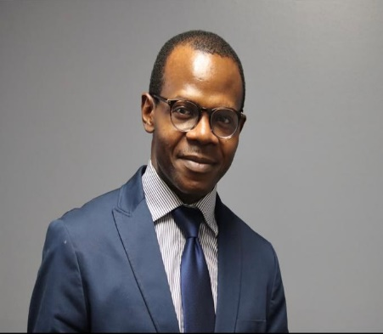
CHRISTOPHER ADEBAJO
Highlights:-
Deployed highly scalable application in various project
Configured the complete CICD pipeline.
Configured higly scalable and secure cloud architecture using AWS
PROFILE SUMMARY
Flexible professional with 7yrs in experience developing and building IT solutions. Confident DevOps Engineer with exemplary expertise in routine application maintenance tasks, including troubleshooting and testing. Enthusiastic technical professional with complete understanding of entire software development lifecycle. Highly trained in Kubernetes, Docker, AWS, Jenkins, Helm Chart and other DevOps tools.
ROLES & RESPONSIBILITIES
EXPERIENCE SUMMARY:
• Monitored automated build and continuous software integration process to drive build/release failure resolution. • Migration of application from virtualization to containerization
• Wrote and updated documentation to outline technical design of entire project.
• Building and provisioning Continuous Delivery/Integration pipelines using the following tools and platforms. Git, Maven, SonarQube, Jenkins, Elasticsearch, Terraform, Ansible, Docker, Kubernetes, ECS, EKS,
• Strive for continuous improvement and build continuous integration, continuous development, and continuous monitoring.
• Constant deployment pipeline (CI/CD Pipeline) • Mentoring and guiding the team members
• Monitoring and measuring customer experience and KPIs
• Managing periodic reporting on the progress to the management and the customer
• Researched and identified new technologies and tools helping to grow DevOps development environment.
• Worked with software development and testing team members to design and develop robust solutions to meet client requirements for functionality, scalability and performance.
• Worked in team of 12 engineers to build and deploy changes to client application using Jenkins pipeline.
• Managed several client and system tickets
• Drove project lifespan from concept to final rollout in development and deployment
• Collaborated with team to determine application requirement specifications
• Built automation tools and applications to deploy next-generation platform
DevOps AUTOMATION
RELEVANT SKILLS:
Strong Communication and Interpersonal Skills
Java Basics, Python and Bash shell scripting
Hadoop Big Data
Jenkins CICD Pipeline
DevOps Systems Version Control Systems (Git, GitHub and Gitlab
Docker and Kubernetes.
Terraform and Ansible
Maven, Jfrog, S3, EC2, EKS, Fargate,
SonarQube, Nexus, Nginx Ingress
Prometheus, Grafana, Nagios, Datadog, CloudWatch, ECR, ECS, VPC, Lambda
Elastic search, Logstash, Kibana
AWS Code build, Code commit, Code
Roles
1. DevOps Engineer
2. SRE
3. Infrastructure Engineer
4. Operation Mgr. IT
5. System Admi
CERTIFICATIONS:
1. Certified Aws Solution Architect Associate.
2. Certified Terraform Associate
3. Certified Professional Manager
4. Certified Kubernetes Application Developer
EDUCATION:
Landmark Metropolitan University
- BTech Computer Engineering –May,2020
Ahmadu Bello University Zaria
- Post Graduate Diploma - 11/2009
Nuhu Bamali Poly Kaduna
Higher National Diploma Degree 05/2002
SUMMARY OF EXPERIENCE
1. Dominion System - Snr DevOps Engineer (June 2018 – Present)
2. Dominion System - Jr DevOps Engineer (Sept 2017 - June 2018)
3. Vanderbilt Medical Center - Patient Service Representative (Feb 2017 – Sept 2017}
4. Zenith Bank Plc - Head of IT Operation (HOP) May 2005 - January 2017. Lagos
5. GTbank PLC - System Administrator
June 2003 - May 2005 - Gombe
Interests
Studying
Playing soccer

Slide 2
PROJECT DETAILS
Client name Dominion System (eCommerce company ) 6 Months
Role/Job Title: Build and Release Engr
Project Summary : Continuous Integration, using Git, GitHub, Maven, Jenkins, Nexus, SonarQube, Slack, Checkstyle Plugins (Regression testing) and Tomact8
Client name Dominion System (eCommerce company - Startup) 6 Months
Role/Job Title DevOps Engr
Project Summary: - AWS CONTINUOUS INTEGRATION PIPELINE (SERVERLESS). Tools : Codecommit, Codebuild, Codeartifact, Codedeploy, Sonar Cloud,
Code Pipeline, S3 Bucket, SNS, IAM, AWS Session Manager, Cloudwatch and Warnings Next Generation Plugins (Checkstyle).
Client name Dominion System (Fintech)) 7 Months
Role/Job Title: Infrastructure Engineer
Project Summary : - CICD using Jenkins Declarative Pipeline as a code, EKS, Helm in a Multi-Tier Environment
Client name Dominion System (Self-Managed Kubernetes Cluster ) 6 Months
Role/Job Title: – DevOps Engr/ Build and monitoring
Project Summary: : AWS Ec2, Configure VPC, Create Subnets, LB, ELB Kubeadm, Weave CNI Plugin, Create and manage Several Control Plane and Nodes, Ingress, Metric Server.
MongoDB and deploy Client application
Client name Dominion System (FinTech) 2 Years
Role/Job Title : DevOps Engr/Deployment
Project Summary: AWS EKS, Secure VPC, WAF Sandwich, AWS EC2, Git, SAST, GitHub, Maven, Jenkins, Nexus, SonarQube, Docker, Docker Hub, Warnings Next Generation,
Helm Chart, Terraform and Prometheus and Grafana. ).

