Slide 1
Smart Energy Meter
Kanishka Rangana (18sea052)

Slide 2
Abstract
A smart energy meter is an electronic device that records information such as consumption of electric energy, voltage levels and current.
This meter is used to know how much energy is consumed.
The Smart meters communicate the information to the consumer for greater clarity of consumption behavior.

Slide 3
Overview
Everyone uses energy but hardly anyone measures it.
Quantifying is the first step in energy saving.
Intelligent approach to save energy, cost and selection of equipment.

Slide 4
Project Aims & Objectives
• Designing compact, rugged and cost-effective smart meter.
• Improving the accuracy of the smart meter.

Slide 5
Advantages of an Smart Energy Meter
Determining energy consumption of various equipment
Determining energy consumption patterns
Possibility to make informed SMART decisions to reduce energy usage opting for more efficient equipment based on capital cost, ROI.
Possibility to reduce energy usage by comparing with the initial usage of ones own self
Possibility to take advantage of off-peak tariff, SMARTLY.

Slide 6
Methodology
• Material Selection & Cost survey
• Time Planning
• Circuit simulation and prototyping
• Testing & evaluation
• Software and hardware implementation
• Debug errors and moderations
• Designing mechanical parts via CAD/CAM
• Finalizing the instrument and handing over the project

Slide 7
Fundamentals of Smart Energy Meter
This project is based on Arduino platform and Arduino-Nano board is the major component of this meter.
Current is measured through the ACS 712 current sensor.
ESP8266 Wi-Fi module is used to transmit data which includes energy consumption details, to the attached display via i2c module portraying real-time values.
Values are forwarded to log the data employing IFTTT platform enabling remote monitoring of data via a web based interface.

Slide 8
Problems Encountered
Noise generation
CT coil has been used successfully to reduce noise and signal was enhanced but when amperage is less than 5A, reading is not very accurate.
Initially for power supply, laptop USB port was used and it was observed that noise level depends on noise of power supply.
USB power adapter with minimum noise was used thereafter.
Problems that could not be overcome
Transferring data to the web interface from database.

Slide 9
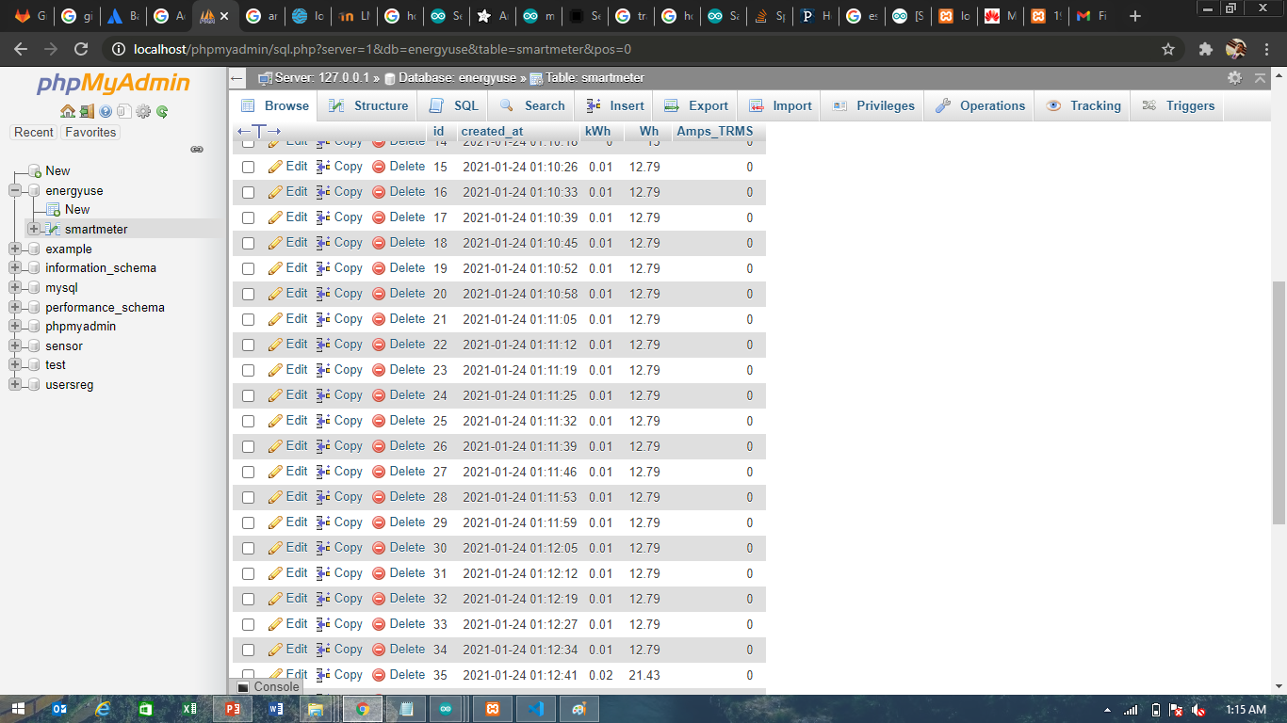
EXPERIMENTAL RESULTS

Slide 10
Thank You

