Slide 1
Battery Intelligence Dashboard for EVs and Drones
Machine-learning based prediction of battery wear, degradation, and remaining useful life
Uses real NASA Li-ion battery aging data stored in the project workspace
Combines ML prediction, anomaly detection, and realistic EV/drone operating stress simulation
Predicts SoH, wear %, RUL, end-of-life, failure probability, thermal risk, and pack imbalance
Training Samples
2533
Real discharge records
Battery Cells
34
Unique NASA cells
SoH MAE
1.58%
Prediction error
RUL MAE
0.97
Cycles error
Team project presentation deck generated automatically from the current codebase

Slide 2
Shortforms Used
Abbreviations used across the model, UI, formulas, and explanation
EV
Electric Vehicle
SoH
State of Health
RUL
Remaining Useful Life
DoD
Depth of Discharge
SoC
State of Charge
MAE
Mean Absolute Error
R²
Coefficient of Determination
C-rate
Charge/Discharge rate normalized by battery capacity
Wh
Watt-hour, energy delivered by the battery
ML
Machine Learning
UI
User Interface
Li-ion / LiPo / LFP
Battery chemistry families used in the scenario layer

Slide 3
How The Project Works
End-to-end workflow from raw NASA battery files to dashboard output
1. Dataset ingestion
MATLAB .mat files are read from NASA battery aging archives in the workspace.
2. Feature engineering
Discharge capacity, voltage, current, temperature, energy, impedance, and C-rate are extracted.
3. Label generation
SoH and RUL labels are derived from each battery’s degradation trajectory.
4. Model comparison
Random Forest, Extra Trees, and Gradient Boosting are trained and benchmarked.
5. Final prediction layer
Best models plus anomaly detection are saved and loaded by the web server.
6. Scenario realism layer
EV/drone profile, chemistry, SoC, DoD, mission stress, age, and fast charging adjust the output.
7. Dashboard output
UI shows SoH, wear, RUL, failure risk, heatmap, contributions, and what-if recommendations.

Slide 4
Dataset And Training Base
Real battery-aging data used to build the ML core
Dataset Facts
Learned Feature Set
Training samples: 2533
Battery cells: 34
Source: NASA Li-ion Battery Aging Dataset and randomized battery usage series
Local workspace contains zipped MATLAB datasets and readme files
Rows are built from discharge and impedance cycles only
Invalid or nonphysical rows are filtered before training
Internal resistance
Capacity
Cycle number
Cell and ambient temperature
Average and minimum voltage
Average / peak current and current variation
Discharge duration, energy delivered, and load C-rate

Slide 5
Parameters Used And Their Effect
How each major input affects the output prediction
Internal resistance
Higher resistance usually increases wear, lowers SoH, and raises failure risk.
Capacity
Lower available capacity directly reduces SoH and shortens RUL.
Cycle number
More cycles generally mean older battery state and lower remaining life.
Temperature
High temperature accelerates degradation and pushes thermal risk upward.
Ambient temperature
Extreme ambient conditions increase stress even if cell temperature looks safe.
Voltage under load
More voltage sag suggests internal stress and possible pack weakness.
Current / C-rate
Higher current increases thermal load and charge/discharge severity.
SoC
Very high or very low SoC can increase stress and aging.
DoD
Deep discharge cycles generally increase long-term degradation.
Age / fast charging / mission stress
Calendar aging and harsh usage lower SoH and increase failure probability.

Slide 6
Core Formulas Used
Main equations used in feature engineering, labeling, and output generation
1. Load C-rate = Average Current / Capacity
Why: normalizes current by battery size and measures how aggressively the battery is being used.
2. Energy (Wh) = Integral[ Voltage x |Current| dt ] / 3600
Why: captures actual energy delivered during discharge, not just instantaneous values.
3. SoH (%) = (Current Capacity / Initial or Best Capacity) x 100
Why: standard battery-health definition used to quantify degradation.
4. RUL (cycles) = End-of-Life Cycle - Current Cycle
Why: directly measures remaining life before the battery crosses the end-of-life threshold.
5. Voltage Sag Risk = (Average Voltage - Minimum Voltage) / 0.7
Why: larger sag often indicates internal resistance rise or stressed cells.
6. Failure Probability = Sigmoid( wear + stress + anomaly + temperature effects )
Why: converts several risk signals into an interpretable probability-like output.
7. Degradation Rate per Cycle = Wear % / Cycle Number
Why: gives a quick estimate of how rapidly the pack is aging.
8. Stress Index = weighted sum of SoC, DoD, age, fast-charge, vibration, distance, speed, and thermal factors
Why: adds real-world EV/drone behavior that does not fully exist in the raw training dataset.

Slide 7
ML Algorithms Used And Why
All prediction and detection algorithms used in the project
Algorithms
Why Model Comparison Matters
RandomForestRegressor
Strong ensemble baseline for nonlinear tabular battery data. Robust and easy to interpret.
Different algorithms behave differently on battery-health tabular data.
The training script evaluates MAE and R² for SoH and RUL separately.
Selected SoH model: extra_trees
Selected RUL model: extra_trees
This makes the system more defensible than choosing a single model without comparison.
ExtraTreesRegressor
Selected final regressor. Gives strong performance on mixed engineered battery features.
GradientBoostingRegressor
Useful comparison model that sequentially improves prediction residuals.
IsolationForest
Detects abnormal battery states that look unusual compared with training data.

Slide 8
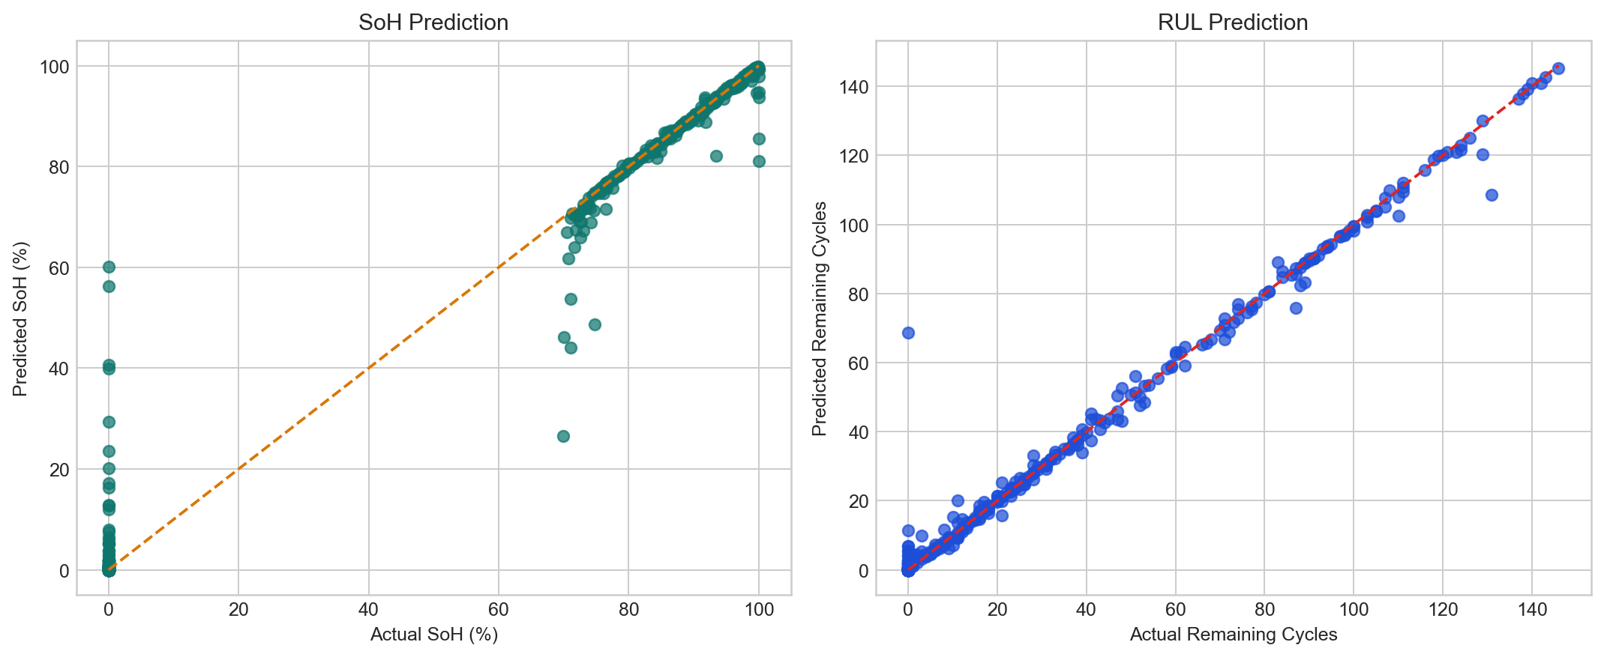
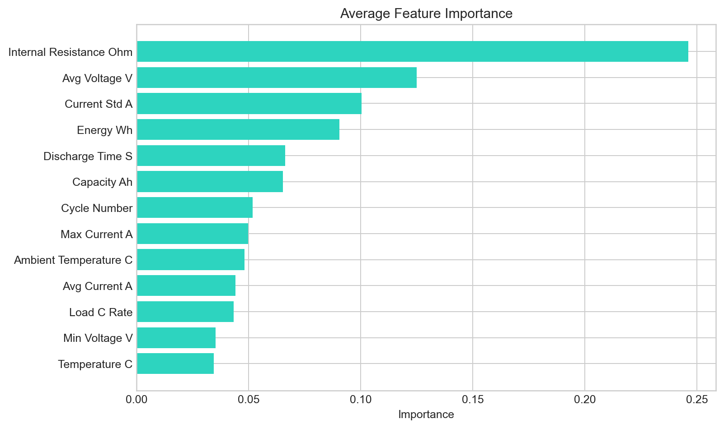
Training Results
Current performance from the latest run in this workspace
SoH MAE
1.58%
Lower is better
SoH R²
0.981
Closer to 1 is better
RUL MAE
0.97
Cycles error
RUL R²
0.990
Closer to 1 is better

Slide 9
Outputs Generated By The System
What the user gets after clicking Run Battery Intelligence
Primary Outputs
Analytical Visuals
State of Health (SoH)
Wear percentage
Remaining Useful Life (RUL)
Estimated end-of-life cycle
Failure probability
Thermal risk label
Confidence score and anomaly flag
Capacity degradation forecast chart
Feature contribution / wear-driver chart
Pack-level heatmap
What-if low-stress scenario
Maintenance recommendations
Downloadable Excel report

Slide 10
UI And User Experience
How the dashboard helps the user understand battery condition
Top cards summarize dataset strength and model performance.
Interactive controls let the user simulate EV or drone battery scenarios.
The health ring gives a quick visual signal of battery condition.
Charts explain both future degradation and the main reasons behind wear.
The report export makes the result easy to share and inspect in Excel.
Why this matters
Transforms raw ML output into an interpretable battery intelligence tool
Useful for predictive maintenance demos and project presentations
Balances engineering realism with an accessible visual interface

Slide 11
Limitations And Future Work
What is realistic already and what can be improved further
Current Limitations
Future Improvements
NASA dataset is real, but some EV/drone mission variables are not directly present in the raw data.
Several scenario variables are modeled through domain logic rather than learned from large telemetry datasets.
The system is strong for demonstration and analysis, but not yet a production battery management system.
Use larger EV/drone telemetry datasets for direct learning of mission stress.
Add sequence models such as LSTM or transformer-based time-series predictors.
Include real cell-balancing, fault-code, and BMS telemetry streams.
Deploy the app as a cloud dashboard or desktop product.

Slide 12
Conclusion
Why this project is meaningful
This project combines real NASA battery-aging data with machine learning and an engineering-based realism layer.
It predicts battery degradation, explains the result visually, and supports EV/drone-specific what-if analysis.
The final system is not just a model, but a complete battery intelligence dashboard with reporting and interpretability.
That makes it a strong academic project, a good portfolio piece, and a useful demo for predictive maintenance concepts.
Presentation generated from the current project artifacts in C:\ML proj

