Slide 1
a
Time
b
Time
E
Average
c
Time
d
Time

Slide 2
Day
Mean (Day or Night)
*all Change Treatment in this example
Night
M02
M08
M13
Example of how the All Change Treatment would look

Slide 3
Mean (Night)
Day
Mean (Day)
*all Change Treatment in this example
Night
M02
M08
M13
M02
M08
M13
Example of how the All Change Treatment would look

Slide 4
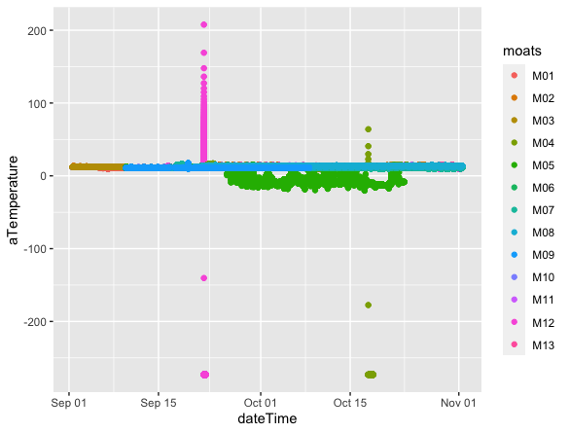
All Moats, Day & Night Periods, Complete Time Series

Slide 5
Slides will be presented in a (1) Both periods, (2) day period, and (3) night period time series plots.
These slides will be followed by the collection of treatment (2-4 MOATs per graphic) and then graphics that represent those MOATs selected for follow on lipids analysis

Slide 6
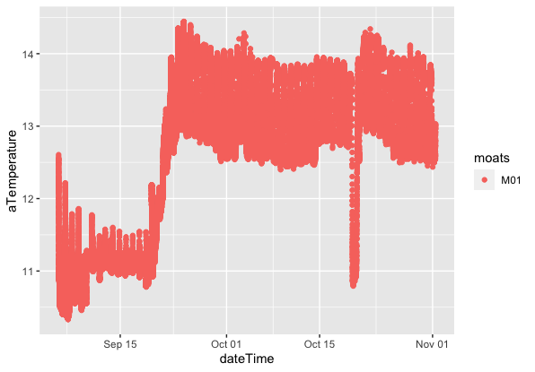
M01, Full-Day, Time Series (Hight Temperature)

Slide 7
M01, Day, Time Series (Hight Temperature)
Day

Slide 8
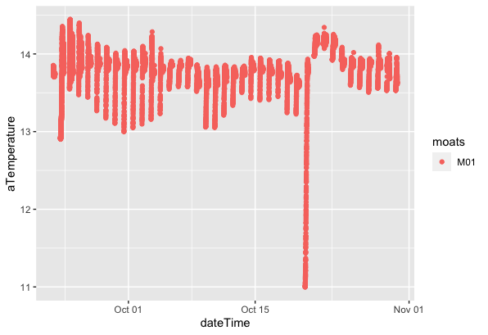
M01, Nights, Time Series (Hight Temperature)

Slide 9
M02, Full-Day, Time Series (Hight Temperature)
Full Day

Slide 10
M02, Day, Time Series (Hight Temperature)
Day

Slide 11
M02, Nights, Time Series (Hight Temperature)
night

Slide 12
M03, Full-Day, Time Series (Hight Temperature)
Full Day

Slide 13
M03, Day, Time Series (Hight Temperature)
Day

Slide 14
M03, Nights, Time Series (Hight Temperature)
night

Slide 15
M04, Full-Day, Time Series (Hight Temperature)
Full Day

Slide 16
M04, Day, Time Series (Hight Temperature)
Day

Slide 17
M04, Nights, Time Series (Hight Temperature)
night

Slide 18
M05, Full-Day, Time Series (Hight Temperature)
Full Day

Slide 19
M05, Day, Time Series (Hight Temperature)
Day

Slide 20
M05, Nights, Time Series (Hight Temperature)
night

Slide 21
M06, Full-Day, Time Series (Hight Temperature)
Full Day

Slide 22
M06, Day, Time Series (Hight Temperature)
Day

Slide 23
M06, Nights, Time Series (Hight Temperature)
night

Slide 24
M07, Full-Day, Time Series (Hight Temperature)
Full Day

Slide 25
M07, Day, Time Series (Hight Temperature)
Day

Slide 26
M07, Nights, Time Series (Hight Temperature)
night

Slide 27
M08, Full-Day, Time Series (Hight Temperature)
Full Day

Slide 28
M08, Day, Time Series (Hight Temperature)
Day

Slide 29
M08, Nights, Time Series (Hight Temperature)
night

Slide 30
M10, Full-Day, Time Series (Hight Temperature)
Full Day

Slide 31
M10, Day, Time Series (Hight Temperature)
Day

Slide 32
M10, Nights, Time Series (Hight Temperature)
night

Slide 33
M11, Full-Day, Time Series (Hight Temperature)
Full Day

Slide 34
M11, Day, Time Series (Hight Temperature)
Day

Slide 35
M11, Nights, Time Series (Hight Temperature)
night

Slide 36
M12, Full-Day, Time Series (Hight Temperature)
Full Day

Slide 37
M12, Day, Time Series (Hight Temperature)
Day

Slide 38
M12, Nights, Time Series (Hight Temperature)
night

Slide 39
M13, Full-Day, Time Series (Hight Temperature)
Full Day

Slide 40
M13, Day, Time Series (Hight Temperature)
Day

Slide 41
M13, Nights, Time Series (Hight Temperature)
night

Slide 42
M01, Complete Time Series (Hight Temperature)

Slide 43
M02, Nights, Time Series (CurrentConditions)

Slide 44
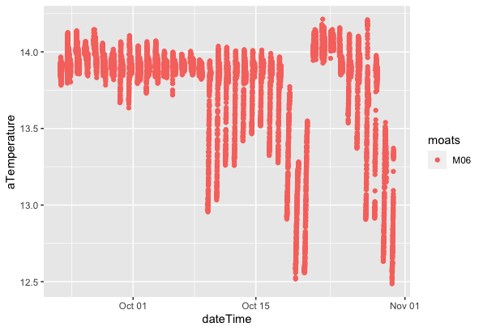

Slide 45
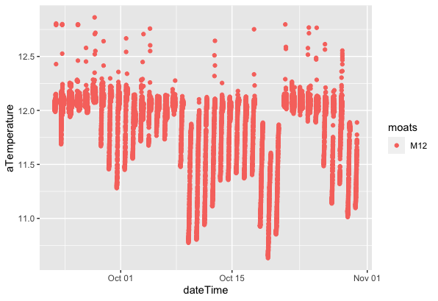

Slide 46
By Treatment- Night Time Series
4 groups

Slide 47
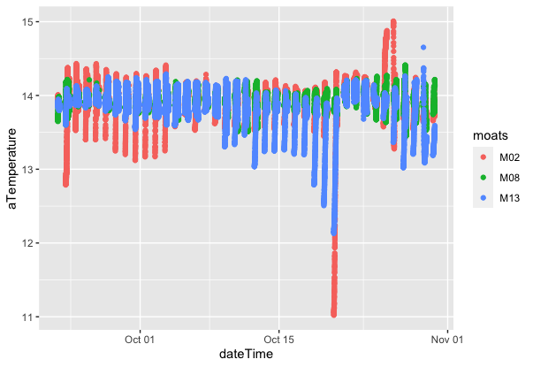
”All Change” Night Time Series

Slide 48
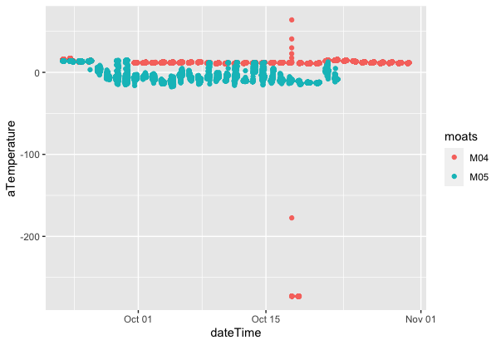
“Ambient” Night Time Series

Slide 49
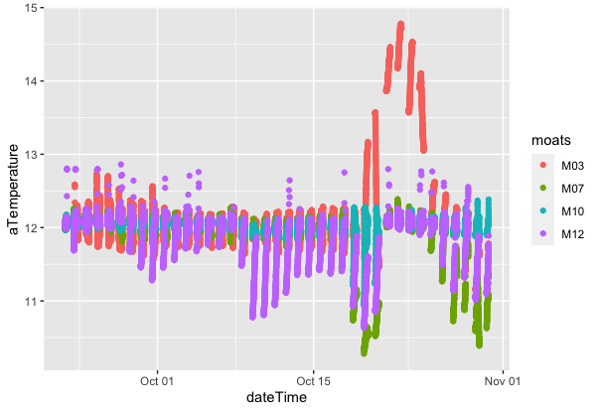
“Current”, Night Time Series

Slide 50
Review of current conditions MOATs selected for lipids testing

Slide 51
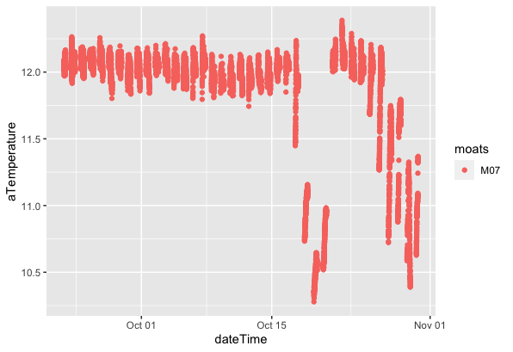
M07, Current, Nigh Period, Time Series

Slide 52
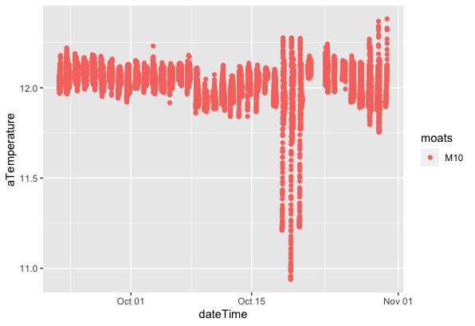
M10, Current, Nigh Period, Time Series

Slide 53
M12, Current, Nigh Period, Time Series

Slide 54
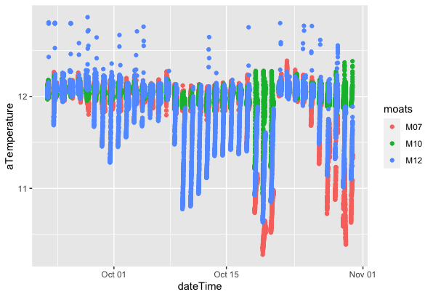
Lipids Dataframe (ldf) Night Period, Time Series
Notes:
Standardize Y

Slide 55
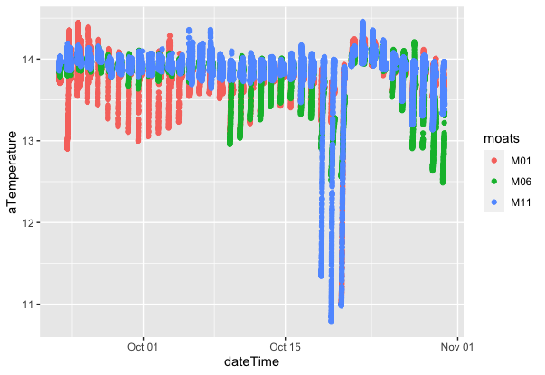
“High Temperature” Night Time Series

