Slide 1
Predictive Maintenance For Airlines Using IBM Watson Studio
BY-
KEERTHANA PEDDINTI
GITAM UNIVERSITY

Slide 2
INTRODUCTION
The airport usage currently increased year by year, the traditional method of airport resource allocation has been unable to adapt to the requirements of the operation of the airport.
Dynamic allocation and scheduling of airport terminal passenger service resources are one of the most effective ways to improve passenger service levels and operational efficiency within the terminal, while the relatively accurate passenger traffic forecasting is the prerequisite for dynamic allocation and scheduling.
In order to cut down the operational cost and also to help engineers by predicting at a faster rate, we make use of Machine Learning (ML).
So the main goal of this project is to build a Machine Learning model to predict the the number of passengers.

Slide 3
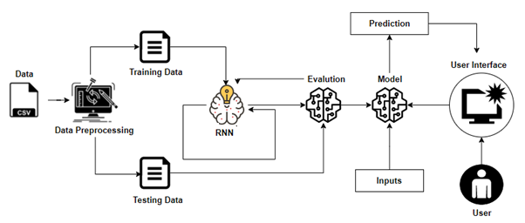
ARCHITECTURE

Slide 4
Project Flow
Machine Learning Model
Data Collection.
Collect the dataset or Create the dataset
Data Preprocessing.
Import the Libraries and the dataset.
Checking for Null Values.
Data Visualization.
Handling Missing Data.
Label encoding And One Hot Encoding.
Feature Scaling.
Splitting Data into Train and Test.
Model Building
Training and testing the model
Evaluation of Model
Application Building
Create an HTML file
Build a Python Code
UI
The user interacts with the UI (User Interface) to enter the data
Entered data is analyzed by the model which is integrated
Once the model analyses the input, the prediction is showcased on the UI

Slide 5

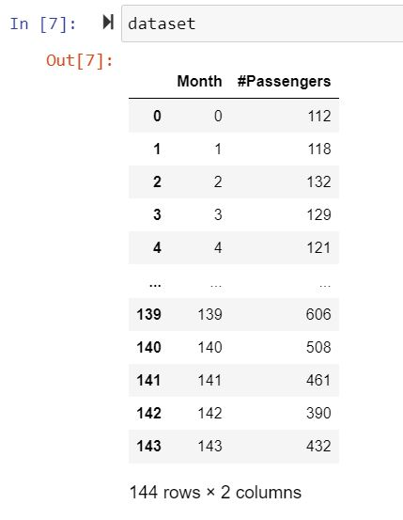
Machine Learning Model
Importing Libraries
Reading the dataset and Viewing the fields
.

Slide 6
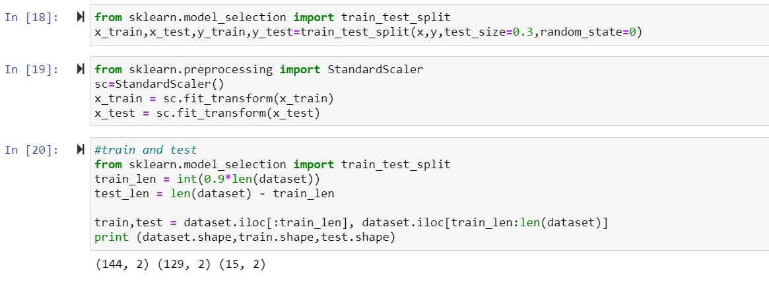
Training and Splitting Data
Applying Ensembled modelling and Predicting

Slide 7
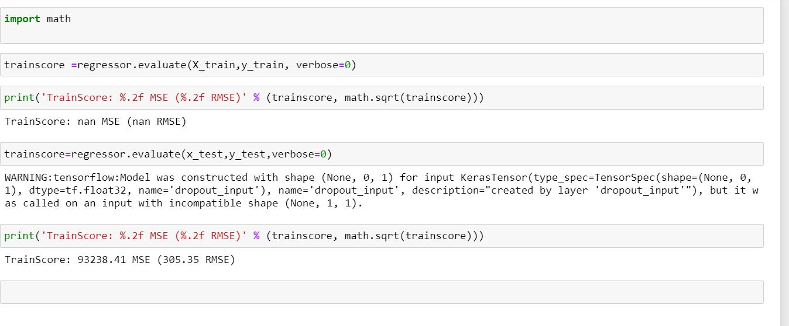
Finding accuracy
Saving it as h5 file to access it in Flask

Slide 8
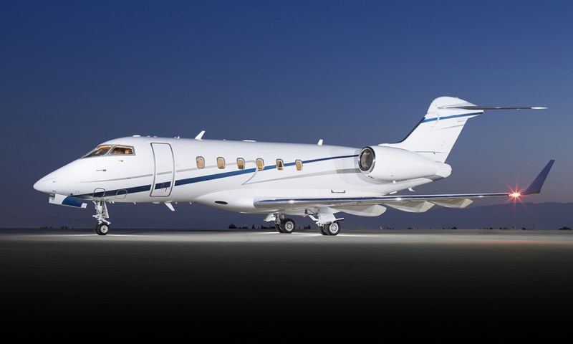
Welcome

Slide 9
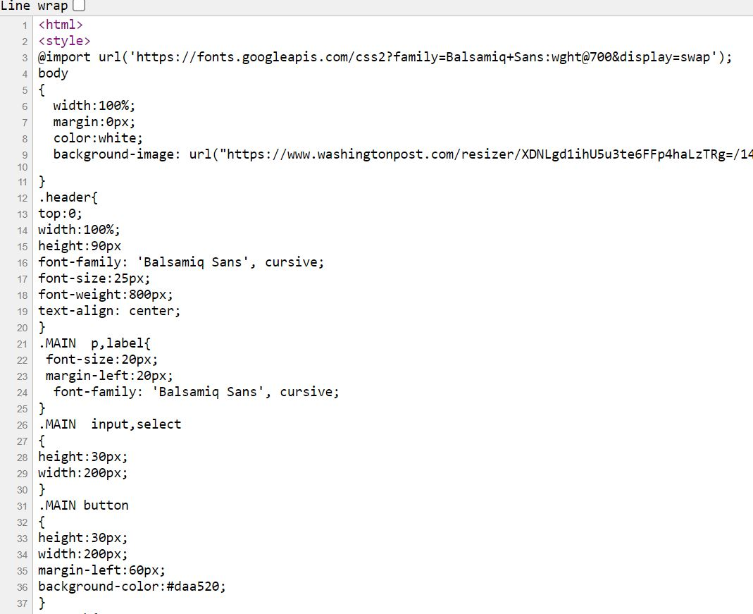
UI

Slide 10
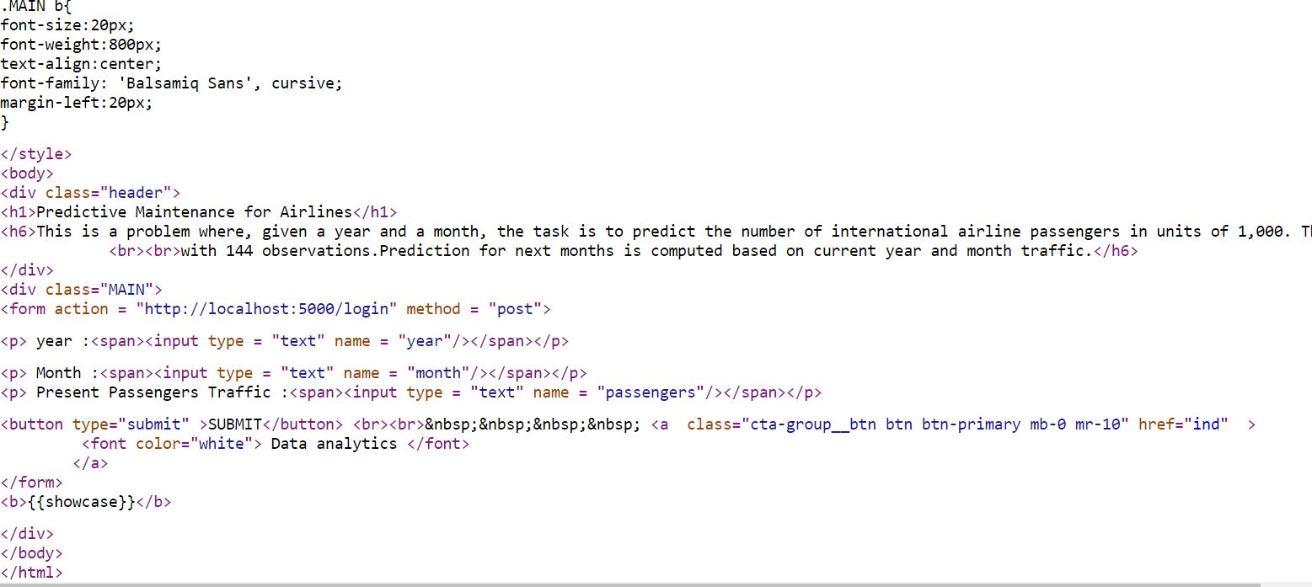
Index UI

Slide 11
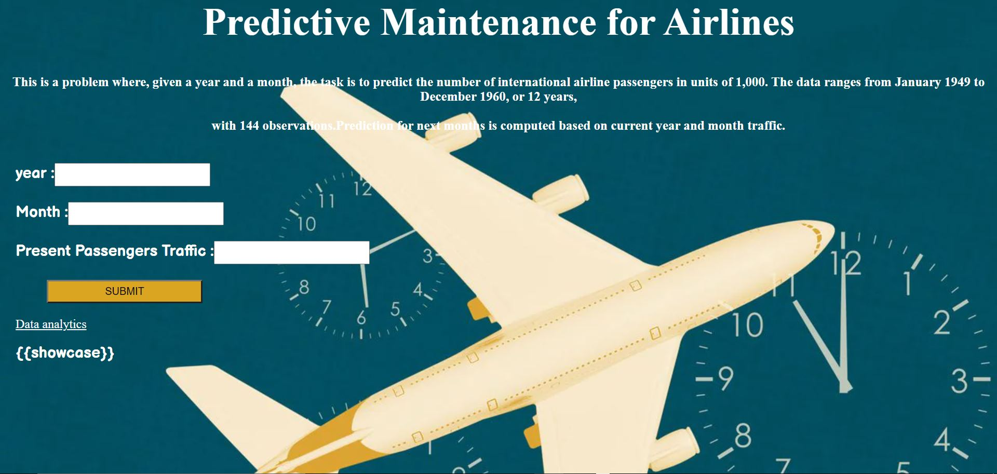
Output UI and the inputs.

Slide 12
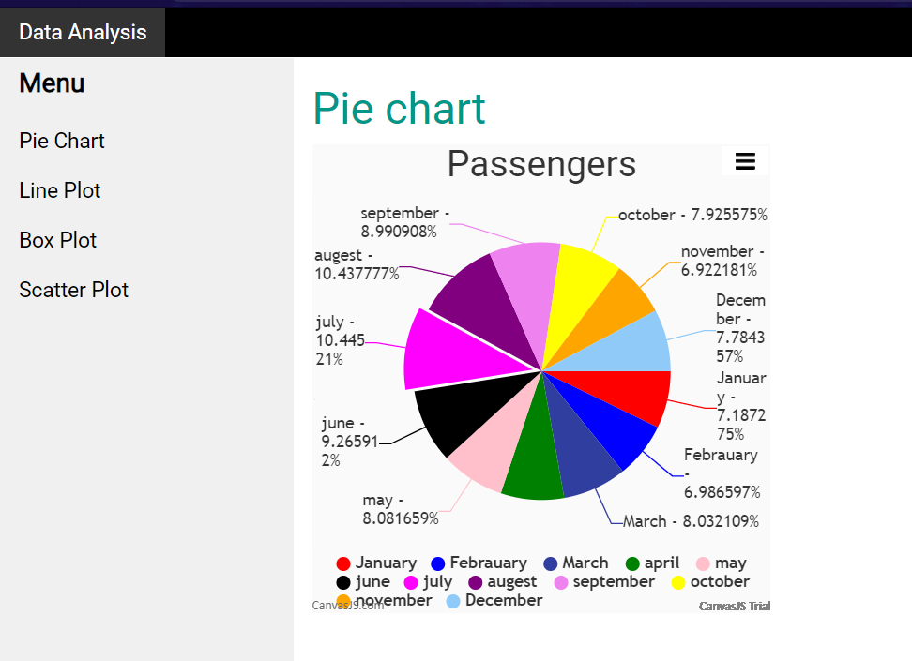
Pie Chart
→Predicting The Quality.

Slide 13
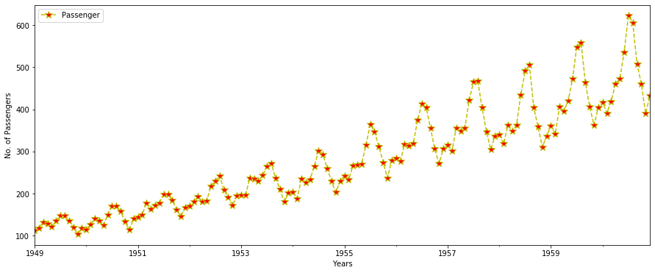
Line Plot

Slide 14
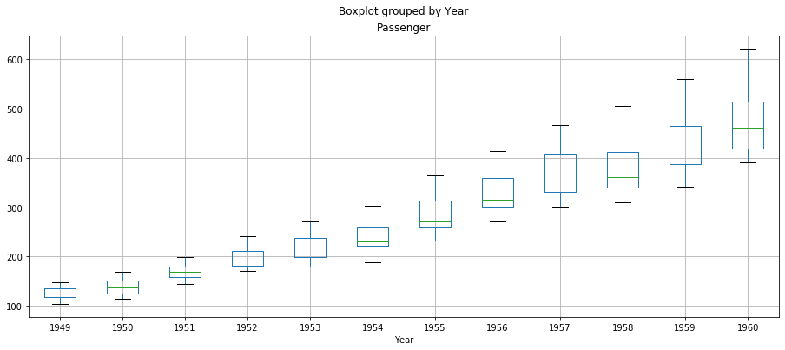
Box Plot

Slide 15
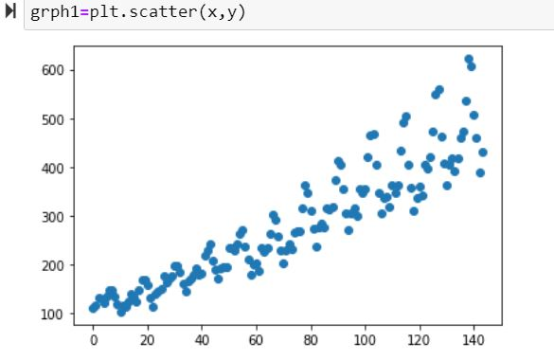
Scatter Plot

Slide 16


