Slide 1


SUPERFOODMAX
ANALYSIS AND PRESENTATION
- KARISHMA PATHAN

Slide 2
The business problem
The Business problem:
The SuperFoodMax wants to increase their market share by 5% over the next two years.
Assumptions:
The loyal customers’ average spending is not increasing.
First time buyers are not converting into loyal customers.
Promiscuous customers are big spenders but purchase a limited range of commodities.
Questions:
What are the sales trends over the years?
Who constitute our customer base, based on loyalty, age group and household type?
What do different loyalty group customers spend most on?
What comparison can we make among all the loyalty types based on their shopping trend?
How did each department and top commodities perform over time?

Slide 3
SuperFoodMax sales data Jan-2019 to May-2022
The data I used for this analysis is the data provided by Super Food Max.
The data is between January 2019 to May 2022.
It contained all the required information about customers and about the departments and products to address the business problem.
By analysing the data, I could extract information about the shopping behaviours of different customer groups as well as performance of different department and commodities over the period of three years.
With the information I was able to generate insights of their impact on the revenue generation and could create recommendations to improve the revenue by 5% in coming two years.
Ethical consideration:
The data does not reveal any personal information about any customer and cannot be used to obtain any.
Care was taken not to produce any wrong information or unfair bias even unintentionally.

Slide 4
Cleaning and Formatting
Duplicate data: duplicate data is found and removed using drop_duplicates() function
Irrelevant Data: For this analysis I did not need the brands and store number as there is only one store data we were working on. So, these two columns were not taken into consideration.
Missing Data: The data is checked of missing data using isna() function.
The date column type is checked for the columns using df.describe() function.
different data-frames were created based on the insights or questions being worked on
For forecasting all dates were set to the beginning of the month

Slide 5

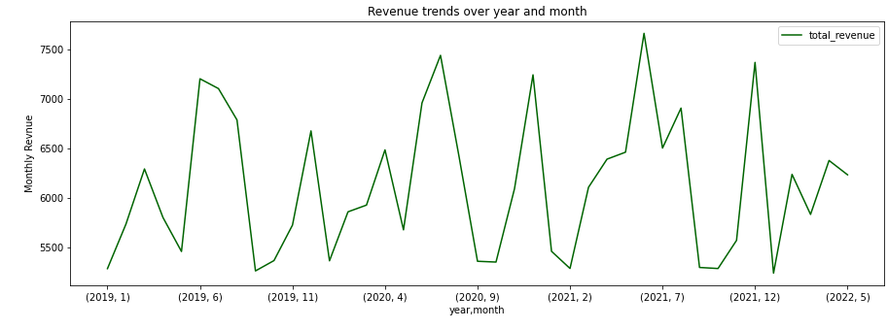
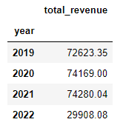
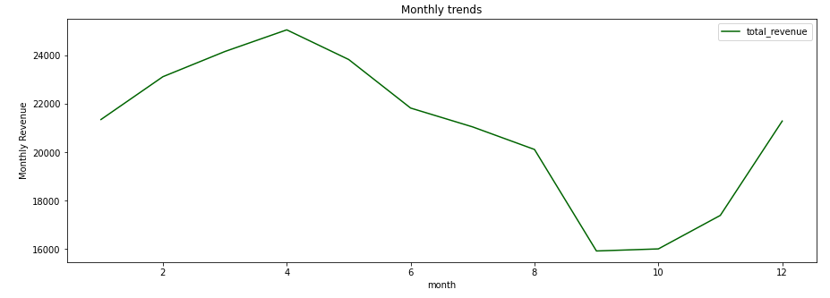
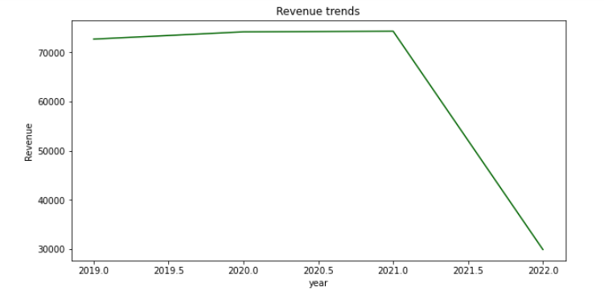
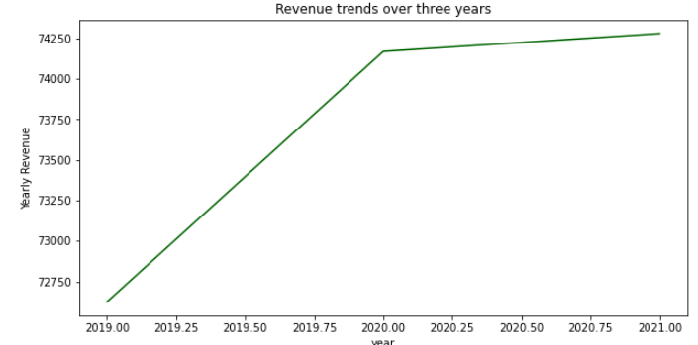
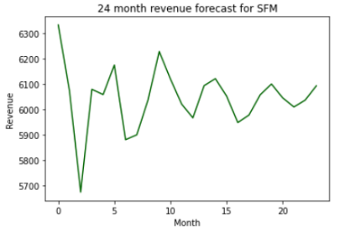
What are the sales trends over the years?
Revenue trend going down as data is till May-22
Other graph shows trend till 2021 which shows slight growth over two years
Seasonality- Revenue increase around April, decrease around September
Forecast suggests overall decrease and stagnation over two years

Slide 6
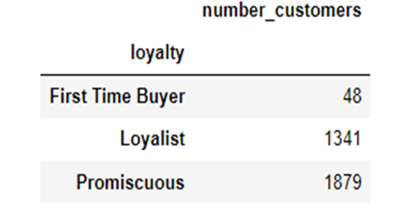
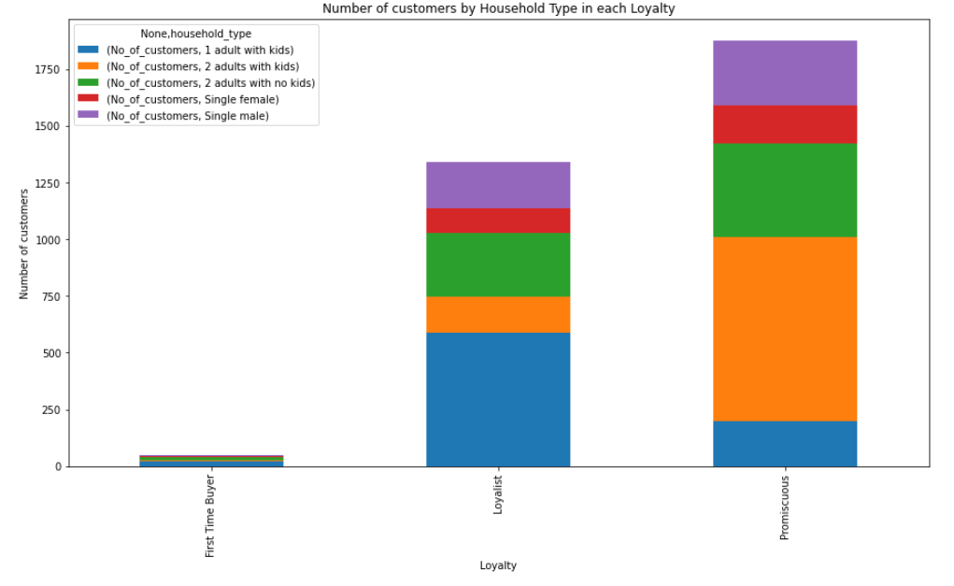
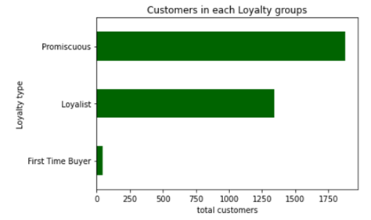
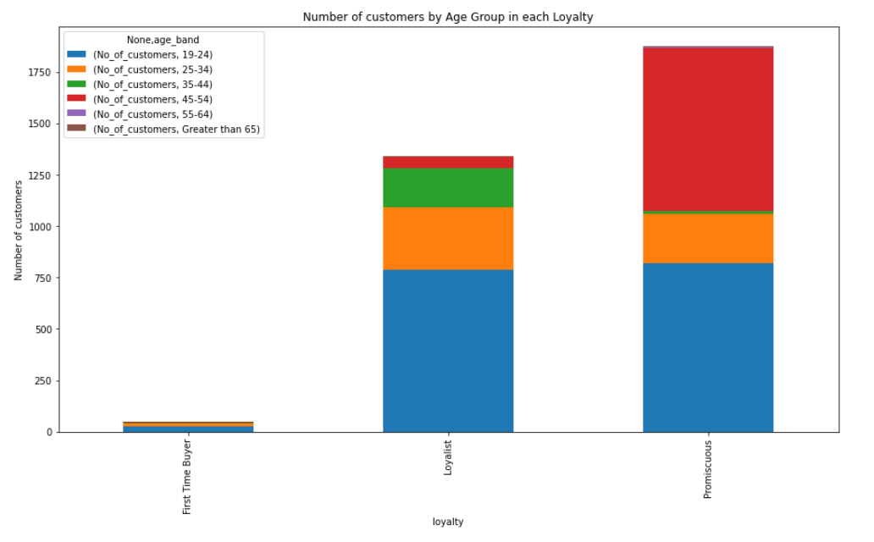
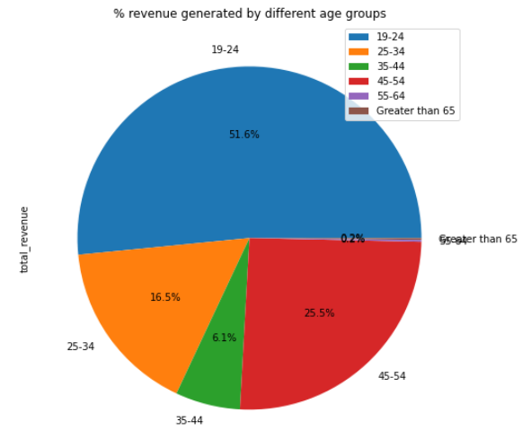
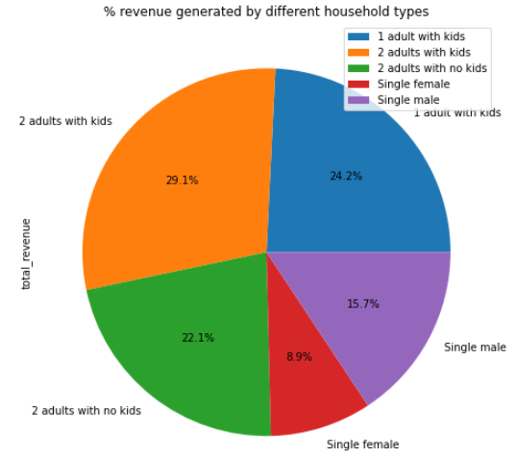
Who are the customers?
Total 3268 customers
1879 Promiscuous customers- highest in the group
48 FTB
19-24 biggest age group for Loyalists and FTB
19-24 and 45-54 years for Promiscuous customers
1 adult with kids followed by 2 adults with no kids are biggest household types for FTB and Loyalists
2 adults with kids followed by 2 adults with no kids for Promiscuous
Overall younger people with family shop more from the store
19-24 group and ‘2 adults with kids’ generate maximum revenue

Slide 7
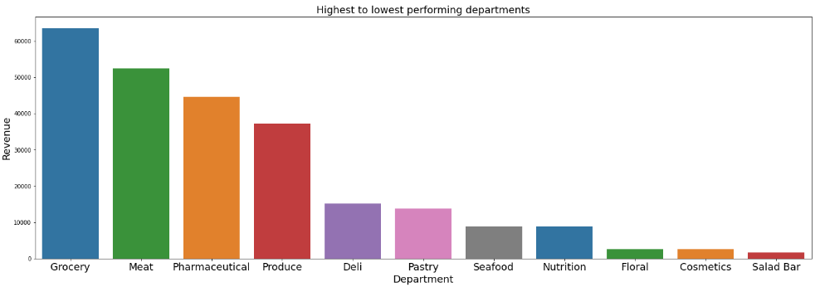
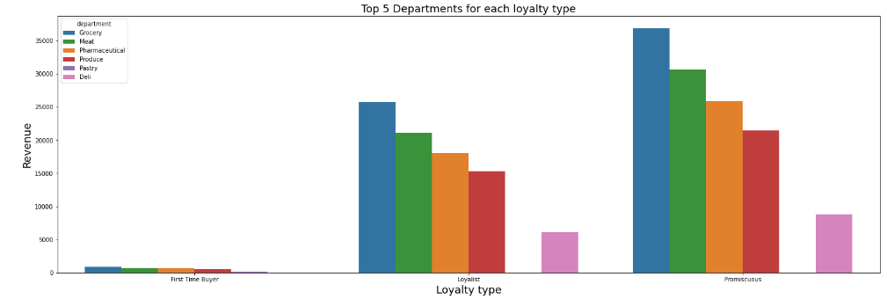
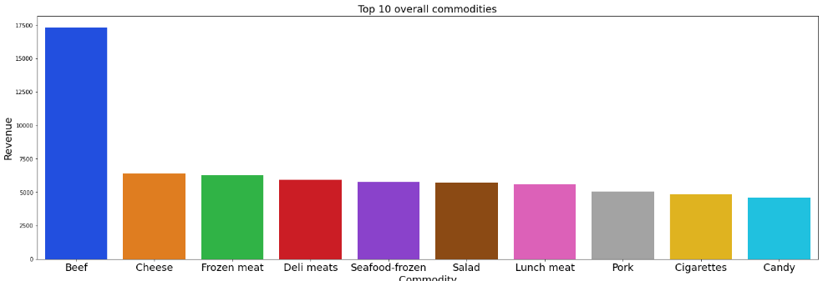
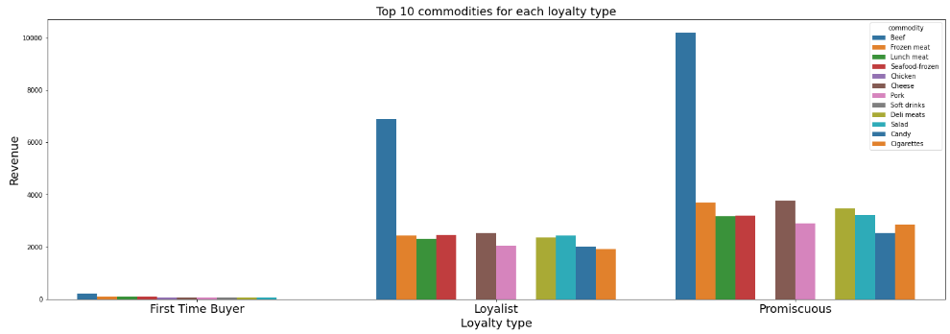
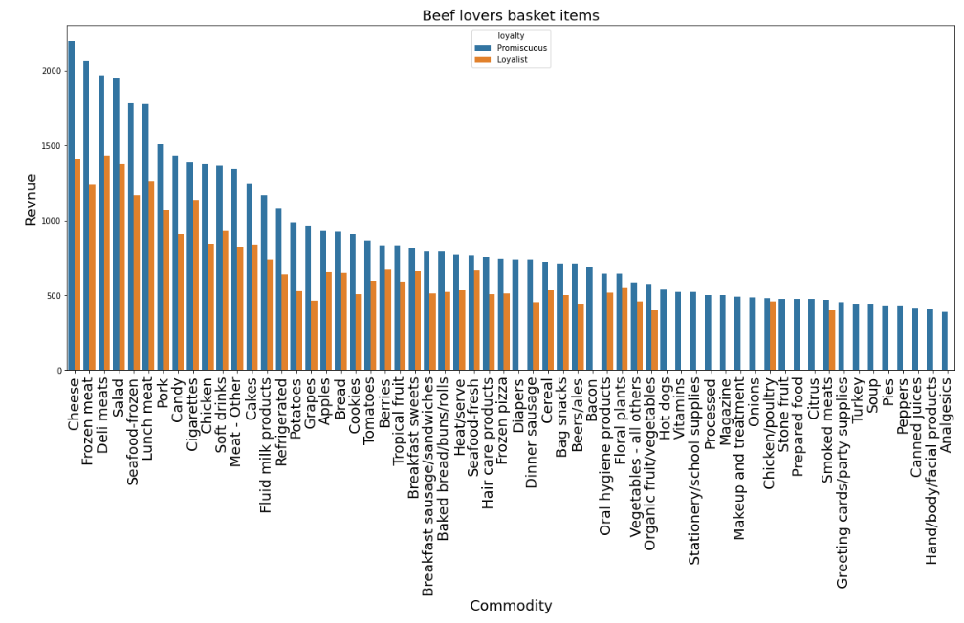
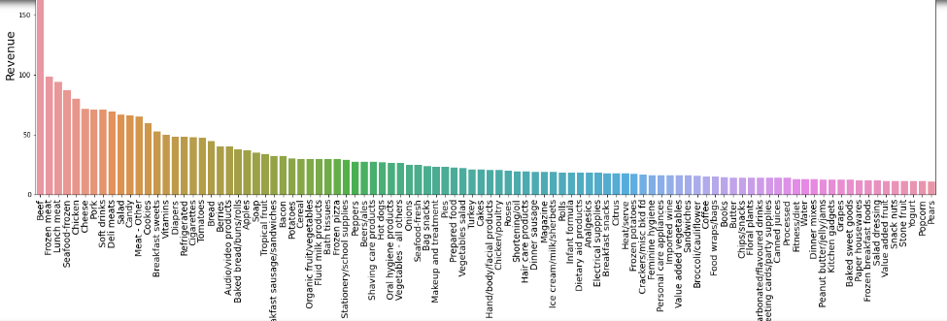
What do different loyalty group customers spend most on?
The top performing departments and top 10 commodities are similar for all loyalty groups
Grocery, Meat, pharmaceutical, Produce and deli top 5 departments and Floral, Cosmetics and Salad bar least performing departments
Beef is the most sold commodity for all 3 loyalties, followed by Cheese, frozen meat, deli meat and seafood frozen in different order
Promiscuous customers buy more verity of items with beef than Loyalists, discount on those items like other meats, cosmetics and pharmaceuticals (bacon, hot dog, processed food, turkey, onion)
Cannot see FTB in top 100 commodities with beef as their share is less
The last chart shows top 100 commodities of FTB suggest their top shopping preferences are similar to other two types although buy variety of products.
Discounts on items they buy the most will encourage them to come back to the SFM.

Slide 8


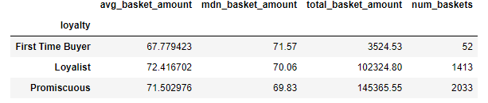
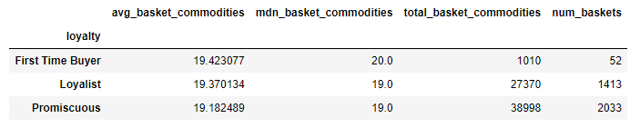
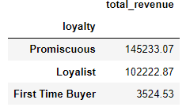
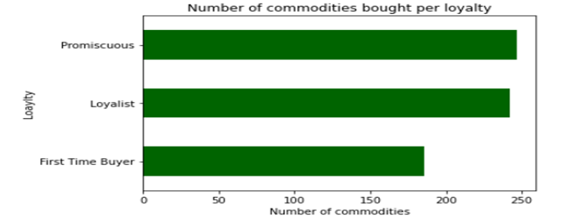
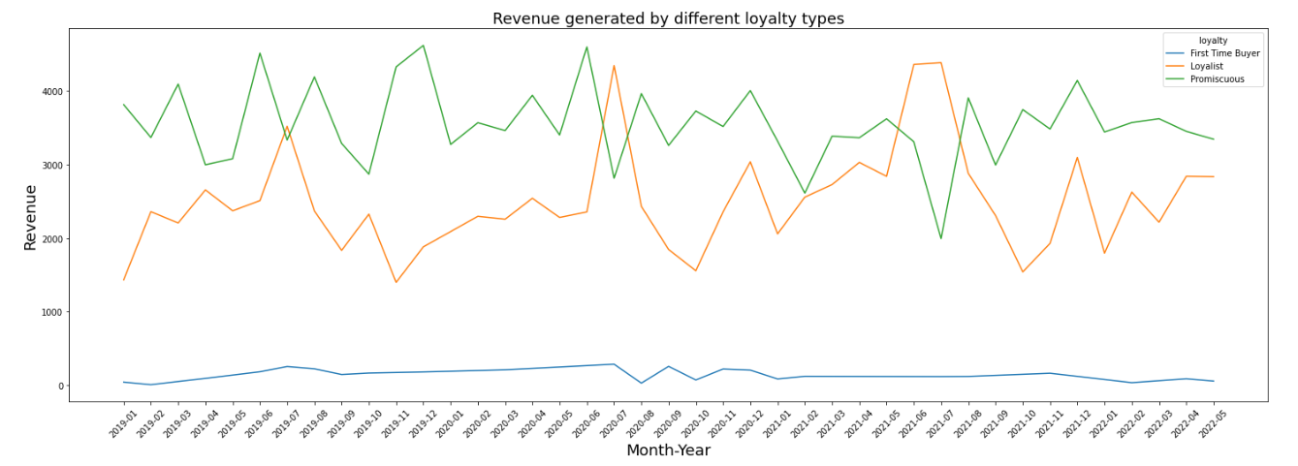
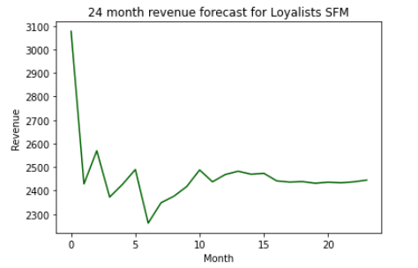
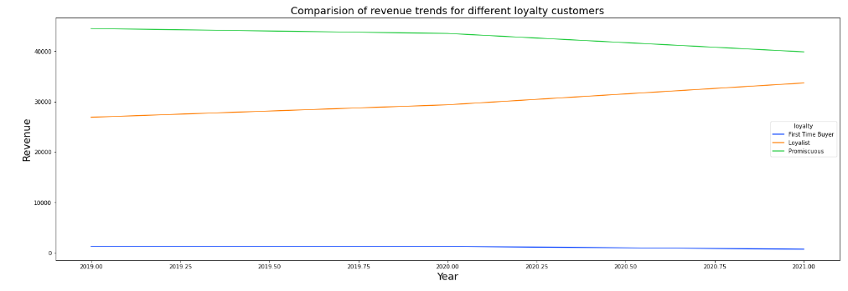
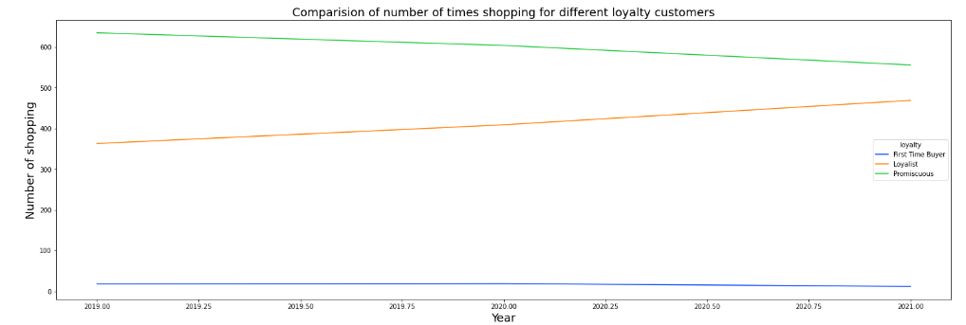
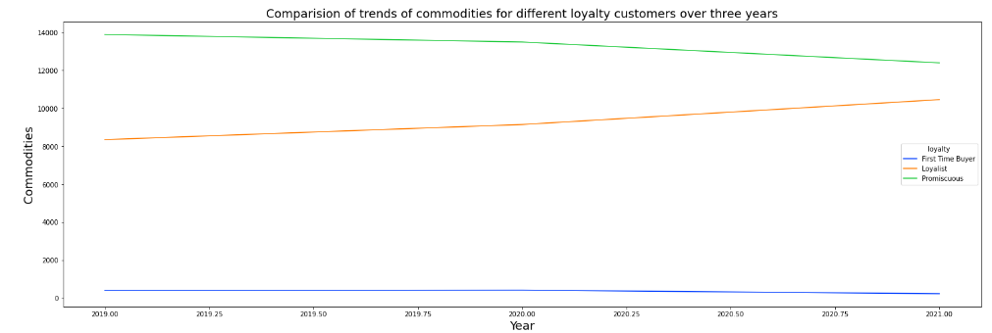
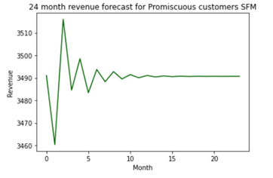



What comparison can we make among all the loyalty types based on their shopping trend?
Promiscuous customers are the biggest spenders
On average Loyalist spend more money each visit
Monthly average spent and items bought by Promiscuous high as high in number
247 total commodities, FTB buy more variety of commodities- 48 FTB bought around 180 items
Trends of revenue generation, commodity bought and shopping frequency show decrease for Promiscuous, increase for Loyalists and stagnant for FTB, challenging the hypothesis of Loyalist stagnation
2-year forecast suggest initial decrease and then stagnation in revenue generated by both loyalties

Slide 9
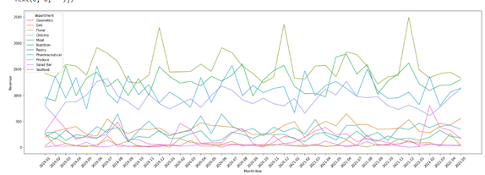
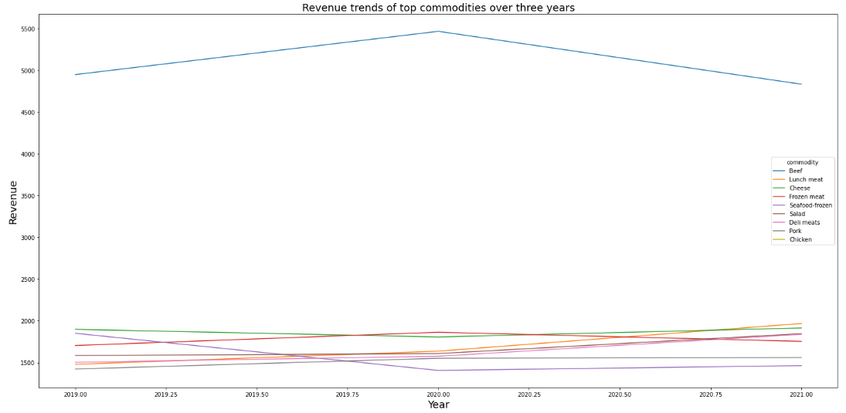
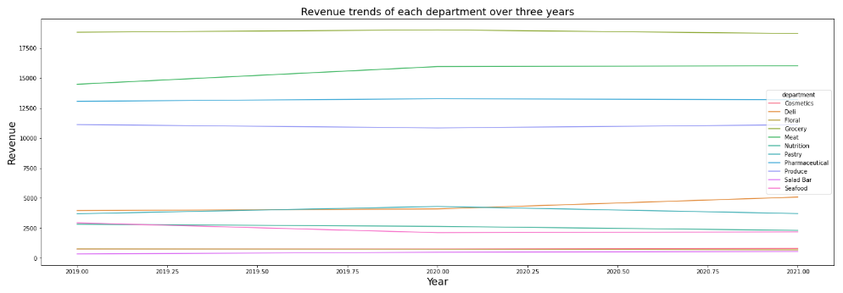
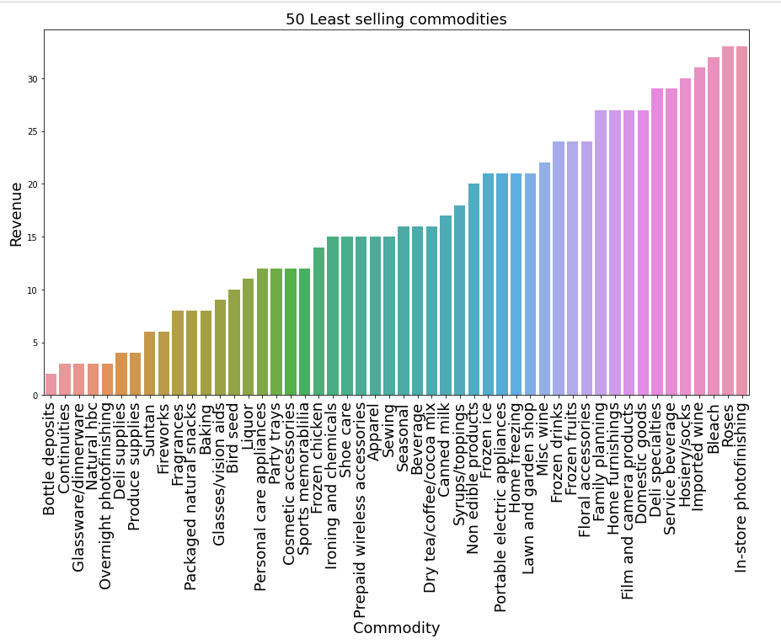
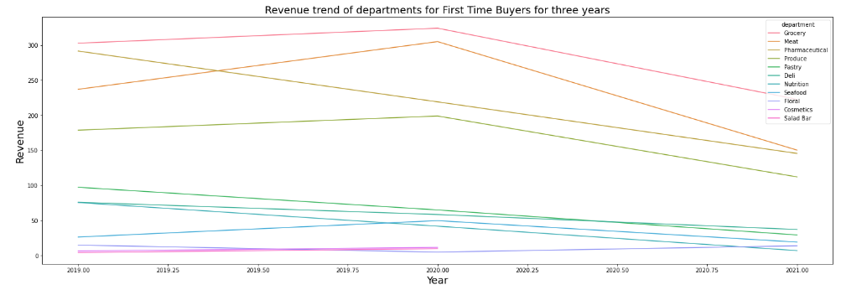
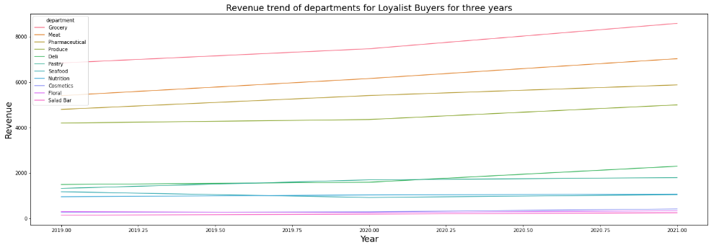
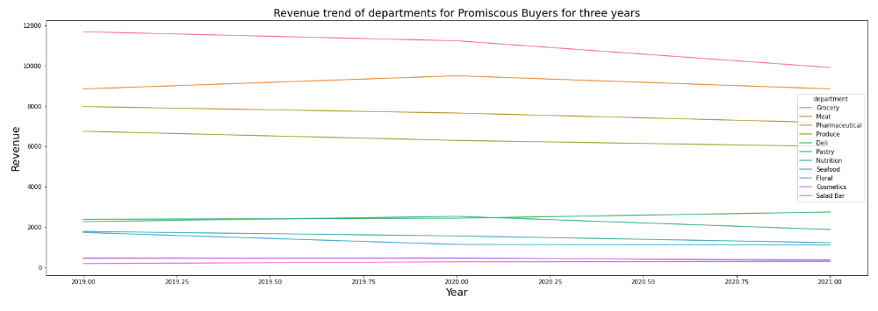
How did each department and top commodities perform over time?
Over the period of 3 years apart from slight rise in Meat and Deli all departments were stagnant
Revenue generated by Promiscuous for each department was decreasing apart from Deli
For Loyalists, the revenue was increasing for all the top 5 departments
FTB have decreased shopping over the years
The revenue for top commodities varies with increase in Deli meat, Lunch meat and Salad and decrease in Beef, Seafood frozen, Pork, Frozen meat and Cheese. These are the high revenue generating commodities, need to be on promotional discounts to increase sale.
The least selling commodities include many seasonal items.

Slide 10
INSIGHTS AND RECOMMENDATIONS
Customer revenue is forecast to flatline for the next two years if present trend countinues.
Trends of revenue generation, commodity bought and shopping frequency show decrease for Promiscuous, increase for Loyalists and stagnant for FTB, challenging the hypothesis of Loyalist stagnation.
Loyalty cards to all customers to collect loyalty points and special discounts will help turn Promiscuous customers into loyal customers and encourage First Time Buyers to visit again.
Grocery, Meat, pharmaceutical, Produce and deli top 5 departments and Floral, Cosmetics and Salad bar least performing departments, but even for the top performing departments the revenue generation is stagnant apart from Deli.
Beef is the most sold commodity for all 3 loyalties, followed by Cheese, frozen meat, deli meat and seafood frozen
The revenue for top commodities varies with increase in deli meat, lunch meat and salad and decrease in beef. Seafood frozen, pork, frozen meat and cheese. These are the high revenue generating commodities
Weekly promotions on top selling commodities
Age group 19-24 and families shop more at SuperFoodMax
!9-24 years and 1 adult with kids in Loyalists and 19-24 years and 45-54 years and 2 adults with kids in Promiscuous customers buy variety of items in more quantities, which their other counterparts don’t buy. These items are infant formula, diapers, breads, cereal, fruits and vegetables and many more.
Discount on items families use the most.
Floral, Cosmetics and Salad bar are the least performing departments.
Promotions on cosmetics to encourage young people and single females
Weekly promotions on healthy items to encourage customer buy more fruit, vegetables, health supplements and other healthy food items.
Some of the least sold items are seasonal, so seasonal discounts
Discounts on products like wine, beer, ale and liquor which are less sold and has higher prices than other less sold items
Discount on second visit if the purchase amount is more than certain amount
Discounts on items First Time Buyers buy the most will encourage them to come back .
If a different than usual Item is bought with the top commodities discount applied will promote sale of varied items.

Slide 11


