Slide 1

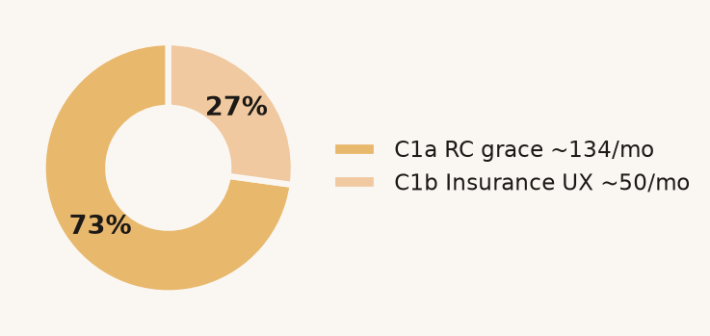
RAPIDO · RAMANATHAN K R · EXTRACT 30 JUN 2026, 23:59 IST
Ship Insurance capture this week (~50/mo). Do not 5× WhatsApp. Do not hire the airport.
The number I will put my name on this week is ~50 extra approved / month (C1b, no Legal). RC grace is ~134/mo only if Legal treats deferred RC as activation — otherwise ~36. 98.7% of mature approved already take a first trip (3,895 / 3,946): documents, not first-order.
If Legal says yes, C1a + C1b (disjoint) — not an unconditional bank
~50 / mo
C1b Insurance UX. Ship this week. Engineering only. This is the unconditional number.
~134 / ~36
C1a RC grace at 60% show-up if Legal yes. If remaining docs still bind: ~36.
0 pp
CAMP_WA_002 honest contrast (clicked vs not). Do not fund 5×.
Rapido Supply · Captain onboarding & airport supply
Ramanathan K R · Rapido Data Science Assessment 1 / 6
Notes:
Lead with C1b ~50. C1a is a Legal scenario. Campaign 0 pp. 98.7% R2A.

Slide 2

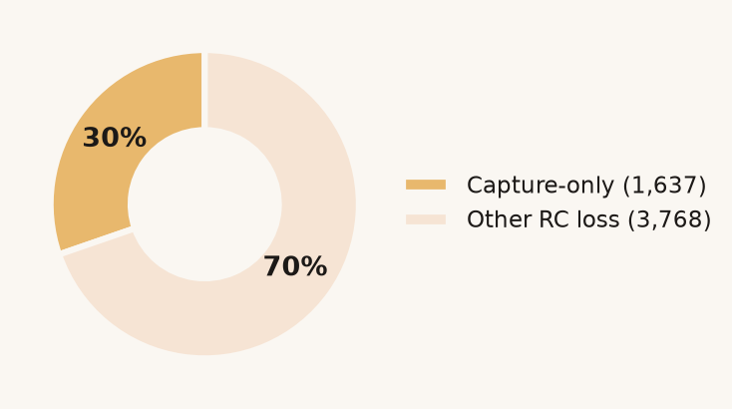
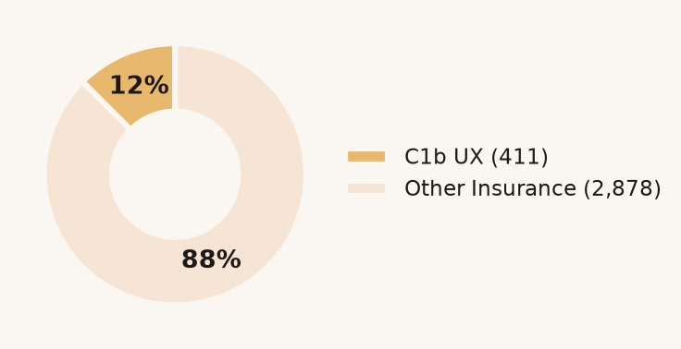
ROOT CAUSE
RC and Insurance are failing as photographs, not documents
Capture-class failures (blur, weak OCR, illegibility) dominate RC and Insurance, and later attempts pass more often. That is a capture / UX problem, not an eligibility one.
RC loss: only the photo slice is C1a
Insurance leftovers — only 411 are C1b
1,637 RC and 411 Insurance captains are capture-only fails — isolated from eligibility (expired, duplicate, wrong type). DL (1,166) is 100% uploaded-fail and cannot be deferred.
Rapido Supply · Captain onboarding & airport supply
Ramanathan K R · Rapido Data Science Assessment 2 / 6

Slide 3

THE FIX
C1b ships this week. C1a is a Legal decision, not a bank.
C1b — ship now
C1a — if Legal
Guided Insurance capture UX — no deferral
Provisional RC · 10-day in-person grace
Who 411 Insurance capture-only fails (~75/mo)
Who 1,637 RC capture-only fails (~300/mo)
Why not defer Liability document — must clear before first ride
Why defer Vehicle identity — no passenger-liability exposure
Retry 67.4% → 73.8% → 76.4% pass on own retry
Show-up Unobserved. 40 / 60 / 80% × 74–78% pass
Bank ~46–52/month additional approved
If Legal yes ~134/month at 60% show-up
Needs Engineering UX only — no Legal sign-off
If docs still bind ~36/month (27% approved | passed RC)
This is the number I would put in a deck with my name on it this week.
Do not add C1a to ~50 until Legal/T&S treat deferred RC as activation.
Rapido Supply · Captain onboarding & airport supply
Ramanathan K R · Rapido Data Science Assessment 3 / 6

Slide 4
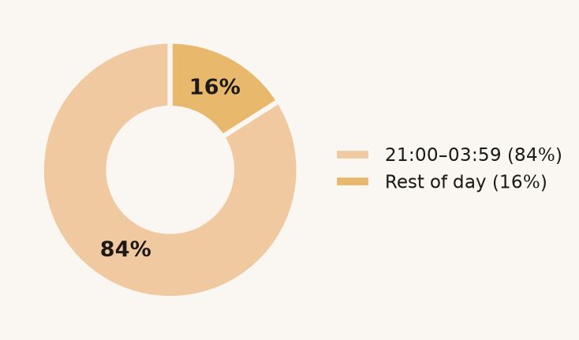
AIRPORT SUPPLY
Do not hire the catchment. After the trip, the night still loses money.
B1 — when the pain sits
B3 — price the deadhead (₹k/mo at ₹35.4/leg)
B2 — after the trip: suburban backhaul and overnight return-in-20min collapse compound. Mix does not shift after dark (χ² p=0.12). New hires inherit both penalties. Not 30% of fare (₹105).
40%
84%
₹35.4
Unfulfilled at terminals vs ~3% elsewhere
Of that gap is 21:00–03:59 — ~13 captains vs ~37 by day
Per eligible night-suburban leg. 4-week pilot; hire only if run-rate falls.
Rapido Supply · Captain onboarding & airport supply
Ramanathan K R · Rapido Data Science Assessment 4 / 6

Slide 5
WHAT DOES NOT WORK — AND HOW EASY IT IS TO BE FOOLED
A campaign with 0 pp lift, and a gap we must not bank
CAMP_WA_002 — WhatsApp campaign
Field vs self-serve — do not double-count
The 29% vs 11% headline is targeting, not effect.
Mechanical ceiling if app/paid converted like field: 128–256 additional/month.
Field teams recruit in person — extract cannot separate who they recruit from how they onboard.
726 of the C1a RC group are the same self-serve captains this gap already counts. Do not add 180 + 128–256.
Fos abandonment after Fitness: 26% vs paid 43% — in-person assist, not WhatsApp.
Honest comparison: clicked vs not-clicked (delivered only) = −1.5 pp; 95% CI [−3.6, +0.6]. That is 0 pp lift. Do not fund 5×.
Correct move: randomised assisted-onboarding pilot on app/paid (~900 per arm to detect a 5 pp lift).
~30% of recipients also got another campaign — confounding further inflated.
Rapido Supply · Captain onboarding & airport supply
Ramanathan K R · Rapido Data Science Assessment 5 / 6

Slide 6
RECOMMENDATIONS & DECISION POINTS
Ranked by what can start Monday. C1a is not in the unconditional bank.
ACTION
MONTHLY IMPACT
COST / RISK
C1b Insurance capture UX — ship this week
Then Legal scoping on C1a RC grace (do not bank 134 yet)
~50/mo now
(+134 only if Legal)
C1b: engineering. C1a: Legal/T&S. Show-up unobserved.
1
Airport Return Assurance at ₹35.4/leg
Do not hire. After-trip mix does not shift (p=0.12).
₹69k–103k/mo sample
Sampled trips ≠ city P&L. Rest-suburban only.
2
Stop CAMP_WA_002 5×. Send/no-send RCT on RC-cleared self-serve captains.
0 pp · cost avoided
Near zero — a redirection, not new spend.
3
Ask of the room (1) Ship Insurance capture UX this week — the ~50. (2) Legal: is deferred RC activation? If no, C1a is ~36 not ~134. (3) Kill 5× WhatsApp; stand up the RCT. (4) Four-week ARA at ₹35.4, not 30% of fare.
Rapido Supply · Captain onboarding & airport supply
Ramanathan K R · Rapido Data Science Assessment 6 / 6

