Slide 1
Wafermap Analysis Report
Generated on 2026-02-20 09:54

Slide 2
Gage R&R Report - Agenda
# | Group | Parameters | Pages | Slides
1 | 📋 Agenda | - | Page 2 | 1
2 | 📖 Calculation Parameters | - | Page 3 | 1
3 | ANLG_ADC | 4 | Page 4-8 | 5
4 | ANLG_DAC | 4 | Page 9-13 | 5
5 | DC_SHORT | 5 | Page 14-18 | 5
6 | 📊 Bridged-Pixels - Pixel Mean | - | Page 19 | 1
7 | 📊 Bridged-Pixels - Pixel Median | - | Page 20 | 1
8 | 📍 Bridged-Pixels - Pixel Position based | 5 dies | Page 21-26 | 6
9 | 📊 Stitched - Pixel Mean | - | Page 27 | 1
10 | 📊 Stitched - Pixel Median | - | Page 28 | 1
11 | 📍 Stitched - Pixel Position based | 5 dies | Page 29-34 | 6
12 | 📊 UniformitySyn - Pixel Mean | - | Page 35 | 1
13 | 📊 UniformitySyn - Pixel Median | - | Page 36 | 1
14 | 📍 UniformitySyn - Pixel Position based | 5 dies | Page 37-42 | 6
Total: 14 Groups | 13 Parameters | 41 Slides

Slide 3
Gage R&R - Calculation Parameters
BASIC STATISTICAL VALUES
Mean (Mittelwert):
Average of all measurements across all files and dies.
Mean = Σ(xi) / n
Std Dev (Standardabweichung):
Measure of dispersion around the mean.
σ = √[Σ(xi - Mean)² / n]
Range (Spannweite):
Difference between maximum and minimum.
Range = Max - Min
LSL / USL (Spec Limits):
Statistical limits (k = sigma factor).
LSL = Mean - kσ | USL = Mean + kσ
GAGE R&R COMPONENTS
Repeatability (EV):
Variation within measurements of one file (equipment).
EV = Mean(σ within each file)
Reproducibility (AV):
Variation between files/operators/trials.
AV = σ(file means)
GRR Total:
Combined measurement system variation.
GRR = R̄ / d₂ (Range Method)
ASSESSMENT METRICS
%GRR (Prozent GRR):
GRR as percentage of total variation or tolerance.
%GRR = (GRR / TV) × 100 or (GRR / Tolerance) × 100
ndc (Using Total Variation):
Number of distinct categories the system can distinguish.
ndc = 1.41 × (TV / GRR)
ASSESSMENT CRITERIA (AIAG MSA)
🟢 EXCELLENT: %GRR < 10%
Measurement system is acceptable.
🟡 ACCEPTABLE: 10% ≤ %GRR < 30%
May be acceptable depending on application.
🔴 UNACCEPTABLE: %GRR ≥ 30%
Measurement system must be improved.
ndc ≥ 5: Good measurement system
Can distinguish ≥ 5 distinct categories.
INTERPRETATION
• High Repeatability → Equipment/method problem
• High Reproducibility → Operator/process/time problem
• ndc should be ≥ 5 for a good measurement system
• Values outside LSL/USL indicate outliers

Slide 4
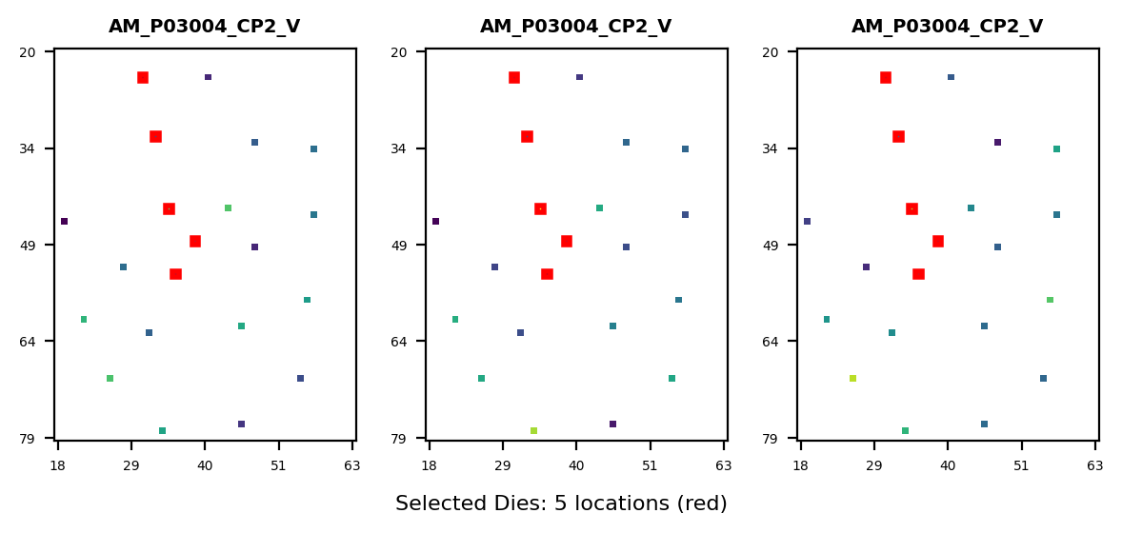
Gage R&R Study Overview - ANLG_ADC
Study Configuration
• Files/Trials: 3 • Dies/Parts: 5 • Parameters: 22
Parameters Analyzed:
1. 11620201: STATIC_I3CSDA-AT-VBG10DIV3BY4_X I3C
2. 11620202: STATIC_GPIO90-AT-VBG10DIV3BY4_X GPI
3. 11620203: STATIC_I3CSDA-AT-VBG10DIV4_X I3C_SD
4. 11620204: STATIC_GPIO90-AT-VBG10DIV4_X GPIO_B
Overall Result: PASS
✓ All parameters show EXCELLENT measurement system capability. No action required.
Assessment: 4 Excellent | 0 Acceptable | 0 Unacceptable

Slide 5
Gage R&R - Calculation Parameters (Formulas)
BASIC STATISTICAL VALUES
Mean (Mittelwert):
Average of all measurements across all files and dies.
Mean = Σ(xi) / n
Std Dev (Standardabweichung):
Measure of dispersion around the mean.
σ = √[Σ(xi - Mean)² / n]
Range (Spannweite):
Difference between maximum and minimum.
Range = Max - Min
LSL / USL (Spec Limits):
Statistical limits (k = sigma factor).
LSL = Mean - kσ | USL = Mean + kσ
GAGE R&R COMPONENTS
Repeatability (EV):
Variation within measurements of one file (equipment).
EV = Mean(σ within each file)
Reproducibility (AV):
Variation between files/operators/trials.
AV = σ(file means)
GRR Total:
Combined measurement system variation.
GRR = R̄ / d₂ (Range Method)
Part Variation (PV):
True variation between parts/dies.
PV = σ(part means)
Total Variation (TV):
Total observed variation.
TV = √(PV² + GRR²)
ASSESSMENT METRICS
%GRR (Prozent GRR):
GRR as percentage of total variation or tolerance.
%GRR = (GRR / TV) × 100 or (GRR / Tolerance) × 100
ndc (Using Part Variation):
Number of distinct categories the system can distinguish.
ndc = 1.41 × (PV / GRR)
ASSESSMENT CRITERIA (AIAG MSA)
🟢 EXCELLENT: %GRR < 10%
Measurement system is acceptable.
🟡 ACCEPTABLE: 10% ≤ %GRR < 30%
May be acceptable depending on application.
🔴 UNACCEPTABLE: %GRR ≥ 30%
Measurement system must be improved.
ndc ≥ 5: Good measurement system
Can distinguish ≥ 5 distinct categories.
INTERPRETATION
• High Repeatability → Equipment/method problem
• High Reproducibility → Operator/process/time problem
• ndc should be ≥ 5 for a good measurement system
• Values outside LSL/USL indicate outliers

Slide 6
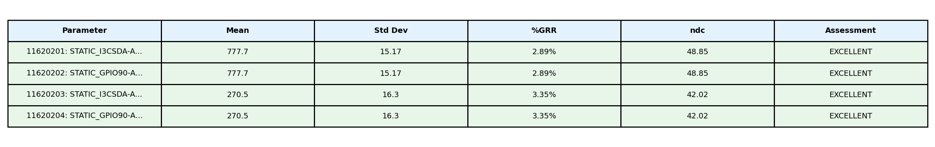
Gage R&R Analysis Summary - ANLG_ADC
Study Information: • Files (Operators/Trials): 3 • Dies (Parts): 5 • Parameters Analyzed: 22

Slide 7
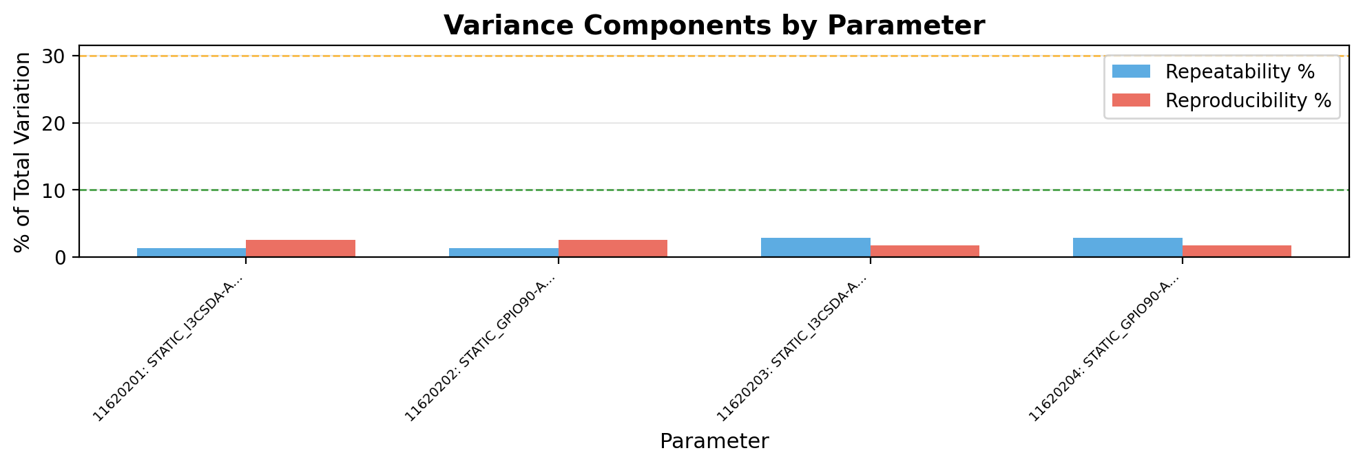
Gage R&R - Variance Components - ANLG_ADC
Interpretation:
• Repeatability (blue): Variation when same operator measures same part multiple times (equipment variation)
• Reproducibility (red): Variation between different operators/trials measuring same part (operator variation)
→ Analysis: Reproducibility (2.1%) > Repeatability (2.1%). Operator/trial variation is dominant. Consider operator training or standardization.

Slide 8
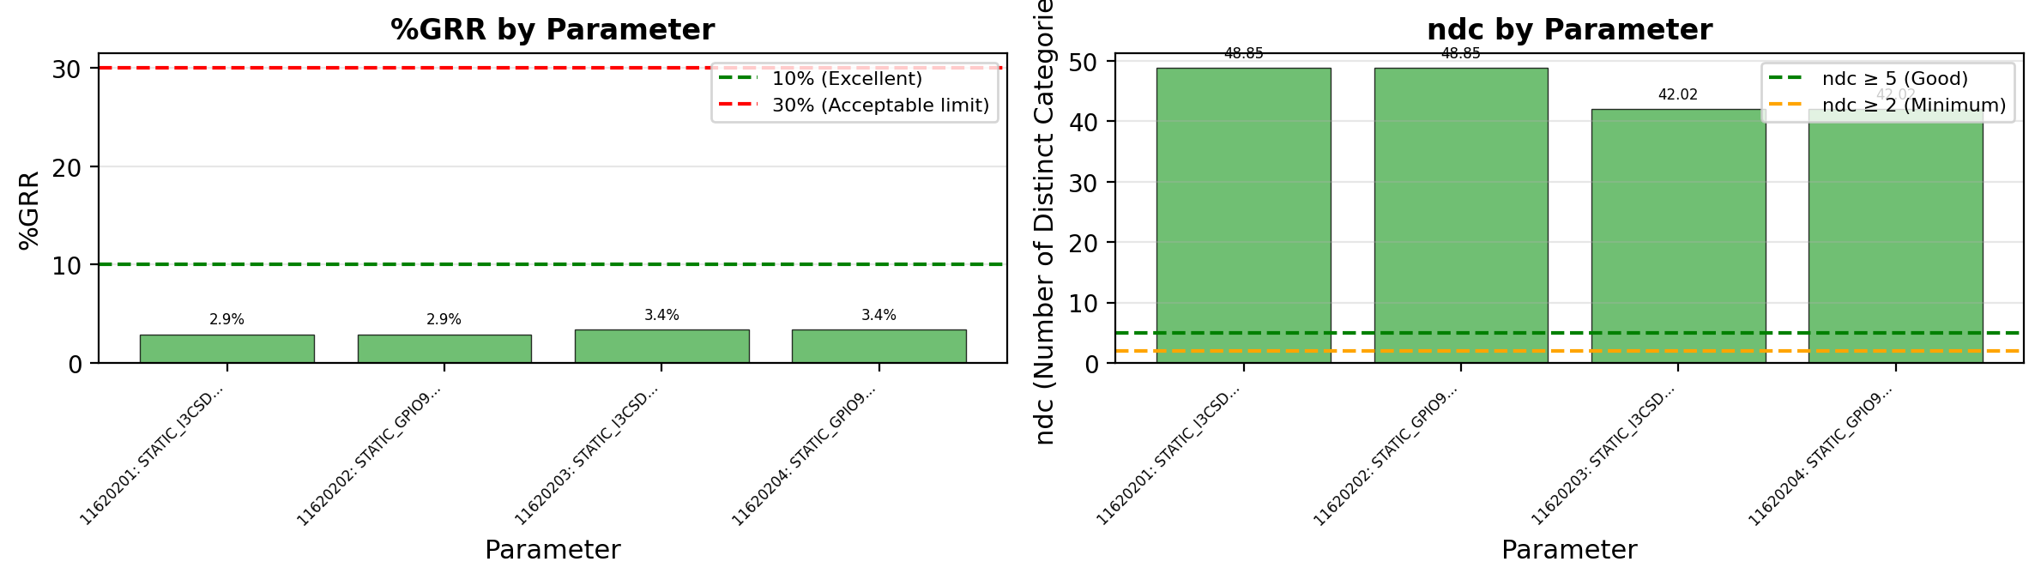
Gage R&R - %GRR and ndc - ANLG_ADC
Acceptance Criteria & Interpretation:
• %GRR < 10%: EXCELLENT - Measurement system is excellent for this application
• %GRR 10-30%: ACCEPTABLE - May be acceptable depending on application criticality
• %GRR > 30%: UNACCEPTABLE - Measurement system needs improvement
• ndc (Number of Distinct Categories): Indicates how many distinct categories the measurement can reliably distinguish. ndc ≥ 5 is recommended.

Slide 9
Gage R&R Study Overview - ANLG_DAC
Study Configuration
• Files/Trials: 3 • Dies/Parts: 5 • Parameters: 22
Parameters Analyzed:
1. 11504101: CAL_CURRENT_ANODETPAD_RED ANODE_TPA
2. 11504102: CAL_CALLOOPSTEP_ANODETPAD_RED CALlo
3. 11504511: 2PTS_CURRENTAT1QFS_ANODETPAD_RED AN
4. 11504512: 2PTS_CURRENTAT3QFS_ANODETPAD_RED AN
Overall Result: PASS
✓ All parameters show EXCELLENT measurement system capability. No action required.
Assessment: 4 Excellent | 0 Acceptable | 0 Unacceptable

Slide 10
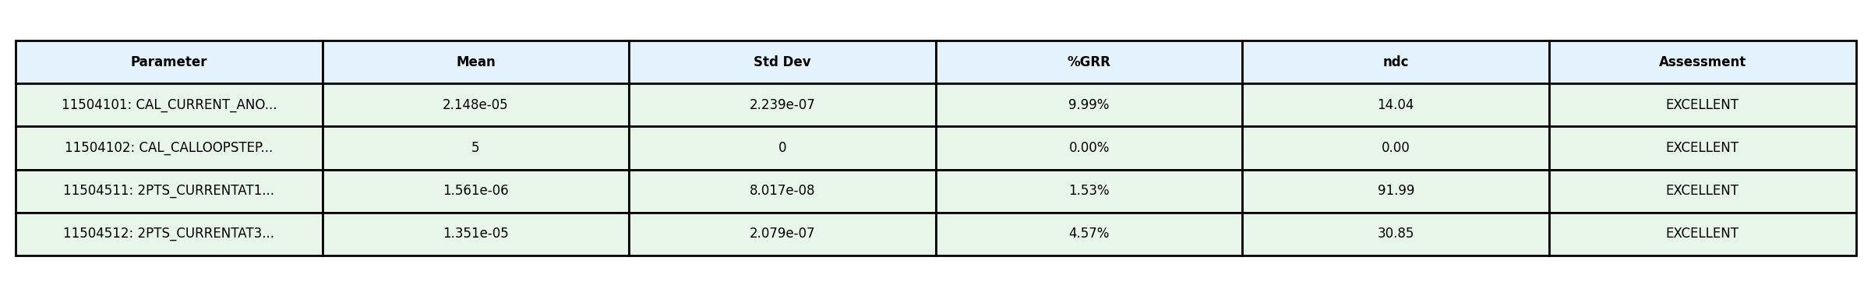
Gage R&R Analysis Summary - ANLG_DAC
Study Information: • Files (Operators/Trials): 3 • Dies (Parts): 5 • Parameters Analyzed: 22

Slide 11
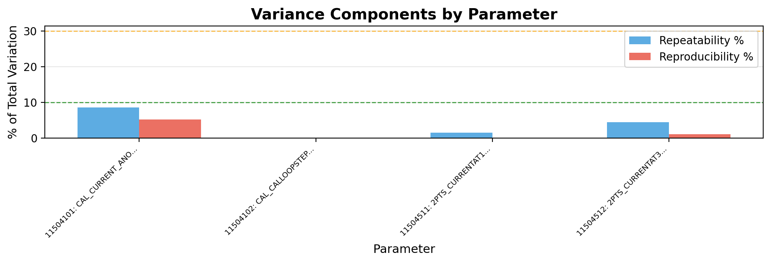
Gage R&R - Variance Components - ANLG_DAC
Interpretation:
• Repeatability (blue): Variation when same operator measures same part multiple times (equipment variation)
• Reproducibility (red): Variation between different operators/trials measuring same part (operator variation)
→ Analysis: Repeatability (3.6%) > Reproducibility (1.6%). Equipment/method variation is dominant. Consider equipment calibration or method refinement.

Slide 12
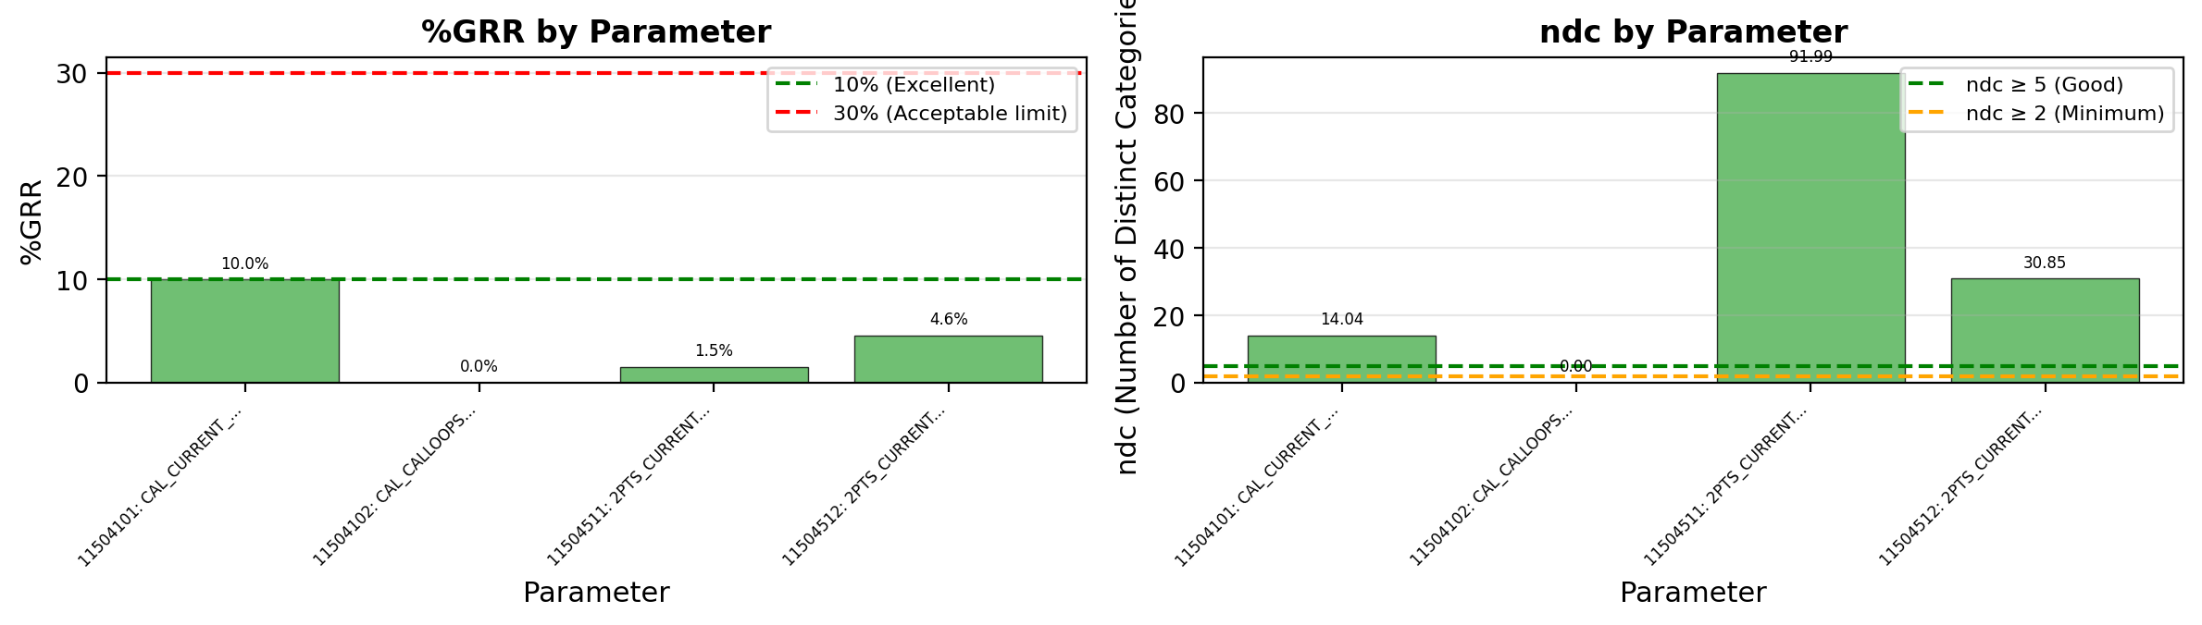
Gage R&R - %GRR and ndc - ANLG_DAC
Acceptance Criteria & Interpretation:
• %GRR < 10%: EXCELLENT - Measurement system is excellent for this application
• %GRR 10-30%: ACCEPTABLE - May be acceptable depending on application criticality
• %GRR > 30%: UNACCEPTABLE - Measurement system needs improvement
• ndc (Number of Distinct Categories): Indicates how many distinct categories the measurement can reliably distinguish. ndc ≥ 5 is recommended.
⚠ Warning: 1 parameter(s) have ndc < 5: ANLG_DACCAL_CALLOOPS

Slide 13
Gage R&R Study Overview - DC_SHORT
Study Configuration
• Files/Trials: 3 • Dies/Parts: 5 • Parameters: 22
Parameters Analyzed:
1. 10020001: LOW_VDD10_FV0P1_X VDD10 22.g404hc <
2. 10020002: LOW_VDD18IO_FV0P1_X VDD18IO 22.a402
3. 10020003: LOW_AVDD18_FV0P1_X AVDD18 22.c403 <
4. 10020004: LOW_VQPSEFUSE_FV0P1_X VQPS_EFUSE 22
5. 10020005: LOW_AVEE_FV0P1_X AVEE 20.w402 <> DC
Overall Result: FAIL
✗ Gage R&R FAILED for 4 parameter(s) due to excessive measurement variation (>30%). Failing parameters: DC_SHORT_LOW_VDD10_FV0P1_, DC_SHORT_LOW_AVDD18_FV0P1, DC_SHORT_LOW_VDD18IO_FV0P (+1 more) Recommendation: Review measurement equipment, operator training, or test methodology.
Assessment: 0 Excellent | 1 Acceptable | 4 Unacceptable

Slide 14
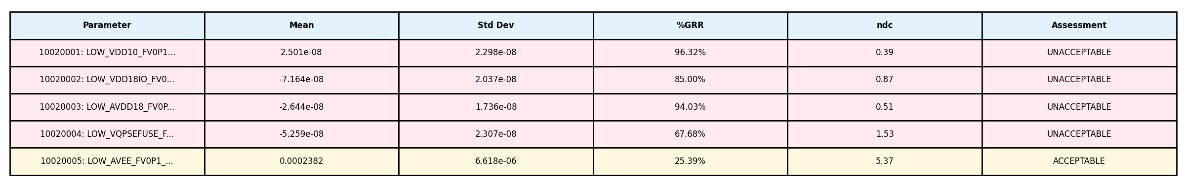
Gage R&R Analysis Summary - DC_SHORT
Study Information: • Files (Operators/Trials): 3 • Dies (Parts): 5 • Parameters Analyzed: 22

Slide 15
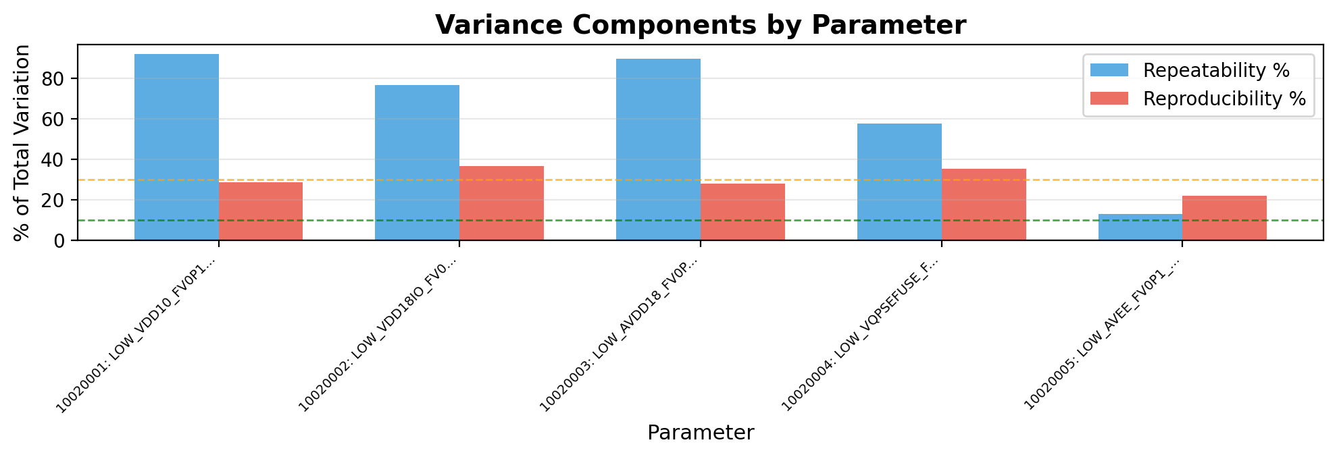
Gage R&R - Variance Components - DC_SHORT
Interpretation:
• Repeatability (blue): Variation when same operator measures same part multiple times (equipment variation)
• Reproducibility (red): Variation between different operators/trials measuring same part (operator variation)
→ Analysis: Repeatability (65.8%) > Reproducibility (30.0%). Equipment/method variation is dominant. Consider equipment calibration or method refinement.

Slide 16
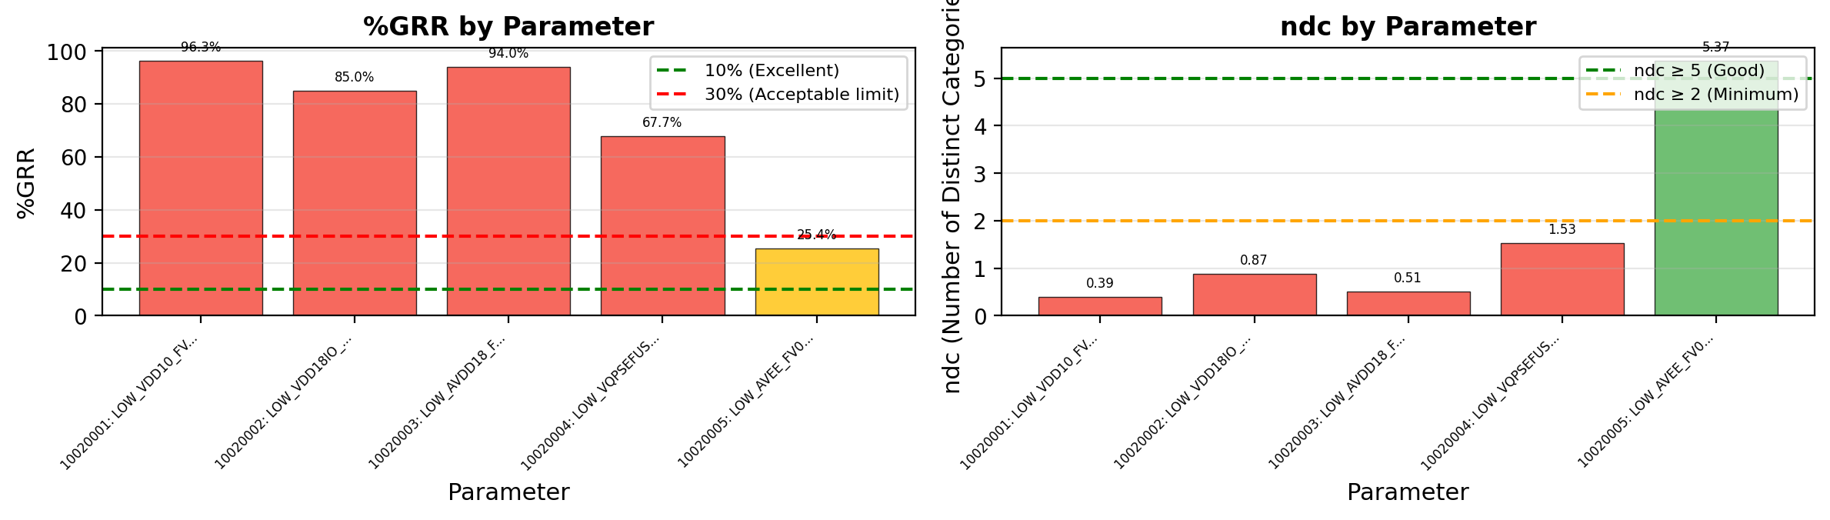
Gage R&R - %GRR and ndc - DC_SHORT
Acceptance Criteria & Interpretation:
• %GRR < 10%: EXCELLENT - Measurement system is excellent for this application
• %GRR 10-30%: ACCEPTABLE - May be acceptable depending on application criticality
• %GRR > 30%: UNACCEPTABLE - Measurement system needs improvement
• ndc (Number of Distinct Categories): Indicates how many distinct categories the measurement can reliably distinguish. ndc ≥ 5 is recommended.
⚠ Warning: 4 parameter(s) have ndc < 5: DC_SHORT_LOW_VDD10_F, DC_SHORT_LOW_VDD18IO, DC_SHORT_LOW_AVDD18_

Slide 17
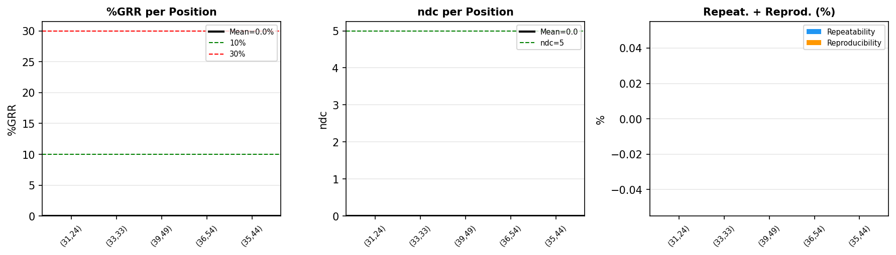
PLM-GAGE Summary (Mean): Bridged-Pixels
Assessment: EXCELLENT
Mean %GRR: 0.00%
Mean ndc: 0.0
Mean Repeatability: 0.00%
Mean Reproducibility: 0.00%
Positions analyzed: 5

Slide 18
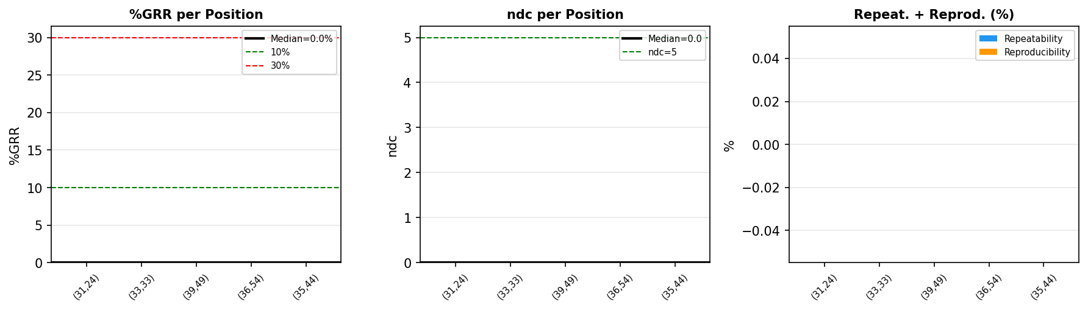
PLM-GAGE Summary (Median): Bridged-Pixels
Assessment: EXCELLENT
Median %GRR: 0.00%
Median ndc: 0.0
Median Repeatability: 0.00%
Median Reproducibility: 0.00%
Positions analyzed: 5

Slide 19
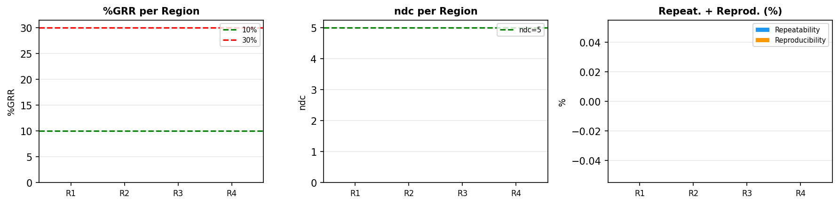
PLM Pixel Analysis - Bridged-Pixels - Die (31,24)
Region | Position | Size | %GRR | ndc | Repeat.% | Reprod.% | Result
R1 | (10,8)->(20,19) | 10x11 | 0.0% | 0.0 | 0.0% | 0.0% | EXCELLENT
R2 | (30,29)->(39,49) | 9x20 | 0.0% | 0.0 | 0.0% | 0.0% | EXCELLENT
R3 | (8,46)->(17,58) | 9x12 | 0.0% | 0.0 | 0.0% | 0.0% | EXCELLENT
R4 | (18,33)->(26,45) | 8x12 | 0.0% | 0.0 | 0.0% | 0.0% | EXCELLENT
Die (31, 24)
PLM Type: Bridged-Pixels
Regions: 4
Files/Trials: 3
Pixels/Region: 110
Best: R1 - %GRR=0.0%
Worst: R1 - %GRR=0.0%

Slide 20
PLM Pixel Analysis - Bridged-Pixels - Die (33,33)
Region | Position | Size | %GRR | ndc | Repeat.% | Reprod.% | Result
R1 | (10,8)->(20,19) | 10x11 | 0.0% | 0.0 | 0.0% | 0.0% | EXCELLENT
R2 | (30,29)->(39,49) | 9x20 | 0.0% | 0.0 | 0.0% | 0.0% | EXCELLENT
R3 | (8,46)->(17,58) | 9x12 | 0.0% | 0.0 | 0.0% | 0.0% | EXCELLENT
R4 | (18,33)->(26,45) | 8x12 | 0.0% | 0.0 | 0.0% | 0.0% | EXCELLENT
Die (33, 33)
PLM Type: Bridged-Pixels
Regions: 4
Files/Trials: 3
Pixels/Region: 110
Best: R1 - %GRR=0.0%
Worst: R1 - %GRR=0.0%

Slide 21
PLM Pixel Analysis - Bridged-Pixels - Die (35,44)
Region | Position | Size | %GRR | ndc | Repeat.% | Reprod.% | Result
R1 | (10,8)->(20,19) | 10x11 | 0.0% | 0.0 | 0.0% | 0.0% | EXCELLENT
R2 | (30,29)->(39,49) | 9x20 | 0.0% | 0.0 | 0.0% | 0.0% | EXCELLENT
R3 | (8,46)->(17,58) | 9x12 | 0.0% | 0.0 | 0.0% | 0.0% | EXCELLENT
R4 | (18,33)->(26,45) | 8x12 | 0.0% | 0.0 | 0.0% | 0.0% | EXCELLENT
Die (35, 44)
PLM Type: Bridged-Pixels
Regions: 4
Files/Trials: 3
Pixels/Region: 110
Best: R1 - %GRR=0.0%
Worst: R1 - %GRR=0.0%

Slide 22
PLM Pixel Analysis - Bridged-Pixels - Die (36,54)
Region | Position | Size | %GRR | ndc | Repeat.% | Reprod.% | Result
R1 | (10,8)->(20,19) | 10x11 | 0.0% | 0.0 | 0.0% | 0.0% | EXCELLENT
R2 | (30,29)->(39,49) | 9x20 | 0.0% | 0.0 | 0.0% | 0.0% | EXCELLENT
R3 | (8,46)->(17,58) | 9x12 | 0.0% | 0.0 | 0.0% | 0.0% | EXCELLENT
R4 | (18,33)->(26,45) | 8x12 | 0.0% | 0.0 | 0.0% | 0.0% | EXCELLENT
Die (36, 54)
PLM Type: Bridged-Pixels
Regions: 4
Files/Trials: 3
Pixels/Region: 110
Best: R1 - %GRR=0.0%
Worst: R1 - %GRR=0.0%

Slide 23
PLM Pixel Analysis - Bridged-Pixels - Die (39,49)
Region | Position | Size | %GRR | ndc | Repeat.% | Reprod.% | Result
R1 | (10,8)->(20,19) | 10x11 | 0.0% | 0.0 | 0.0% | 0.0% | EXCELLENT
R2 | (30,29)->(39,49) | 9x20 | 0.0% | 0.0 | 0.0% | 0.0% | EXCELLENT
R3 | (8,46)->(17,58) | 9x12 | 0.0% | 0.0 | 0.0% | 0.0% | EXCELLENT
R4 | (18,33)->(26,45) | 8x12 | 0.0% | 0.0 | 0.0% | 0.0% | EXCELLENT
Die (39, 49)
PLM Type: Bridged-Pixels
Regions: 4
Files/Trials: 3
Pixels/Region: 110
Best: R1 - %GRR=0.0%
Worst: R1 - %GRR=0.0%

Slide 24
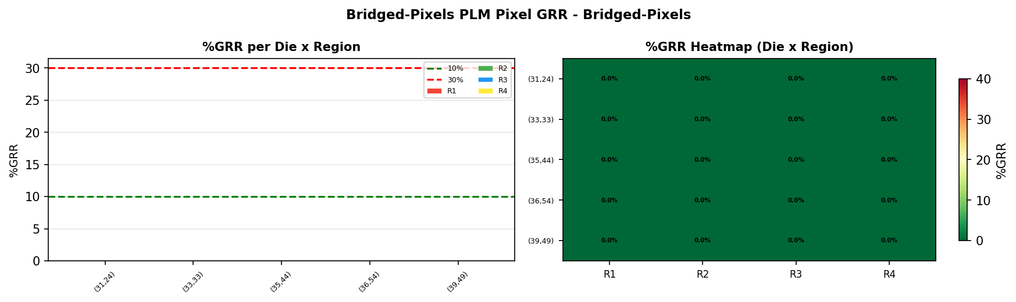
PLM Pixel Analysis - Bridged-Pixels Overview - Bridged-Pixels
Die | R1 %GRR | R2 %GRR | R3 %GRR | R4 %GRR | Avg %GRR
(31,24) | 0.0% | 0.0% | 0.0% | 0.0% | 0.0%
(33,33) | 0.0% | 0.0% | 0.0% | 0.0% | 0.0%
(35,44) | 0.0% | 0.0% | 0.0% | 0.0% | 0.0%
(36,54) | 0.0% | 0.0% | 0.0% | 0.0% | 0.0%
(39,49) | 0.0% | 0.0% | 0.0% | 0.0% | 0.0%
Bridged-Pixels Die Comparison
PLM Type: Bridged-Pixels
Total Dies: 5
Regions per Die: 4
Files/Trials: 3
Best: Die(31,24) R1 - 0.0%

Slide 25
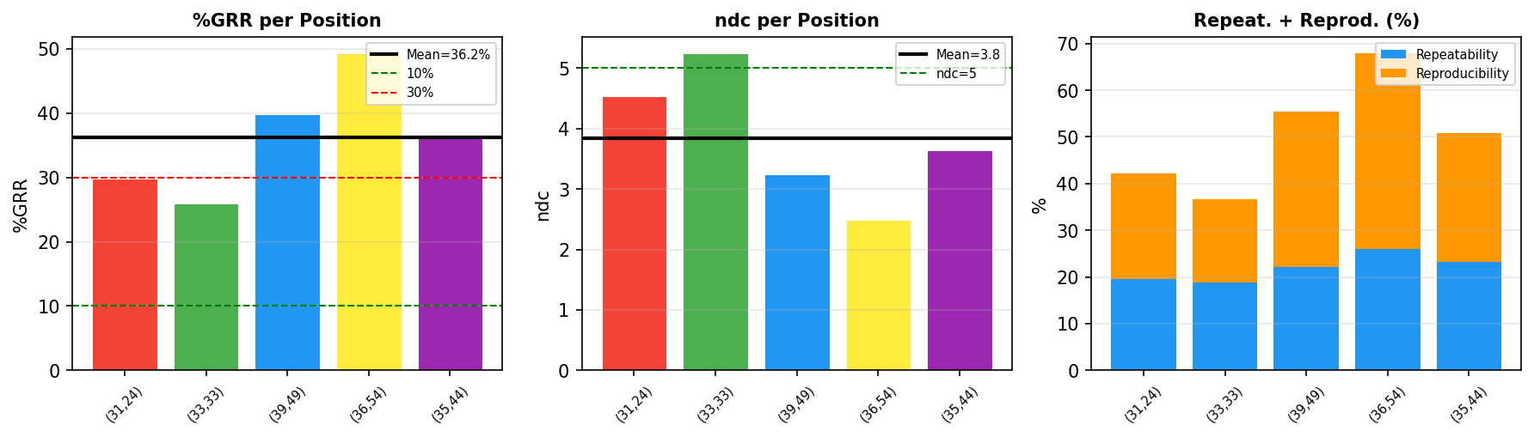
PLM-GAGE Summary (Mean): Stitched
Assessment: UNACCEPTABLE
Mean %GRR: 36.25%
Mean ndc: 3.8
Mean Repeatability: 21.96%
Mean Reproducibility: 28.64%
Positions analyzed: 5

Slide 26

PLM-GAGE Summary (Median): Stitched
Assessment: UNACCEPTABLE
Median %GRR: 36.14%
Median ndc: 3.6
Median Repeatability: 22.21%
Median Reproducibility: 27.70%
Positions analyzed: 5

Slide 27
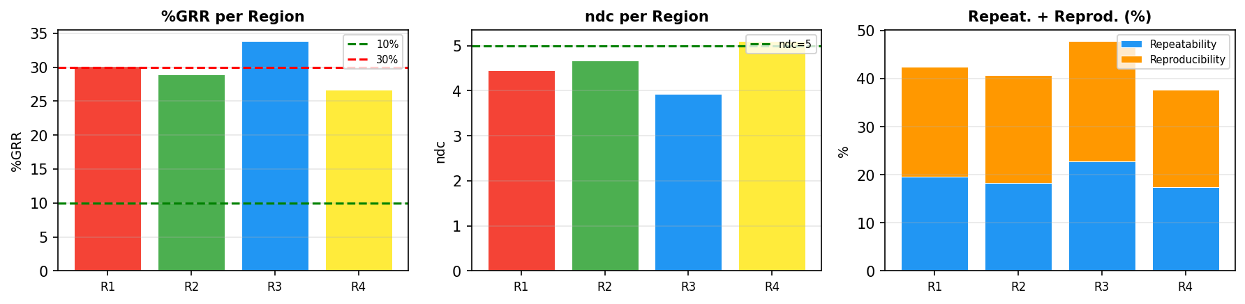
PLM Pixel Analysis - Stitched - Die (31,24)
Region | Position | Size | %GRR | ndc | Repeat.% | Reprod.% | Result
R1 | (10,8)->(20,19) | 10x11 | 30.1% | 4.5 | 19.6% | 22.9% | UNACCEPTABLE
R2 | (30,29)->(39,49) | 9x20 | 28.9% | 4.7 | 18.3% | 22.3% | ACCEPTABLE
R3 | (8,46)->(17,58) | 9x12 | 33.8% | 3.9 | 22.7% | 25.0% | UNACCEPTABLE
R4 | (18,33)->(26,45) | 8x12 | 26.7% | 5.1 | 17.4% | 20.2% | ACCEPTABLE
Die (31, 24)
PLM Type: Stitched
Regions: 4
Files/Trials: 3
Pixels/Region: 110
Best: R4 - %GRR=26.7%
Worst: R3 - %GRR=33.8%

Slide 28
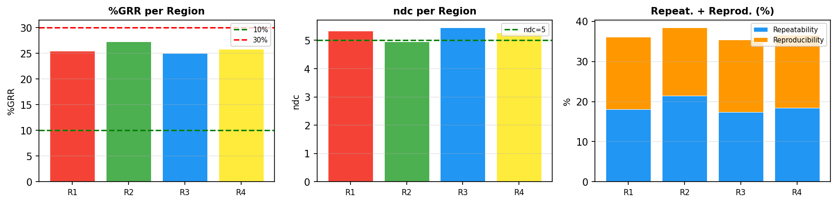
PLM Pixel Analysis - Stitched - Die (33,33)
Region | Position | Size | %GRR | ndc | Repeat.% | Reprod.% | Result
R1 | (10,8)->(20,19) | 10x11 | 25.5% | 5.3 | 18.1% | 18.0% | ACCEPTABLE
R2 | (30,29)->(39,49) | 9x20 | 27.3% | 5.0 | 21.5% | 16.9% | ACCEPTABLE
R3 | (8,46)->(17,58) | 9x12 | 25.1% | 5.4 | 17.3% | 18.1% | ACCEPTABLE
R4 | (18,33)->(26,45) | 8x12 | 25.9% | 5.3 | 18.4% | 18.2% | ACCEPTABLE
Die (33, 33)
PLM Type: Stitched
Regions: 4
Files/Trials: 3
Pixels/Region: 110
Best: R3 - %GRR=25.1%
Worst: R2 - %GRR=27.3%

Slide 29
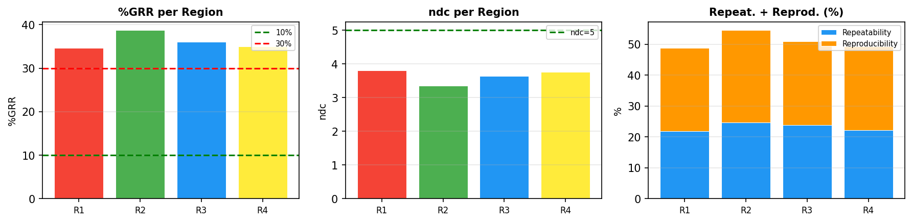
PLM Pixel Analysis - Stitched - Die (35,44)
Region | Position | Size | %GRR | ndc | Repeat.% | Reprod.% | Result
R1 | (10,8)->(20,19) | 10x11 | 34.7% | 3.8 | 21.9% | 26.9% | UNACCEPTABLE
R2 | (30,29)->(39,49) | 9x20 | 38.7% | 3.4 | 24.8% | 29.7% | UNACCEPTABLE
R3 | (8,46)->(17,58) | 9x12 | 36.1% | 3.6 | 23.9% | 27.1% | UNACCEPTABLE
R4 | (18,33)->(26,45) | 8x12 | 35.1% | 3.8 | 22.3% | 27.1% | UNACCEPTABLE
Die (35, 44)
PLM Type: Stitched
Regions: 4
Files/Trials: 3
Pixels/Region: 110
Best: R1 - %GRR=34.7%
Worst: R2 - %GRR=38.7%

Slide 30
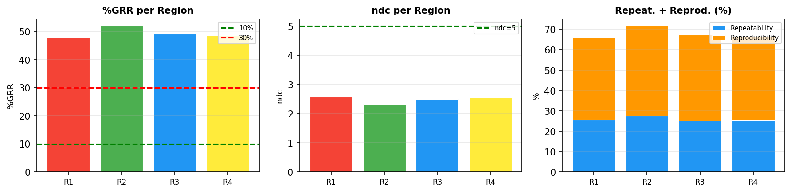
PLM Pixel Analysis - Stitched - Die (36,54)
Region | Position | Size | %GRR | ndc | Repeat.% | Reprod.% | Result
R1 | (10,8)->(20,19) | 10x11 | 47.9% | 2.6 | 25.7% | 40.4% | UNACCEPTABLE
R2 | (30,29)->(39,49) | 9x20 | 51.9% | 2.3 | 27.7% | 43.9% | UNACCEPTABLE
R3 | (8,46)->(17,58) | 9x12 | 49.2% | 2.5 | 25.2% | 42.3% | UNACCEPTABLE
R4 | (18,33)->(26,45) | 8x12 | 48.5% | 2.5 | 25.6% | 41.3% | UNACCEPTABLE
Die (36, 54)
PLM Type: Stitched
Regions: 4
Files/Trials: 3
Pixels/Region: 110
Best: R1 - %GRR=47.9%
Worst: R2 - %GRR=51.9%

Slide 31
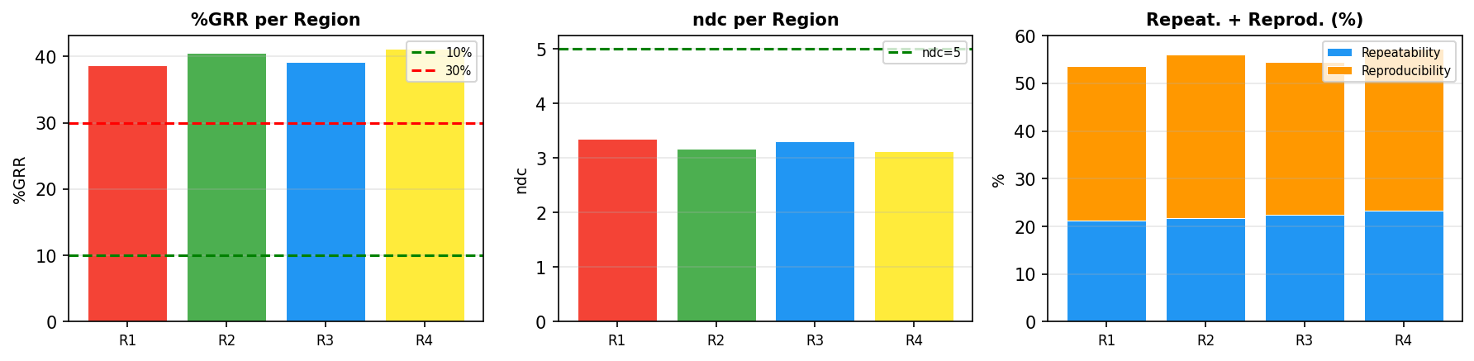
PLM Pixel Analysis - Stitched - Die (39,49)
Region | Position | Size | %GRR | ndc | Repeat.% | Reprod.% | Result
R1 | (10,8)->(20,19) | 10x11 | 38.7% | 3.4 | 21.3% | 32.3% | UNACCEPTABLE
R2 | (30,29)->(39,49) | 9x20 | 40.6% | 3.2 | 21.8% | 34.3% | UNACCEPTABLE
R3 | (8,46)->(17,58) | 9x12 | 39.1% | 3.3 | 22.5% | 32.0% | UNACCEPTABLE
R4 | (18,33)->(26,45) | 8x12 | 41.1% | 3.1 | 23.3% | 33.9% | UNACCEPTABLE
Die (39, 49)
PLM Type: Stitched
Regions: 4
Files/Trials: 3
Pixels/Region: 110
Best: R1 - %GRR=38.7%
Worst: R4 - %GRR=41.1%

Slide 32
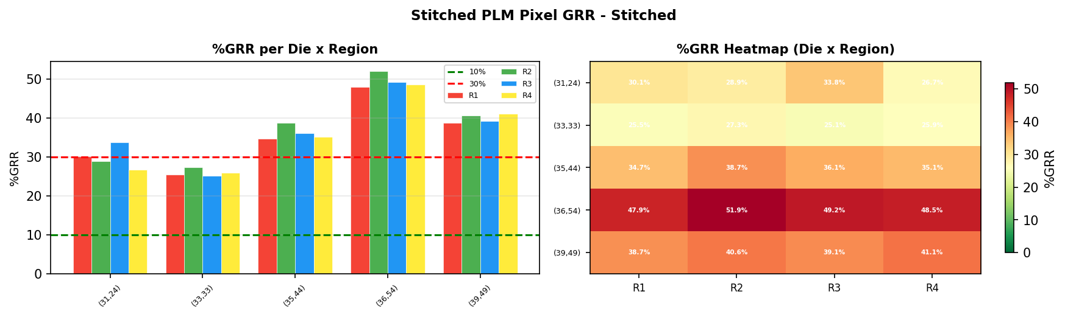
PLM Pixel Analysis - Stitched Overview - Stitched
Die | R1 %GRR | R2 %GRR | R3 %GRR | R4 %GRR | Avg %GRR
(31,24) | 30.1% | 28.9% | 33.8% | 26.7% | 29.9%
(33,33) | 25.5% | 27.3% | 25.1% | 25.9% | 26.0%
(35,44) | 34.7% | 38.7% | 36.1% | 35.1% | 36.1%
(36,54) | 47.9% | 51.9% | 49.2% | 48.5% | 49.4%
(39,49) | 38.7% | 40.6% | 39.1% | 41.1% | 39.9%
Stitched Die Comparison
PLM Type: Stitched
Total Dies: 5
Regions per Die: 4
Files/Trials: 3
Best: Die(33,33) R3 - 25.1%
Worst: Die(36,54) R2 - 51.9%

Slide 33
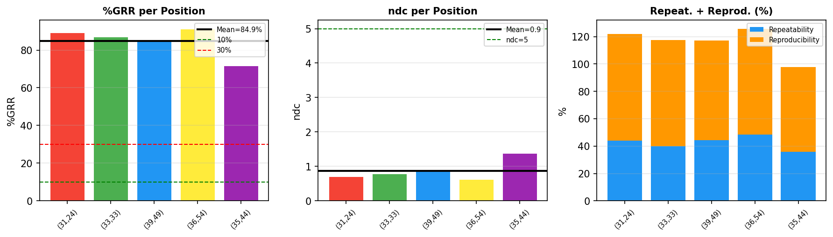
PLM-GAGE Summary (Mean): UniformitySyn
Assessment: UNACCEPTABLE
Mean %GRR: 84.94%
Mean ndc: 0.9
Mean Repeatability: 42.52%
Mean Reproducibility: 73.49%
Positions analyzed: 5

Slide 34

PLM-GAGE Summary (Median): UniformitySyn
Assessment: UNACCEPTABLE
Median %GRR: 87.09%
Median ndc: 0.8
Median Repeatability: 44.09%
Median Reproducibility: 77.33%
Positions analyzed: 5

Slide 35
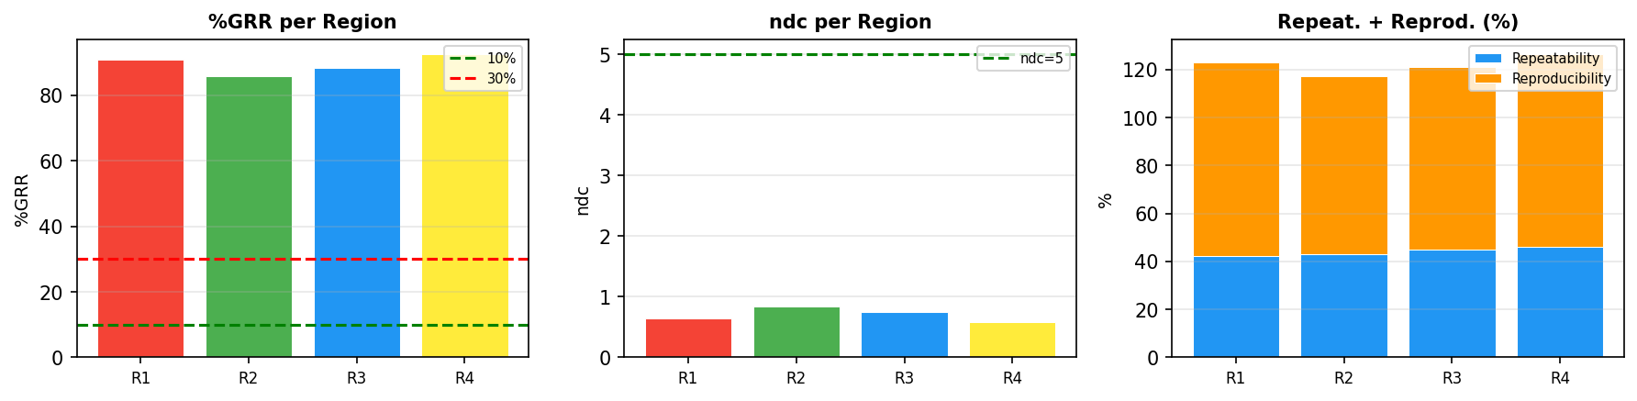
PLM Pixel Analysis - UniformitySyn - Die (31,24)
Region | Position | Size | %GRR | ndc | Repeat.% | Reprod.% | Result
R1 | (10,8)->(20,19) | 10x11 | 91.0% | 0.6 | 42.2% | 80.6% | UNACCEPTABLE
R2 | (30,29)->(39,49) | 9x20 | 85.8% | 0.8 | 43.1% | 74.2% | UNACCEPTABLE
R3 | (8,46)->(17,58) | 9x12 | 88.4% | 0.7 | 44.8% | 76.2% | UNACCEPTABLE
R4 | (18,33)->(26,45) | 8x12 | 92.4% | 0.6 | 46.2% | 80.0% | UNACCEPTABLE
Die (31, 24)
PLM Type: UniformitySyn
Regions: 4
Files/Trials: 3
Pixels/Region: 110
Best: R2 - %GRR=85.8%
Worst: R4 - %GRR=92.4%

Slide 36
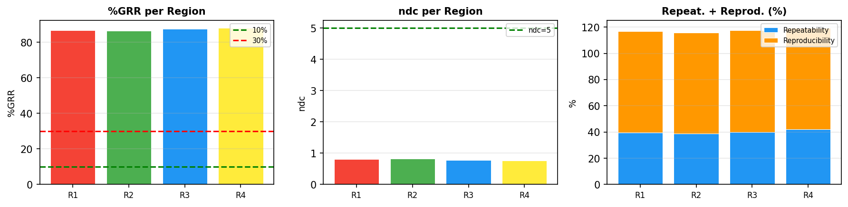
PLM Pixel Analysis - UniformitySyn - Die (33,33)
Region | Position | Size | %GRR | ndc | Repeat.% | Reprod.% | Result
R1 | (10,8)->(20,19) | 10x11 | 86.8% | 0.8 | 39.7% | 77.2% | UNACCEPTABLE
R2 | (30,29)->(39,49) | 9x20 | 86.3% | 0.8 | 38.7% | 77.1% | UNACCEPTABLE
R3 | (8,46)->(17,58) | 9x12 | 87.4% | 0.8 | 39.8% | 77.8% | UNACCEPTABLE
R4 | (18,33)->(26,45) | 8x12 | 87.9% | 0.8 | 42.0% | 77.2% | UNACCEPTABLE
Die (33, 33)
PLM Type: UniformitySyn
Regions: 4
Files/Trials: 3
Pixels/Region: 110
Best: R2 - %GRR=86.3%
Worst: R4 - %GRR=87.9%

Slide 37
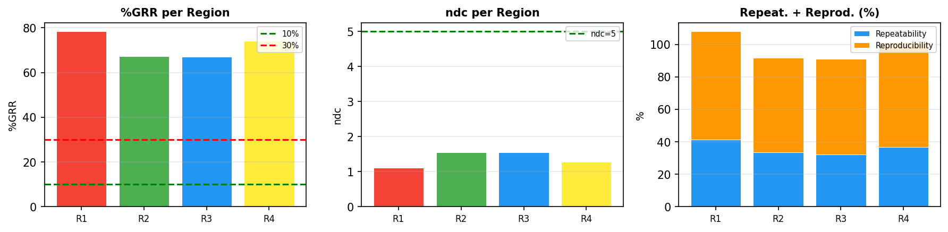
PLM Pixel Analysis - UniformitySyn - Die (35,44)
Region | Position | Size | %GRR | ndc | Repeat.% | Reprod.% | Result
R1 | (10,8)->(20,19) | 10x11 | 78.3% | 1.1 | 41.4% | 66.5% | UNACCEPTABLE
R2 | (30,29)->(39,49) | 9x20 | 67.2% | 1.6 | 33.4% | 58.3% | UNACCEPTABLE
R3 | (8,46)->(17,58) | 9x12 | 67.1% | 1.6 | 32.0% | 59.0% | UNACCEPTABLE
R4 | (18,33)->(26,45) | 8x12 | 74.1% | 1.3 | 36.9% | 64.2% | UNACCEPTABLE
Die (35, 44)
PLM Type: UniformitySyn
Regions: 4
Files/Trials: 3
Pixels/Region: 110
Best: R3 - %GRR=67.1%
Worst: R1 - %GRR=78.3%

Slide 38
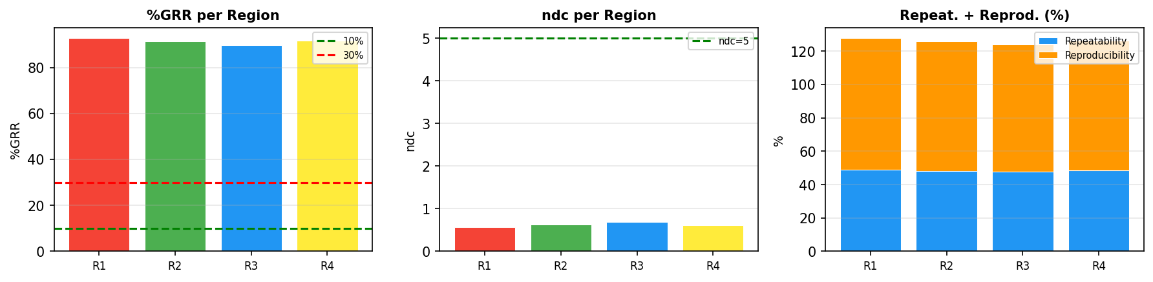
PLM Pixel Analysis - UniformitySyn - Die (36,54)
Region | Position | Size | %GRR | ndc | Repeat.% | Reprod.% | Result
R1 | (10,8)->(20,19) | 10x11 | 92.7% | 0.6 | 48.9% | 78.7% | UNACCEPTABLE
R2 | (30,29)->(39,49) | 9x20 | 91.4% | 0.6 | 48.1% | 77.7% | UNACCEPTABLE
R3 | (8,46)->(17,58) | 9x12 | 89.8% | 0.7 | 47.6% | 76.1% | UNACCEPTABLE
R4 | (18,33)->(26,45) | 8x12 | 91.6% | 0.6 | 48.5% | 77.7% | UNACCEPTABLE
Die (36, 54)
PLM Type: UniformitySyn
Regions: 4
Files/Trials: 3
Pixels/Region: 110
Best: R3 - %GRR=89.8%
Worst: R1 - %GRR=92.7%

Slide 39
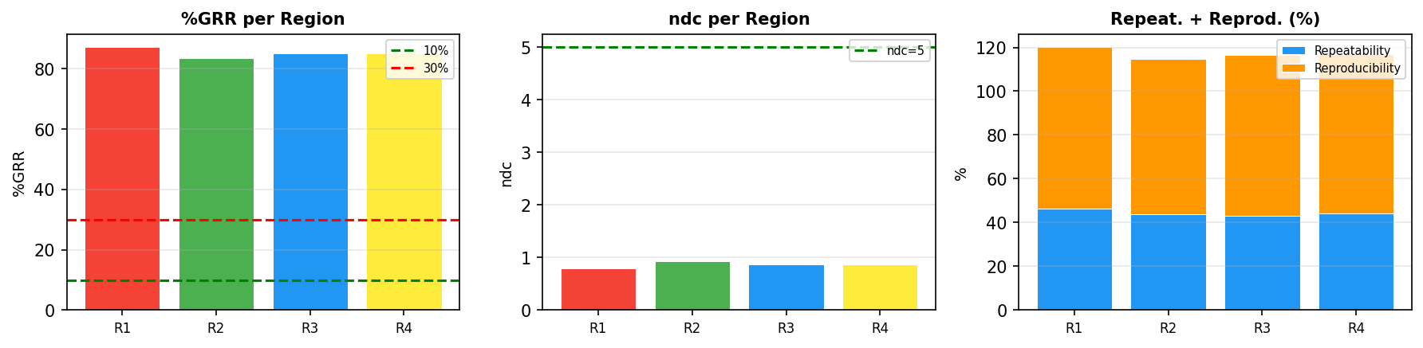
PLM Pixel Analysis - UniformitySyn - Die (39,49)
Region | Position | Size | %GRR | ndc | Repeat.% | Reprod.% | Result
R1 | (10,8)->(20,19) | 10x11 | 87.1% | 0.8 | 46.2% | 73.8% | UNACCEPTABLE
R2 | (30,29)->(39,49) | 9x20 | 83.5% | 0.9 | 43.7% | 71.2% | UNACCEPTABLE
R3 | (8,46)->(17,58) | 9x12 | 85.1% | 0.9 | 42.9% | 73.4% | UNACCEPTABLE
R4 | (18,33)->(26,45) | 8x12 | 85.2% | 0.9 | 44.0% | 72.9% | UNACCEPTABLE
Die (39, 49)
PLM Type: UniformitySyn
Regions: 4
Files/Trials: 3
Pixels/Region: 110
Best: R2 - %GRR=83.5%
Worst: R1 - %GRR=87.1%

Slide 40
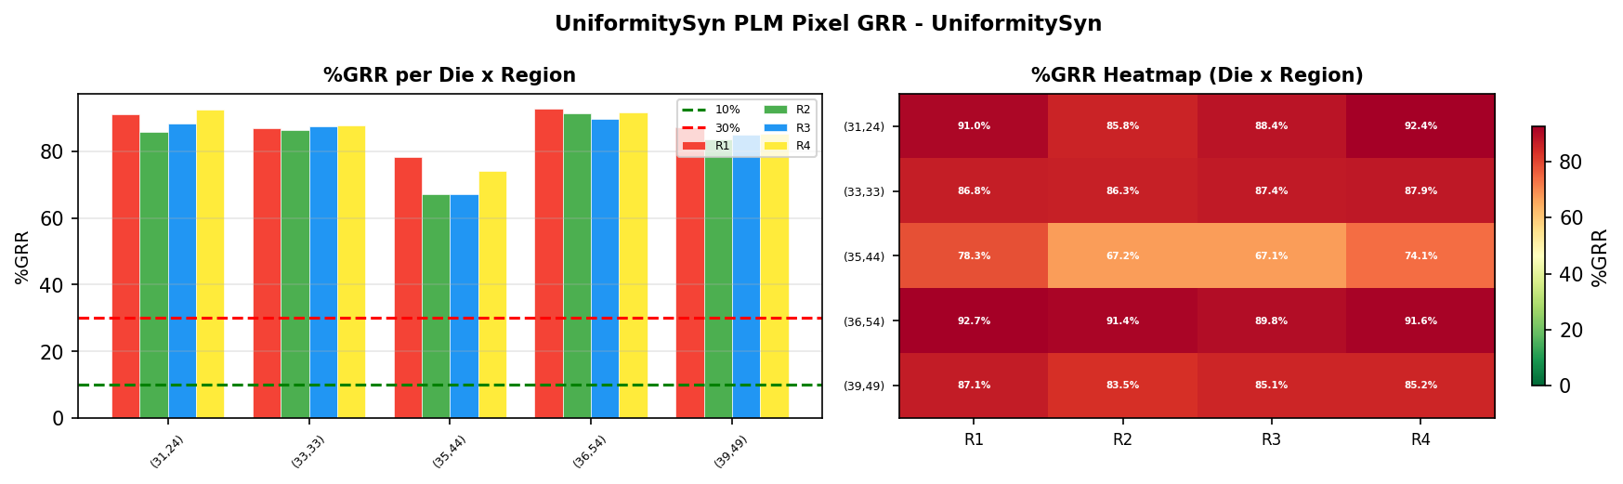
PLM Pixel Analysis - UniformitySyn Overview - UniformitySyn
Die | R1 %GRR | R2 %GRR | R3 %GRR | R4 %GRR | Avg %GRR
(31,24) | 91.0% | 85.8% | 88.4% | 92.4% | 89.4%
(33,33) | 86.8% | 86.3% | 87.4% | 87.9% | 87.1%
(35,44) | 78.3% | 67.2% | 67.1% | 74.1% | 71.7%
(36,54) | 92.7% | 91.4% | 89.8% | 91.6% | 91.4%
(39,49) | 87.1% | 83.5% | 85.1% | 85.2% | 85.2%
UniformitySyn Die Comparison
PLM Type: UniformitySyn
Total Dies: 5
Regions per Die: 4
Files/Trials: 3
Best: Die(35,44) R3 - 67.1%
Worst: Die(36,54) R1 - 92.7%

