Slide 1
Stock Price Prediction using Time Series analysis
Kumar Saurav (2015-1055)
Pragati Kumar (2015-1042)
Mohit Kumar Singh (2015-1051)
Group Mentor:- Mr. Biswanath Pal (Assistant Professor UIT,BU)

Slide 2
Table Of Contents
1. Introduction …………………………………….….
2. Methodology ………………………………………
3. Dataset Description……………………………..
4. Result Analysis …………………………………….
5. Conclusion ………………………..…………….....
6. Future Scope ………………………..……………..
References ……………………………………….....

Slide 3
INTRODUCTION
Prediction of stock market has been an attractive topic to the stock brokers and the researchers from various fields.
There have been numerous studies to predict the price of the stocks of a particular company using various machine learning techniques.
In this project we would be using ARIMA algorithm to predict the stock price of the companies.

Slide 4
Methodology
An ARIMA is a class of statistical models for analyzing and forecasting time series data. ARIMA is an acronym that stands for AutoRegressive Integrated Moving Average. Briefly they are-
1. AR: Autoregression. A model that shows dependent relationship between an observation and some number of lagged observation.
2. Integrated. It uses of differencing of raw observations (e.g. subtracting an observation from an observation at the previous time step) in order to make the time series stationary.
3. MA: Moving Average. A model that uses the dependency between an observation and a residual error from a moving average model applied to lagged observations.

Slide 5
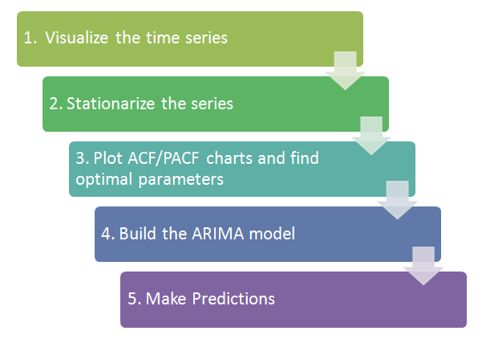
Steps For Predicting Stock Prices

Slide 6
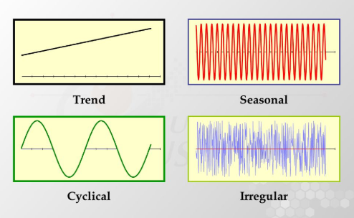
COMPONENTS OF TIME SERIES
The various reasons or the forces which affect the values of an observation in a time series are the components of a time series. The four categories of the components of time series are
Trend
Seasonal Variations
Cyclic Variations
Random or Irregular movements

Slide 7
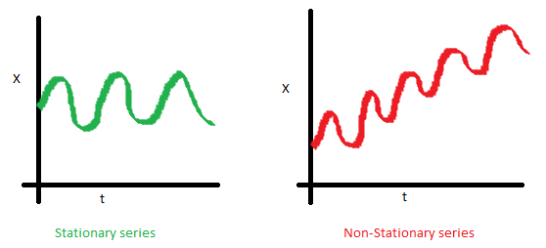
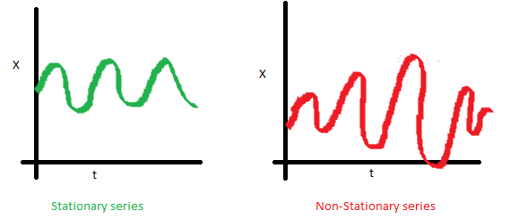
Stationary Series
There are two basic criterion for a series to be classified as stationary series :
1. The mean of the series should not be a
function of time rather should be a constant.
2. The variance of the series should not a
be a function of time.

Slide 8
STATIONARITY
Why do we need ‘stationarity’ of a time series?
Here until unless your time series is stationary, we cannot build a time series model. In cases where the stationary criterion are violated, the first requisite becomes to stationarize the time series and then try stochastic models to predict this time series.
Dickey Fuller Test of Stationarity
Here is a small tweak which is made for our equation to convert it to a Dickey Fuller test:
Y(t) = Rho * Y(t-1) + Er(t)
Y(t) - Y(t-1) = (Rho - 1) Y(t - 1) + Er(t)
We have to test if Rho – 1 is significantly different than zero or not. If the null hypothesis gets rejected, we’ll get a stationary time series.
The value of Rho to see if we can make the series stationary.
perfectly stationary series with Rho = 0 .
Rho = 1 a special case which comes out badly in stationary test.

Slide 9
Commonly used technique to make a time series stationary:
1. Detrending : Here, we simply remove the trend component from the time series. For instance, the equation of my time series is:
Y(t) = (mean + trend * t) + error
We’ll simply remove the part in the parentheses and build model for the rest.
2. Differencing : This is the commonly used technique to remove non-stationarity. Here we try to model the differences of the terms and not the actual term. For instance,
Y(t) – Y(t-1) = ARMA (p , q)
This differencing is called as the Integration part in AR(I)MA.

Slide 10
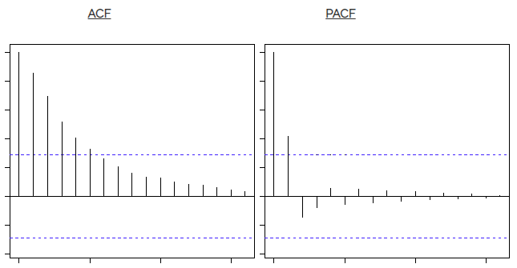
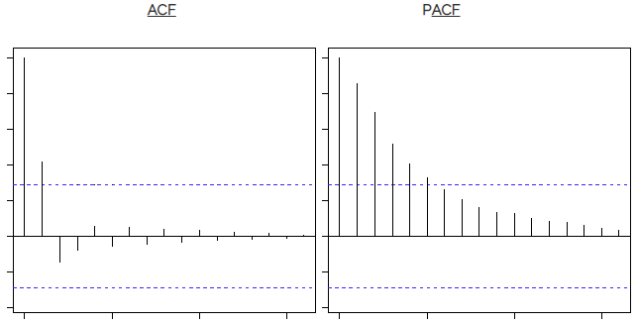
ACF/PACF CHARTS
1. ACF is a plot of total correlation between different lag functions
2. PACF is a plot of partial correlation between different lag functions.
The blue line here shows significantly different values than zero.
Clearly, the graph above has a cut off on PACF curve after
2nd lag which means this is mostly an AR(2) process.
Clearly, the graph above has a cut off on ACF curve after
2nd lag which means this is mostly a MA(2) process.

Slide 11

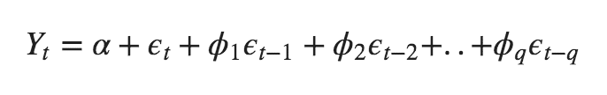
ARIMA model
Auto Regressive (AR only) model is one where Yt depends only on its own lags. That is, Yt is a function of the ‘lags of Yt’
Moving Average (MA only) model is one where Yt depends only on the lagged forecast errors.
ARIMA model is one where the time series was differenced at least once to make it stationary and you combine the AR and the MA terms. So the equation becomes:

Slide 12
Parameters Of ARIMA
Each of these components are explicitly specified in the model as a parameter. A standard notation is used of ARIMA (p, d, q) where the parameters are substituted with integer values to quickly indicate the specific ARIMA model being used. An ARIMA model consists of coordinates (p, d, q):
p stands for the number of autoregressive terms, i.e. the number of observations from past time values used to forecast future values. e.g. if the value of p is 4, then this means that four previous time observations in the series are being used to forecast the future trend.
d denotes the number of differences needed to make the time series stationary (i.e. one with a constant mean, variance, and autocorrelation). For instance, if d = 1, then it means that a first-difference of the series must be obtained to transform it into a stationary one.
q represents the moving average of the previous forecast errors in our model, or the lagged values of the error term. As an example, if q has a value of 1, then this means that we have one lagged value of the error term in the model.

Slide 13
Akaike’s Information Criterion (AIC)
According to the Box Jenkins methodology, the values of p and q for AR and MA respectively can be calculated by using the correlogram.
The ACF graph helps find the correct value of q while the PACF graph is helpful for finding the value of p.
While PACF values die out or cut off after lag p for AR (p) model, auto-regressive of order p, for an MA (q) model, moving average of order q, ACF values die out or cut off after lag q.
This process of choosing the best order of AR and MA model can be confirmed by least values of Akaike’s Information Criterion (AIC) where the minimum value of AIC is considered as most suitable.

Slide 14
Data Set Description
The data set was extracted from top 500 companies of SMP500 under NYSE (New York Stock Exchange) for time period of 5 Yrs.
Each company has approximately 1258 records with six attributes including closing price, low price, high price, opening price, adjacent closing price and volume.
We have chosen ‘Opening Price’ of the stock for prediction.
Data set is split into three parts: Training data set, Validation data set and Testing data set.
Our Training dataset consist of 60% of the data, Validation consist of 20% of the data while Testing consist of 20% of the data.

Slide 15
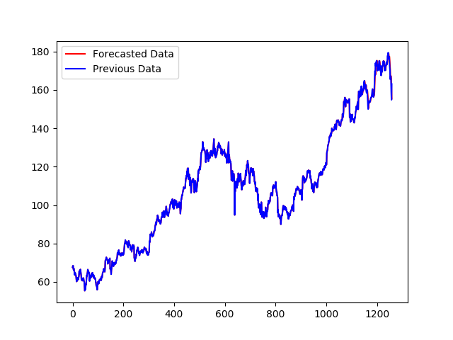
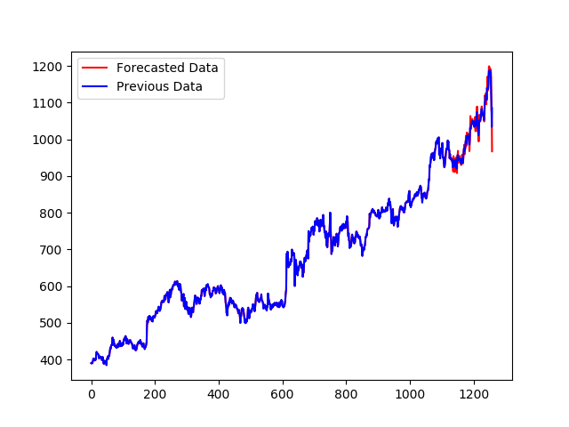
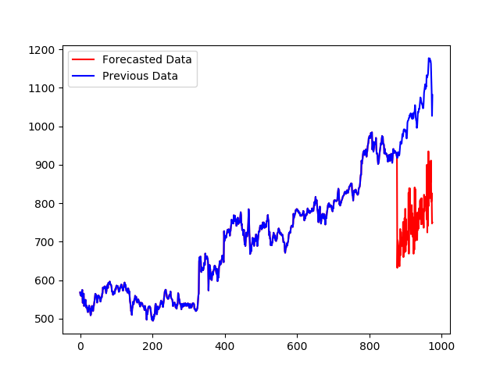
Result Analysis
The graphs below represents the actual prices and predicted stock prices of the next day for stocks of different companies.
Mean Squared Error values for most of the stocks significantly small with respect to actual data.

Slide 16
Conclusion
Our model has assumed that there is no seasonality in data to prevent manual choice of parameters.
Our model predicted the future prices for stocks in a very general sense, strongly. We believe this is not because of the model itself, but because of the market performance during and after the provided data. Our model was mostly unsuccessful in ignoring the noise, even with our best efforts to station the data.
We predicted the stock price of next day given the past stock prices and mean squared error are significantly low for most of the stocks.
It can be efficiently used for short term prediction.

Slide 17
FUTURE SCOPE
This model is very beneficial to predict stock prices for short term. But stock price not only depends upon previous stock prices but also on status of the company in the market. We can use sentiment analysis for that.
Apart from that, to prevent manual intervention, we didn’t accounted for seasonality in the data. For Better performance of the algorithm, we need to choose parameters manually for seasonality and use SARIMA instead of ARIMA.

Slide 18
REFERENCES
[1] Anderson, D. R. (2007). Model based inference in the life sciences: a primer on evidence. Springer Science & Business Media.
[2] Ariyo, A. A., Adewumi, A. O., and Ayo, C. K. (2014). Stock price prediction using the arima model. In Computer Modelling and Simulation (UKSim), 2014 UKSim-AMSS 16th International Conference on, pages 106–112. IEEE.
[3] Box, G. E., Jenkins, G. M., Reinsel, G. C., and Ljung, G. M. (2015). Time series analysis: forecasting and control. John Wiley & Sons.
[4] Box, G. E. and Tiao, G. C. (1975). Intervention analysis with applications to economic and environmental problems. Journal of the American Statistical association, 70(349):70– 79.
[5] Gupta, A. and Dhingra, B. (2012). Stock market prediction using hidden markov models. In Engineering and Systems (SCES), 2012 Students Conference on, pages 1–4. IEEE.

Slide 19


