Slide 1
Version control and GitHub

Slide 2
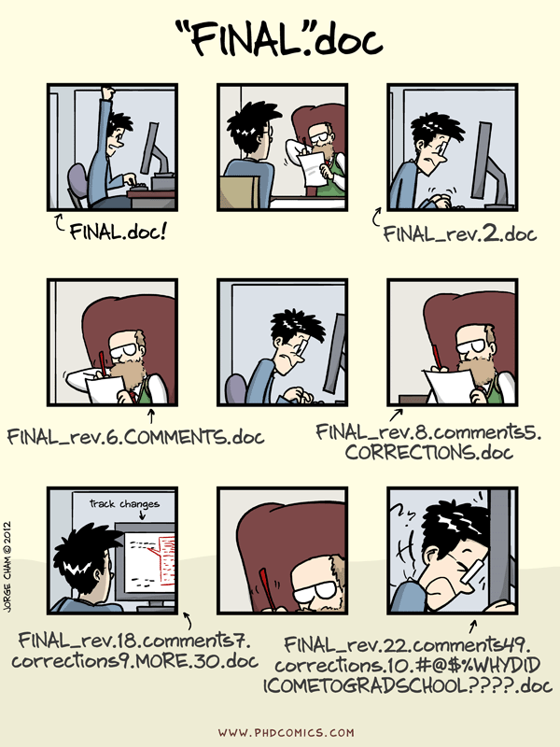
Why use version control?

Slide 3
Version control and Git
Main features of a version control system:
Save each new set of changes sequentially
Keep track of different versions of a document/project
Merge changes from multiple versions
Git is a specific version control system
Think “track changes” in Word + Dropbox, but much more general and powerful
A whole new system to learn. Is it worth the effort?
Maybe not when working alone
But critical to avoid disaster when collaborating
The gold standard in the private sector – used EVERYWHERE

Slide 4
GitHub
GitHub is a specific website that uses Git to host projects in the cloud
We will use GitHub at a few points in this course
Lecture slides
Assignment 2
Term project
Why?
To start building habits of using version control
To get you used to the basic terminology and actions of Git and GitHub
“Real” developers & data scientists use Git at the command line
I’m not going to require you to do that now
But I encourage you to learn it on your own

Slide 5
Getting set up with GitHub
Create a GitHub account (unless you already have one)
Download GitHub Desktop
Connect GitHub Desktop to your GitHub account

Slide 6
1. Create a GitHub account
Go here and fill out the forms: https://github.com/
No need to apply for the GitHub Student benefits (though you can if you want to)

Slide 7
2. Download GitHub Desktop
Go here: https://desktop.github.com/
GitHub Desktop is a standalone app for using Git and GitHub through a graphical user interface (GUI).
Recommend but not strictly required
You can submit assignments directly through the GitHub website, but it will end up being harder in many ways
You can use Git at the command line (shell) if you already know it or want to learn

Slide 8
3. Connect GitHub Desktop to your GitHub account
Open GitHub Desktop and go to File -> Options
If you need help, try this: https://docs.github.com/en/desktop/installing-and-configuring-github-desktop/installing-and-authenticating-to-github-desktop/setting-up-github-desktop

Slide 9
Basic workflow (only 1 contributor)
ON GITHUB (Remote)
Original repository
First commit
Second commit
CLONE
PUSH
PUSH
ON YOUR COMPUTER (Local)
COMMIT
First commit
COMMIT
Second commit
Original repository
(work)
(work)

Slide 10
Workflow for your project
On GitHub.com, create a new repository
Clone this repository to your local machine
Do some work (edit the repository)
Commit changes (i.e., save a draft)
Push your commit to GitHub (back it up to the cloud)

Slide 11
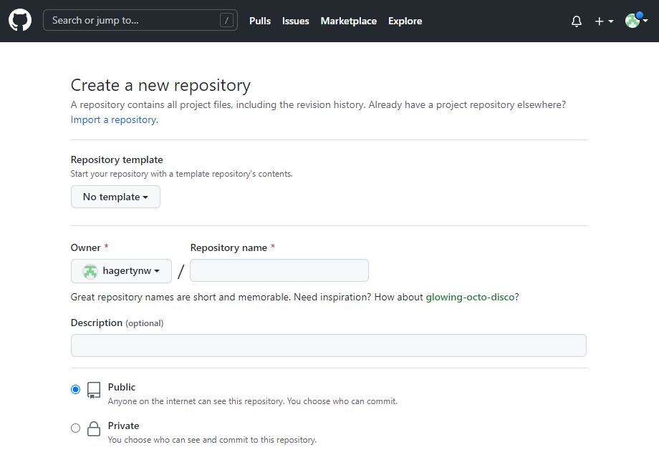
1. Create a new repository
A repository (repo) is the full record of a project folder and all its changes ever.

Slide 12
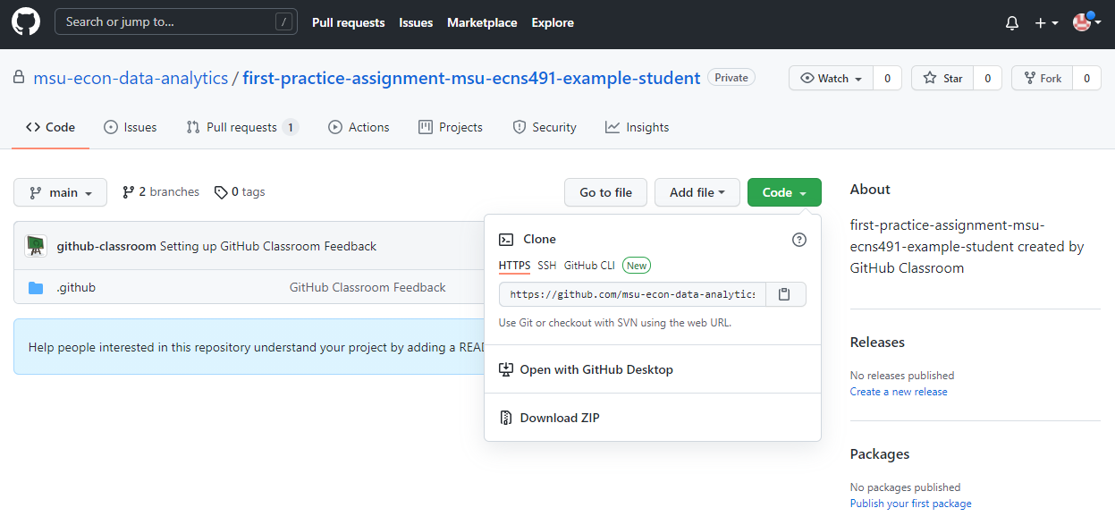
2. Clone the repo to your local machine
Clone downloads a full copy of the repo from GitHub to file storage on your computer

Slide 13
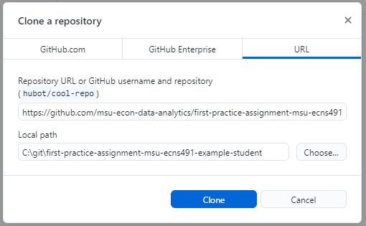
2. Clone the repo to your local machine
GitHub Desktop should now come up
Choose where you want to store the repo on your computer (the default location is probably fine)

Slide 14
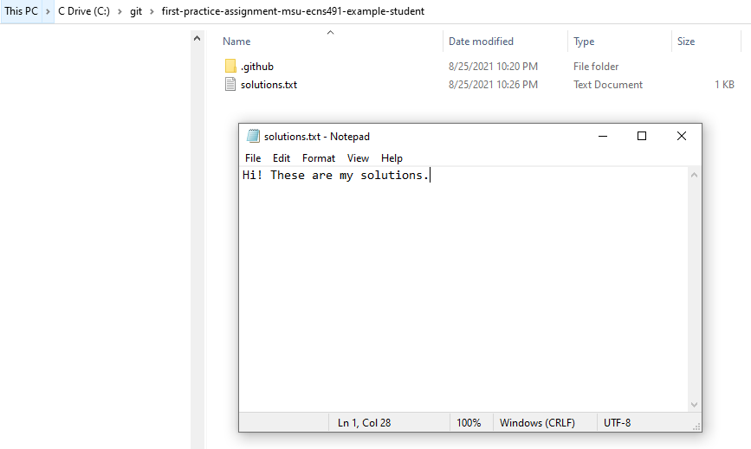
3. Do the assignment (edit the repo)
Create or edit scripts and documents as you like.
Save all documents related to this project in the repo’s folder on your computer.

Slide 15
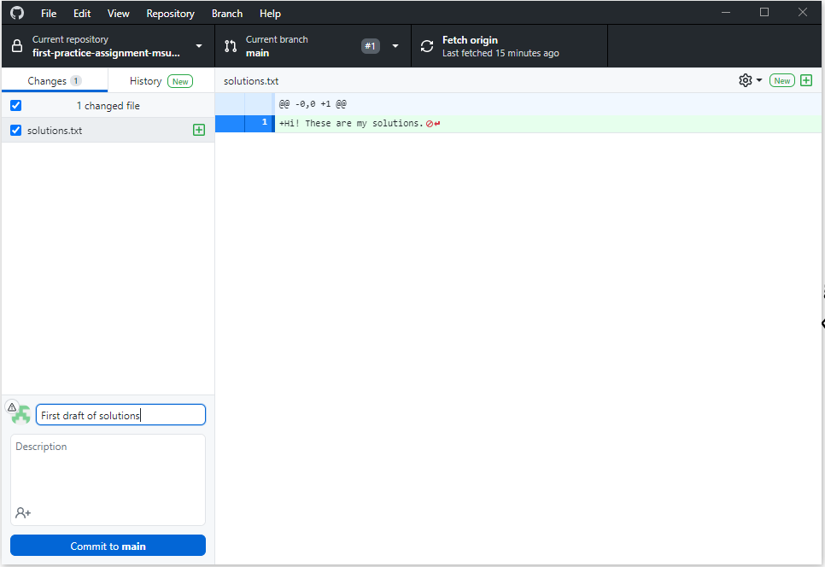
4. Commit your changes
Commit is like Save, but for your whole project
It records a snapshot of your whole directory at this point
Unlike Save (but like version history in Google Docs), you can go back to a particular commit later
Write an informative commit message so you can easily look back and see what changes you made at this point

Slide 16
4. Commit your changes
Commit early and often!
Every time you make a major change, or take a break from working
If you make a big mistake, you can use GitHub Desktop to roll back to an earlier commit

Slide 17
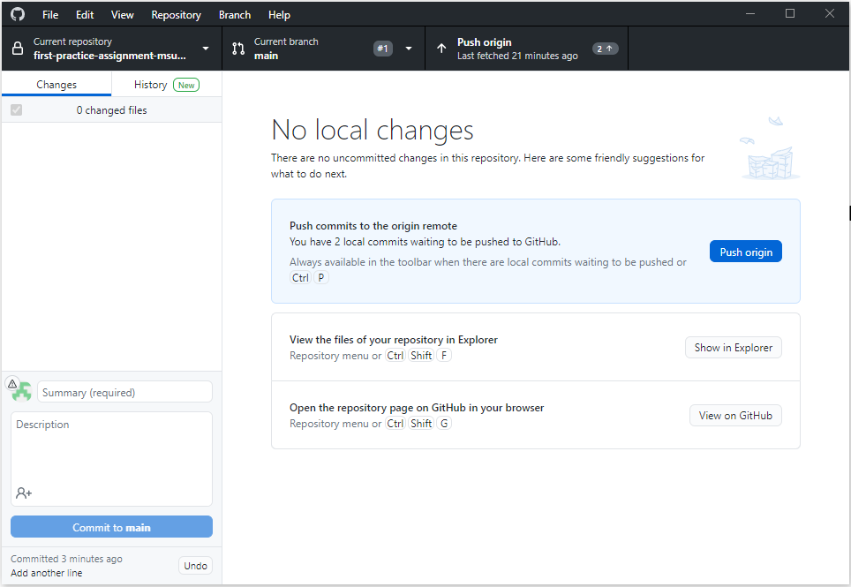
5. Push your commit to GitHub
Commit is only local (your changes aren’t on GitHub yet)
Now we need to push the commit(s) to the remote GitHub repository
Push uploads your changes to the cloud (GitHub)

Slide 18
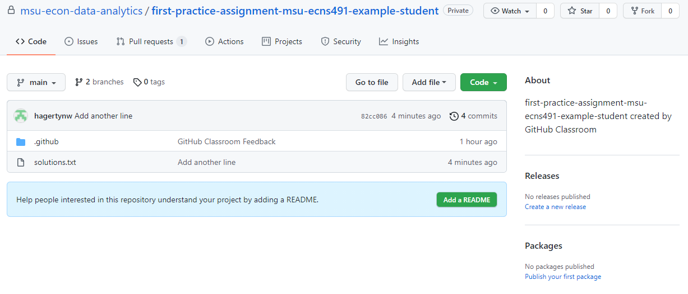
5. Push your commit to GitHub
Now, back on GitHub, you can see the new files you added

Slide 19
Workflow for each assignment
Starting assignment repository
ON GITHUB (Remote)
First commit
Second commit
CLONE
PUSH
PUSH
ON YOUR COMPUTER (Local)
Starting assignment repository
COMMIT
COMMIT
First commit
Second commit
(work)
(work)

Slide 20
Example collaborative workflow
ON YOUR COLLABORATOR’S COMPUTER (Local)
COMMIT
Original repository
First commit
Second commit
FETCH & PULL
PUSH
ON GITHUB (Remote)
Starting repository
First commit
First commit
Second commit
Second commit
FETCH & PULL
CLONE
PUSH
ON YOUR COMPUTER (Local)
Original repository
COMMIT
First commit
Second commit

Slide 21
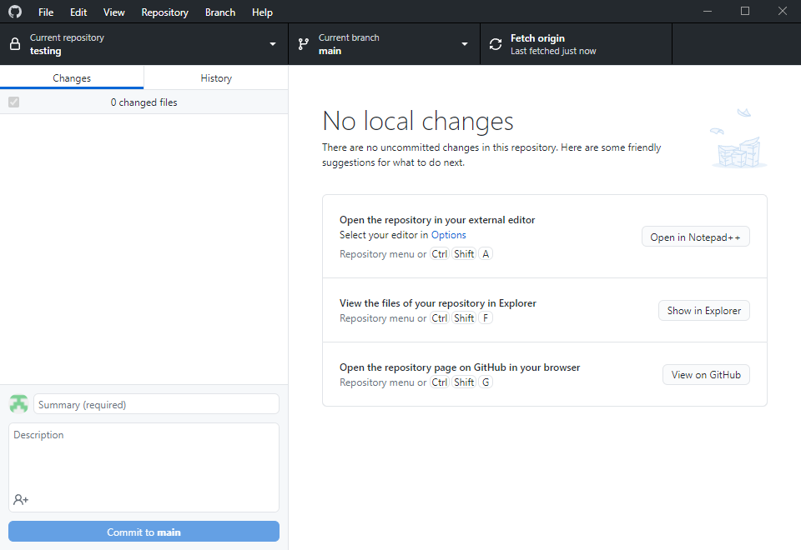
Always Fetch and Pull before you Push
Your collaborator might have made changes since you last worked on it
Fetch to check for changes

Slide 22
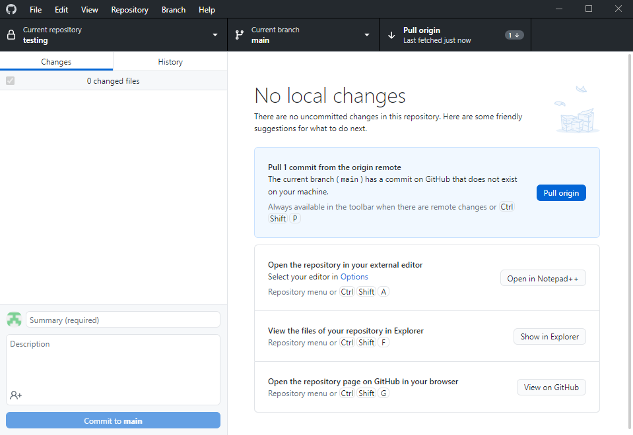
Always Fetch and Pull before you Push
Your collaborator might have made changes since you last worked on it
Fetch to check for changes
Push to merge their changes with yours
Resolve any merge conflicts
Now you can push!

Slide 23
Many more features & workflow options
(All optional, but very useful for collaborating)
Forking and pull requests: https://guides.github.com/activities/forking/
Branches and merges: https://guides.github.com/activities/hello-world/
For much more, see the other “Git and GitHub” resources on the course resource list: https://github.com/msu-econ-data-analytics/course-materials#git-and-github

