Slide 1
Task Packing to Maximize
CPU Utilization
By: Kshitij Ramesh Tadkase
Nandika Rohilla

Slide 2
ACKNOWLEDGEMENTS
We would like to express our sincere gratitude to our supervisor Dr. Ravi Shankar Singh and Mr. Navin Mani Upadhyay for their constant guidance and support during the project work.
Place: IIT (BHU) Varanasi Kshitij Ramesh Tadkase and
Date: 30/04/2020 Nandika Rohilla

Slide 3
ABSTRACT
Although an application is balanced, due to external factors load imbalance can occur in a parallel computing system.
In this report, we aim to improve the CPU scheduling process by carrying out Task Packing using dynamic programming approach. This is a NP hard problem and thus we have devised an exponential time solution using dynamic programming.
Our main aim is to reduce the number of CPUs used for scheduling of the processes keeping execution time same.
The aim is to reduce the idle cycles for the CPUs such that they can be put to some other use.

Slide 4
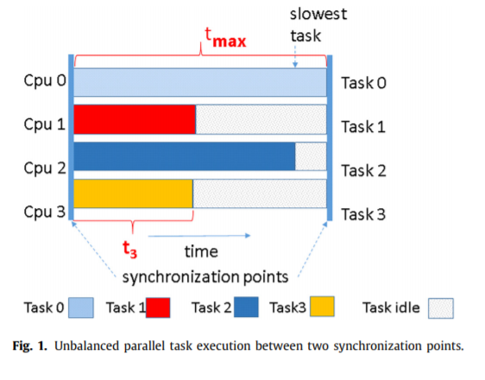
OBJECTIVE
We aim to reduce the load imbalance in parallel systems. Multiple tasks arrive and are allocated to the CPUs refer Fig.1, among these tasks are different requirements of CPU time, so after the usage of completion smaller tasks are required to wait for the slowest task to reach synchronization point to move ahead and allocate the CPUs to next batch of tasks.
In this case, Task 0 is the slowest task, so other tasks are required to wait in idle mode. Our job proposes that by packing tasks 1 and 3 together, we can free a CPU which does not increase the time too, since the tasks are scheduled to wait till the next synchronization point. We use the Subset Sum algorithm to carry out the task packing to maximize CPU utilization.

Slide 5
Introduction to the problem
Load imbalance is the uneven distribution of work across resources. Load imbalance can impact scalability.
It is a source of efficiency loss in parallel computing systems. Load imbalance results in loss of resources due to wasting of CPU cycles in idle state of processes, also it reduces the performance capability of an application by inefficient use of the High Performance Computing (HPC) system.
With the ever-growing energy requirements of the High Performance Computing systems, it is now crucial to save the wasted resources to the farthest level possible.
Due to the complexity of the problem and the variety of data / scenarios it is presented, load imbalance does not have any standard solution.

Slide 6
Problem
Given the number of processes and the time requirements of each process (excluding the synchronization time). A subset sum algorithm is used along with bitmask in the approach to schedule the processes and output the minimum number of CPUs used and the indexes of the processes on each CPU.
We use a scheduling strategy to reallocate tasks in CPUs in such a way that n tasks, each one with time duration t_{i} and being t_{max} the largest task duration, can be bounded to a CPU if they satisfy the condition: ∑ t_{i} ≤ t_{max} (for i=0 to n) .
After getting a sequence of processes/ jobs to be executed, we can allot CPUs to the processes using a simple greedy approach according to the sum of their time durations t_{i} such that,
let, the number of processes on any CPU = k
each process has a time duration, let it be t_{i} for i=1 to k (processes are indexed from 1)
we have max time duration = t_{max}
so, sum of time duration of processes on the CPU will be less than or equal to t_{max}.

Slide 7
Implementation
Algorithm for scheduling:
Sort the processes according to their iteration times in ascending order.
Store the time taken by maximum time taking process as max_sized_proc. This will be the upper bound of the sum of times of process in our subset. This will also be the upper limit on the total time of processes on a single CPU.
The Dynamic Programming algorithm is implemented by function subsetSum which is explained in section 3.1.2.
After step 3 we will have a sequence of processes which need to be carried out through a parent array (this is a helper array to store sequence of processes). We store it in a vector named arr.
Now, we have our maximum limit previously stored in step 2.
Now, we will just use the maximum limit and assign processes to CPUs greedily such that no CPU is left idle if it can still accommodate some process
Algorithm for Dynamic Programming:
The array dp stores pairs in which dp[i] = {x,y} stores: x number of CPUs are used till first i processes and they have y time left to complete.
Now we start filling the dp in a bottom-up manner. Here the set bits in binary representation of i gives the CPUs which are alloted some process.
We simultaneously store the indexes of the process with their previous process through the helper array i.e. parent array. This parent array gives the sequence in which the processes are carried out.

Slide 8
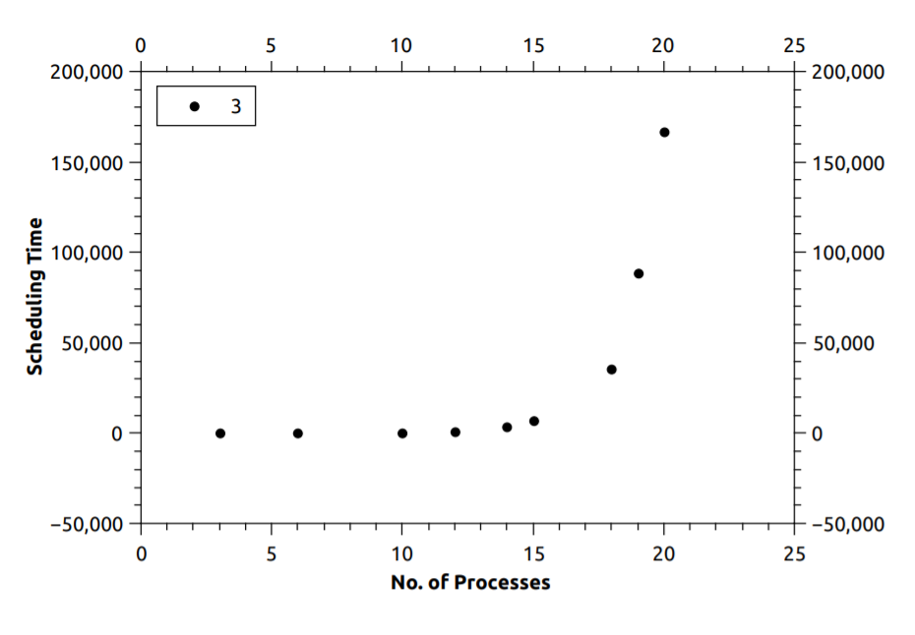
Results and Evaluations
We plotted the time taken to schedule the processes against the number of processes and the
graph obtained is shown in Fig.
This shows that as the number of processes to be scheduled increases, the program takes more time to allot CPUs.
But this algorithm is quite fast when the number of processes is around 30.

Slide 9
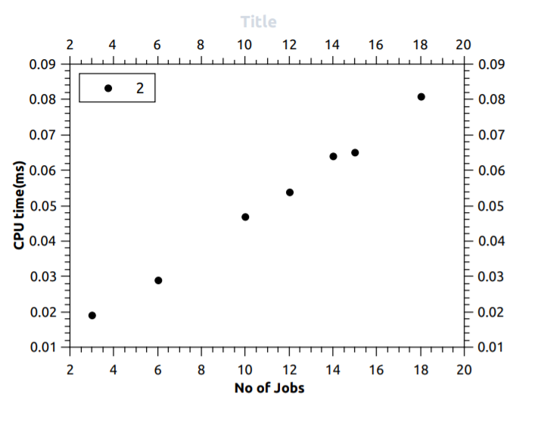
Next, to check power consumption on the CPU, we plotted number of processes to be scheduled by time it takes on the CPU i.e. CPU time.
We used Intel’s Vtune Profiler for calculating the CPU time used by our program and then used the data obtained to plot the graph using Qtiplot. The graph is shown in Fig.

Slide 10
CONCLUSIONS AND DISCUSSIONS
The current work aims to maximize CPU utilization by packing the given tasks over minimum possible CPUs by the calling of Subset Sum Algorithm to reduce the load imbalance in parallel computing systems.
The Subset Sum Algorithm in use here is NP-complete, so the solution occurs in polynomial time and isn’t the most efficient , as seen with results , it loses the value of CPU utilization due to increase in scheduling times as the number of tasks rise above 30.
Future work will be oriented towards finding the optimal solution keeping scheduling time in mind while not compromising the primary aim.

Slide 11
Thank You
Kshitij Tadkase Nandika Rohilla
18075029 18075040

