Slide 1



EXPLORATORY DATA ANALYSIS
(STUDENT PROFILE) (COURSE MANAGER)
NAME :K.RAMA VENKATA RAMI REDDY Mr. A.RAGHU RAM
BATCH.NO : 77 (COURSE INSTRUCTOR)
Ph.no: 9959209995 Mr. KANAV BANSAL
E-MAIL:kramireddy900@gmail.com
COMPANY(website) : Booking.com

Slide 2

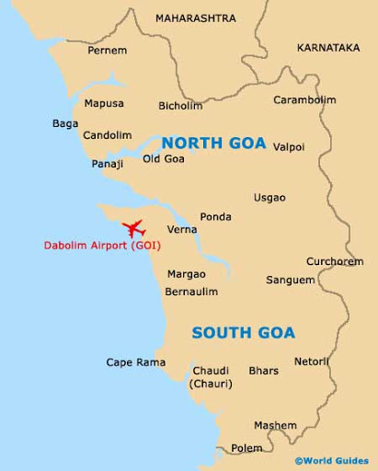
About Tourism in INDIA
The Indian travel and tourism sector contributed nearly $194 billion, around 6.8% of GDP, during calendar year 2019. Out of 185 economies, India stood 10th in terms of the size of travel and tourism spend in 2019.
In 2019, the domestic tourists arriving to the state of Goa accounted for approximately 7.1 million, while the foreign tourist arrivals accounted for over 0.9 million.
About Booking.com
Founded in 1996 in Amsterdam, Booking.com has grown from a small Dutch startup to one of the world’s leading digital travel companies.
Part of Booking Holdings Inc. (NASDAQ: BKNG), Booking.com’s mission is to make it easier for everyone to experience the world.
Booking.com enables properties all over the world to reach a global audience and grow their businesses.
Booking.com is available in 43 languages and offers more than 28 million total reported accommodation listings, including over 6.2 million listings alone of homes, apartments and other unique places to stay.
CEO-Glenn Fogel

Slide 3




Problem Statement-
2020

Slide 4
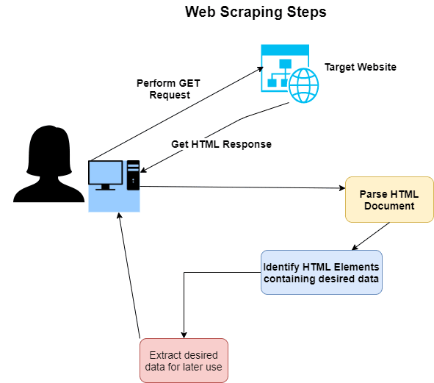

df = pd.DataFrame.from_dict(a, orient='index')
df = df.transpose()
Technical Challenges
1
2
Iterates over a big list of .mp3 links to get the metadata tags and save it to an Excel file. Results in this error.
Hence we use the following code
df = pd.DataFrame.from_dict(a, orient='index’)
df = df.transpose()

Slide 5
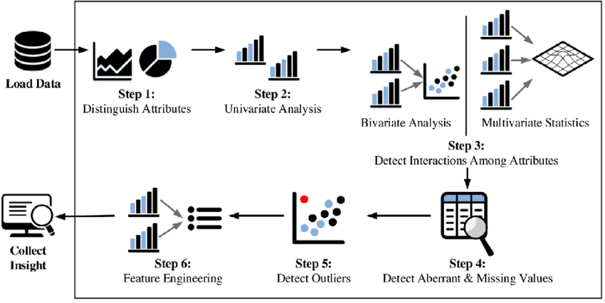

Slide 6
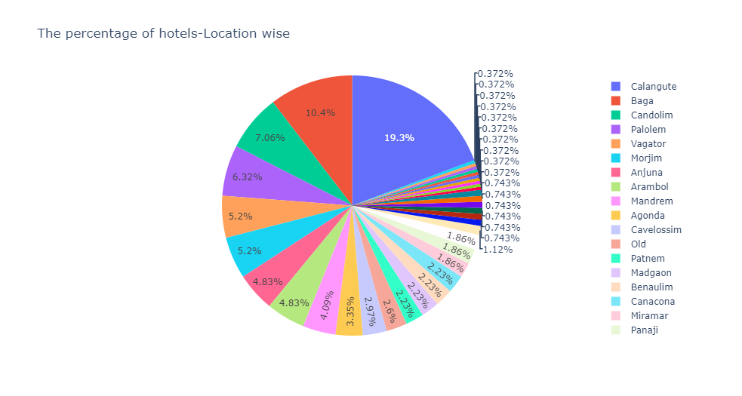
Observation->From the figure above,we can observe that 19.3 % of the hotels are located on 'Calangute' beach. Next comes the 'Baga' beach holding 10.4 % of the hotels.

Slide 7
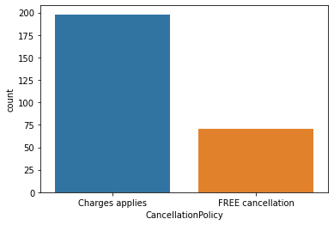
Visualizing the 'CancellationPolicy' variable
Observation->From the figure above,we can observe that the proportion of hotels providing 'FREE Cancellation' on hotel bookings are least compared to one that are charging some charges.

Slide 8
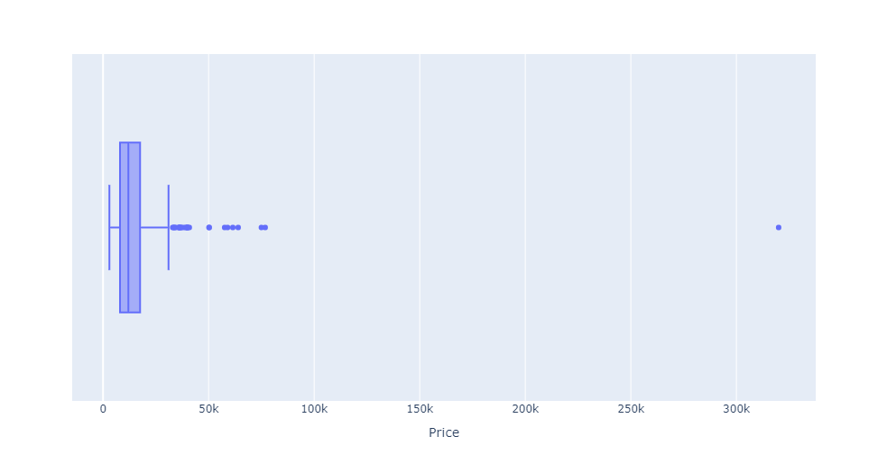
Visualizing the 'Price' variable
Observation->From the figure above,we can observe that the median of the price is '12k'. And the minimum price is '3k', 25 % of the hotels have price of '8k', 75 % of the hotels have price of '17k',the maximum price is '31k'. And the 'Price' holds some outliers,they holds prices of range '33k-319k'.

Slide 9
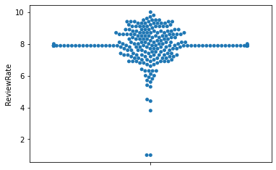
Visualizing the 'ReviewRate' variable
Observation->From the above figure we observe that there is high scatteredness at the 'ReviewRate' 7.9 to 8.0

Slide 10
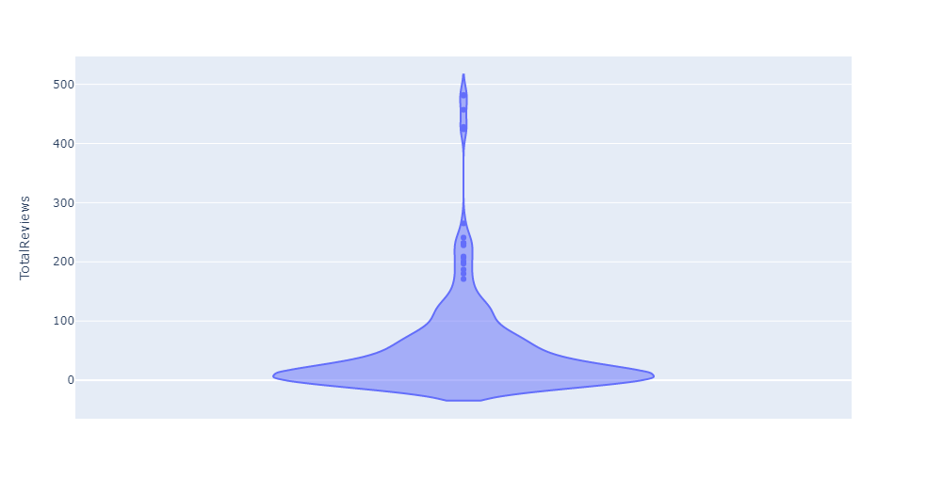
Visualizing the ‘TotalReview' variable
Observation->From the figure above,we can observe that the distribution is 1.004(kde) with median '21'.

Slide 11
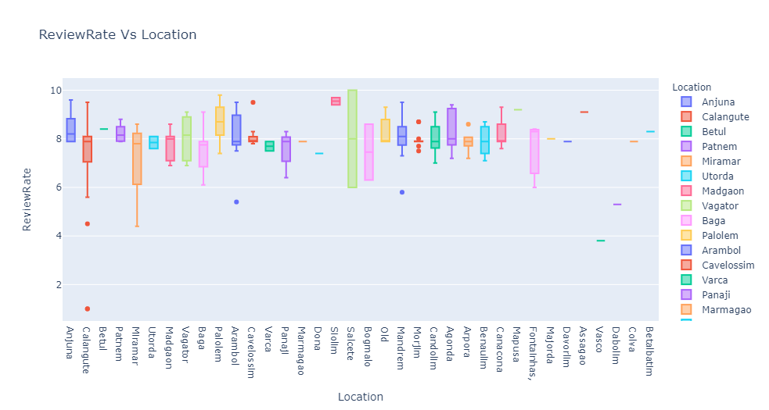
Observation-The four locations that holds high review rate on an average are-Palolem-8.7(7.14,8.15,9.3,9.8),Anjuna-8.2(7.8,8.825,9.6),Vagator-8.15(6.9,7.1,8.9,9.1),Patnem-8.15(7.8,7.9,8.5,8.8).

Slide 12
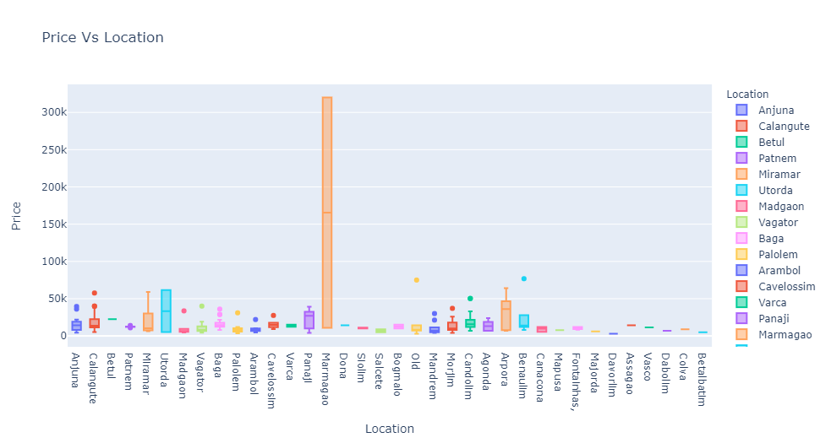
Observation- The hotels in Madgaon (4k,5k,6k,9k,33k), Salcete (5k,7k,9k), Vagator (4k,6k,8k,12k,19k,40k),Palolem (3k,5k,8k,10k,12k,31k) beaches have the least median value which allows us to conclude that hotels here are relatively cheapest to stay for.

Slide 13
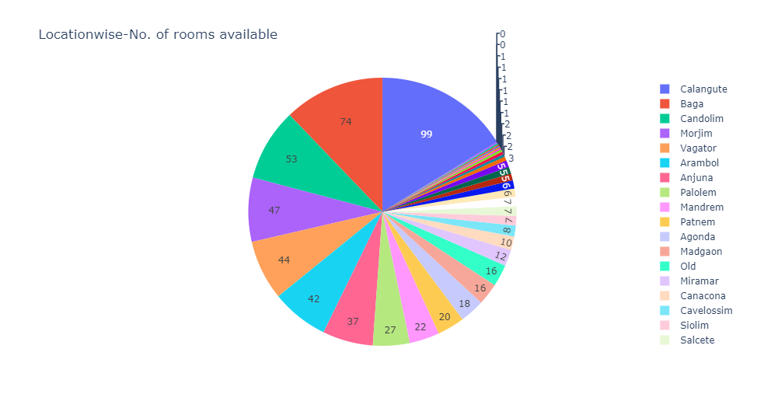
Observation- The number of rooms available based on location are as follows- Calangute-99,Baga-74,Candolim-53,Morjim-47,
Vagator-44,Arambol-42,Anjuna-37,Palolem-27,etc...

Slide 14
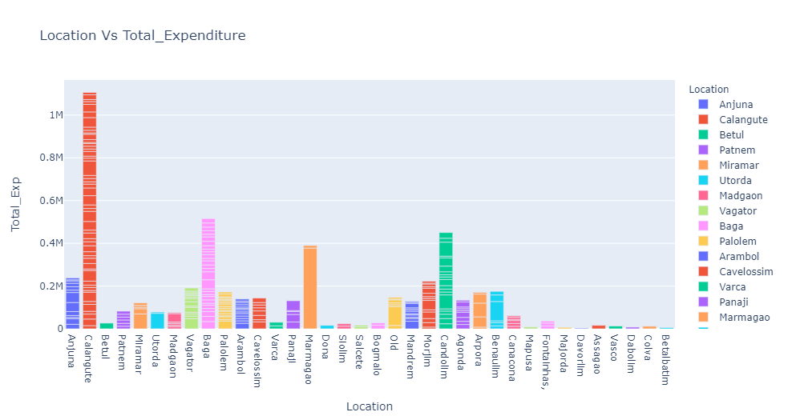
Observation- The hotels in Madgaon(4660),Salcete(7550),Vagator(14.515),Palolem(8960).

Slide 15
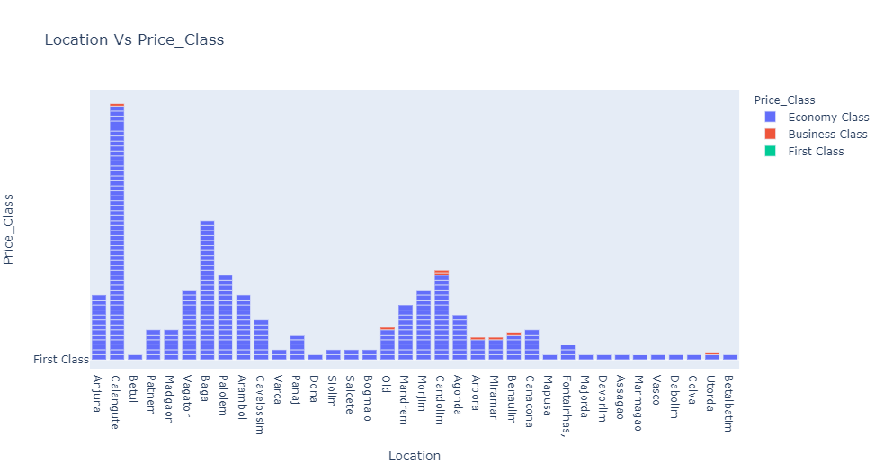
Observation-First Class(>100000 rupees),Business Class(50000-100000 rupees),Economy Class(<=50000 rupees).
Out of total 269 hotels. Economy Class-260,First Class-1,Business Class-8.

Slide 16
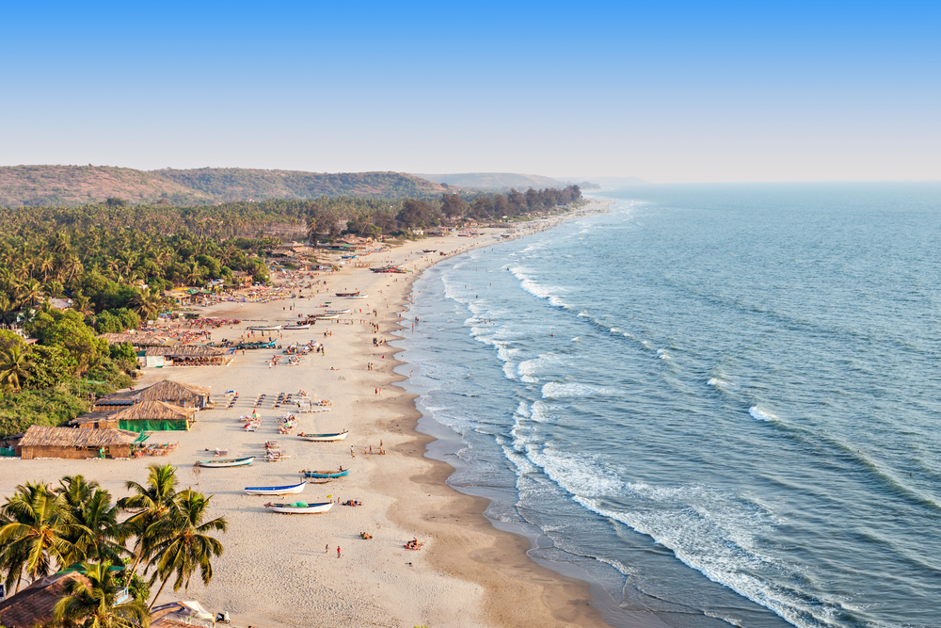
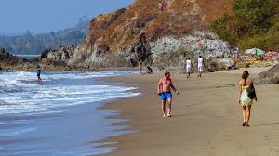
Conclusion
Palolem
Valagate

Slide 17


